Slide 1
Deadlines and such
Rough Drafts are due tonight at midnight!
1 per group
Includes annotated bibliography (w/ at least 1 “academic” source)
See my example drafts!!
Peer Evaluations are also due tonight.
1 per person
PDF or Word doc provided on my website
Be honest!
Submission boxes open on ELMS

Slide 2
Deadlines and such
I will return rough drafts with feedback by next week
Final drafts due in 2 weeks
These will be due at noon on March 4th
First debate will also take place in 2 weeks
Email me now if you have a conflict with any of the debate days
Otherwise, be ready to present whenever
First quiz is next week (Thursday)
I will review some material in class next week however I highly suggest you review Chapters 1 -4 in the book

Slide 3
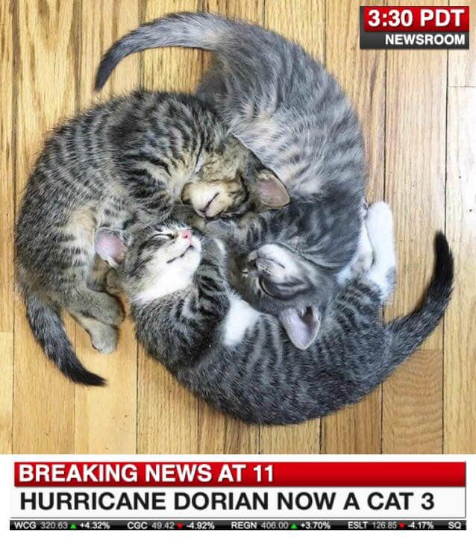
Discussion 2/19: Heat and Energy transfer
TA: Joey Knisely

Slide 4
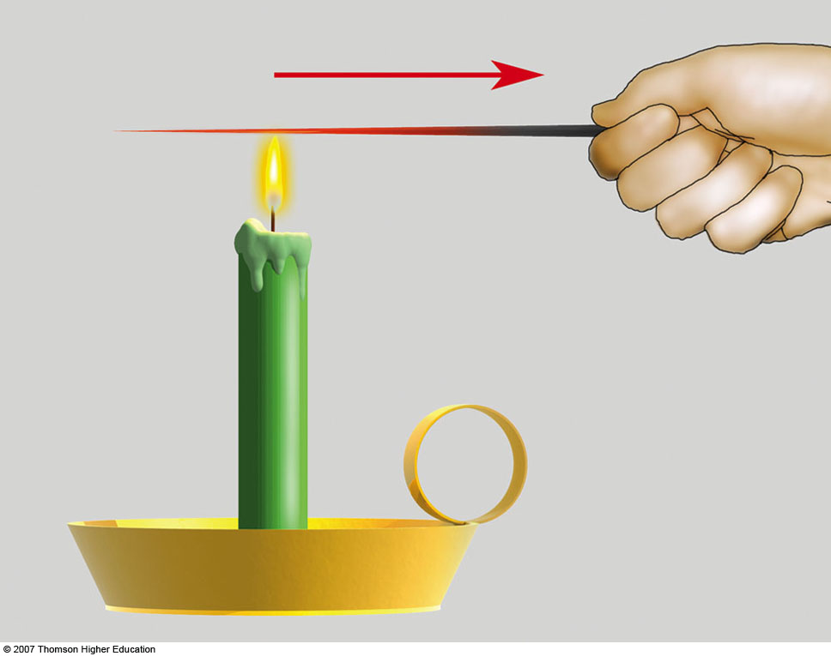
Conduction
Conduction: Transfer of heat through contact, collision, and transfer of molecular vibrations
Heat is transferred from hot to cold objects
Molecules with high kinetic energy (hot) come in contact with molecules with less kinetic energy (cooler) and transfer energy
High kinetic energy objects decrease in kinetic energy as a result
Air is a bad conductor, so the transfer of heat is carried out in another method

Slide 5
Convection
Convection: vertical fluid motion of a gas or liquid due to buoyancy
Ideal gas law can tell us why warm air rises and cold air sinks
PV=nRT
P=ρRT
P is pressure, V is volume, n is # of moles of gas (similar to mass), R is gas constant, T is temperature, and ρ is density
Assume pressure stays equal to environmental pressure; assume mass stays constant (n is constant)
As temperature increases, volume must increase → the “parcel” expands
As temperature increases and volume increases, density decreases → less dense objects rise, denser objects sink → net heat transfer upward

Slide 6
Atmospheric “Thermals”
Pockets of warm air that conduct heat from the surface → thermal expansion → pocket of air rises and cools (can then condense to form clouds) → continues rising until it’s equal to environmental temperature

Slide 7
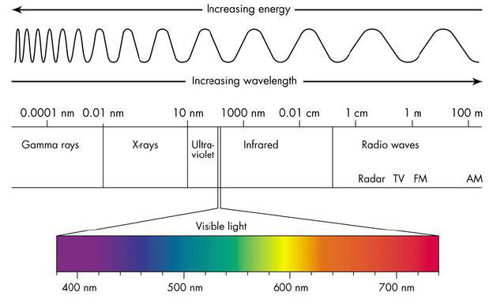
Radiation
We can think of electromagnetic radiation as waves of energy whose properties are dependent on temperature
High temperature objects emit higher energy waves (smaller wavelengths or larger frequency); colder objects emit lower energy waves (larger wavelengths or smaller frequency)
Higher frequency (crest to trough pulsation) waves have smaller wavelengths (crest to crest distance)
When you hear “longwave” or “thermal” radiation, we are usually talking about infrared radiation
When you hear “shortwave” or “solar” radiation, we are typically talking about ultraviolet or visible radiation

Slide 8
Radiation
Sun is much hotter than Earth, so it emits most energy in the Ultraviolet to short Infrared wavelengths
Peaks at the visible spectrum (max at yellow)
Emits mostly Infrared (~50%)
Earth’s emission spectra peaks in the Infrared

Slide 9
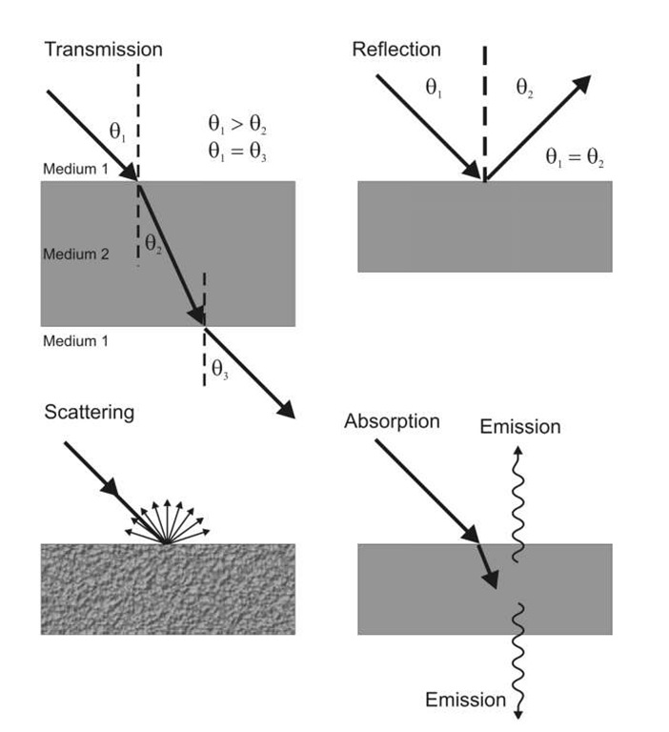
Radiative Interactions
Transmission: waves are able to travel through object
Absorption: radiation absorbed and converted to kinetic energy / heat → can be re-emitted as thermal radiation
Reflection: turning back of a wave, without entering the medium (ex. A red apple would absorb all visible radiation except for red, which it reflects)
Albedo = Fraction of incoming sunlight that is reflected by an object (snow has high albedo ~80-90%, but water has low albedo of ~10%)
Scattering: waves are deflected in numerous directions

Slide 10
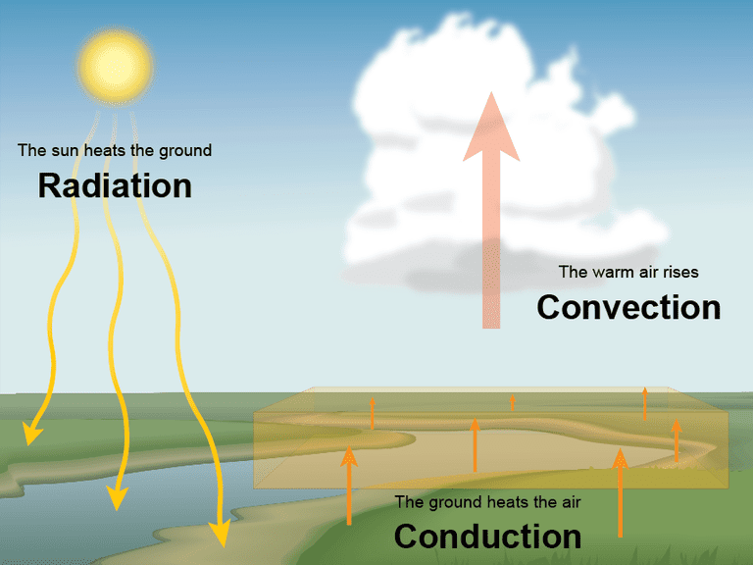
Let’s put all three concepts together…

Slide 11
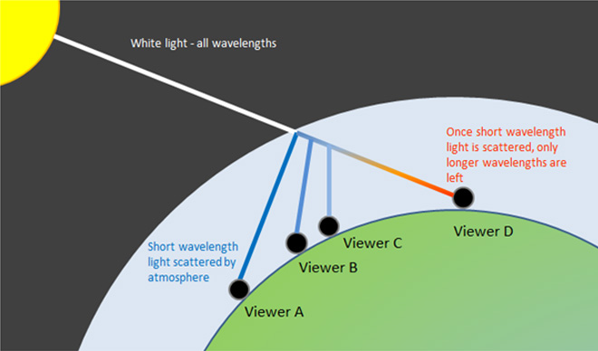
Applications of Scattering
Why is the sky blue??
Nitrogen and Oxygen are efficient at scattering visible light at shorter wavelengths
Remember, the wavelength of visible radiation from largest to shortest: Red, Orange, Yellow, Green, Blue, Indigo, Violet (ROYGBIV)
Red is not scattered easily, but blue is!
At sunset, waves must travel longer distance through atmosphere (waves/radiation are more “diffuse”) → most blue light has already been scattered → reds and yellows remain

Slide 12
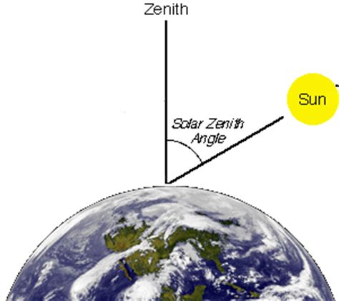
Solar Zenith Angle
Zenith – the point directly over your head
Solar Zenith Angle – the angle between the sun and a point directly overhead
Lower SZA = more direct radiation that makes it to the surface
Explains why regions closer to the equator are hotter than regions closer to the poles

Slide 13
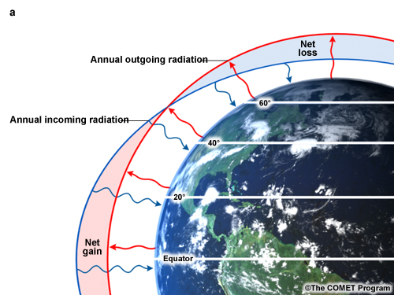
Radiative Equilibrium
More direct solar radiation makes it to the surface near the Equator
Lower solar zenith angle
Lower albedo (polar regions have ice)
This leads to a net gain of energy in tropics and a net loss at the poles
Energy (heat) must be transferred from the tropics to the Poles (ex. Gulf Stream, Hadley cell circulations)

Slide 14
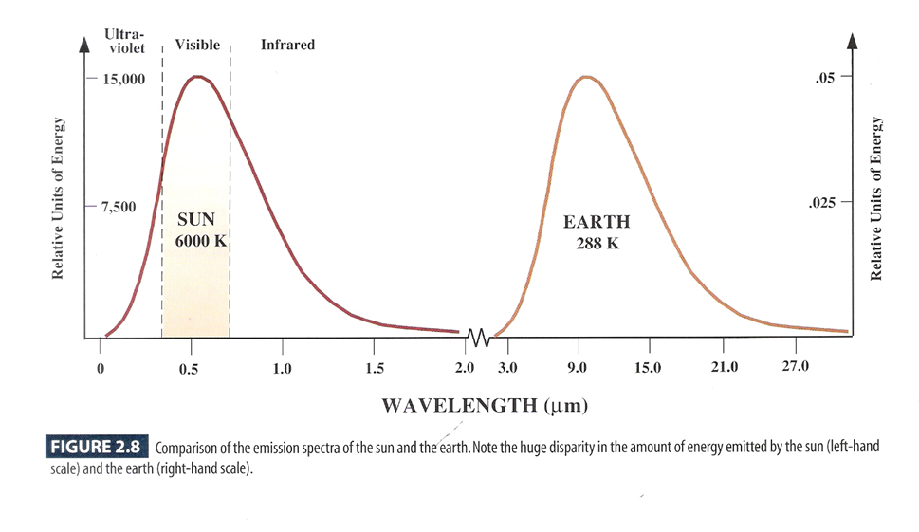
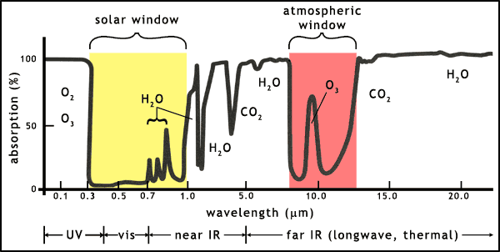
Atmospheric Window
Image shows atmospheric absorption of different wavelengths by gases
Low absorption = high transmittance → known as an atmospheric window
Solar (visible) window is important because it helps warm our planet
Infrared window is important because this is the energy emitted by Earth that is emitted back to space (around 7-12 micrometers)
Some IR radiation is absorbed by gases, leading to…

Slide 15
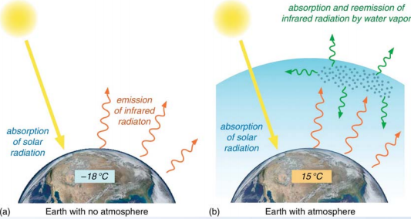
What is the greenhouse effect (Hint: It’s not fake news)
A greenhouse gas is able to absorb and emit infrared energy (more heat!!)
Examples: CO₂, N₂O, H₂O, CH₄
H₂O is most important GHG
CO₂ is most important anthropogenic (human-caused) GHG
Earth would not be habitable without this effect!
Without an atmosphere, surface temperature would be 255 K… or -18°C
With an atmosphere, surface temperature are 288 K… or 15°C

