Slide 1
https://forms.gle/
8NGrdRgnc2GqF4Zm8

Slide 2
Week 2 – 3 Review
www.atmos.umd.edu/~jknisely

Slide 3
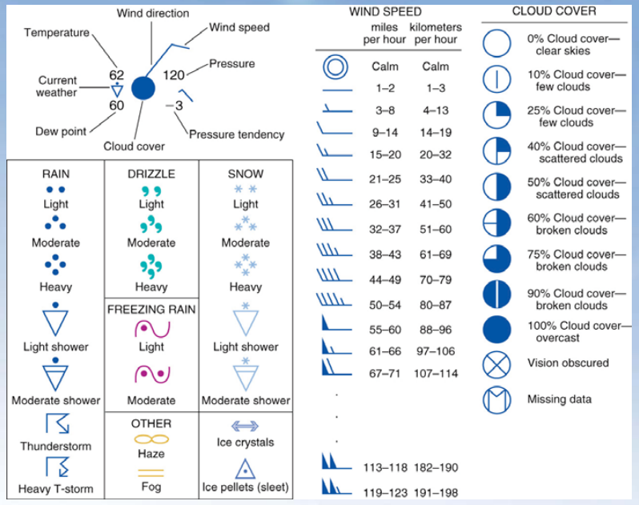
Weather Station Model

Slide 4
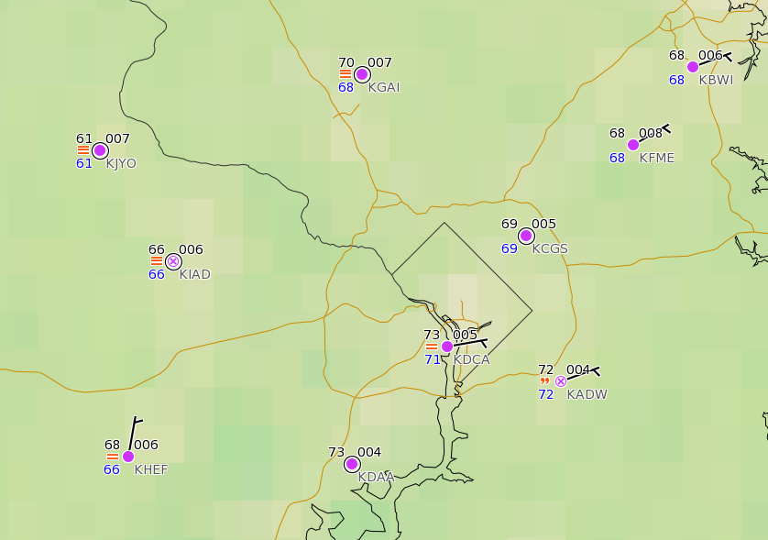
Station Plot Examples
Andrews AFB (KADW)
Temperature:
Dew Point:
Pressure:
Wind:
Wind Direction:
Sky Cover:
Weather:
72°F
72°F
1000.4 mb
~5 kts
ENE
obscured
light drizzle

Slide 5
Station Plot Examples
Reagan Int’l (KDCA)
Temperature:
Dew Point:
Pressure:
Wind:
Wind Direction:
Sky Cover:
Weather:
73°F
71°F
1000.5 mb
~5 kts
ENE
overcast
fog

Slide 6
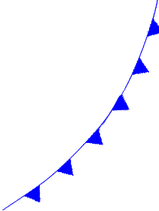
Cold vs Warm Front

Slide 7
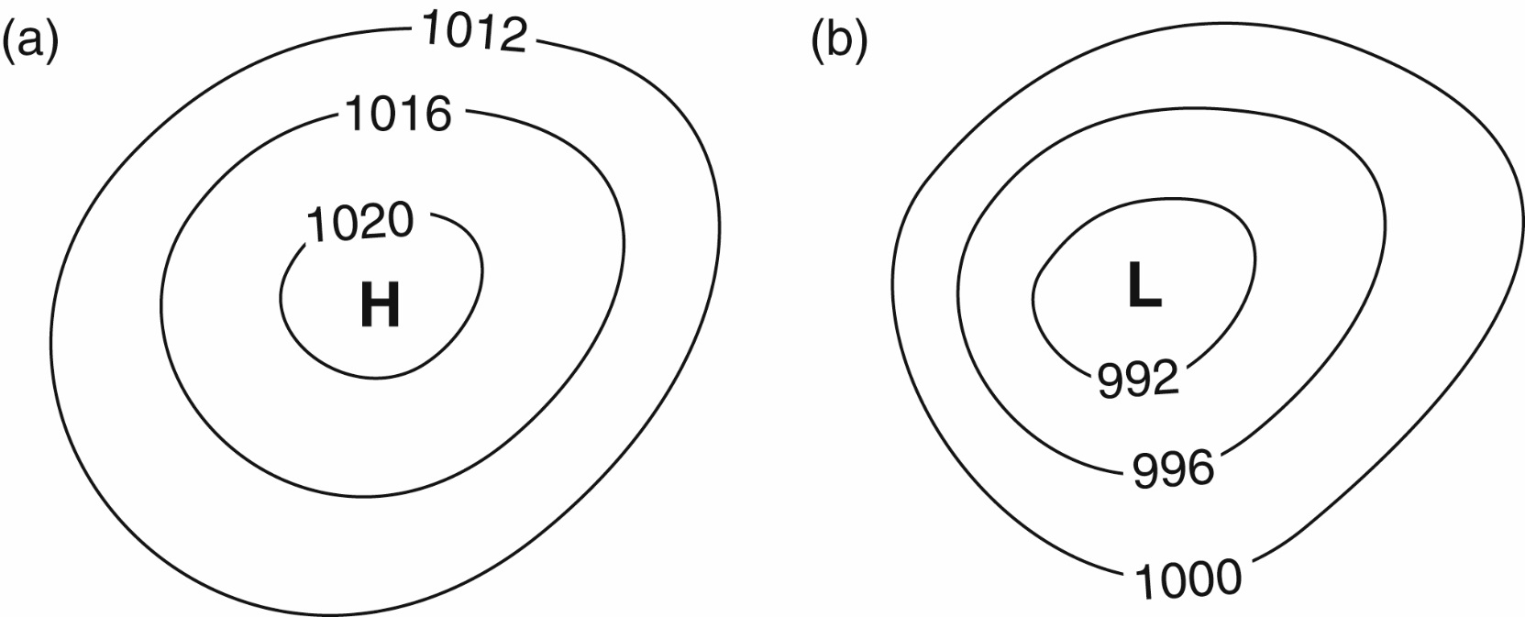
Pressure Maps
Mountain
Basin
Closed contours define regions of high pressure and low pressure.
Fig 2-5 Weather: A Concise Introduction

Slide 8
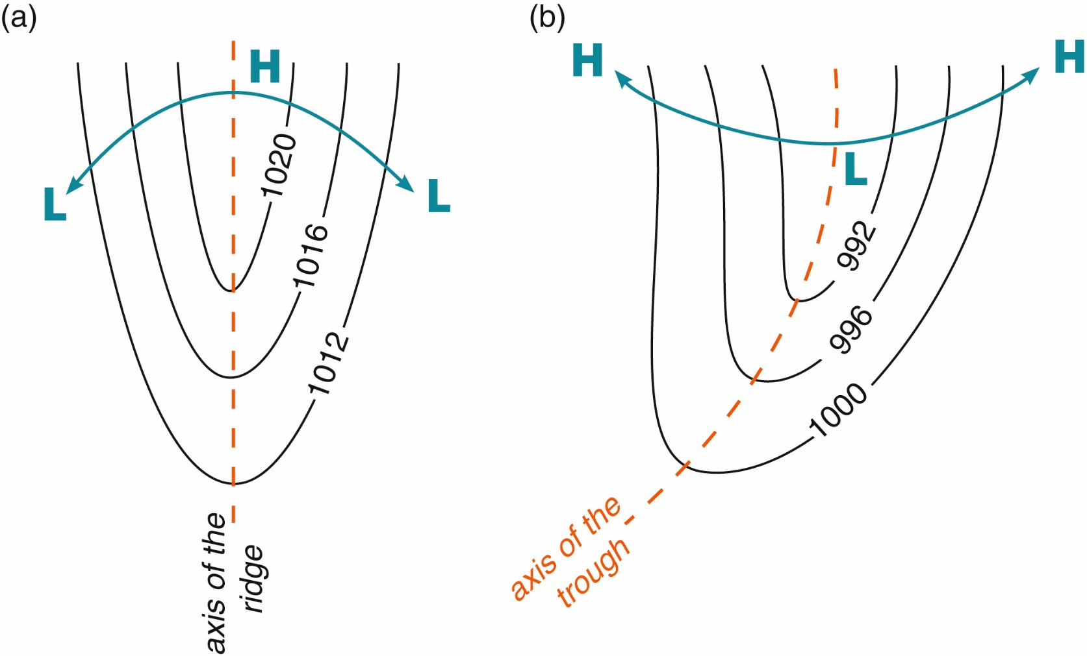
Pressure Maps
Isobars that aren’t closed can still help us define regions of increasing and decreasing pressure.
Fig 2-6 Weather: A Concise Introduction

Slide 9
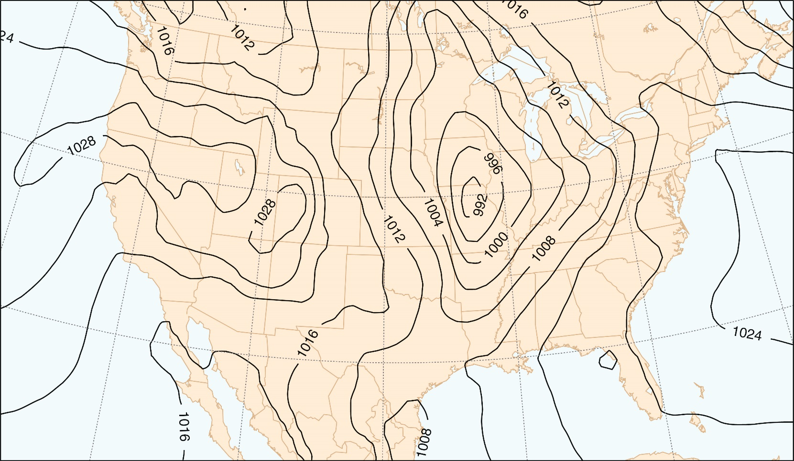
Pressure Maps
The black lines indicate “isobars” or lines of constant pressure. These maps help us identify regions of high pressure (“H”) and low pressure (“L”). They also give some indication of surface wind speed and direction. The numbers are the actual pressure (no conversion needed)
Fig 2-4 Weather: A Concise Introduction

Slide 10
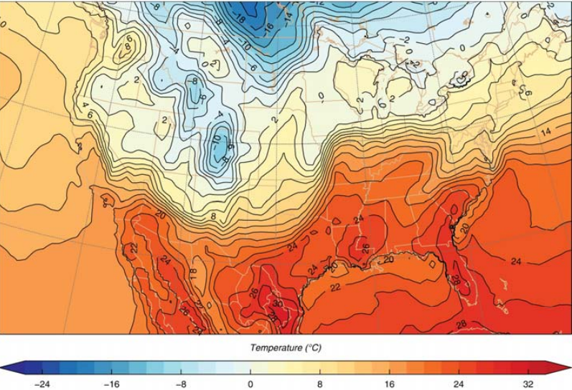
Spot the fronts!

Slide 11
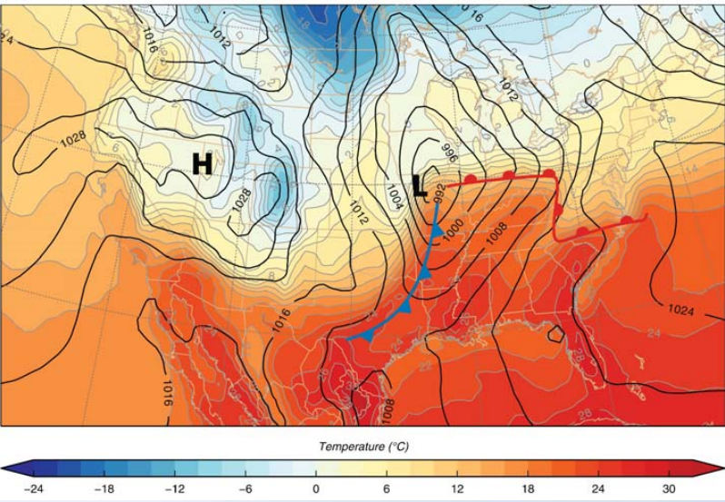
Spot the fronts!

Slide 12
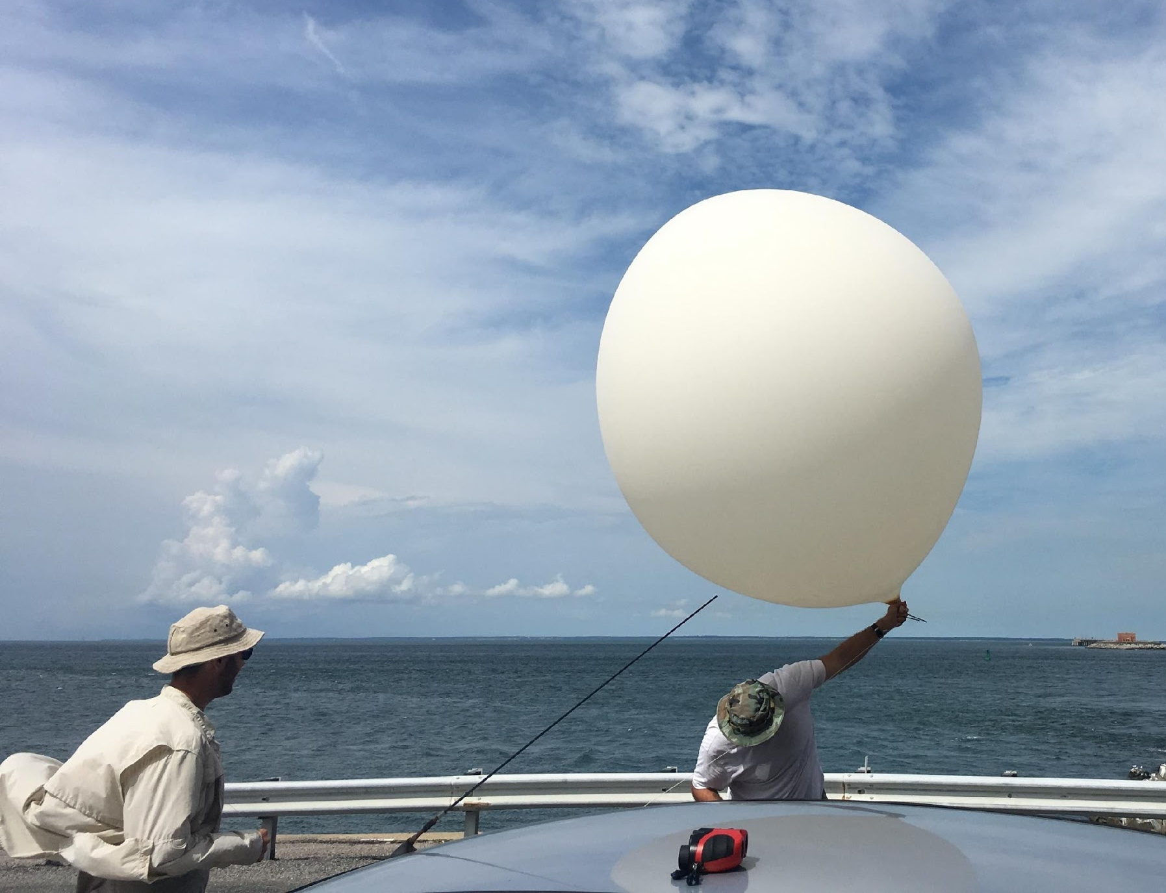
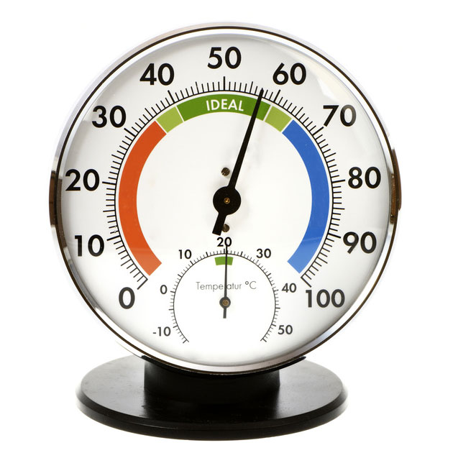
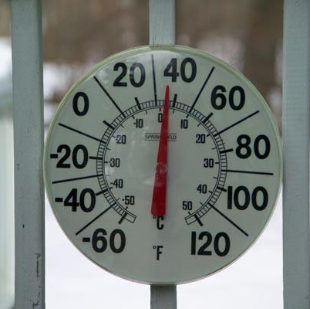
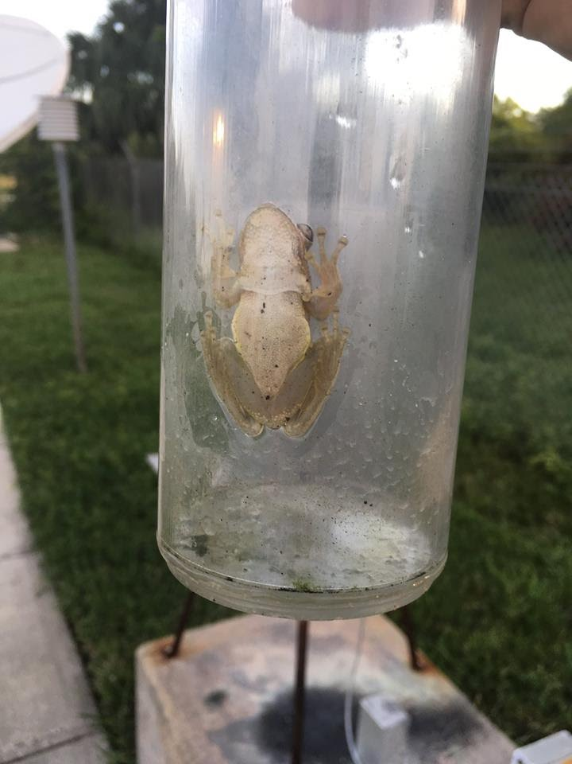
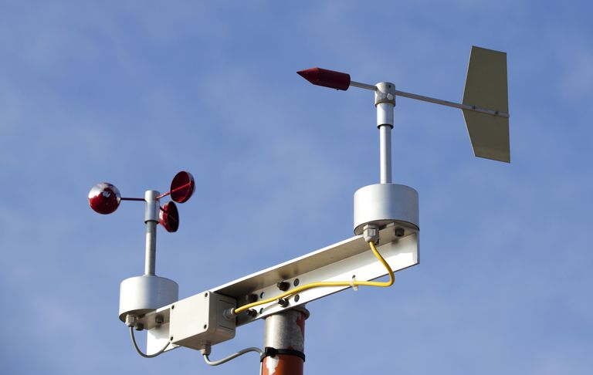
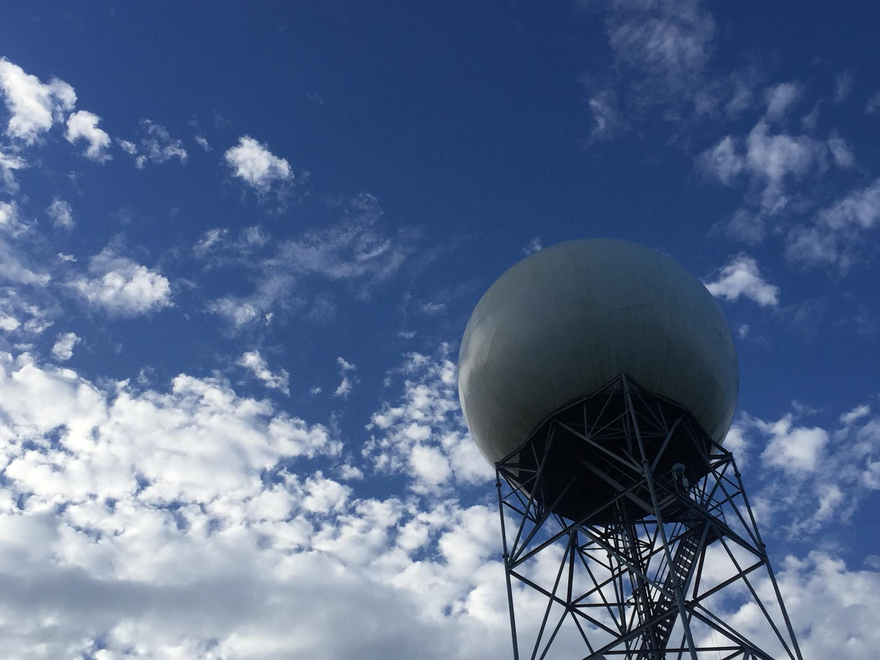
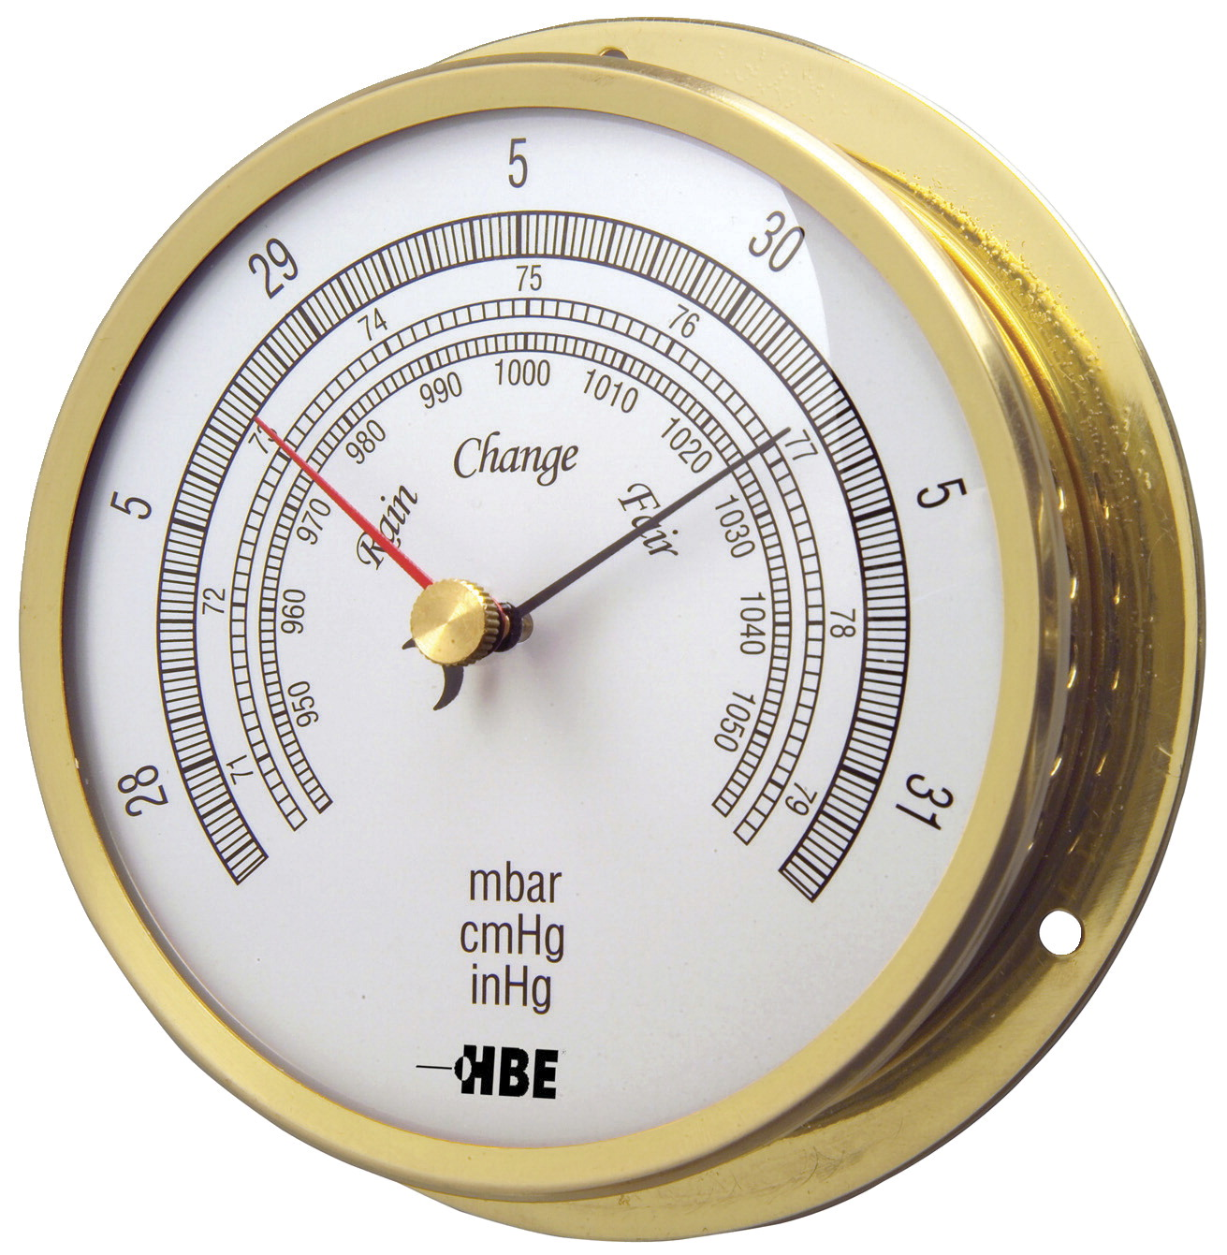
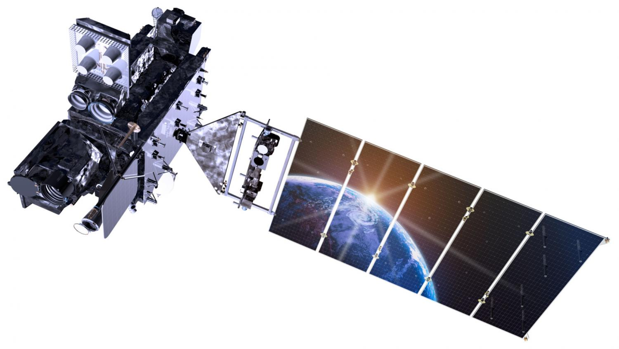
Other instruments meteorologists use
1
Radiosonde/rawinsonde
Thermometer
Hygrometer
Anemometer
Rain gauge
Barometer
Radar
Satellite
3
2
5
4
8
6
7

Slide 13
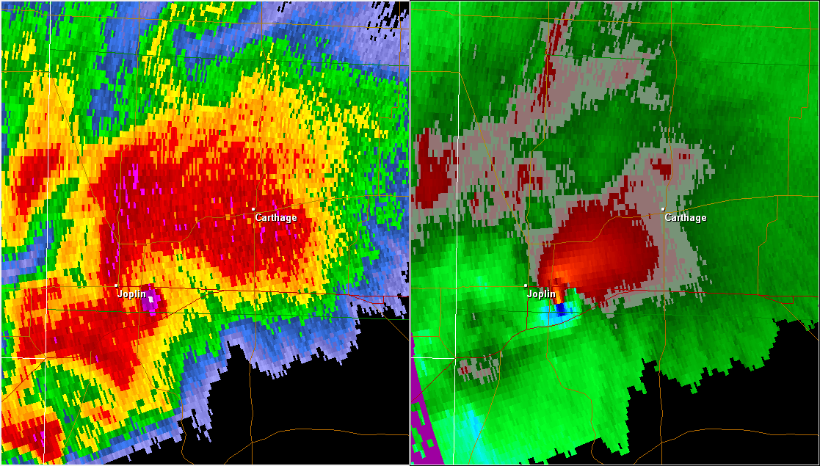
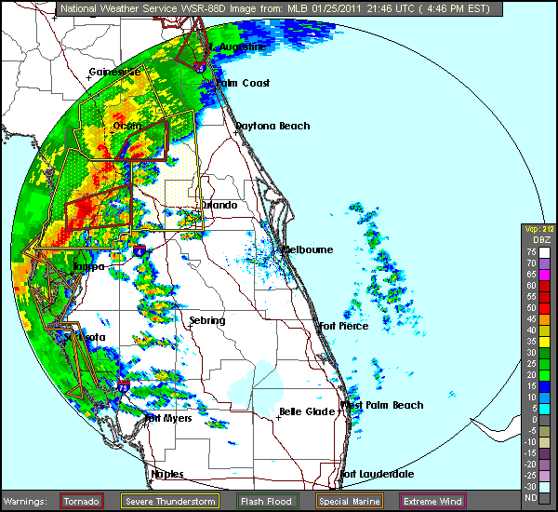
Radar Review
Joplin, MO EF-5 tornado (May 22, 2011)
Sends out electromagnetic pulse and listens
Bounces off rain, dust, bugs, birds, hail, etc.
Energy returned will depict “echoes” on radar imagery
Can indicate hail, debris, wind direction/speed, total rainfall, and many more
NWS Melbourne squall line (January 25, 2011)

Slide 14
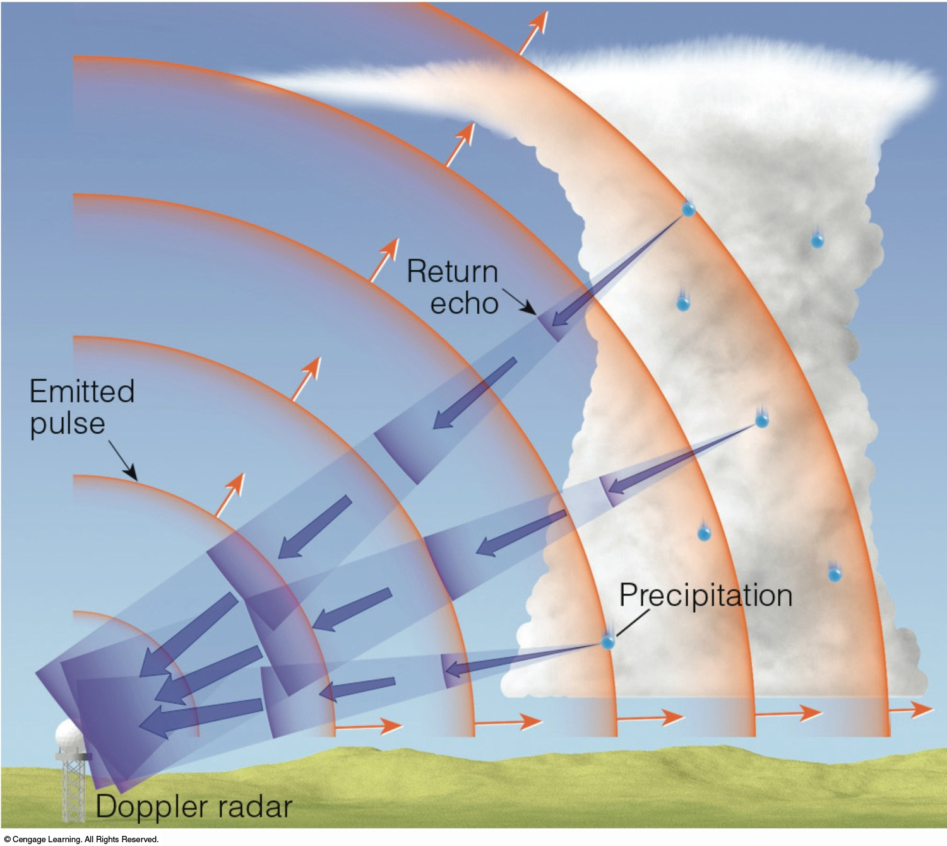
RADAR: RAdio Detection and Ranging
RADAR measures the time it takes for the signal to return
Fig 5.45: Essentials of Meteorology

Slide 15
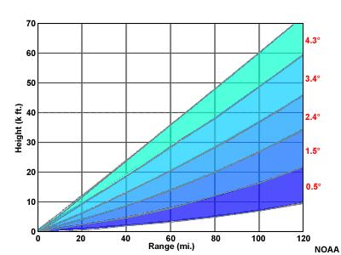
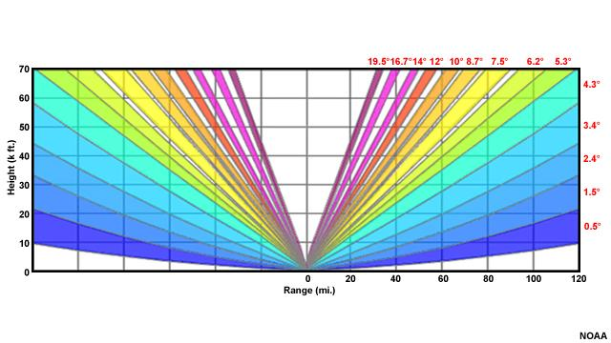
Radar Limitations
Cannot see directly above (called the Cone of Silence)
Limited to a certain radius
Beam can be blocked by buildings, mountains
Resolution
And many more!
Clear air mode
Precipitation (severe wx) mode

Slide 16
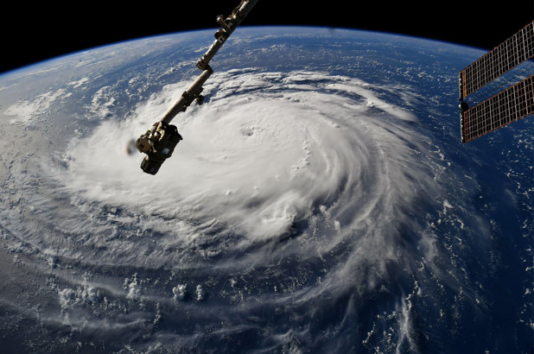
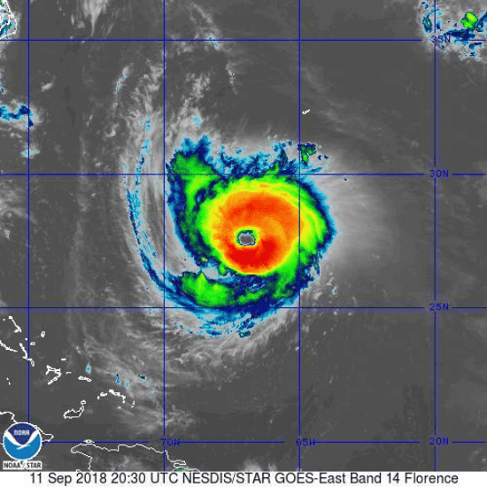
Satellite Review
Hurricane Florence!
Visible: viewing the sunlight reflected off Earth
Limitation: cannot use at night
Infrared: several channels! Senses re-emitted radiation
Shortwave IR: can be used to detect wildfires
Water vapor channel
Longwave IR: cloud top temperatures

Slide 17
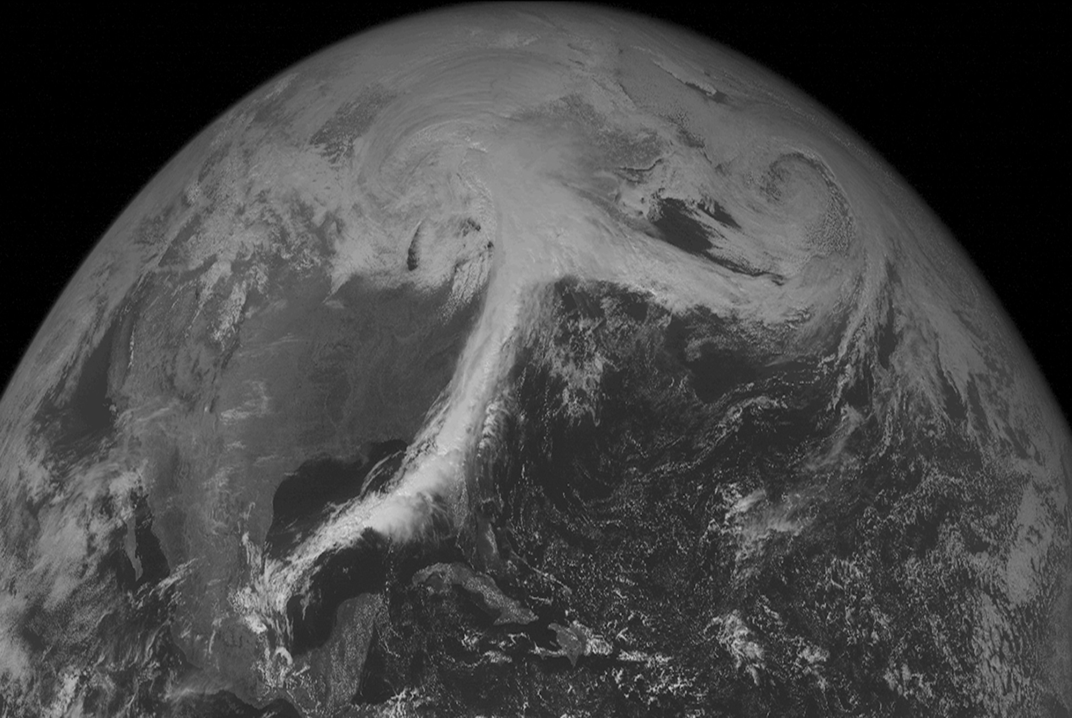
Satellite Imagery: Visible
Fig 2-13 Weather: A Concise Introduction

Slide 18
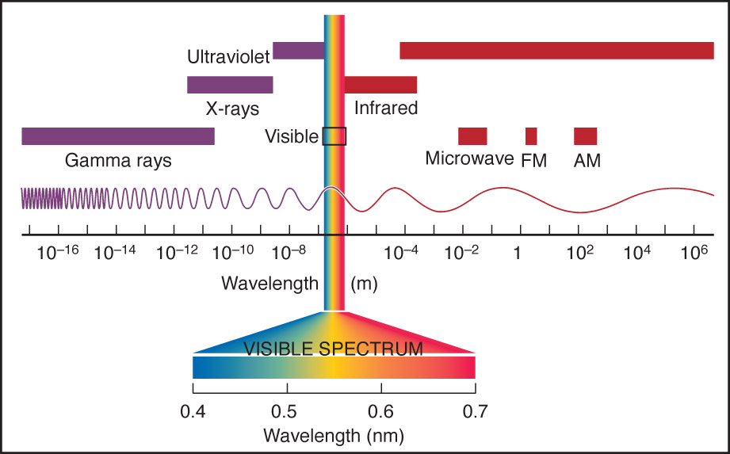
Electromagnetic Spectrum
Fig 2-7 Meteorology: Understanding the Atmosphere

Slide 19
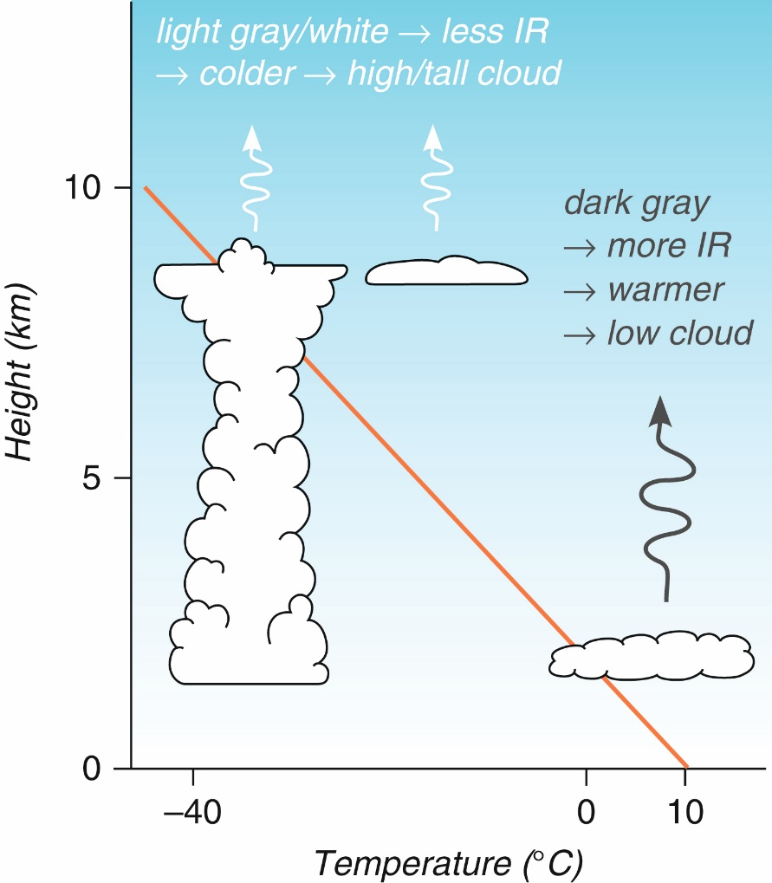
Satellite Imagery: Infrared (heat)
This is a “false color” image. The lighter the color, the colder the temperature.
What does this tell us about clouds?
Can you think of a limitation of the infrared image?
Fig 2-14 Weather: A Concise Introduction

Slide 20
Satellite Imagery: Visible
Fig 2-13 Weather: A Concise Introduction

Slide 21
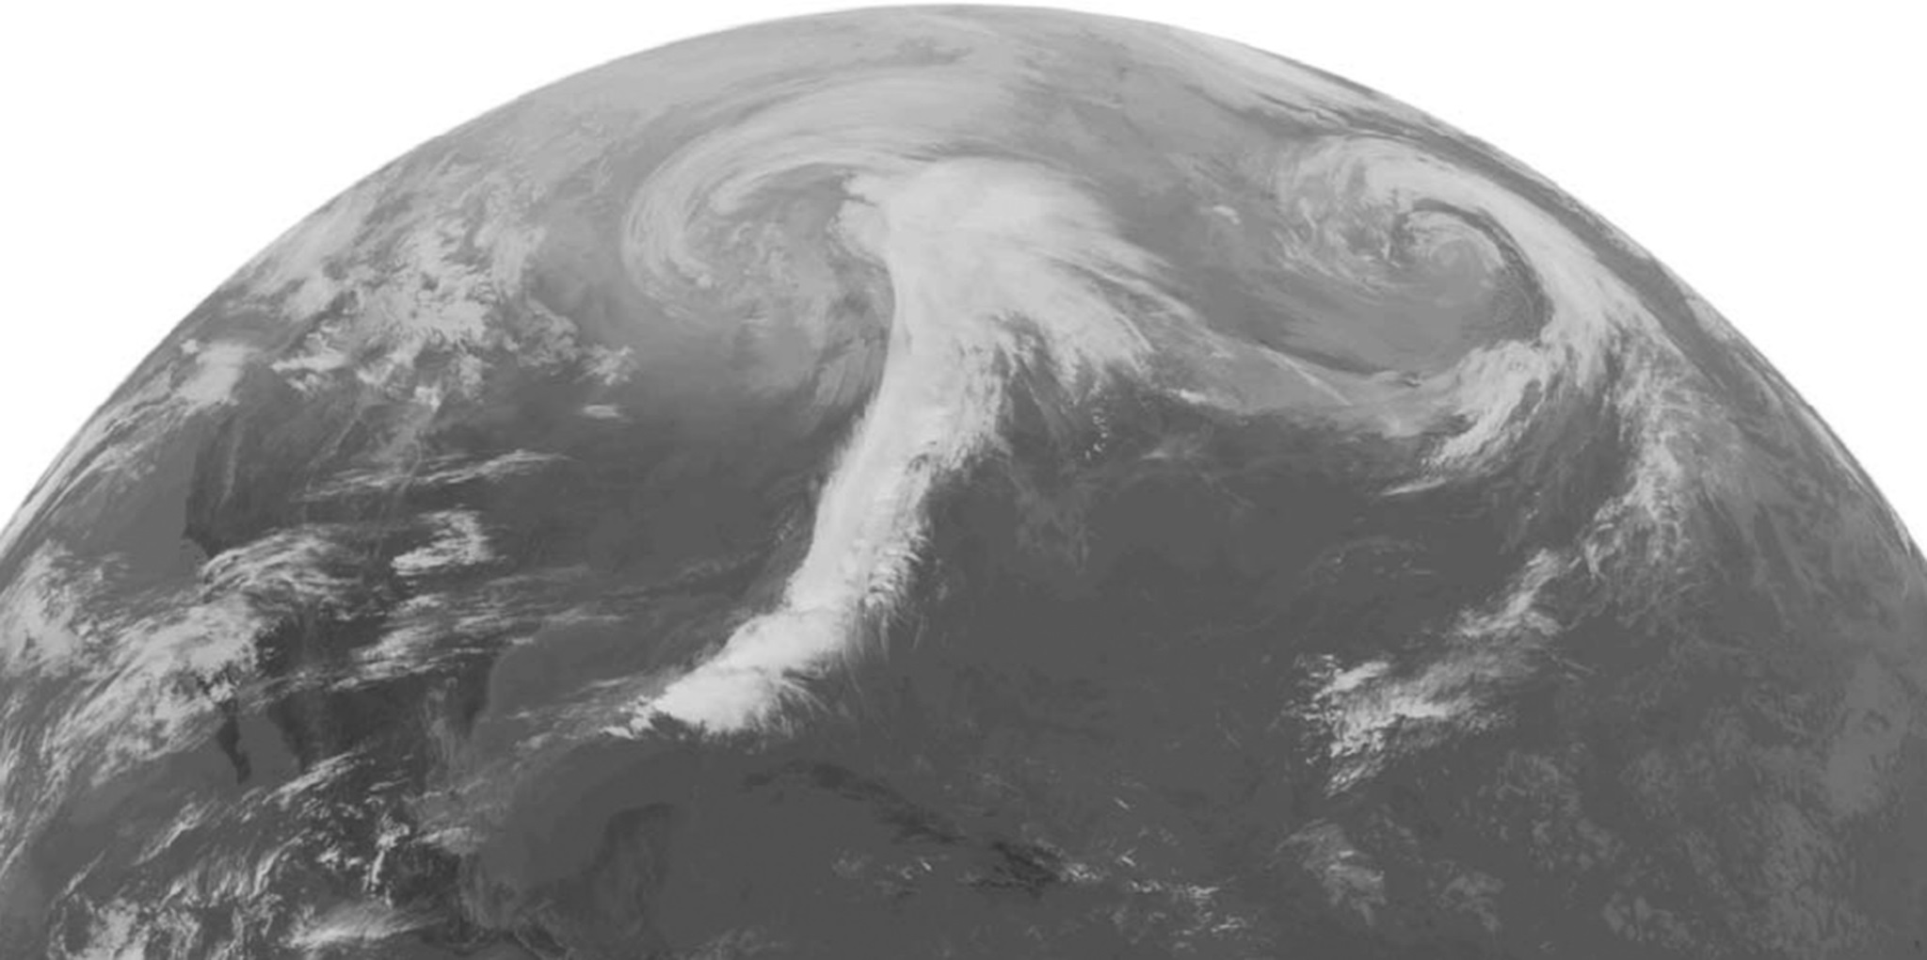
Satellite Imagery: Infrared (heat)
Fig 2-14 Weather: A Concise Introduction

Slide 22
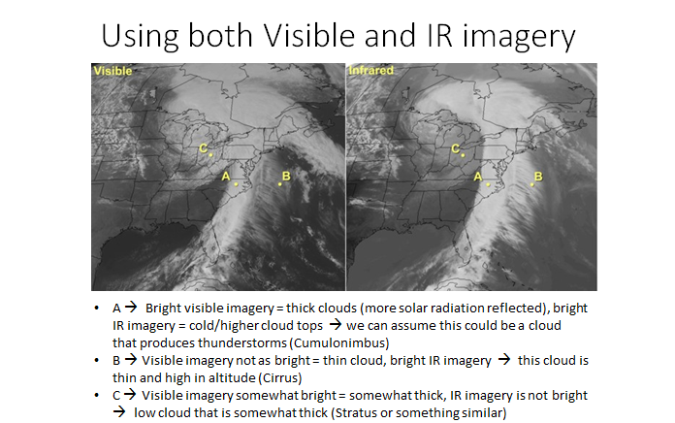

Slide 23
Geostationary satellites: Orbits the Earth at the same angular speed as the Earth. They are “parked” in orbit over Earth and stay over the same location.
Provide a lot of information at all times but only at one location and have difficulty seeing the polar regions…
Fig 2-19 Weather: A Concise Introduction

Slide 24
Polar orbiting satellites: Travel over the poles. Orbits wrap around the Earth. Need to travel quickly to provide cover the globe. Can be very high resolution because they orbit closer to the surface than geostationary satellites
Problems: Data gaps in time and space.
Fig 2-24 Weather: A Concise Introduction

Slide 25
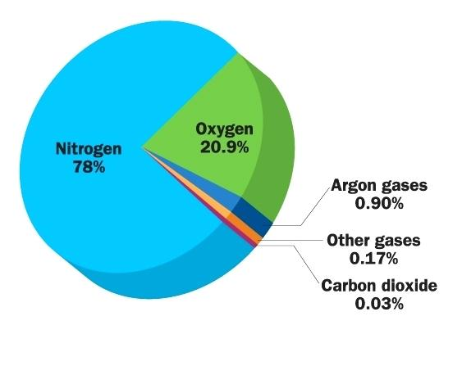
Earth’s Atmospheric Composition
** approximate values
Other gases:
Water vapor
Sulfur Dioxide
Ozone
Formaldehyde
Nitrogen Dioxide
Methane
Carbon Monoxide
Neon
etc etc etc…
Which one of these are greenhouse gases?

Slide 26
Ideal Gas Law
Shows relationship between pressure (P), volume (V), and temperature (T)
R = universal gas constant, R_{d} = dry gas constant
n = number of moles
ρ = density (mass/volume)

Slide 27
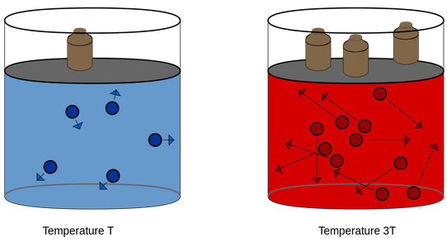
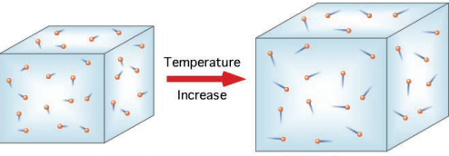

Slide 28
Project 1 Reminders
½ way peer evals and rough drafts due Feb. 19
After rough drafts are submitted, I will post example final drafts to my webpage

