Slide 1
Wind: Discussion
Pressure Gradient Force
Sea and Land Breezes (Thermal Wind)
Coriolis Force
Geostrophic Wind
Centrifugal Force & Friction
Gradient Wind
Surface vs Aloft Winds
Mountain Breezes
Katabatic Winds

Slide 2
Force: a quick lesson
Newton’s second law
Force = mass x acceleration
Bold letters indicate vectors (direction and magnitude)
Acceleration refers to change in velocity
Understanding winds amounts to understanding forces applied to air under certain circumstances
When there is more than one force, we find the net force
In particular, we will be discussing horizontal forces

Slide 3
Pressure Gradient Force
Pressure Gradient Force: due to differences in pressure over a distance
Always pushes from high pressure to low pressure
As the glass is lifted, gravity pulls the water down creating high pressure at the surface and forcing the water into the lower pressure surroundings.
Fig 8.1 Weather: A Concise Introduction

Slide 4
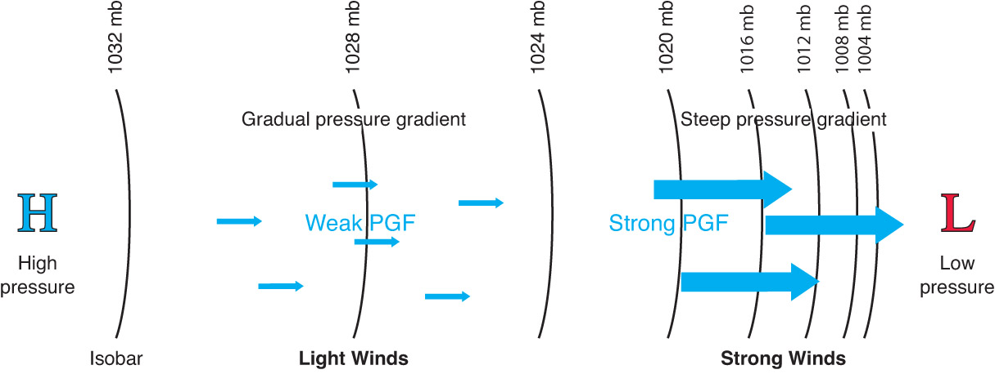
Pressure Gradient Force (PGF)
Force that results from differences (i.e. gradients) in pressure across a surface
Larger gradients (tightly packed isobars) result in faster winds
Smaller gradients (spaced out isobars) result in weaker winds

Slide 5
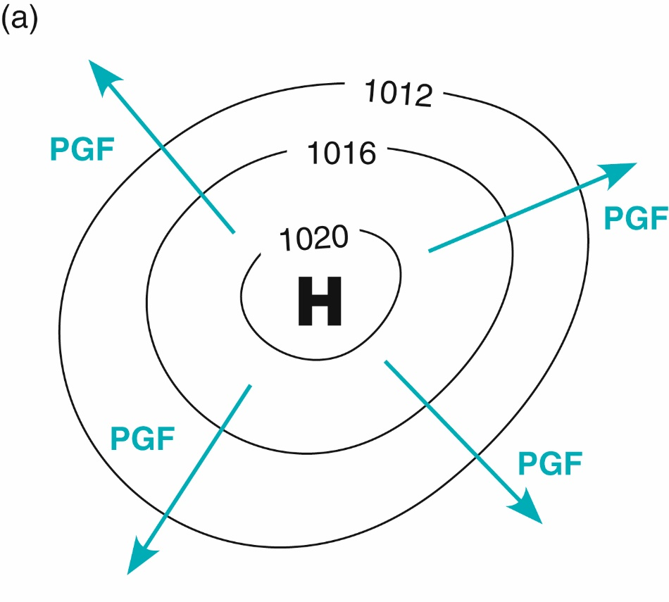
Pressure Gradient Force
Points FROM areas of high pressure
Points TOWARDS areas of low pressure

Slide 6
Sea Breeze
Aloft
Surface
Fig 8.2 Weather: A Concise Introduction

Slide 7
Sea Breeze
Aloft
Surface
Fig 8.2 Weather: A Concise Introduction

Slide 8
Sea Breeze
Aloft
Subsidence
Surface
Fig 8.2 Weather: A Concise Introduction

Slide 9
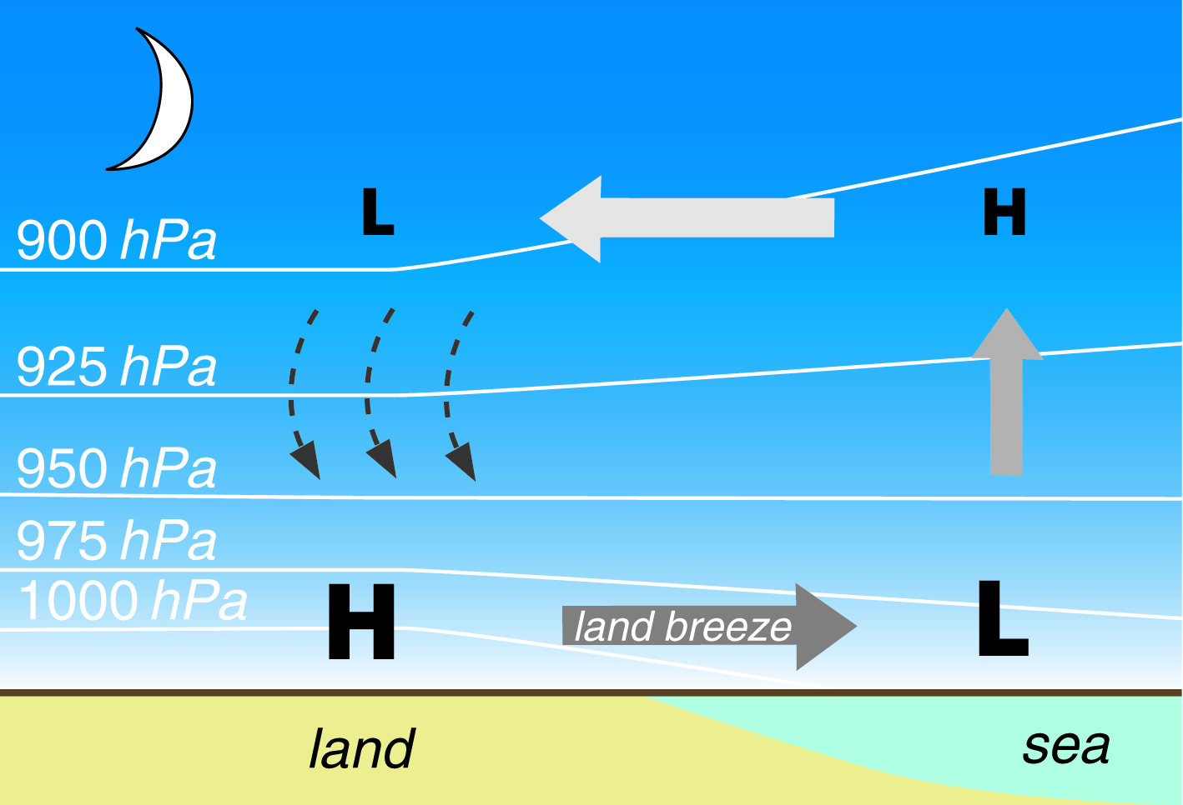
Land Breeze
Sea and Land Breezes are examples of Thermal Wind!
Fig 8.3 Weather: A Concise Introduction

Slide 10
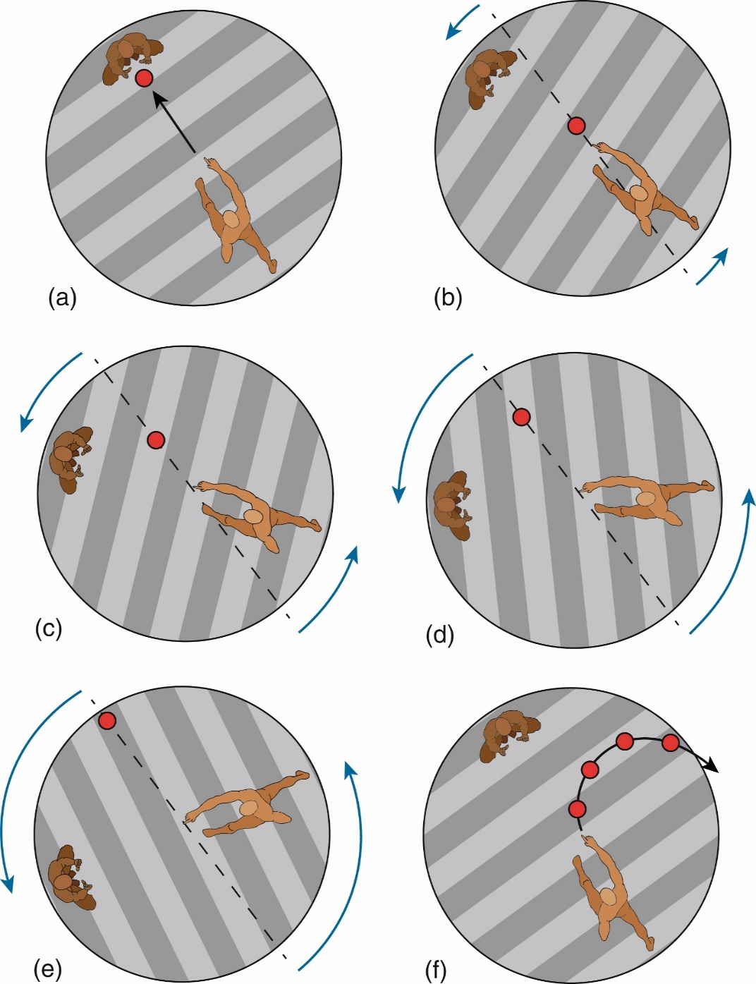
Coriolis Force
Apparent force
Pattern of deflection as air travels around the globe
Does not exist at the equator!
At the equator, Coriolis is at a minimum (i.e. zero)
At the pole, Coriolis is at a maximum
Coriolis force increases as velocity increases
Only affects wind direction, not speed
Will pull objects in motion to the right of motion in the Northern Hemisphere (to the left for Southern Hemisphere)

Slide 11
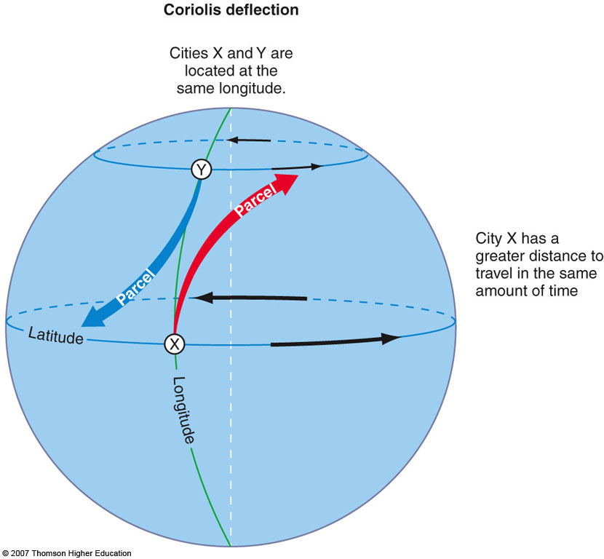

Slide 12
Low pressure
High pressure
Remember: we can switch between pressure contours and height contours
Fig 8.6 Weather: A Concise Introduction

Slide 13
Low pressure
High pressure
Remember: we can switch between pressure contours and height contours
Fig 8.6 Weather: A Concise Introduction

Slide 14
Low pressure
High pressure
Remember: we can switch between pressure contours and height contours
Fig 8.6 Weather: A Concise Introduction

Slide 15
Low pressure
High pressure
The parcel starts moving from high to low pressure. As it speeds up, the Coriolis force increases but always pulls to the right.
Eventually the PGF is balanced by Coriolis and we reach:
Geostrophic Balance
Fig 8.6 Weather: A Concise Introduction

Slide 16
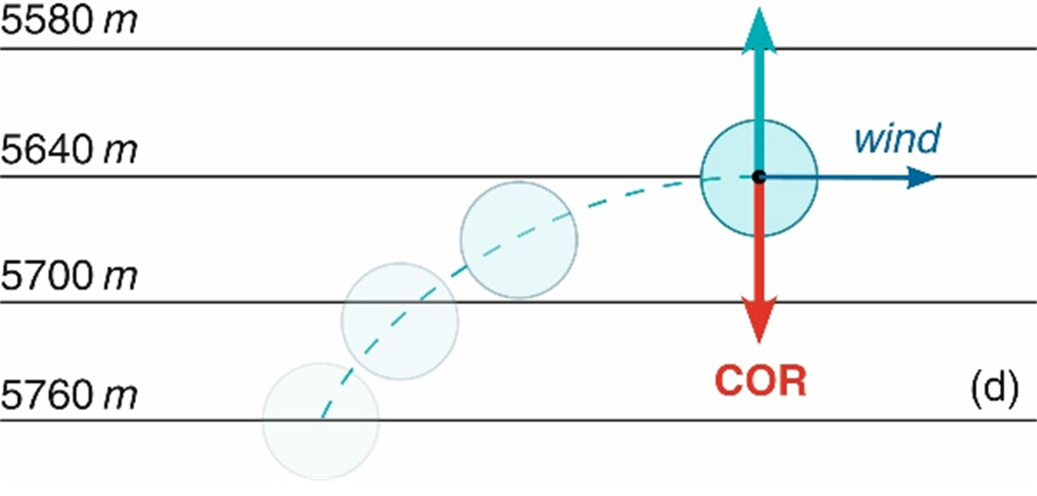
Geostrophic Wind
Remember PGF always points from HIGH to LOW
When the PGF and Coriolis force are in perfect balance, the wind flows parallel to the isobars (aka geostrophic balance)
Expect this aloft (high off the surface, where we have no friction)!

Slide 17
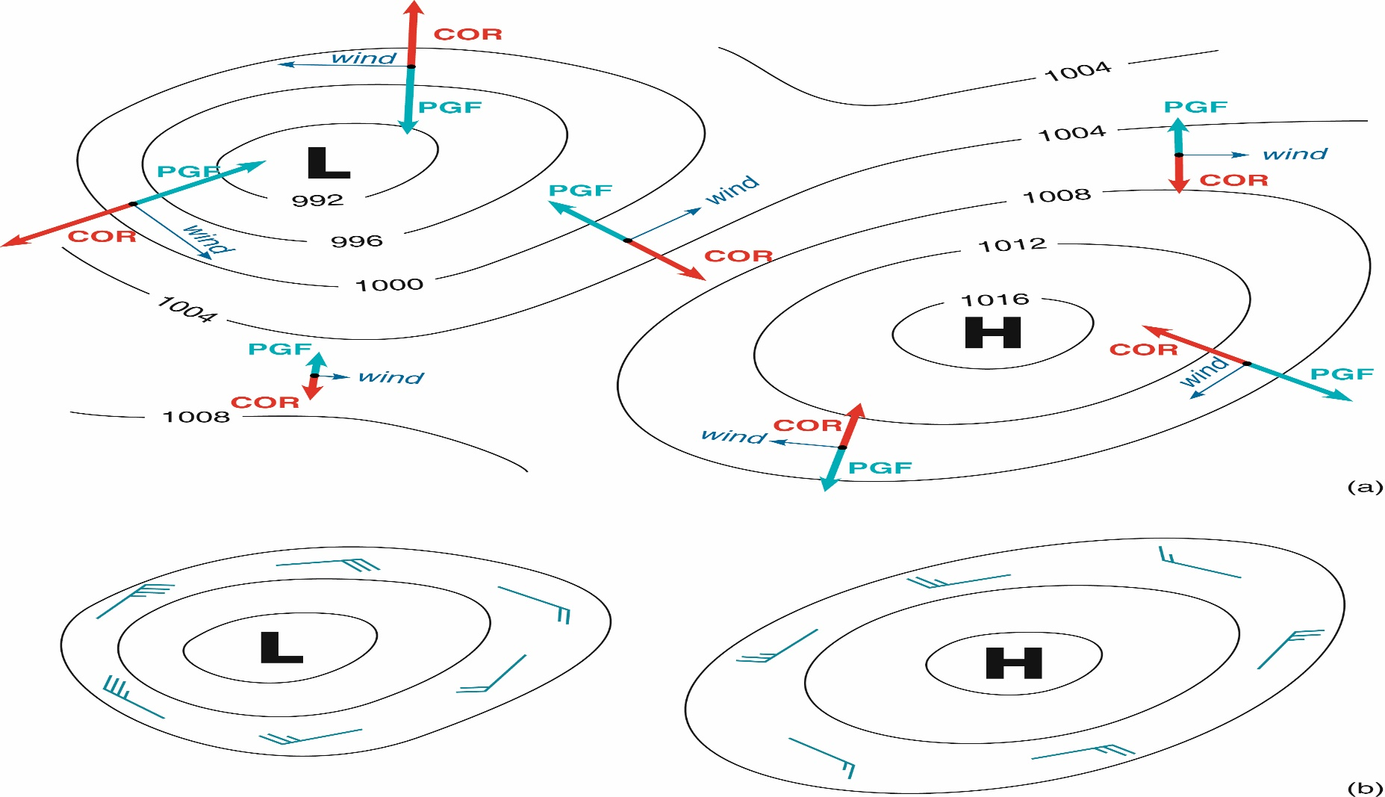
Winds aloft (in Northern Hemisphere)
Winds spin counter-clockwise around low
Otherwise known as cyclonic
Winds spin clockwise around high
Otherwise known as anti-cyclonic
Fig 8.13 Weather: A Concise Introduction

Slide 18
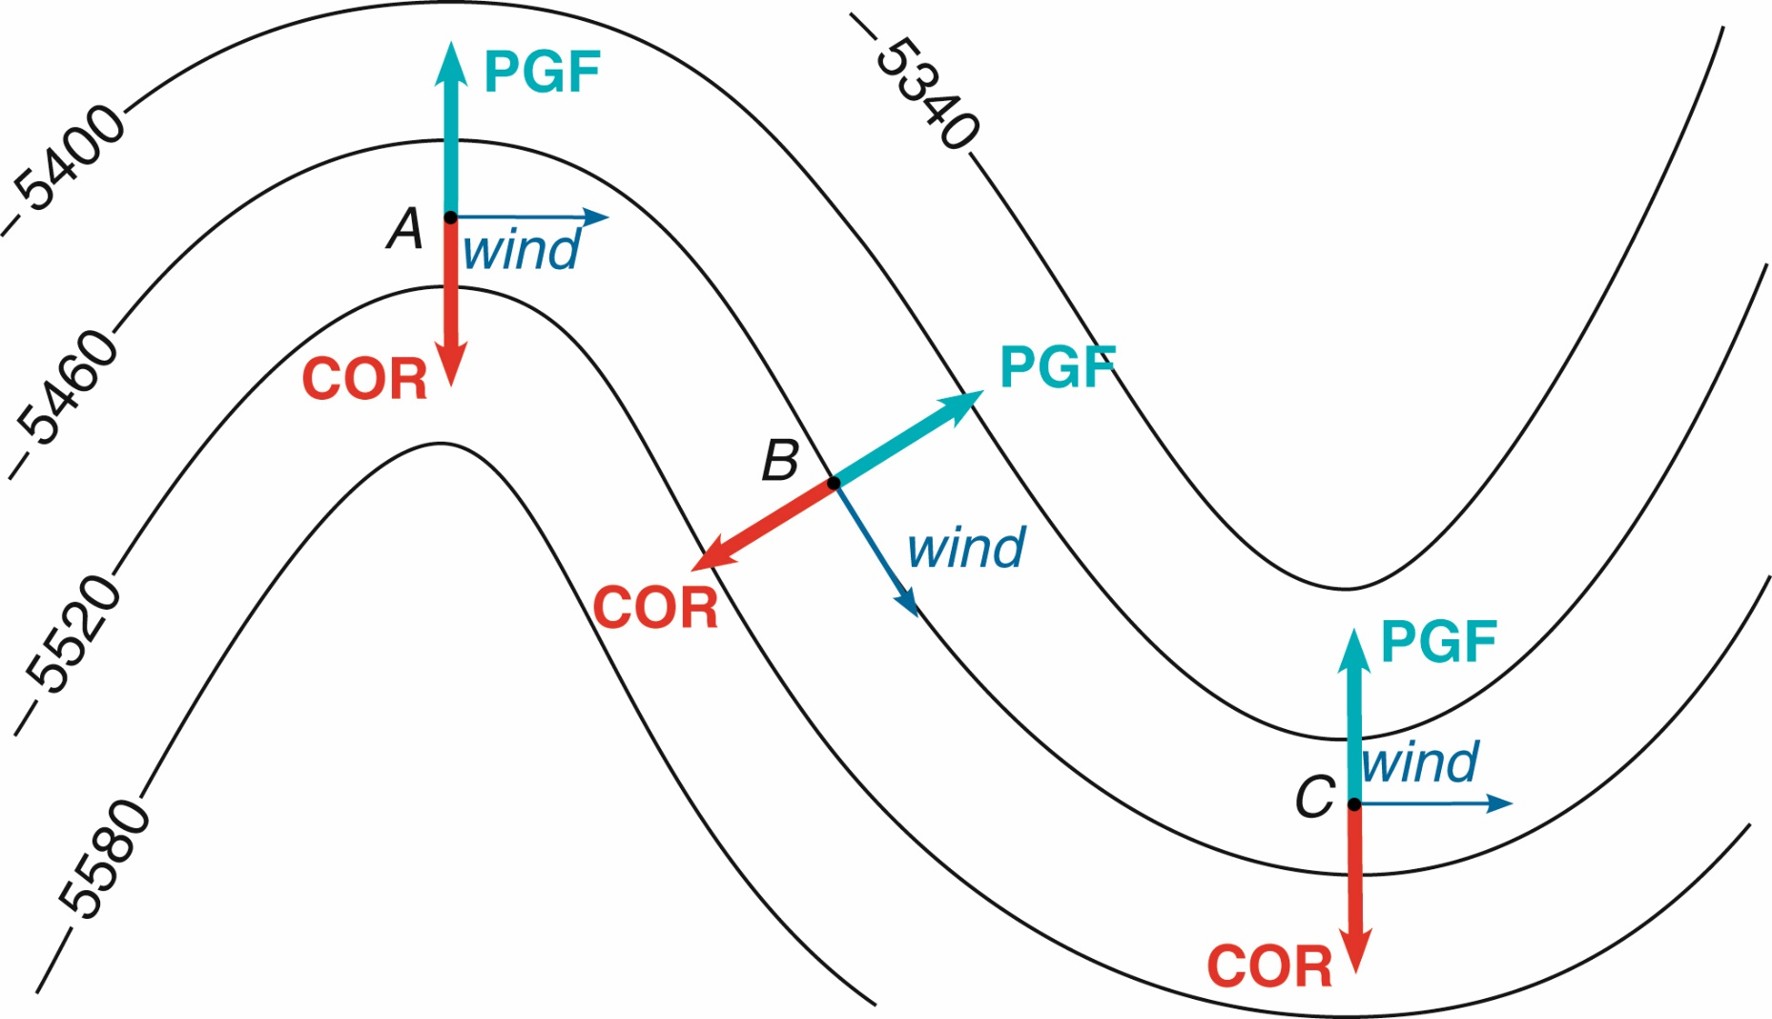
What happens when the isobars are curved? For the most part, the wind follows along with the isobars. But notice here our wind parcel does cross the 5460 line. What happened?
Turns out we’re missing another force…
Fig 8.9 Weather: A Concise Introduction

Slide 19
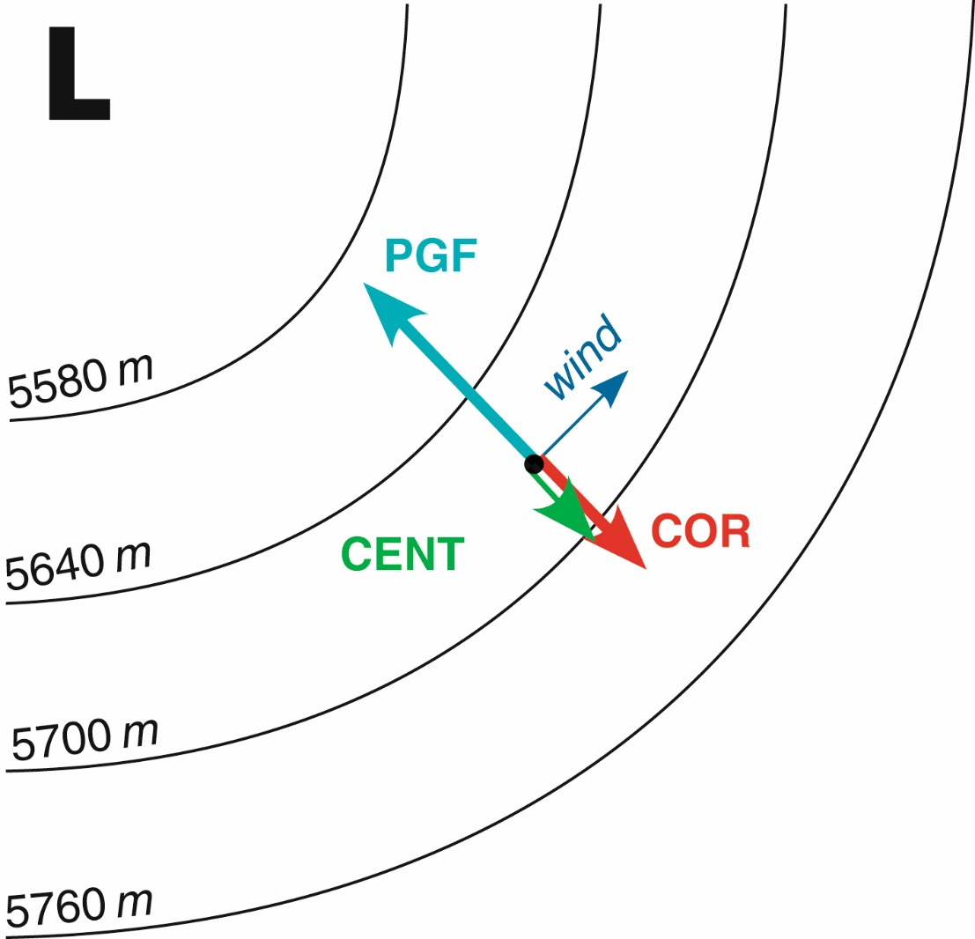
Centrifugal force
Like Coriolis, it’s an apparent force and depends on wind speed
Centrifugal force points “outward”
Same force you feel as you make a sharp turn in a car
Will combine with PGF or Coriolis force depending on direction of motion
Fig 8.10 Weather: A Concise Introduction

Slide 20
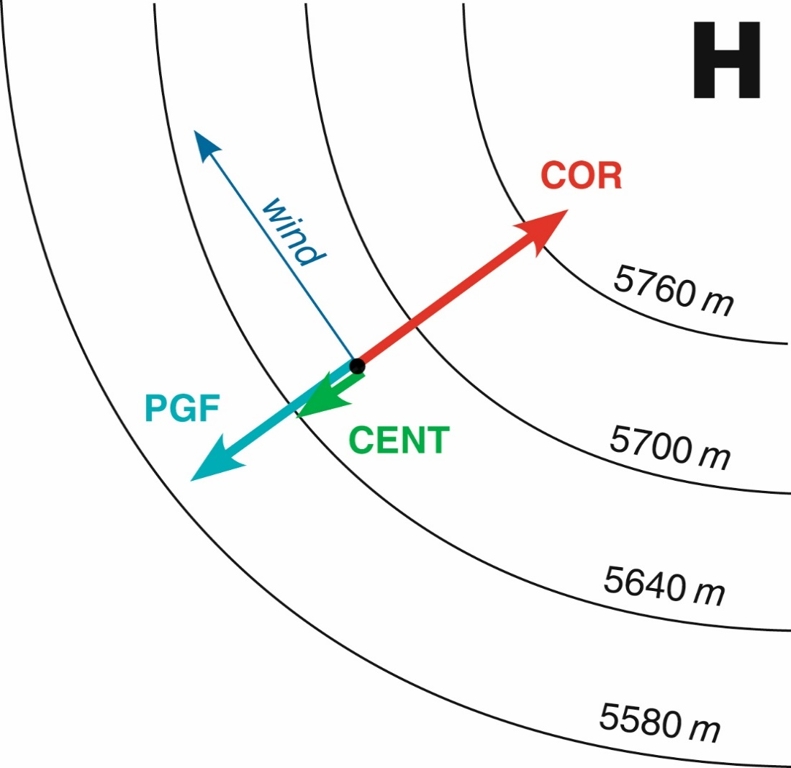
Around a low pressure system,
PGF = Coriolis + Centrifugal
Around a high pressure system,
PGF + Centrifugal = Coriolis
Fig 8.10 Weather: A Concise Introduction

Slide 21
Around a low, Coriolis force is combined with centrifugal force to offset PGF.
Thus, a smaller Coriolis force is required to create a balance
A smaller Coriolis force corresponds to a slower wind speed
We call this slower wind subgeostrophic
Fig 8.11 Weather: A Concise Introduction

Slide 22
Around a high, PGF is combined with centrifugal force to offset Coriolis
Thus, a larger Coriolis force is required to create a balance
A larger Coriolis force corresponds to a faster wind speed
We call this faster wind supergeostrophic
Fig 8.11 Weather: A Concise Introduction

Slide 23
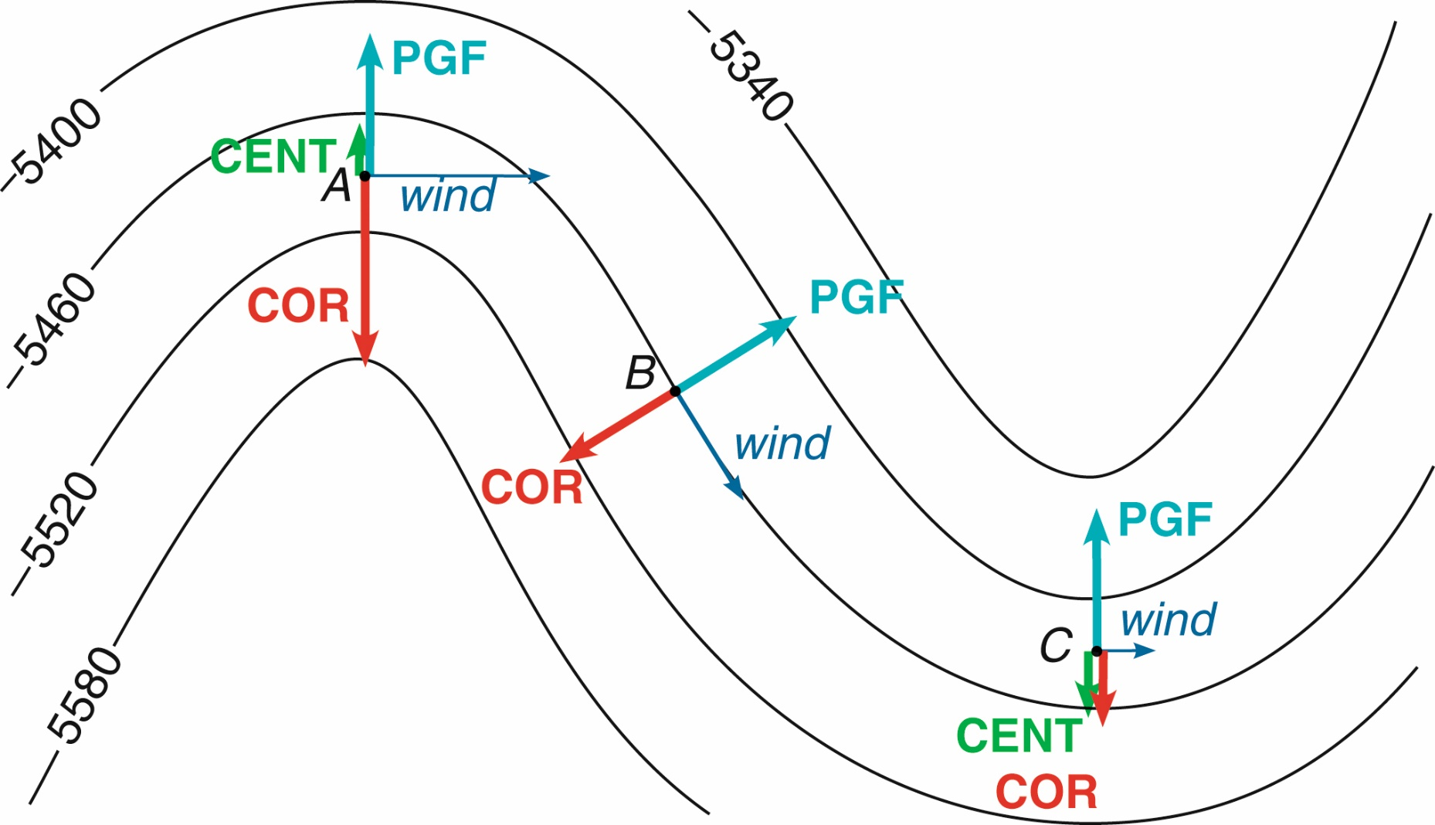
We call this: Gradient Wind
Trough
Ridge
In general: wind is supergeostrophic around a ridge and subgeostrophic around a trough
Fig 8.12 Weather: A Concise Introduction

Slide 24
We’re not done yet…
Geostrophic and gradient wind are just approximations
In real life, we know that winds don’t flow perfectly – it’s slowed down by objects on the surface, such as buildings, trees, mountains, etc.
This resistance provides a new force: friction
Friction acts in the opposite direction of motion, and seeks to slow the speed of the winds

Slide 25
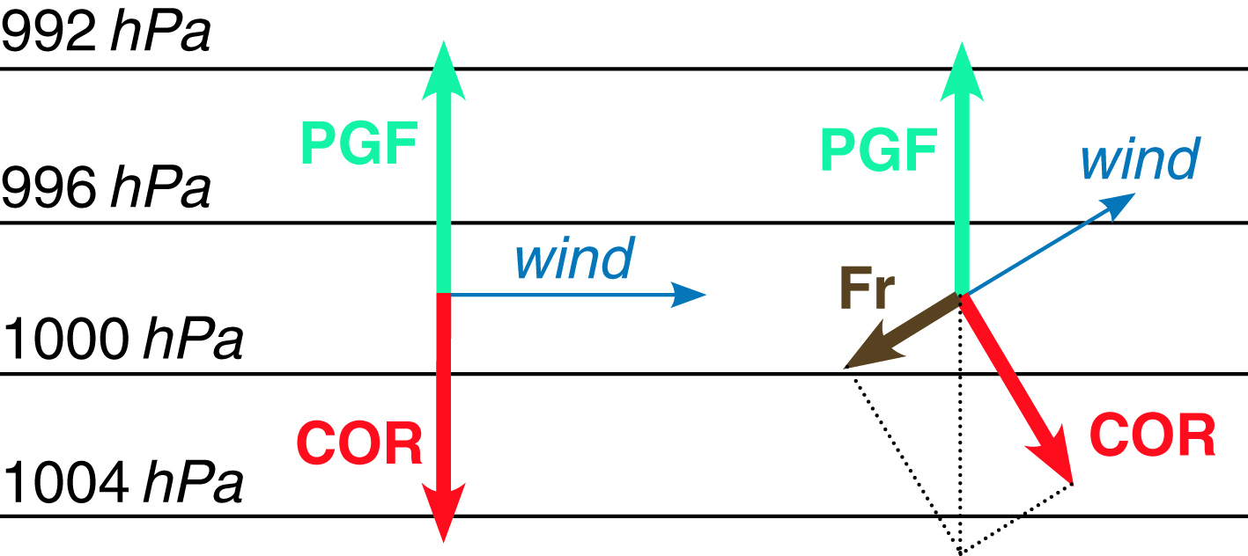
Surface Winds
Friction will slow wind speed, acting directly opposite wind direction
If the wind is slower, Coriolis and Centrifugal forces will be weaker as well
Fig 8.14 Weather: A Concise Introduction

Slide 26
Gradient wind
Fig 6-18 Meteorology: Understanding the Atmosphere

Slide 27
Gradient wind
Fig 6-18 Meteorology: Understanding the Atmosphere

Slide 28
Gradient wind
Fig 6-18 Meteorology: Understanding the Atmosphere

Slide 29
Gradient wind
Fig 6-18 Meteorology: Understanding the Atmosphere

Slide 30
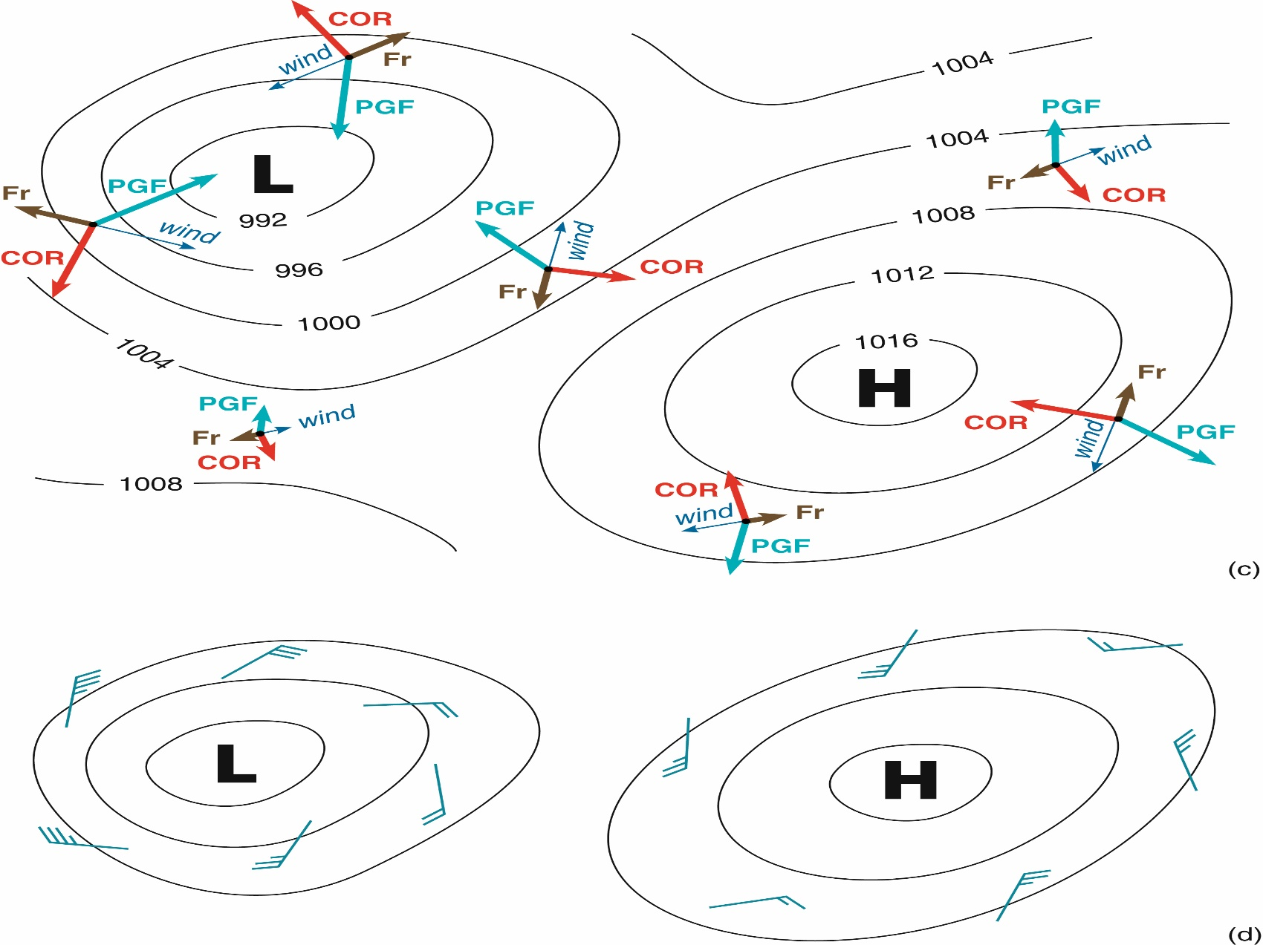
Surface winds (in Northern Hemisphere)
Winds spin counter-clockwise inward around low
Otherwise known as cyclonic
Winds spin clockwise outward around high
Otherwise known as anti-cyclonic
Fig 8.13 Weather: A Concise Introduction

Slide 31
Surface vs Aloft Winds
Surface:
Low pressure:
Winds spirals counterclockwise and into the low pressure center (cross-isobaric flow)
High pressure:
Winds spiral clockwise and out of the high pressure center (cross-isobaric flow)
Aloft:
Low pressure:
Winds spiral counterclockwise parallel to the isobars
High pressure:
Winds spiral clockwise parallel to the isobars
Remember, if we were in the southern hemisphere, these systems would spin in the opposite direction because the Coriolis Force acts in the opposite direction (to the left)!

Slide 32
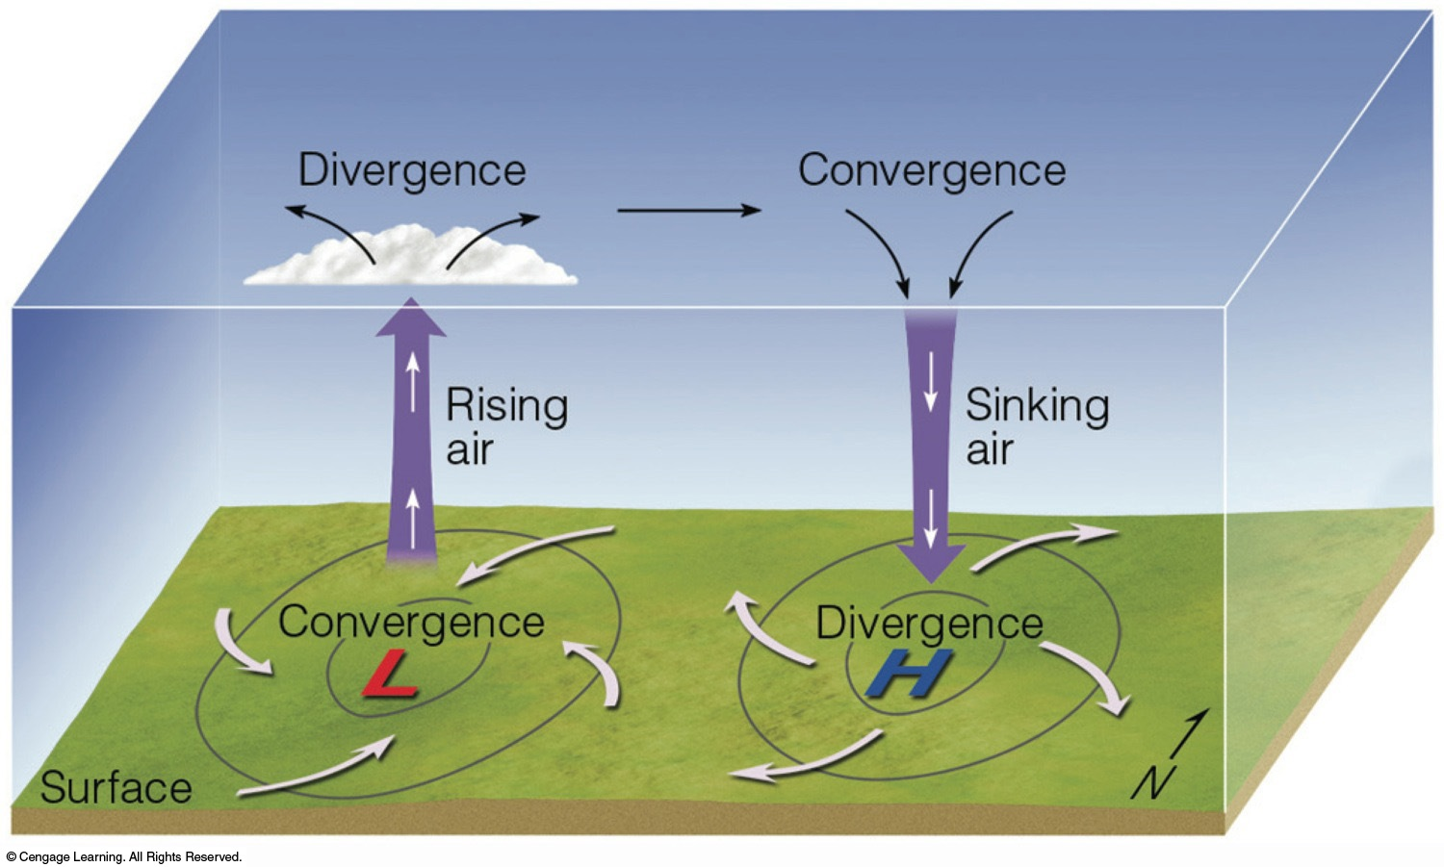
Fig 6.22: Essentials of Meteorology

Slide 33
Fig 6.22: Essentials of Meteorology

Slide 34
Valley Breeze
During the day, the “walls” of the valley heat faster than air over the valley, and air from these areas rise and form clouds
Air from the bottom of the valley flows up along the “walls” while relatively cool air sinks down into the valley
Thus a valley breeze is formed that moves from the valley up the sides of the mountains
Fig 8.18 Weather: A Concise Introduction

Slide 35
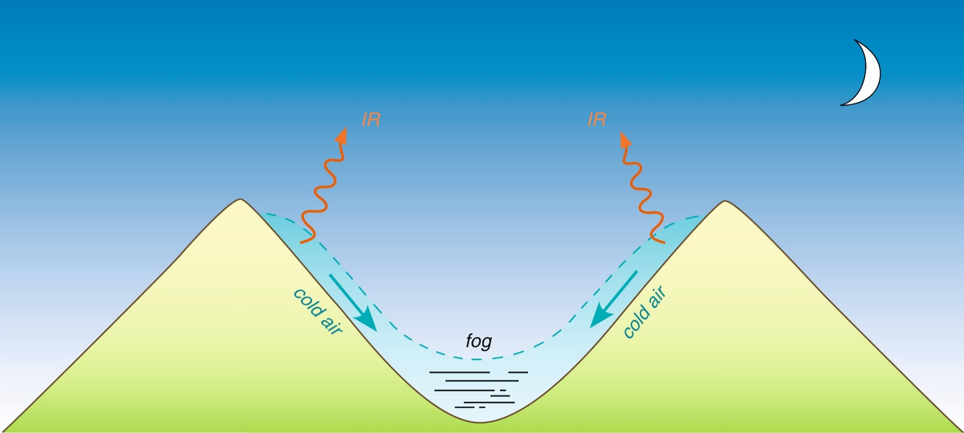
Mountain Breeze
The reverse process occurs at night
The “walls” cool due to emission of IR radiation. Cold air sinks down into the valley and accumulates. Thus, a mountain breeze blows from high to low elevation
As the night goes on, this air continues to cool until it reaches the dew point and forms fog
Fig 8.19 Weather: A Concise Introduction

Slide 36
Katabatic Winds
Winds forced down mountain slopes by PGF and gravity
Heat due to adiabatic expansion
Produce hot, very fast winds

