Slide 1
Discussion: Clouds & Precipitation
Lifting mechanism review
Warm vs Cold Clouds
Growth in Warm Clouds
Growth in Cold Clouds
Types of Precipitation
Hail formation

Slide 2
Lifting Mechanism Review
Lifting mechanisms allow parcels to move vertically through the atmosphere
If the parcel becomes saturated due to lower temperatures, condensation will occur on condensation nuclei, liquid water will form, and subsequently clouds may start to form
Lifting Mechanisms:
Orographic lifting
Convergence
Convection
Frontal lifting
After saturation, parcels will no longer follow the dry adiabatic lapse rate and will instead cool at the moist adiabatic lapse rate
Lifting mechs DON’T include conduction, advection, evaporation, updraft, orthographic, orthogonal, adiabatic, etc etc.
This is a map projection!!!!!

Slide 3
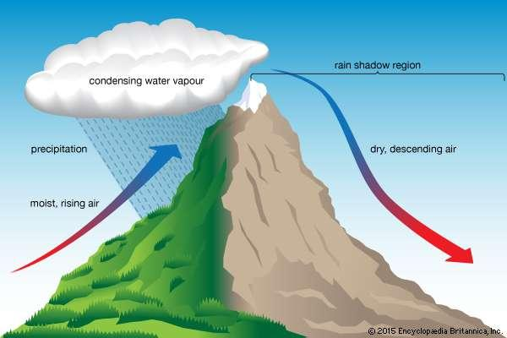
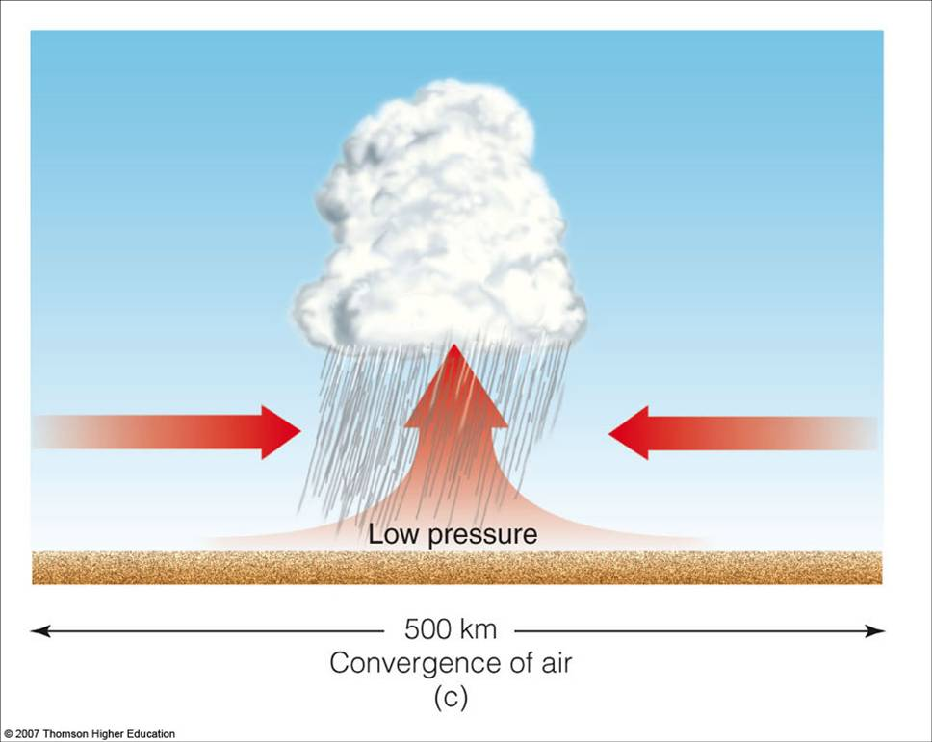
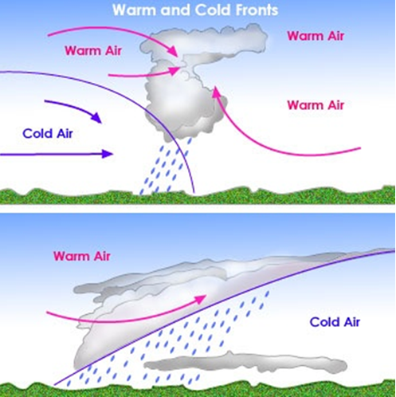
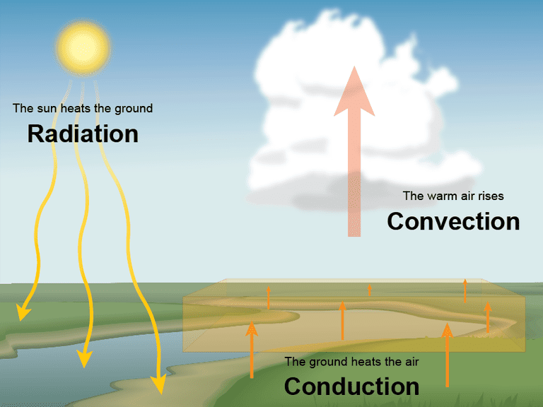

Slide 4
Warm Clouds
Cold Clouds
Temperatures everywhere above freezing (T>0°C)
Contain exclusively liquid water droplets & water vapor
Droplets grow through collision and coalescence
Example: Fair-weather cumulus
Parts of cloud are below freezing
Contain liquid water, water vapor, supercooled droplets, and ice crystals
Ice crystals grow through Bergeron Process, accretion/aggregation
Examples: cirrus, cumulonimbus

Slide 5
How does precip form in Warm Clouds?
Warm cloud process: happens primarily in the summer and tropics
Tiny droplets form on cloud condensation nuclei (CCNs)
Tiny droplets ride updrafts and collect more water as they rise and fall
They get big enough that gravity will take over

Slide 6
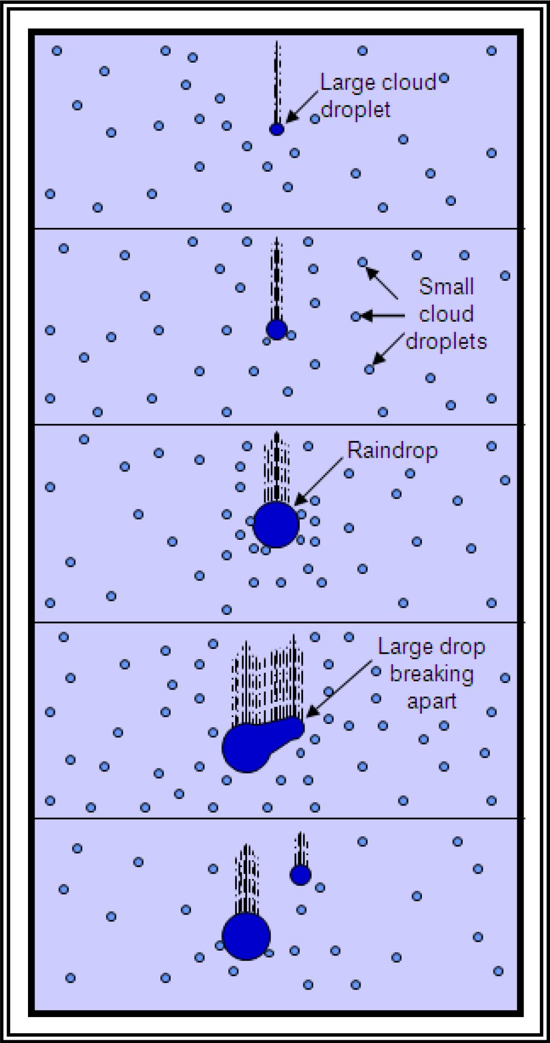
Collision / Coalescence
Water must first condense onto an aerosol particle (Cloud Condensation Nuclei)
Examples: soot, pollen, salt, dust, etc.
Droplet then collides and coalesce with smaller droplets (due to updrafts), becoming larger
Occasionally, the larger droplet will break apart, forming smaller droplets
Droplets then collide with smaller droplets, process continues until the droplets become heavy enough (no longer supported by the updraft) and rain out (gravity takes over)

Slide 7
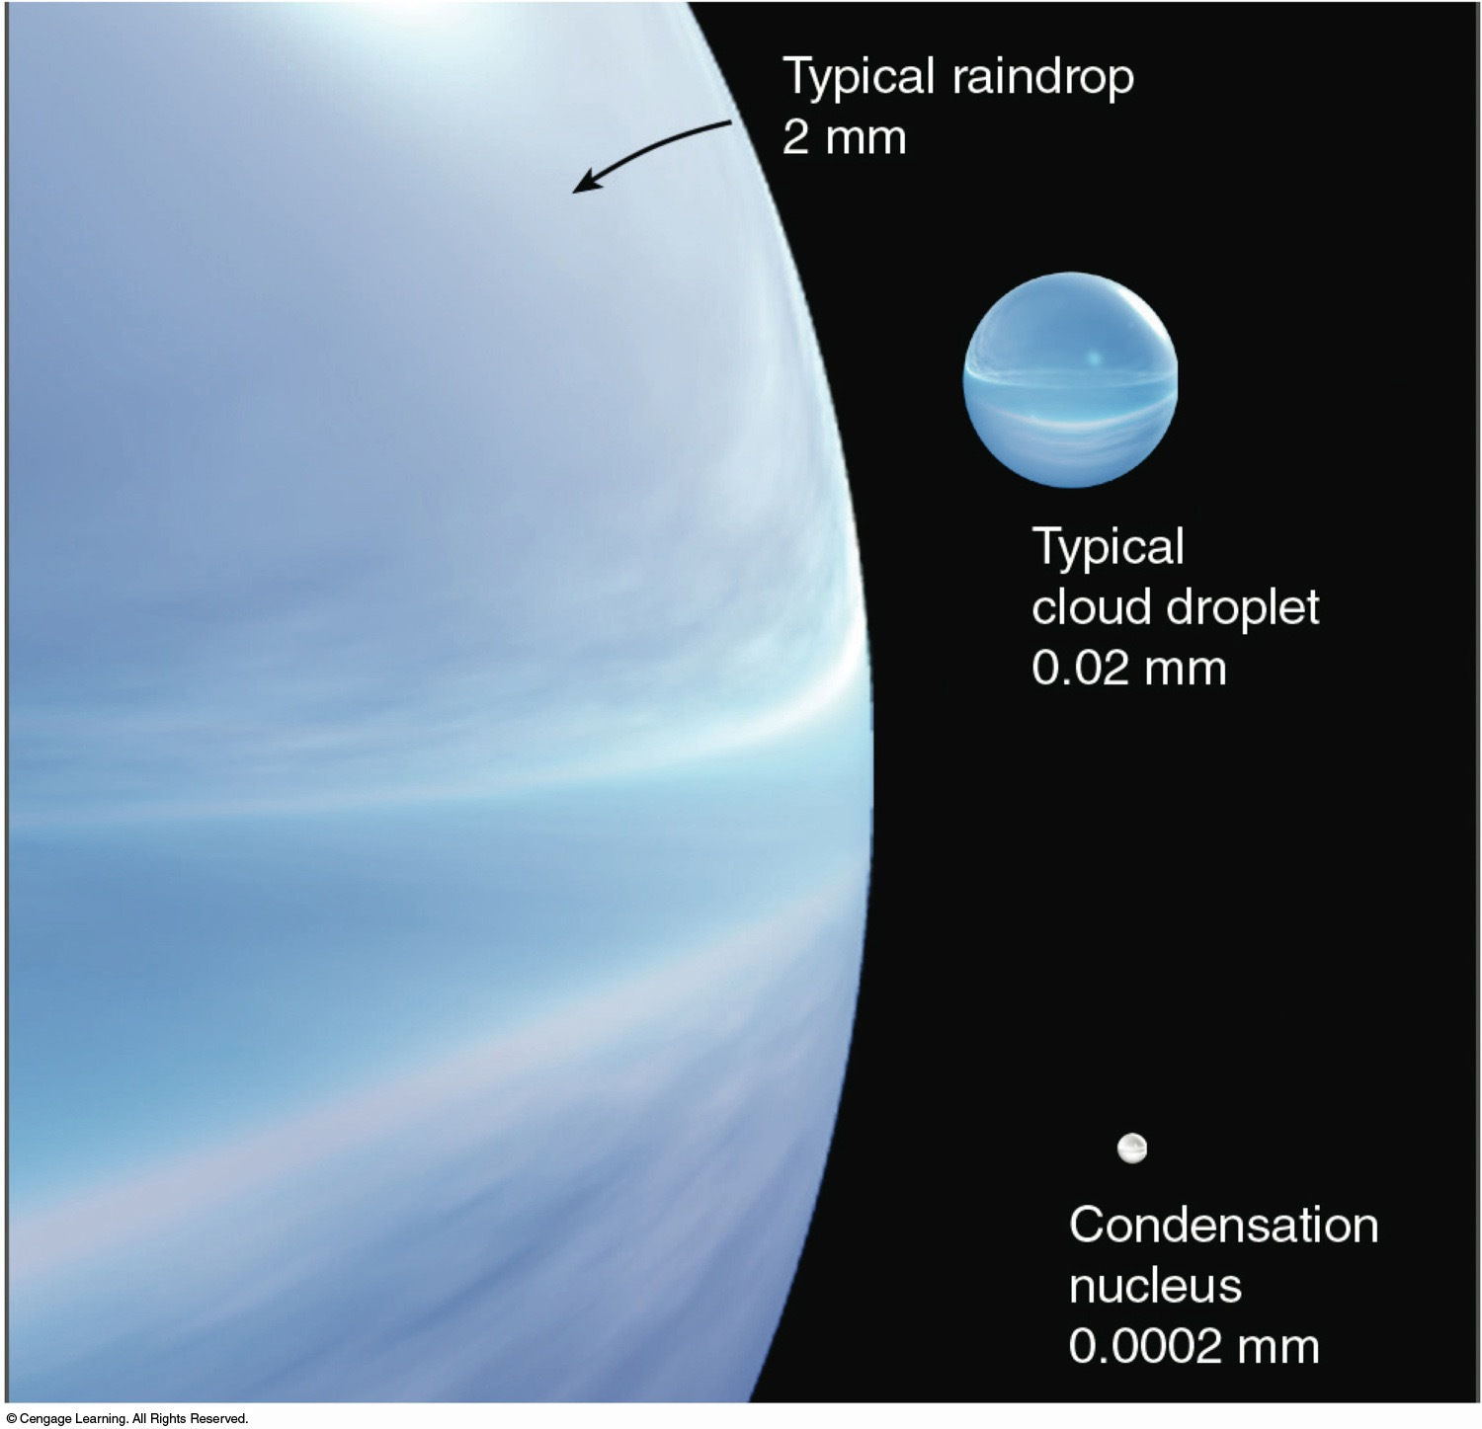
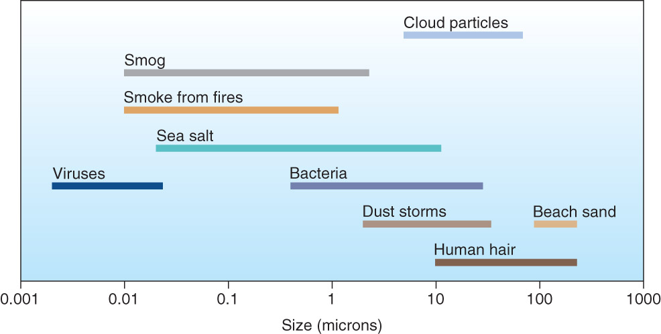
Examples of aerosols which may form cloud condensation nuclei

Slide 8
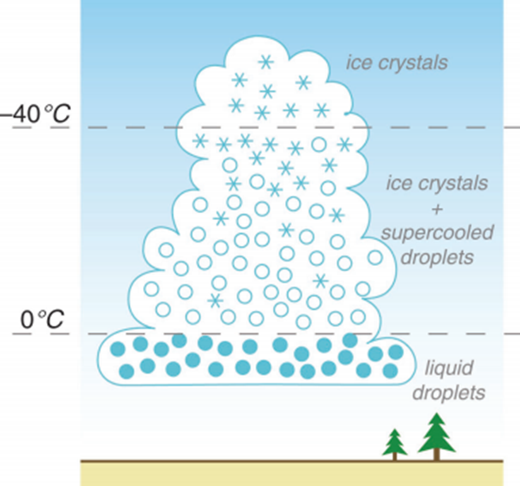
What about cold clouds?
A single mixed-phase cloud can contain multiple forms of water, depending on altitude
Between 0 and -40 °C, water exists as vapor, ice crystals, and supercooled droplets
Supercooled droplets will persist until they form an ice crystal (homogeneous nucleation) or come in contact with an ice nucleus (similar to CCN)
Below -40 °C, only ice crystals exist

Slide 9
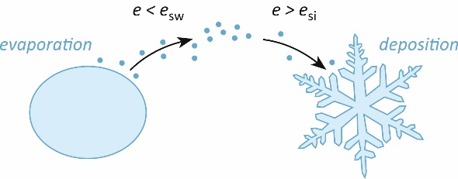
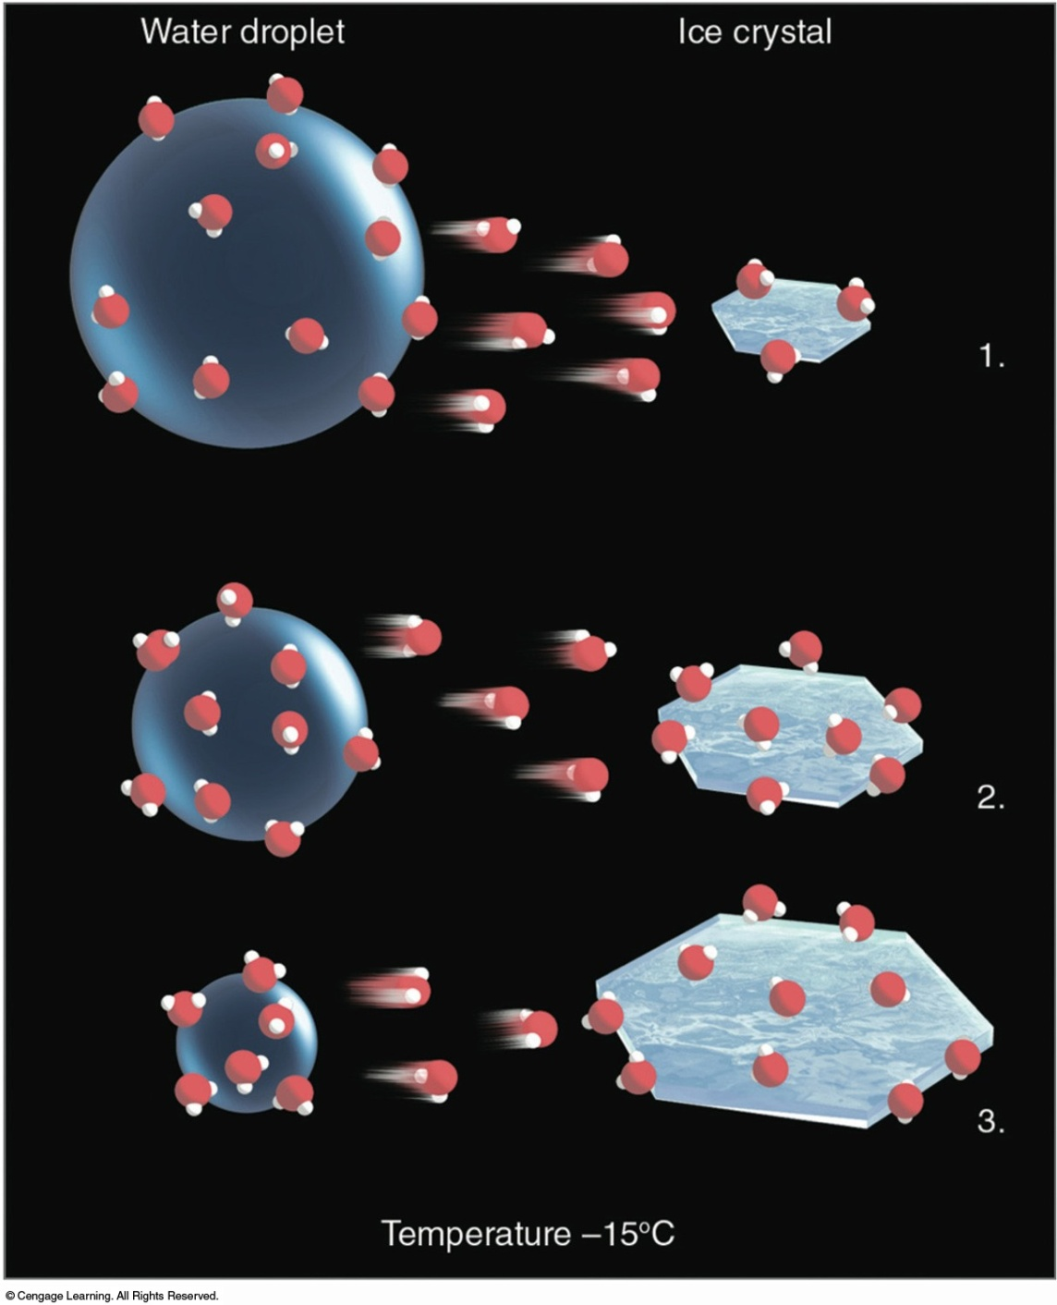
Bergeron Process
Saturation water vapor pressure over ice is less than saturation water vapor pressure over water
In other words, water vapor will more readily deposit on ice than condense on liquid water
As vapor deposits on ice, it evaporates from droplets. In short, ice crystals steal water from liquid droplets

Slide 11
Types of Precipitation
A) Snow: stays frozen throughout the entire profile
B) Sleet: may start out frozen, but enters a warmer layer where melting occurs, then enters a colder layer (below freezing) where freezing occurs before it hits surface
C) Freezing rain: may start out frozen, but enters a warmer layer where melting occurs, then enters a cold layer at or near the surface where droplets cool, contact with surface causes freezing to occur
D) Rain: may start out frozen, but melts as it falls due a warm atmosphere

Slide 12
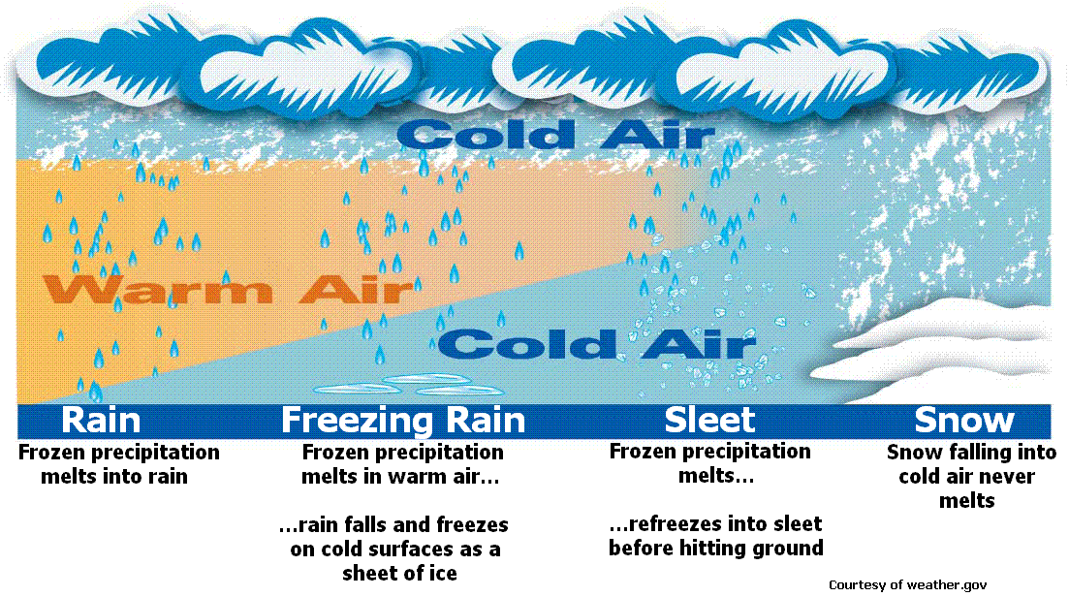

Slide 13
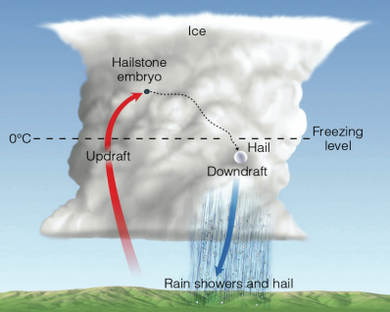
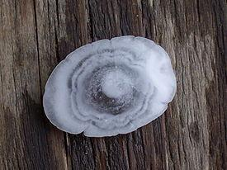
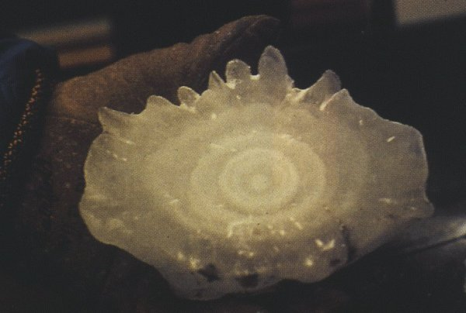
Hail formation
Cold water freezes onto ice nuclei
Gets bounced around by the strong updraft
More water freezes onto hail stone, creating layers of ice
Eventually it gets heavy enough that gravity takes over

