Slide 1
Global Wind Systems & General Circulations
Single Cell Model
Three Cell Model
Hadley (Equator to 30° latitude)
Ferrel (30° to 60° latitude)
Polar (60° to 90° latitude)
Jet Streams
Surface level Pressures
Indian Monsoon
Ekman Transport
ENSO (El Nino/Southern Oscillation)

Slide 2
Sea Breeze
Aloft
Subsidence
Surface
Fig 8.2 Weather: A Concise Introduction

Slide 3
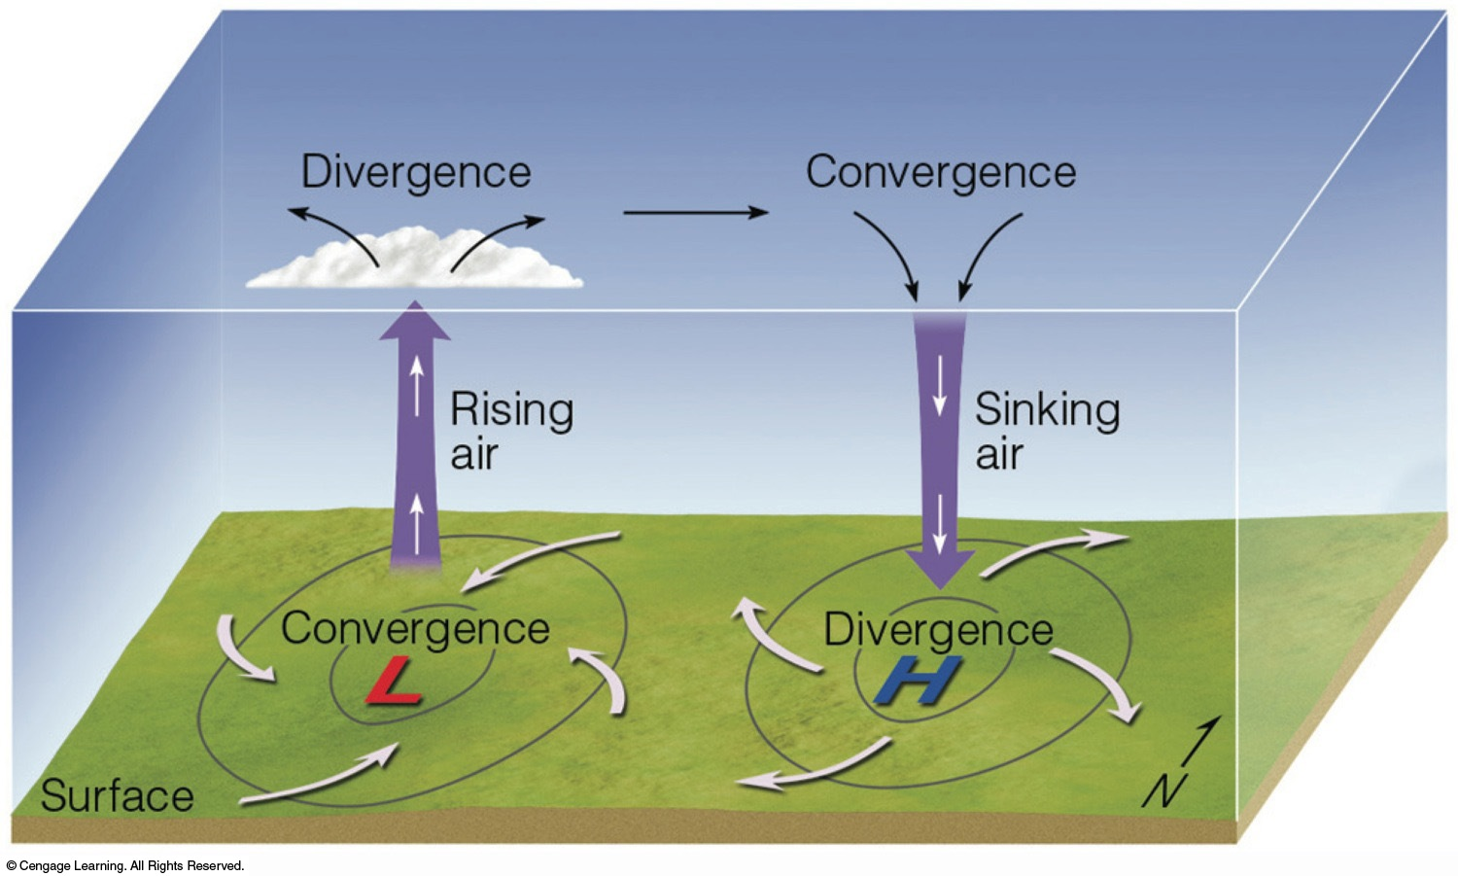
Fig 6.22: Essentials of Meteorology

Slide 4
Single Cell Model (Hadley Cell)
Air rises at the equator (warmest/most convection, thus low pressure)
Air aloft at equator flows to poles and sinks, creating high pressure at poles
Air moves from the poles to the equator at the surface
If we apply the Coriolis force to surface winds, we find that this model can only explain surface easterlies (ex. trade winds), but not the midlatitude westerlies

Slide 5
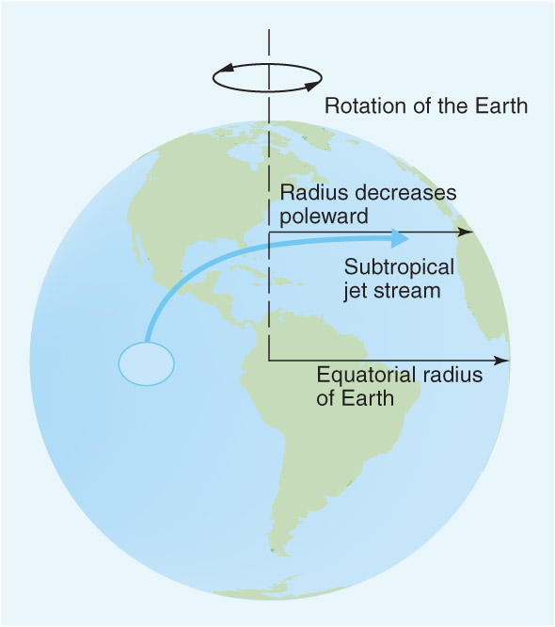
Single Cell Model (Hadley Cell)
(Aloft)

Slide 6
Jet Streams

Slide 7
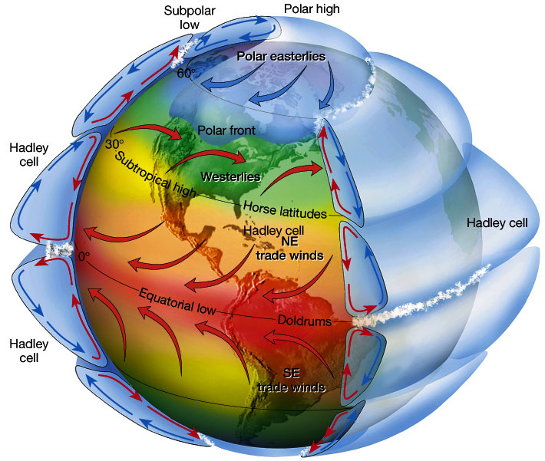
Three Cell Model
Polar cell
Ferrel cell
The single cell model adequately explains the trade winds, as well as cloudiness/precipitation at the ITCZ (intertropical convergence zone)
Because the single cell model does not explain Westerlies or the existences of two jet streams, we know it is inadequate in explaining global wind patterns
Instead, we examine a 3 cell model that better explains these phenomenon

Slide 8
Three Cell Model:
How does the single cell model become the three cell model?
Single cell model:
Two circulation cells (northern hemisphere, southern hemisphere)
Warm air rises, cold air sinks
Thermally direct!
Air rises at equator, travels poleward aloft
Air sinks at poles, air near surface travels equatorward
Assumption: no or very slow rotation

Slide 9
Ω
How does the single cell model become the three cell model?
Polar
Once you introduce rotation… the winds start to deflect
More cells begin to appear due to the Coriolis force
Reminder: Coriolis is an apparent force that pulls to the right in the NH
Three cell model emerges:
Tropics: Hadley Cell
Thermally direct
Midlatitudes: Ferrel Cell
Thermally indirect
Polar region: Polar Cell
Thermally direct
Midlatitudes (Ferrel)
Tropics (Hadley)
Tropics (Hadley)
Midlatitudes (Ferrel)
Polar

Slide 10
Ω
How does the single cell model become the three cell model?
Polar
Tropics: Hadley Cell
Thermally direct (i.e. rising where it is hot; convection)
Rising motion at/near equator
Low pressure at surface
Air hits max height and starts to travel poleward
Air begins to deflect (right in NH, left in SH)
Winds aloft reach geostrophic balance
Winds can’t travel any further north
Air will sink near midlatitudes (high pressure)
Return flow to equator, producing trade winds (easterlies)
Midlatitudes (Ferrel)
H
Tropics (Hadley)
L
Tropics (Hadley)
H
Midlatitudes (Ferrel)
Polar

Slide 11
Ω
How does the single cell model become the three cell model?
Polar
Midlatitudes: Ferrel Cell
Thermally indirect
Sinking air due to Hadley leads to semi-permanent high pressure near 30ºN, 30ºS
i.e. sinking air (divergence)
This is where many deserts are located
Air moves poleward near the surface
Deflected by Coriolis, leads to surface westerly winds (westerlies)
Air rises near 60ºN, 60ºS when it converges with cold polar air
Large temp. differences lead to the polar front
Low surface pressure
Return flow equatorward aloft
L
Midlatitudes (Ferrel)
H
Tropics (Hadley)
L
Tropics (Hadley)
H
Midlatitudes (Ferrel)
L
Polar

Slide 12
Ω
H
How does the single cell model become the three cell model?
Poles: Polar Cell
Thermally direct
Air rises near 60ºN, 60ºS when it converges with Ferrel cell westerlies
Low pressure
Air eventually stops rising then travels poleward
Eventually, air sinks near poles (90ºN, 90ºS)
high pressure due to sinking air
Air returns equatorward at surface
Deflected eastward, forming polar easterlies
Notice: Our jet streams are located where two cells meet
Subtropical jet (between Hadley and Ferrel)
Polar jet (between Ferrel and Polar)
Polar
L
Midlatitudes (Ferrel)
H
Tropics (Hadley)
L
Tropics (Hadley)
H
Midlatitudes (Ferrel)
L
Polar
H

Slide 13
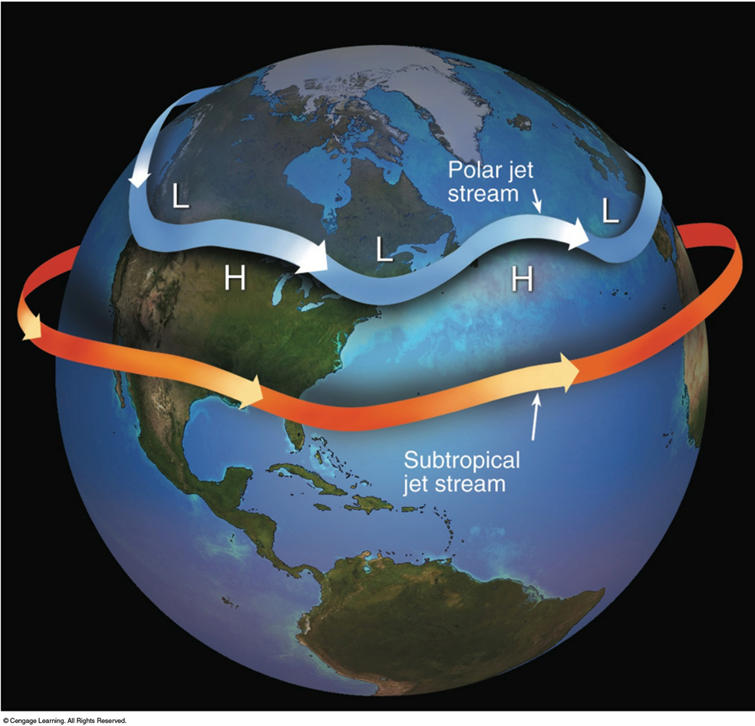
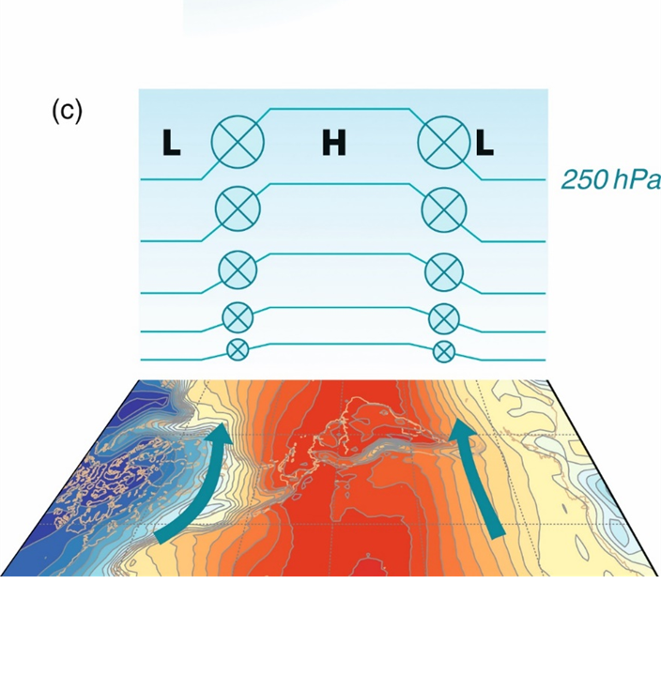
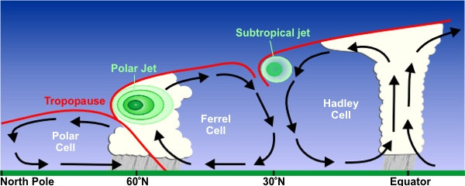
Jet Streams
Our jet streams are located where two cells meet
Driven by deflected winds aloft, as well as by strong temperature gradients
Polar front

Slide 14
Three Cell Model
http://wowzahttp.cengage.com/digital-production/earthscience/global_circulation.mp4
Global Winds
https://earth.nullschool.net/

Slide 15
Sea Level Pressures During Summer
Notice the semi-permanent sub-tropic highs
During NH summers, temps are high over land, leading to thermal low-pressure systems in the NH
ITCZ is shifted slightly north of equator

Slide 16
Sea Level Pressures During Winter
Notice the semi-permanent sub-tropic highs
During NH winters, temps are low over land, leading to high-pressure systems in the NH
Seasonal low-pressure systems, such as Icelandic & Aleutian Low, develop
ITCZ is shifted slightly south of equator

Slide 17
Indian Monsoon
During summer months, ITCZ shifts northward
Land heats up and pressure gradient forms, wind blows from ocean to land, bringing moist air from ocean
Lots of convection + moist, warm air = lots of precipitation
During winter months, ITCZ shifts southward
Wind patterns reverse, causing winds to blow from land to sea
Significantly drier conditions result

Slide 18
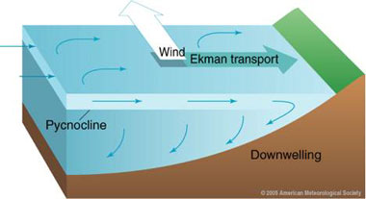
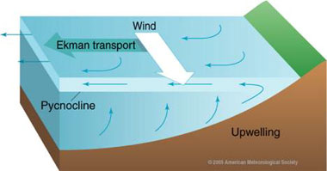
Ekman Transport
Northern Hemisphere
Winds drive ocean currents
This flow is also impacted by the Coriolis Force, which acts to push the water to the right in the northern hemisphere
This surface flow impacts the flow in the layer beneath
We have a net transport of water 90 degrees to the right of the surface wind (Ekman Transport)
If the Ekman Transport is moving water towards the land, surface water must sink to the bottom to conserve mass
Downwelling
If the Ekman Transport is moving water away from land, deeper water must move towards the surface to conserve mass
Upwelling of colder water (Ekman pumping)

Slide 19
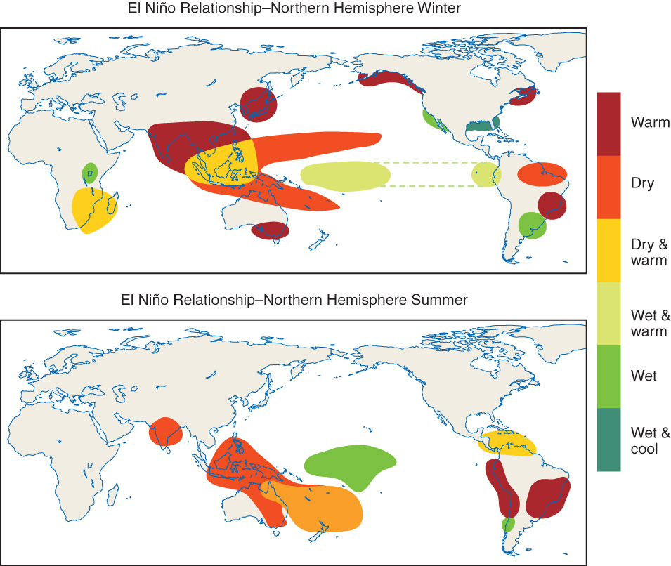
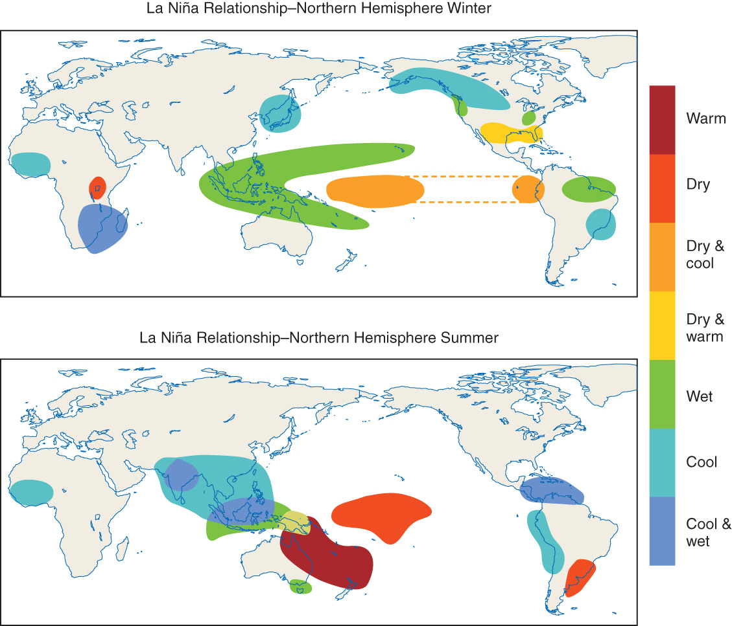
El Niño/La Niña
Fig 9.19 Weather: A Concise Introduction

Slide 20
Normal conditions (middle): easterlies push warm water to western Pacific Ocean, with relatively cooler water in the eastern Pacific Ocean; tilted thermocline
El Niño conditions (left): trade winds (easterlies) weaken and the warm water sloshes east towards the coast of South America; thermocline flattens (temperatures don’t change rapidly with depth)
La Niña conditions (right): trade winds (easterlies) strengthen and the warm water sloshes further towards the western Pacific Ocean, with eastern Pacific waters becoming colder (more upwelling; thermocline becomes steeper)

Slide 21
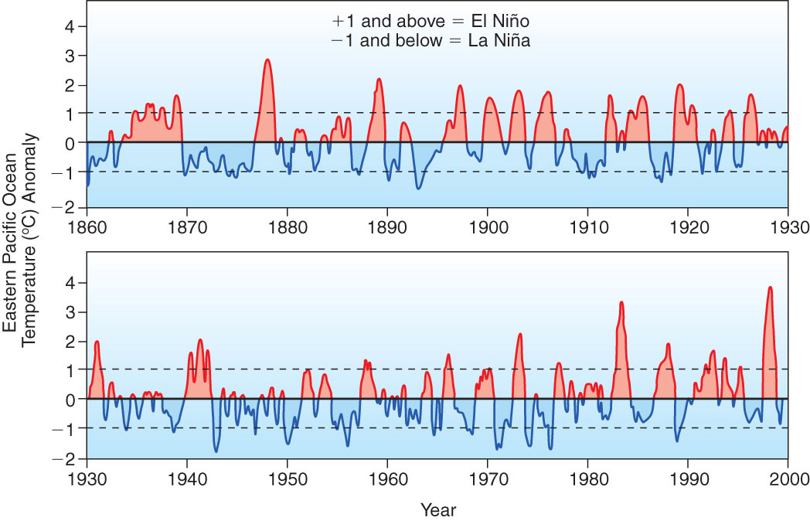
El Niño/La Niña
Fig 8-11 Meteorology: Understanding the Atmosphere

