Slide 1
Topic of the Day 1 Review
My name is Joey Knisely (shocker!)
There will be 4 dropped admission tickets
  Also accepted 2 since there was a typo on ELMS
Final Dates (I accepted either)
  Section 01: Tuesday May 19th 1:30 PM
  Section 02: Monday May 18th 10:30 AM

Slide 2
General Project Feedback
Too much pathos, not enough facts/statistics/logical arguments etc.
Cut back on direct quotes
Label subtopic sections & sources with your name
Make sure your bibliography has a consistent format
If you do not share your Google doc with me, you will lose points!
When submitting final draft, please identify group in file name (e.g. Section 0301 Group 7 Final Draft)
Several people had issues with submitting PDFs, stick to word docs

Slide 3
General Project Feedback
Remember you need to speak for 2 min 30 seconds ± 15 seconds
  Note this doesn’t mean you need to cut down your papers. Just decide what’s most important in your papers and present that
You don’t have to memorize your entire part, in fact I encourage you not to!
Remember note cards will lose you points, but if you feel you absolutely need them, keep them to a minimum
Today: coordinate with your opposing team to make sure you’re subtopics match up

Slide 4
Overall Format
  Introduction
    1st Supportive Speaker
    1st opposing Speaker
  Sub-Topic A
    2nd Supportive Speaker
    2nd Opposing Speaker
    Q&A
  Sub-Topic B
    3rd supporting Speaker
    3rd opposing Speaker
    Q&A
  Sub-Topic C
    4th supporting Speaker
    4th opposing Speaker
    Q&A
  Conclusion
    5th supporting Speaker
    5th opposing Speaker
  Open discussion
2.5 minutes ± 15 seconds per speaker, 3 minutes per Q&A, 5 minutes for open discussion

Slide 5
Name:______________
Debate Project – Audience Participation Sheet
Before the Debate: Circle which side you most agree with.
Group 1 Group 2
During the Debate: Take notes on what you’ve learned/questions you have.
____________________________________________________________________________________________________________________________________________________________________________________________________________________________________________________________________________________________________________________________________________________
After the Debate: Write something you’ve learned (“nothing” is not an acceptable answer).
_______________________________________________________________________________________________________________________________________________________________________________________________________________________________________________________________
Circle which side you most agree with after hearing both sides’ arguments.
Group 1 Group 2

Slide 6
Quiz 1 Review
Chapters 1-4
TA: Joey Knisely

Slide 7
Some Basics
International System of Units (SI)
  Length: Meter
  Mass: Kilogram
  Time : Second
  Force: Newton
    (kg * m / s^2)
  Pressure: Pascal (Hectopascal is more common)
    Force over an Area (N / m^2)
  Temperature
    ˚Celsius
    Kelvin

Slide 8
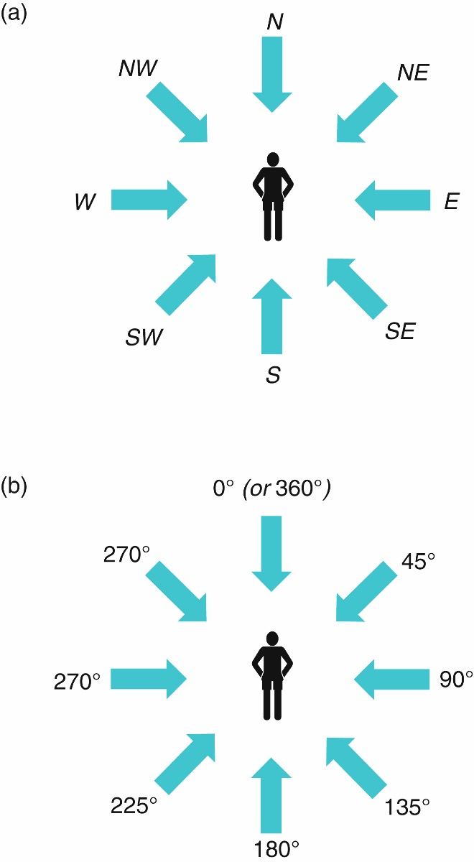
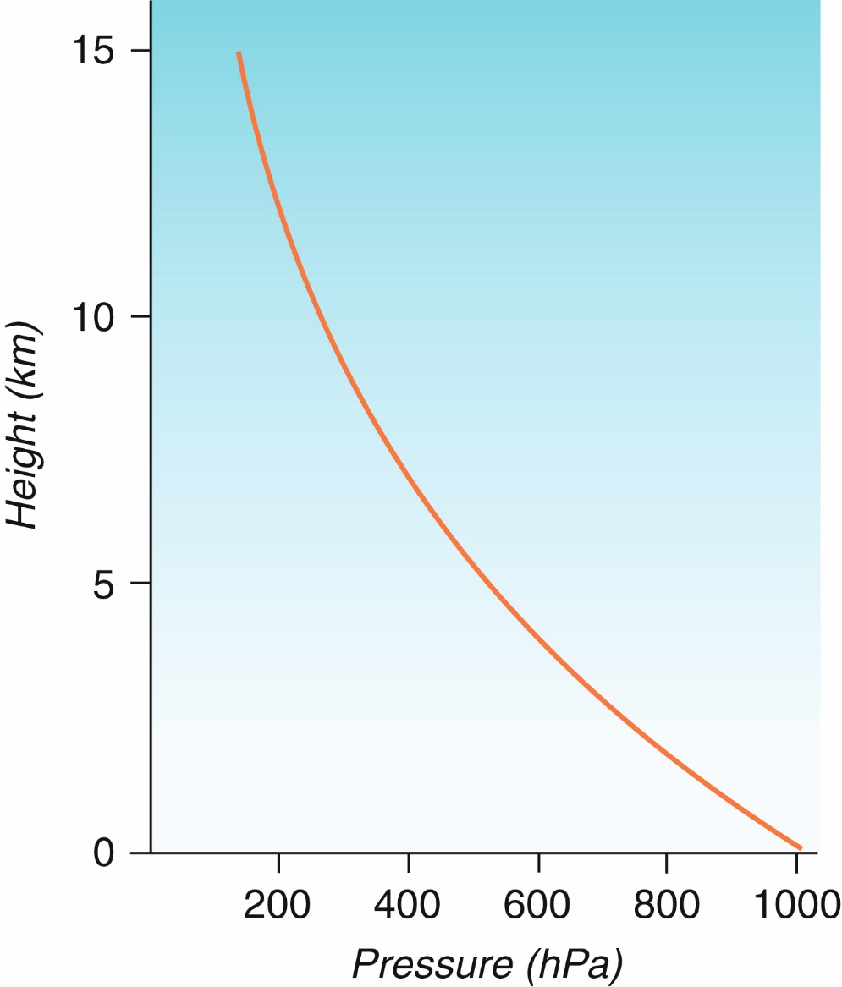
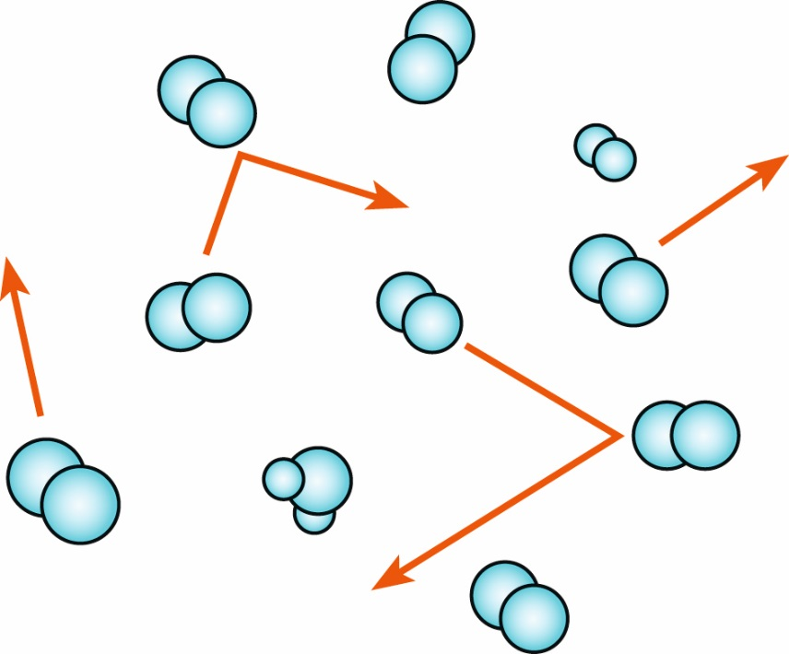
Some Basics
Wind Direction
Temperature: Average Kinetic Energy

Slide 9
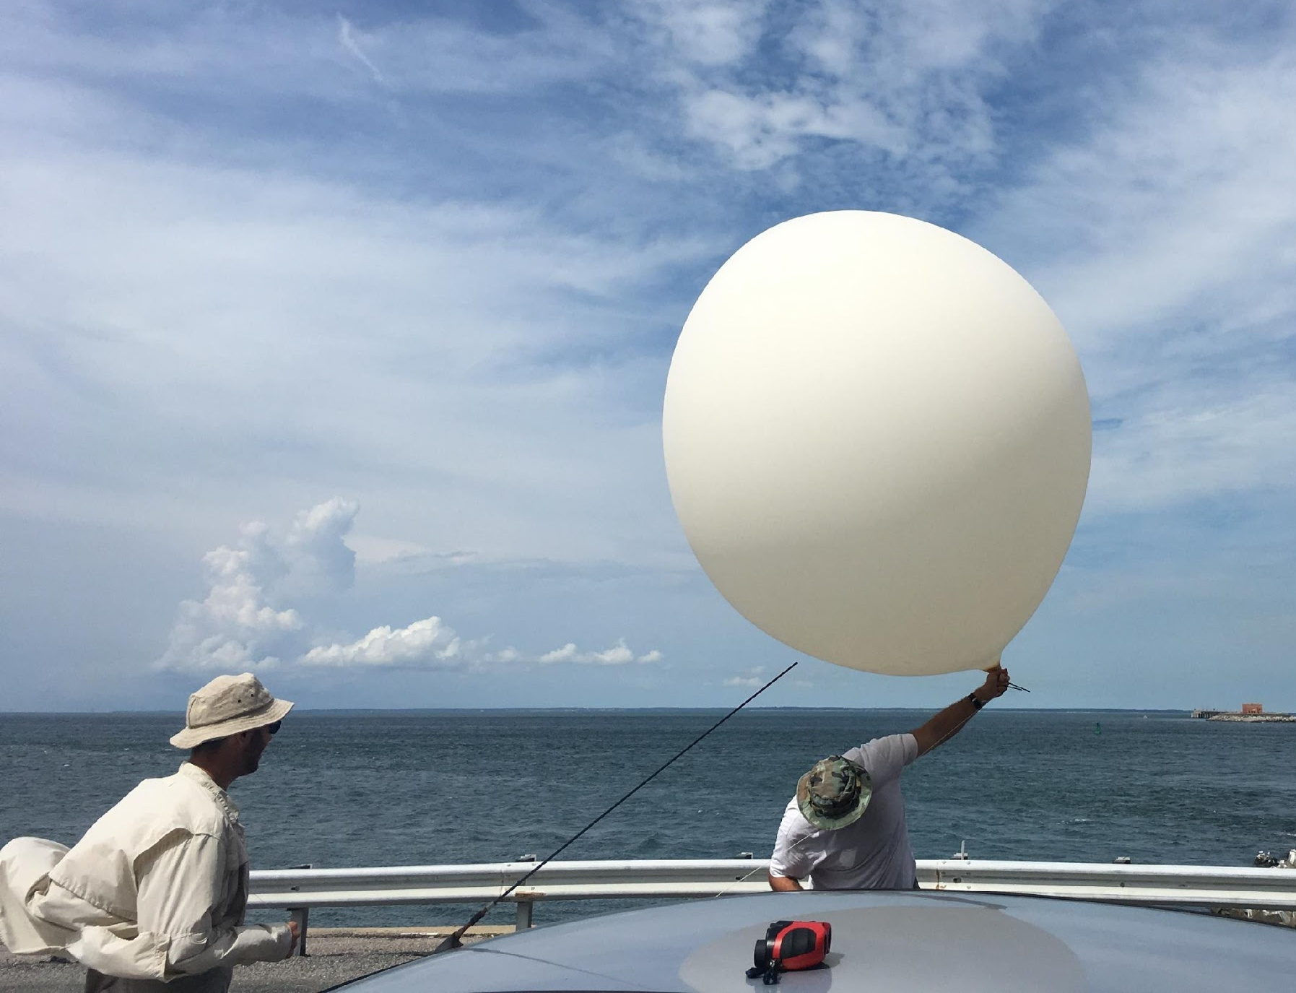
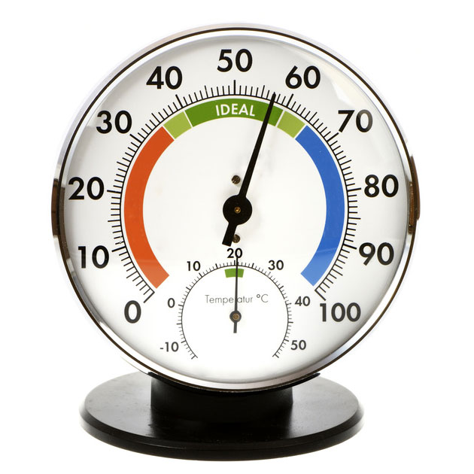
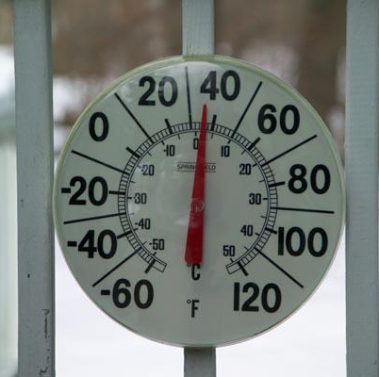
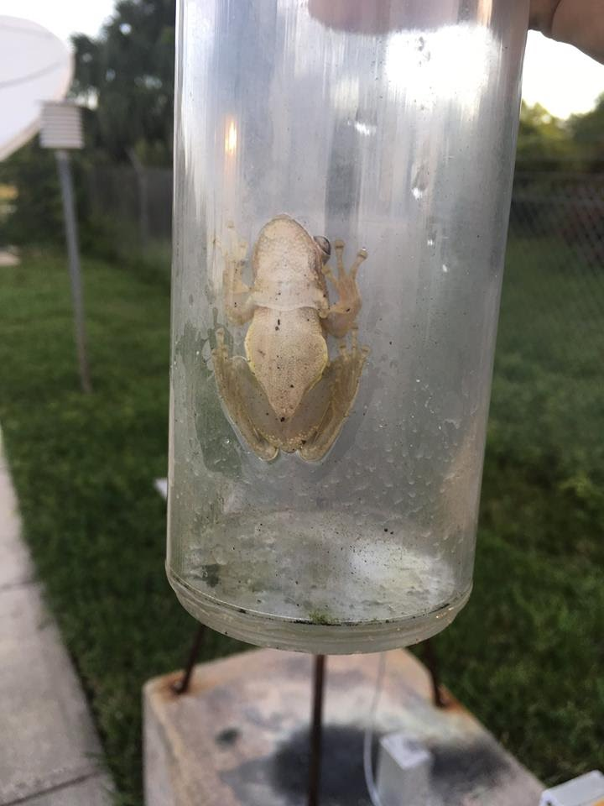
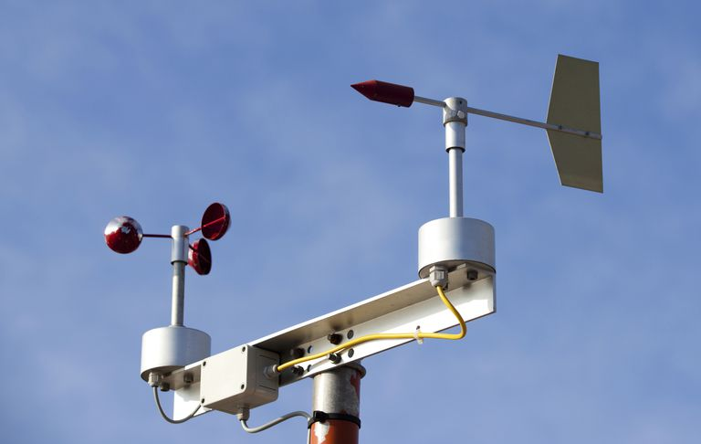
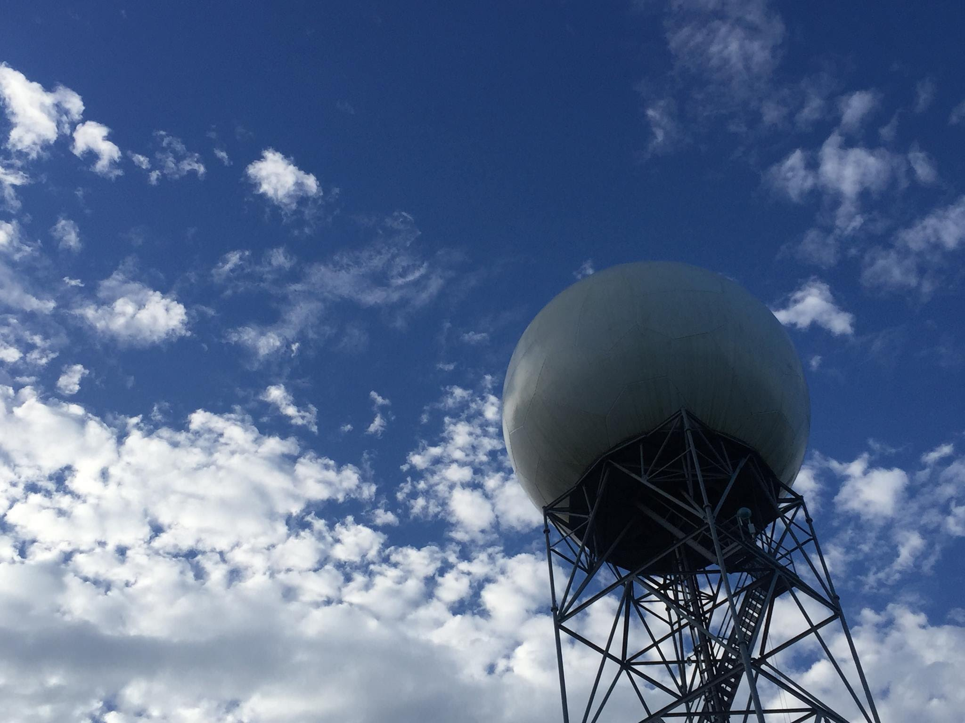
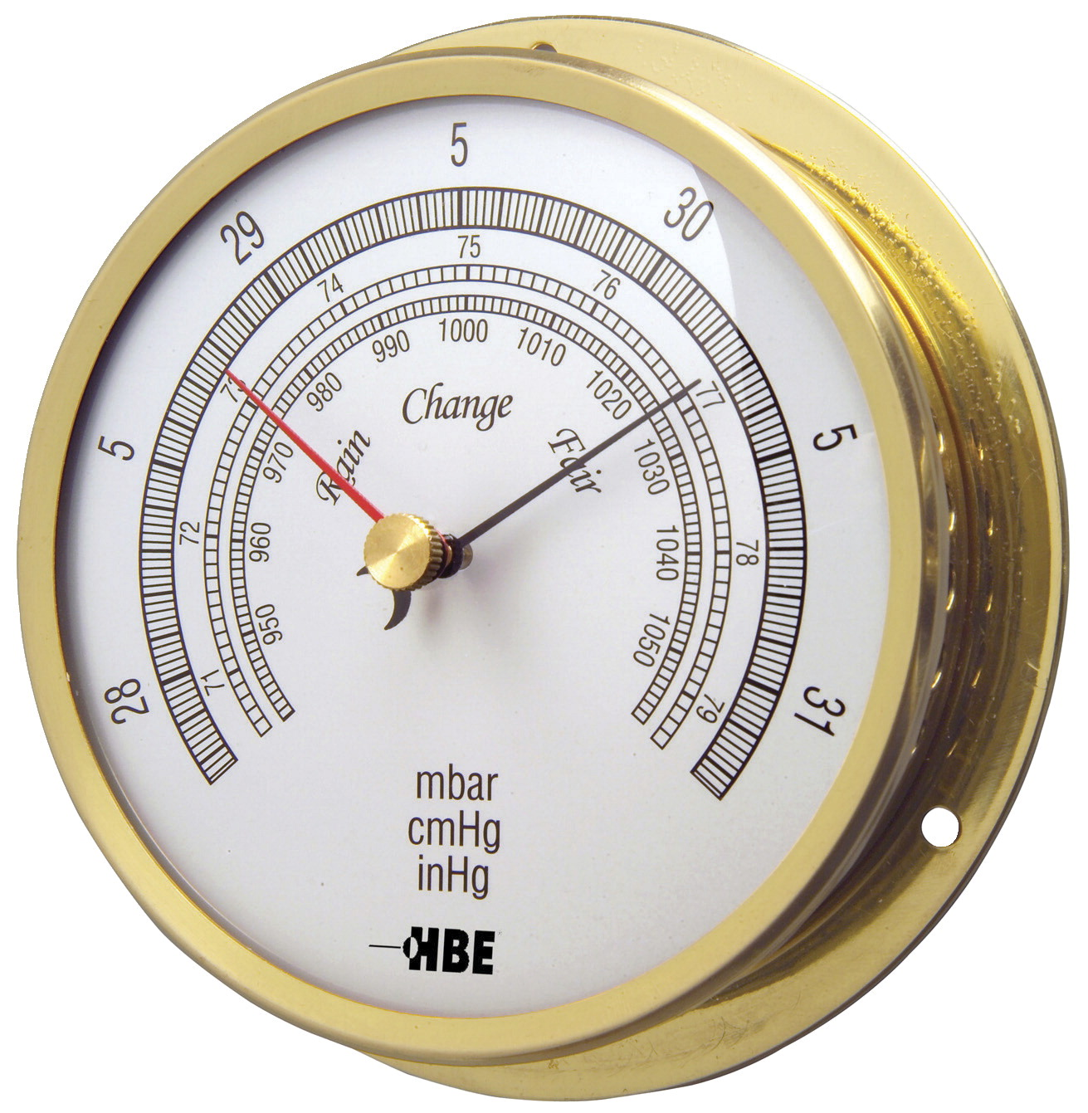
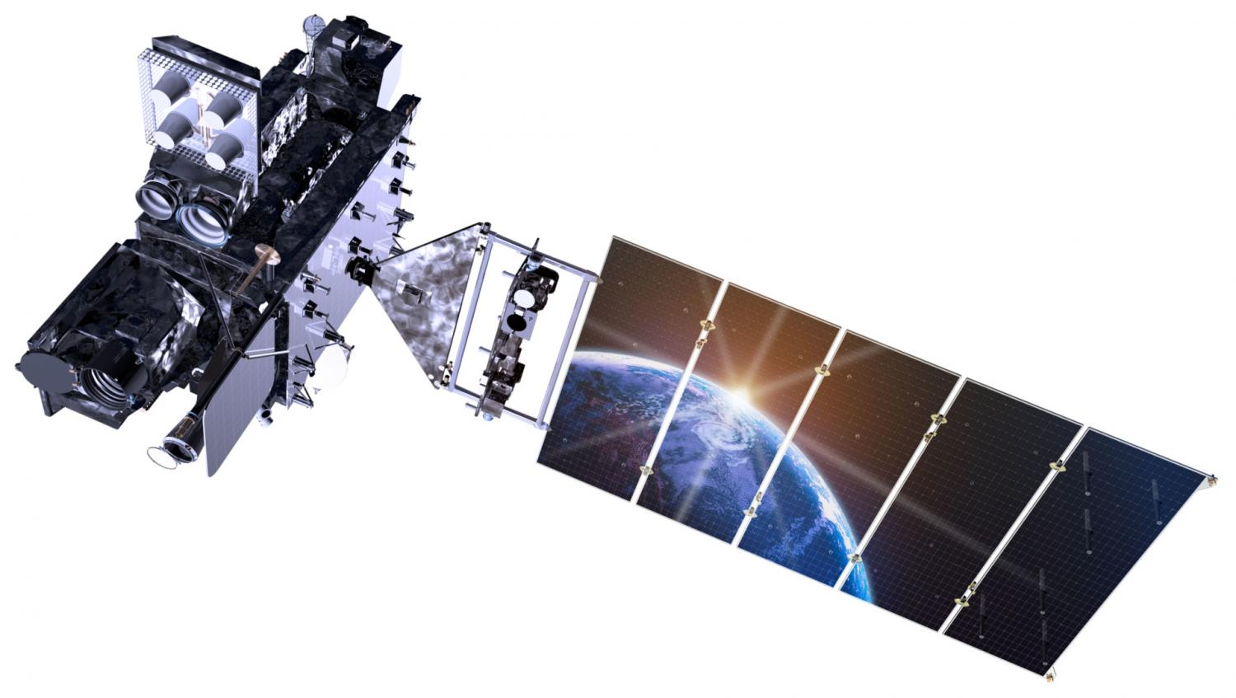
Some Instruments meteorologists use
1
Radiosonde/rawinsonde
Thermometer
Hygrometer
Anemometer
Rain gauge
Barometer
Radar
Satellite
3
2
5
4
8
6
7

Slide 10
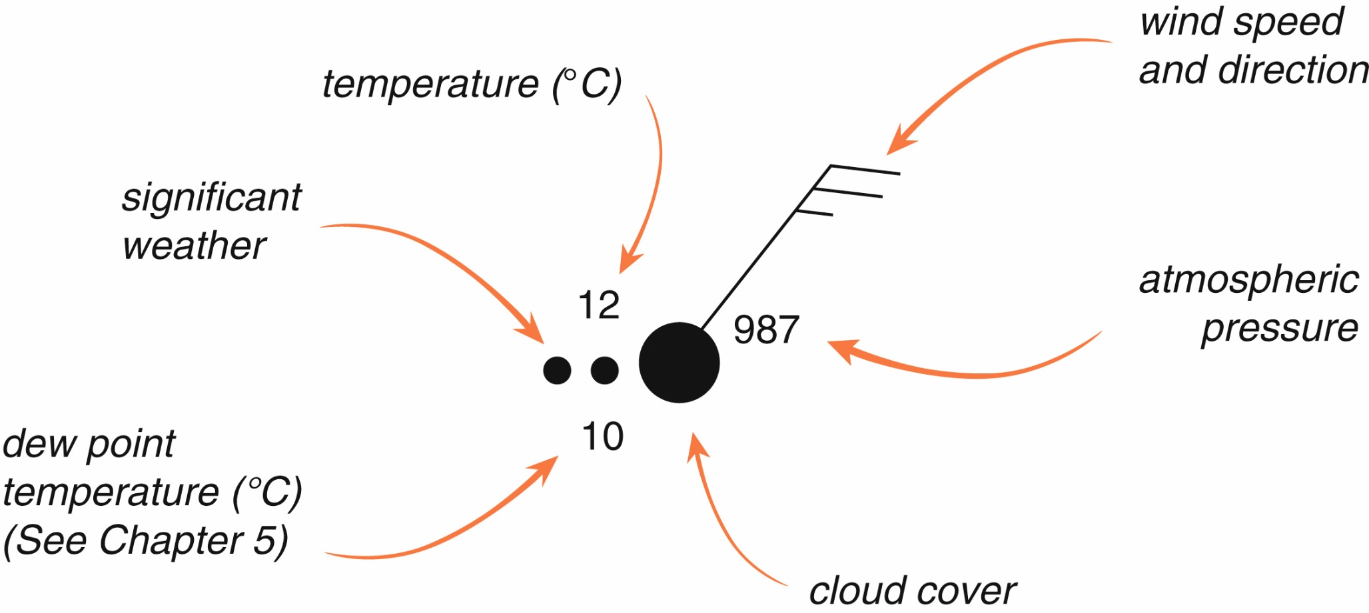
Weather Maps and Station Models

Slide 11
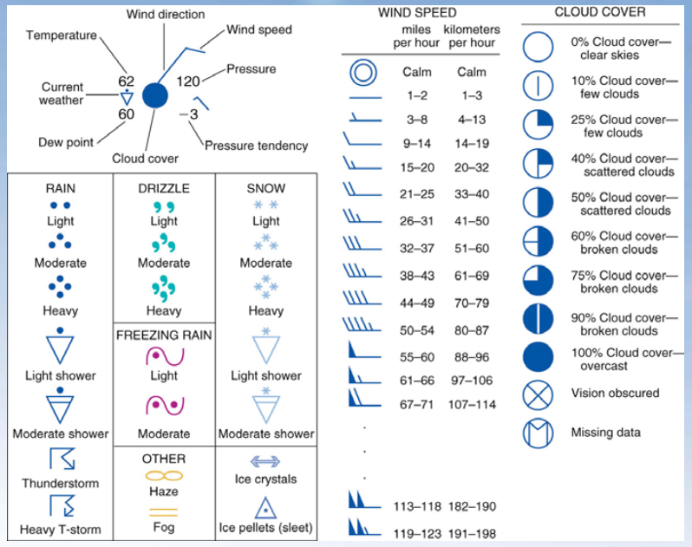

Slide 13
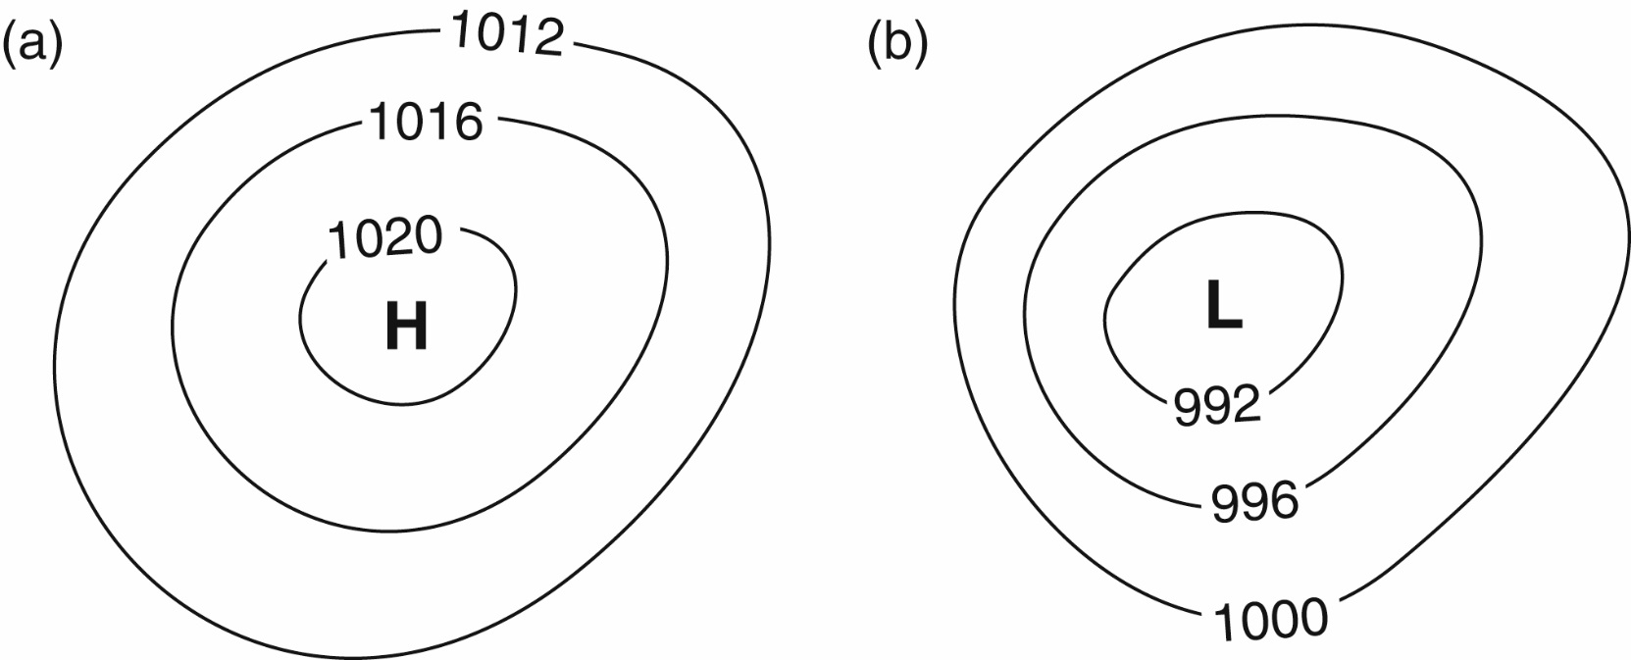
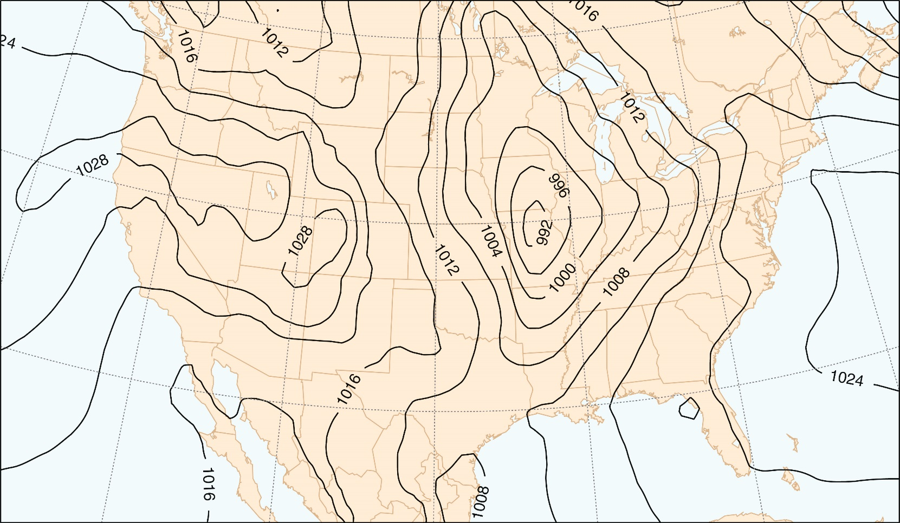
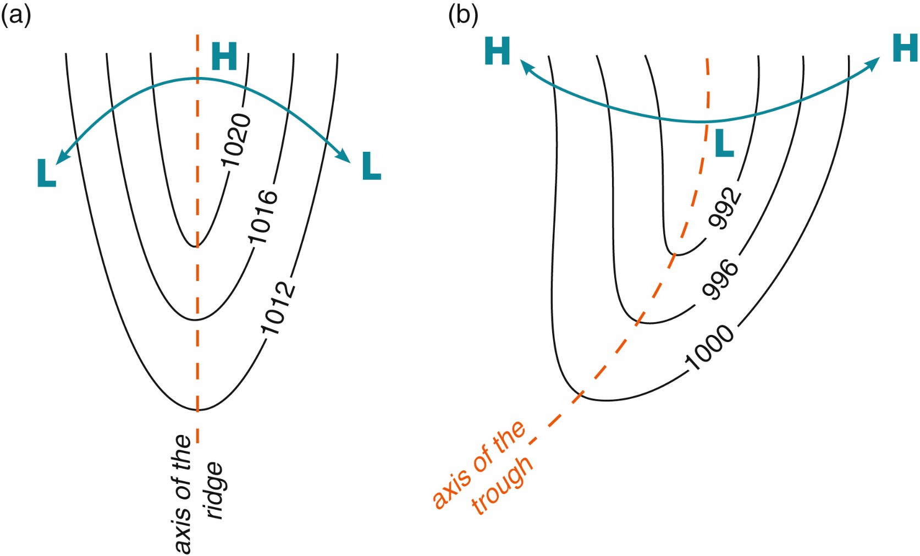
Pressure Maps
What do tight isobars suggest? How about troughs?

Slide 14
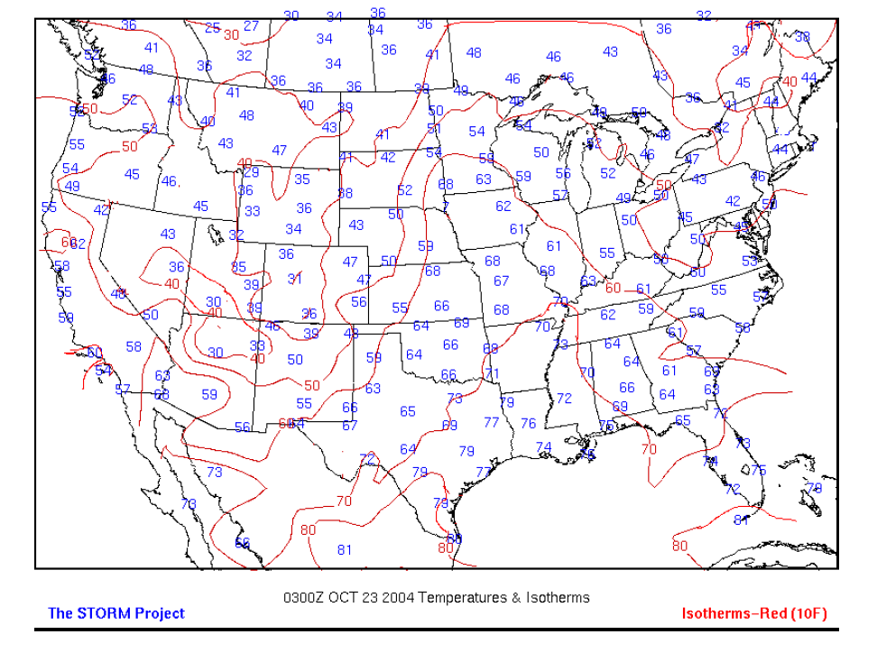
Isotherms

Slide 15
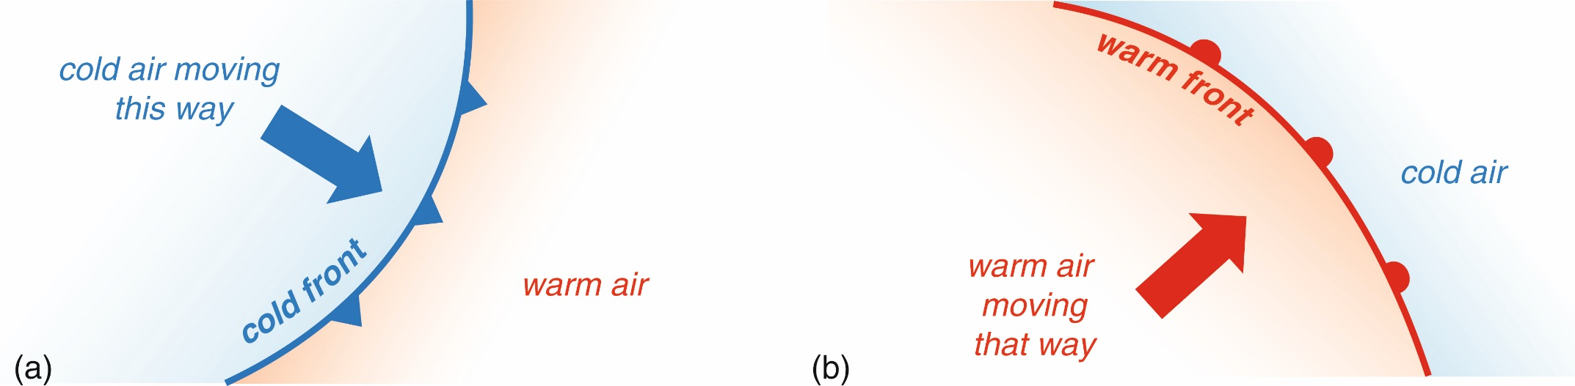
Temperature Fronts
Cold Front - a zone separating two air masses, of which the cooler, denser mass is advancing and replacing the warmer.
Warm Front - a transition zone between a mass of warm air and the cold air it is replacing.
Stationary Front - a front between warm and cold air masses that is moving very slowly or not at all.
Occluded Front - front that occurs when cold front catches up to warm front (we’ll learn more later in semester)

Slide 16
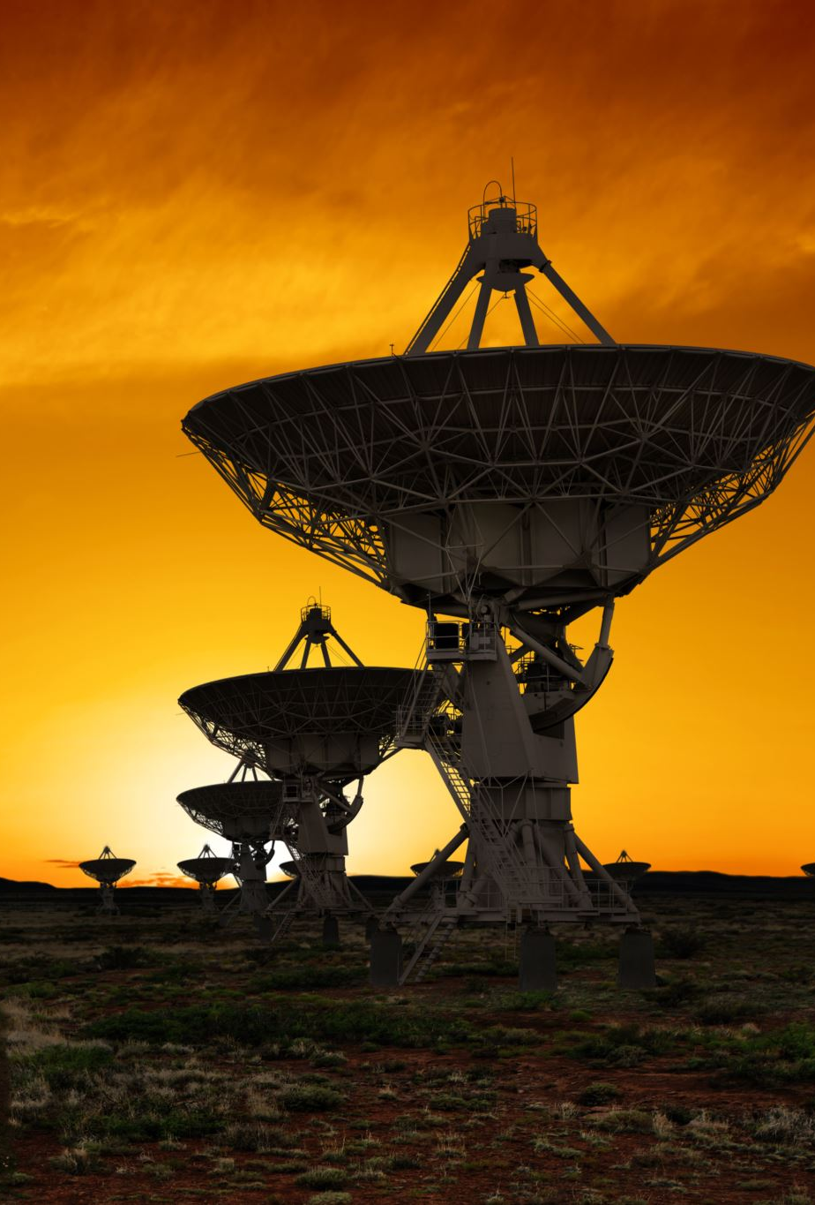
RADAR
RADAR: Radio Detection and Ranging
Emits radio waves at precipitation masses, which reflect back with information
Used to determine rate of precipitation as well as location
More advanced Doppler radar can be used to determine speed and direction of rain/wind
Even more advanced polarized radar signals can be used to determine shape of precipitation particles

Slide 17
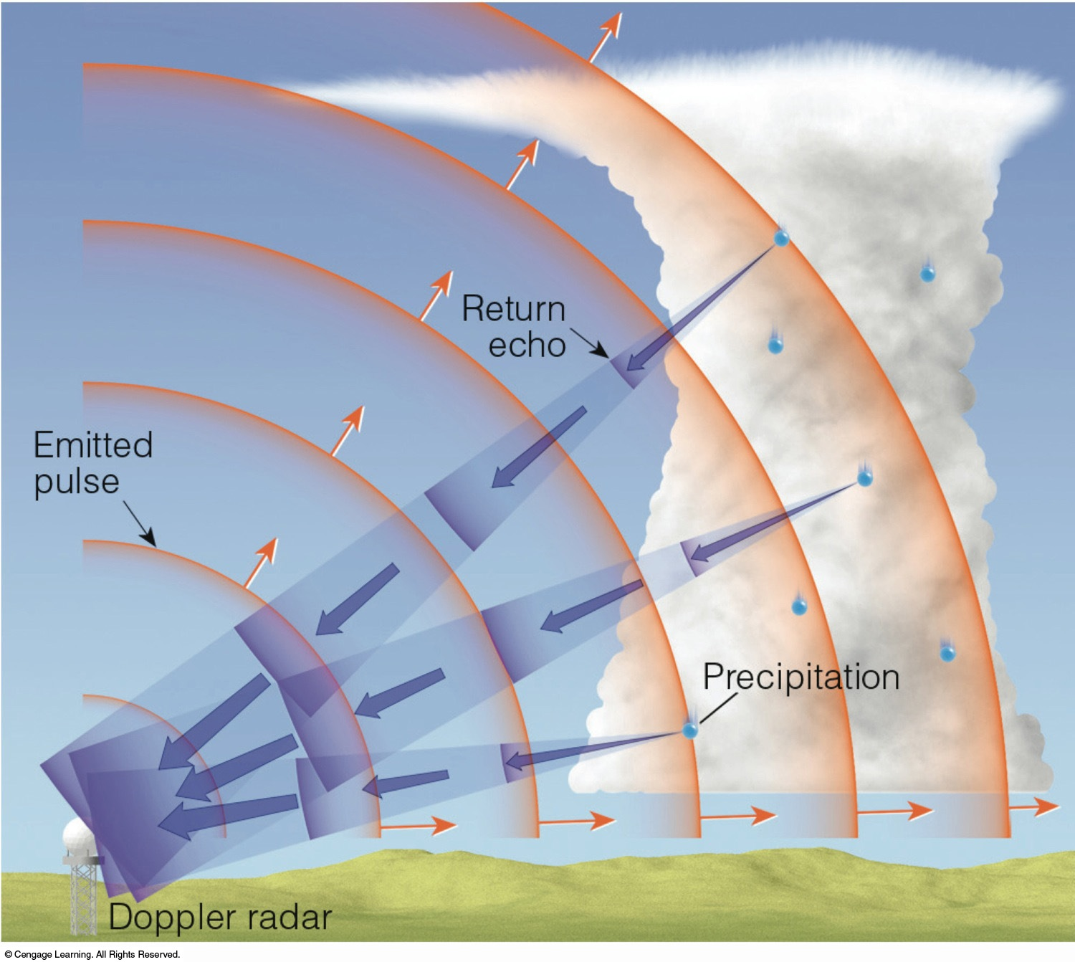
RADAR: Radio Detection and Ranging
RADAR measures the time it takes for the signal to return
Fig 5.45: Essentials of Meteorology

Slide 18
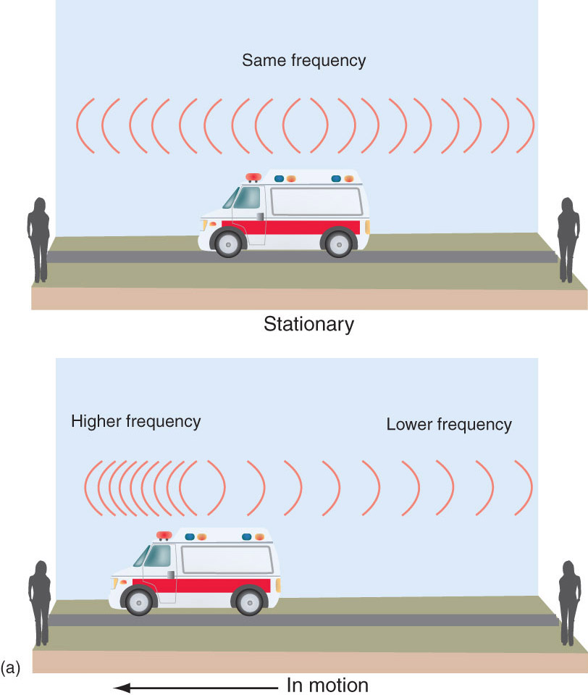
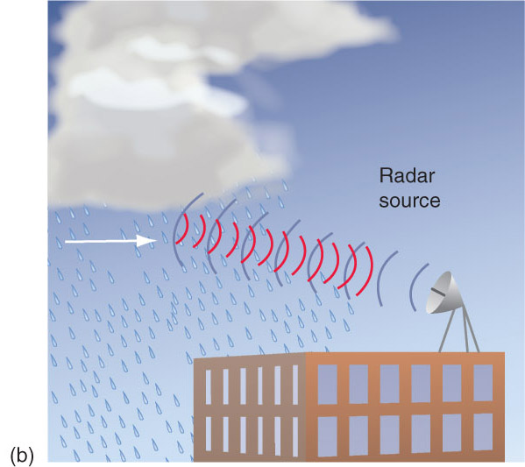
Doppler radar
Doppler RADAR measures changes in the return signal
Fig 5-22 Meteorology: Understanding the Atmosphere
Notes:
Tornado that hit Greensburg, KS.

Slide 19
Satellites
Weather satellites carry sensors that measure different kinds of radiation.
We’re interested in three: visible, infrared, and water vapor.
Visible: Useful for tracking cloud movement, but useless when obstructed by high altitude clouds, or at night.
Infrared: Takes a “temperature image” of Earth
Dark shades indicate warm features, lighter shades indicate cold
Water Vapor: Darker colors indicative of drier conditions, lighter colors indicate higher water vapor content

Slide 20
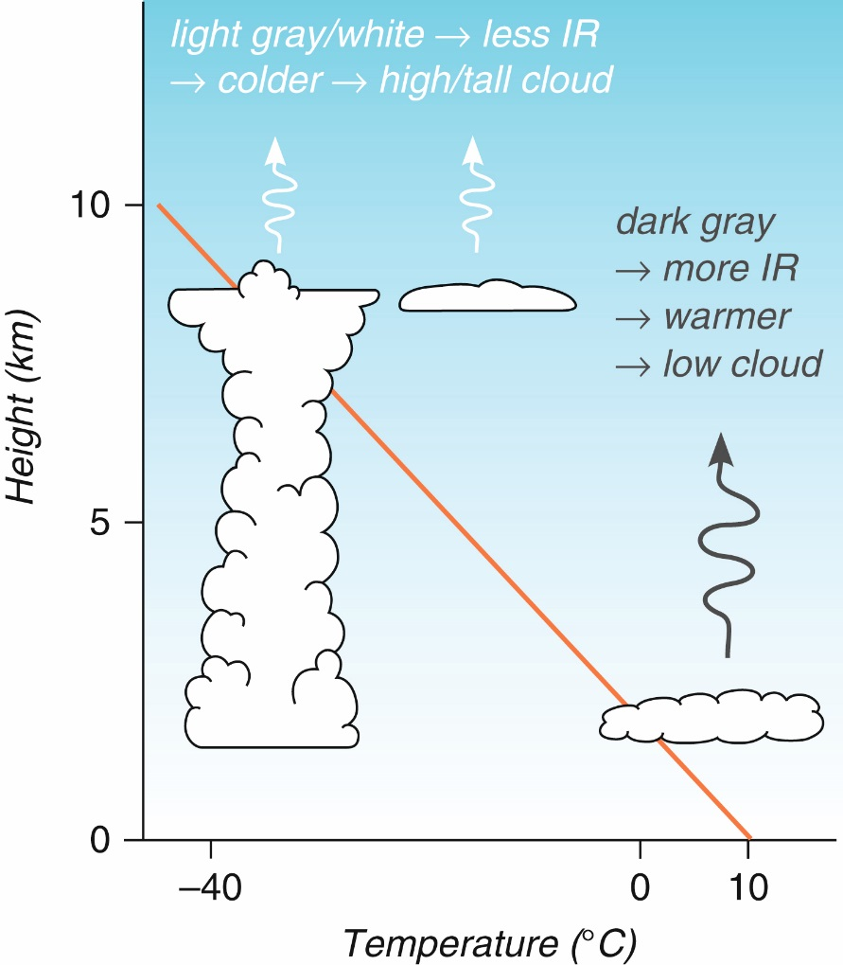
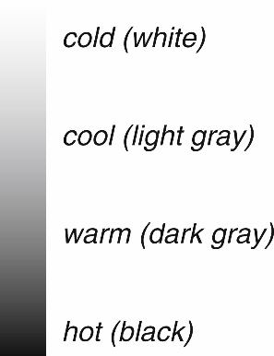
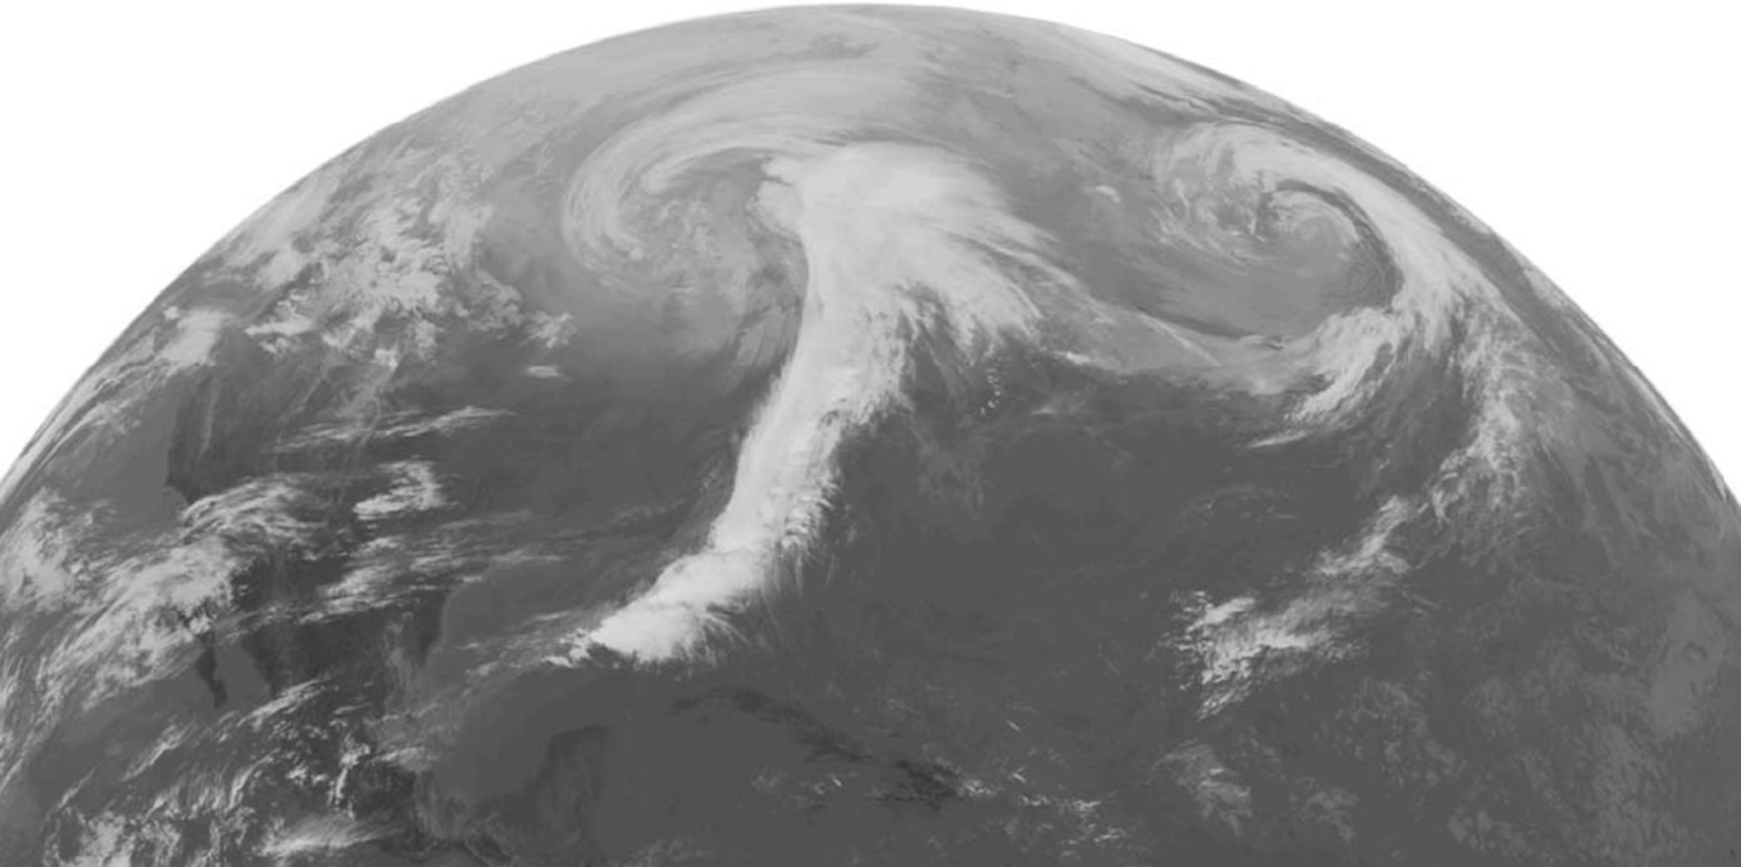
Infrared Light

Slide 21
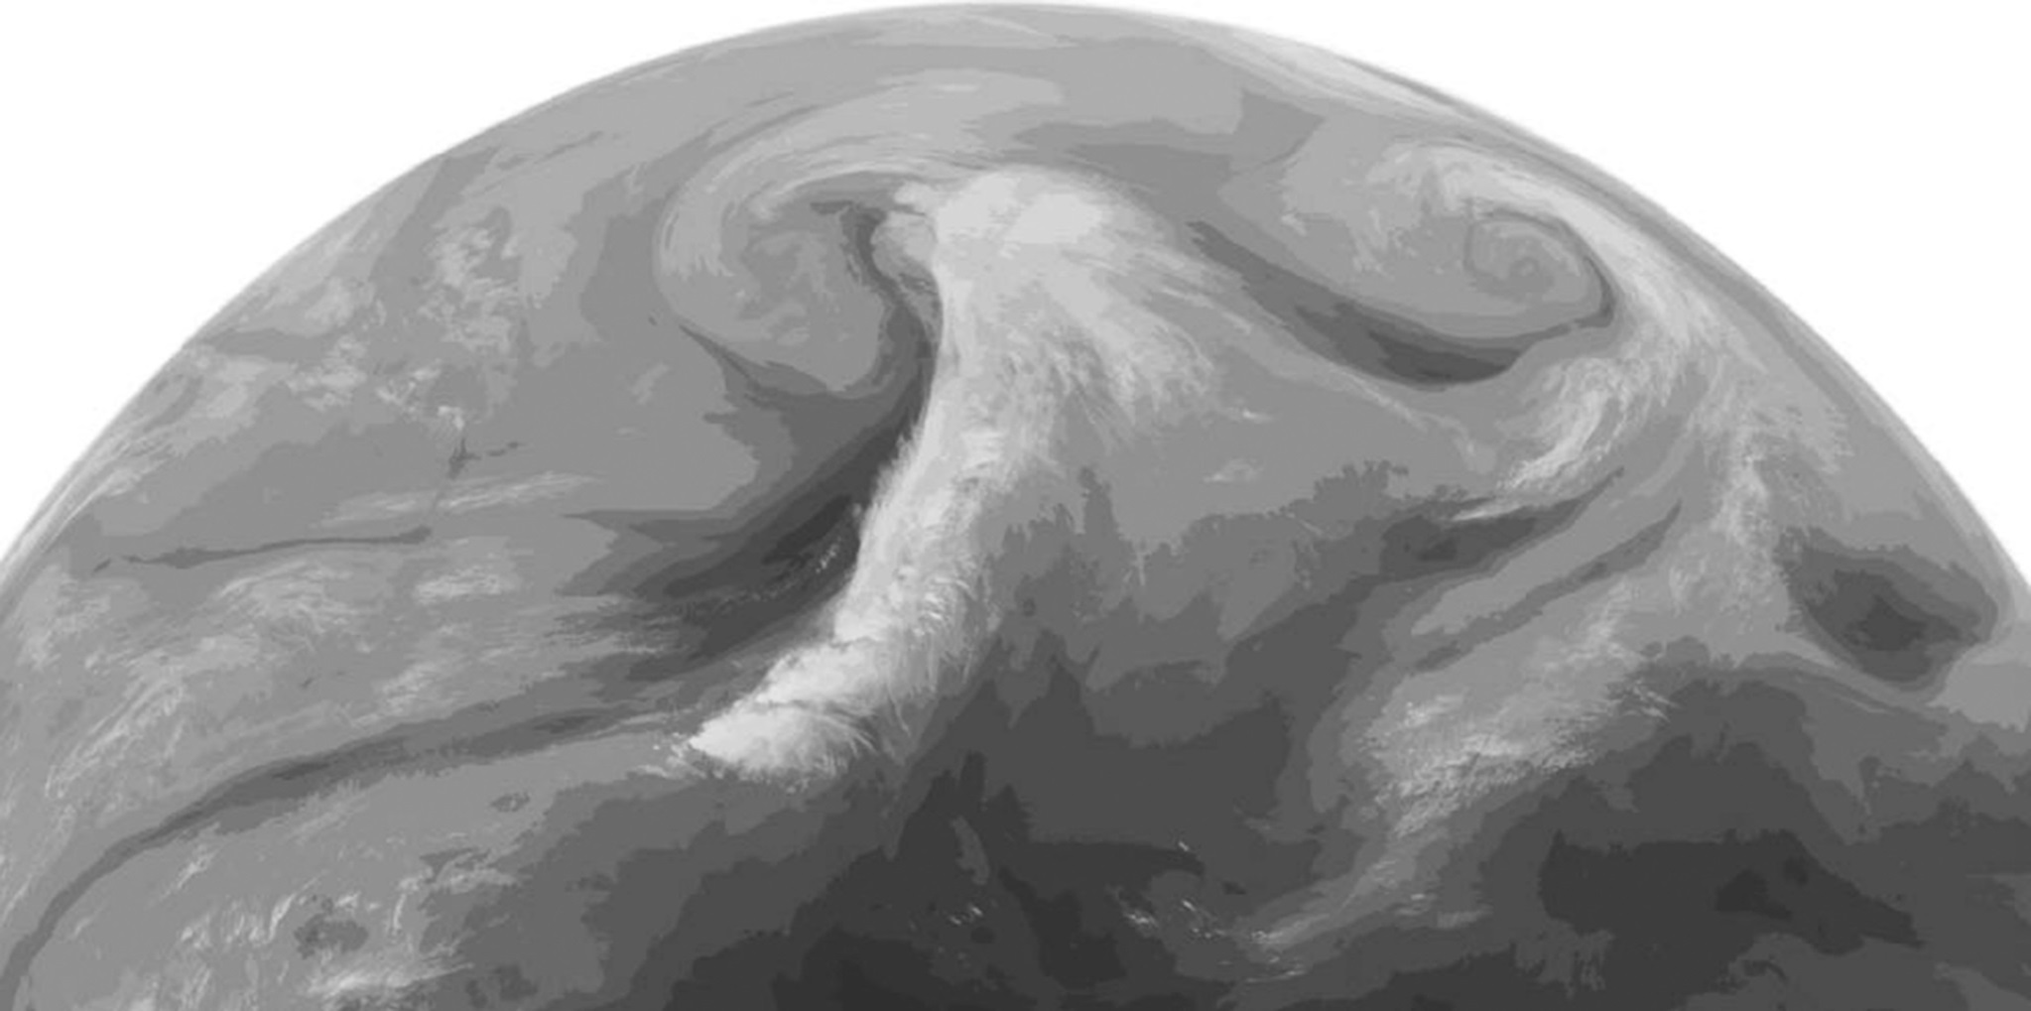
Water Vapor

Slide 22
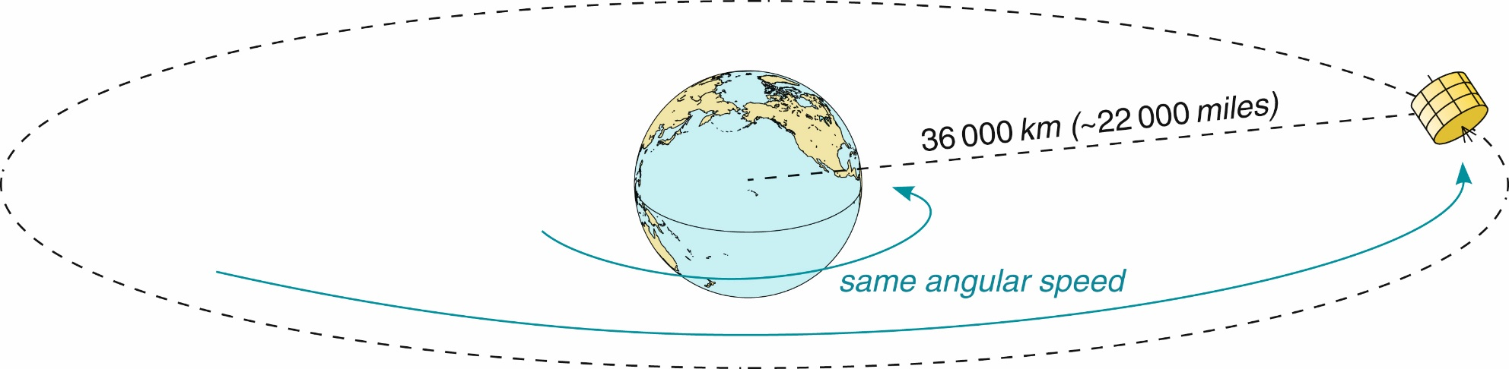
Geostationary satellites: Orbits the Earth at the same angular speed as the Earth. They are “parked” in orbit over Earth and stay over the same location.
Provide a lot of information at all times but only at one location and have difficulty seeing the polar regions…
Fig 2-19 Weather: A Concise Introduction

Slide 23
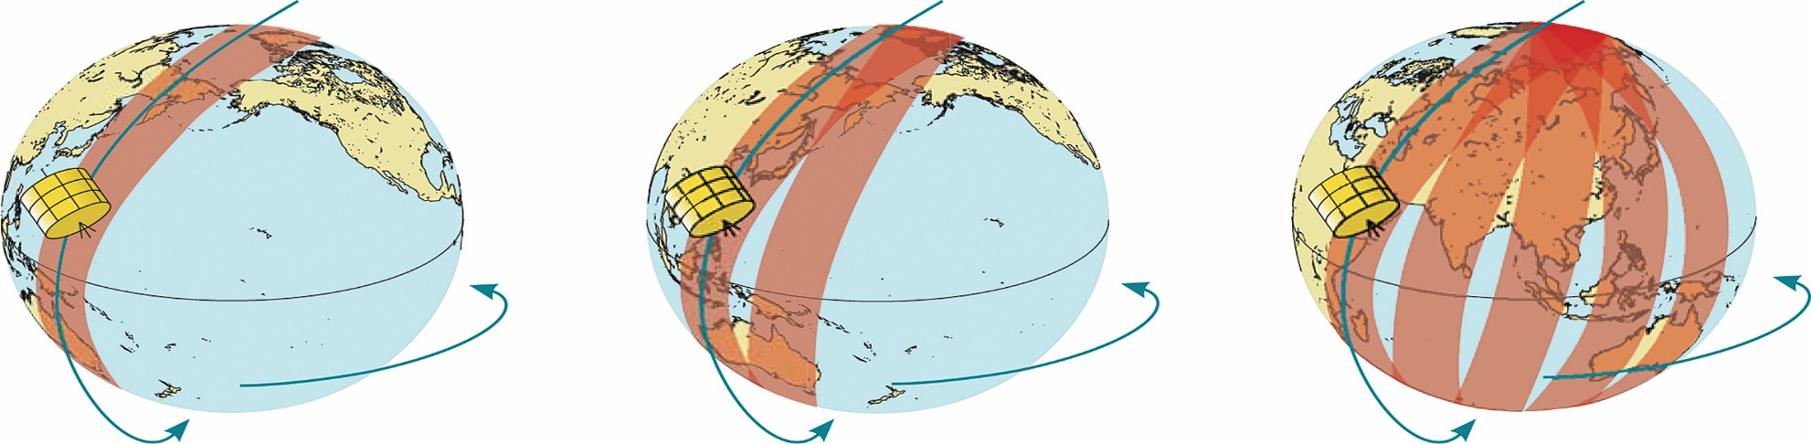
Polar orbiting satellites: Travel over the poles. Orbits wrap around the Earth. Need to travel quickly to provide cover the globe. Can be very high resolution because they orbit closer to the surface than geostationary satellites
Problems: Data gaps in time and space, only 2 observations a day
Fig 2-24 Weather: A Concise Introduction

Slide 24
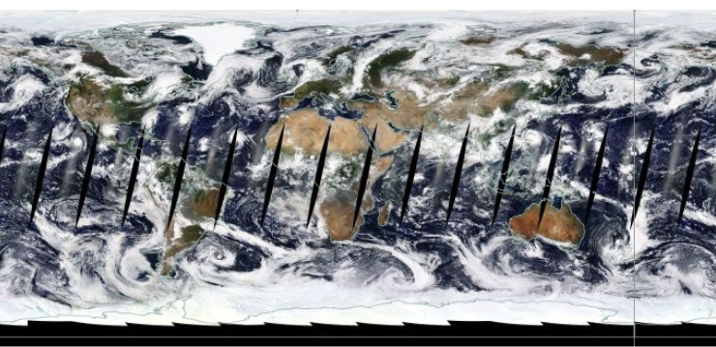

Slide 25
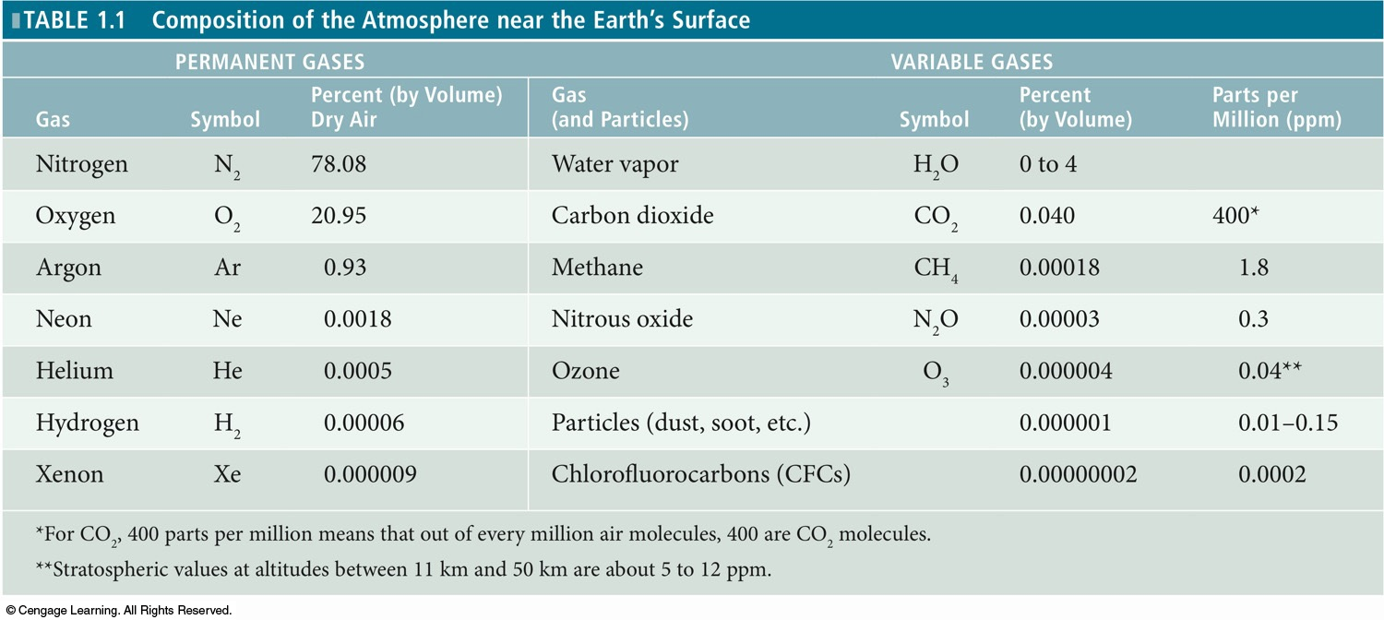
Permanent vs Trace (Variable) Gases

Slide 26

Greenhouse Gases
CO2
Methane
Water Vapor
Nitrous Oxide
Ozone
Chlorofluorocarbons
Hydrofluorocarbons

Slide 27
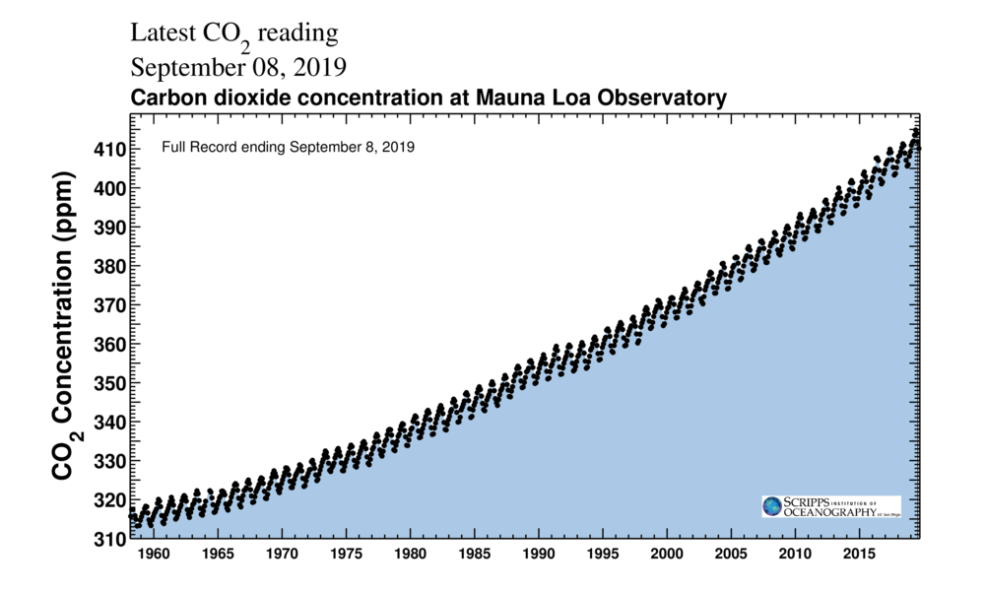
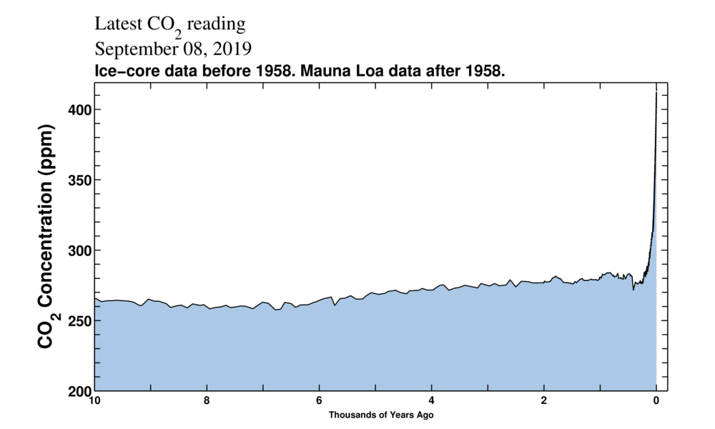
Keeling Curve

Slide 28
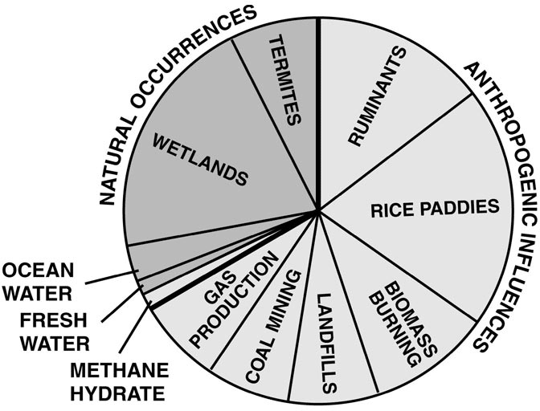
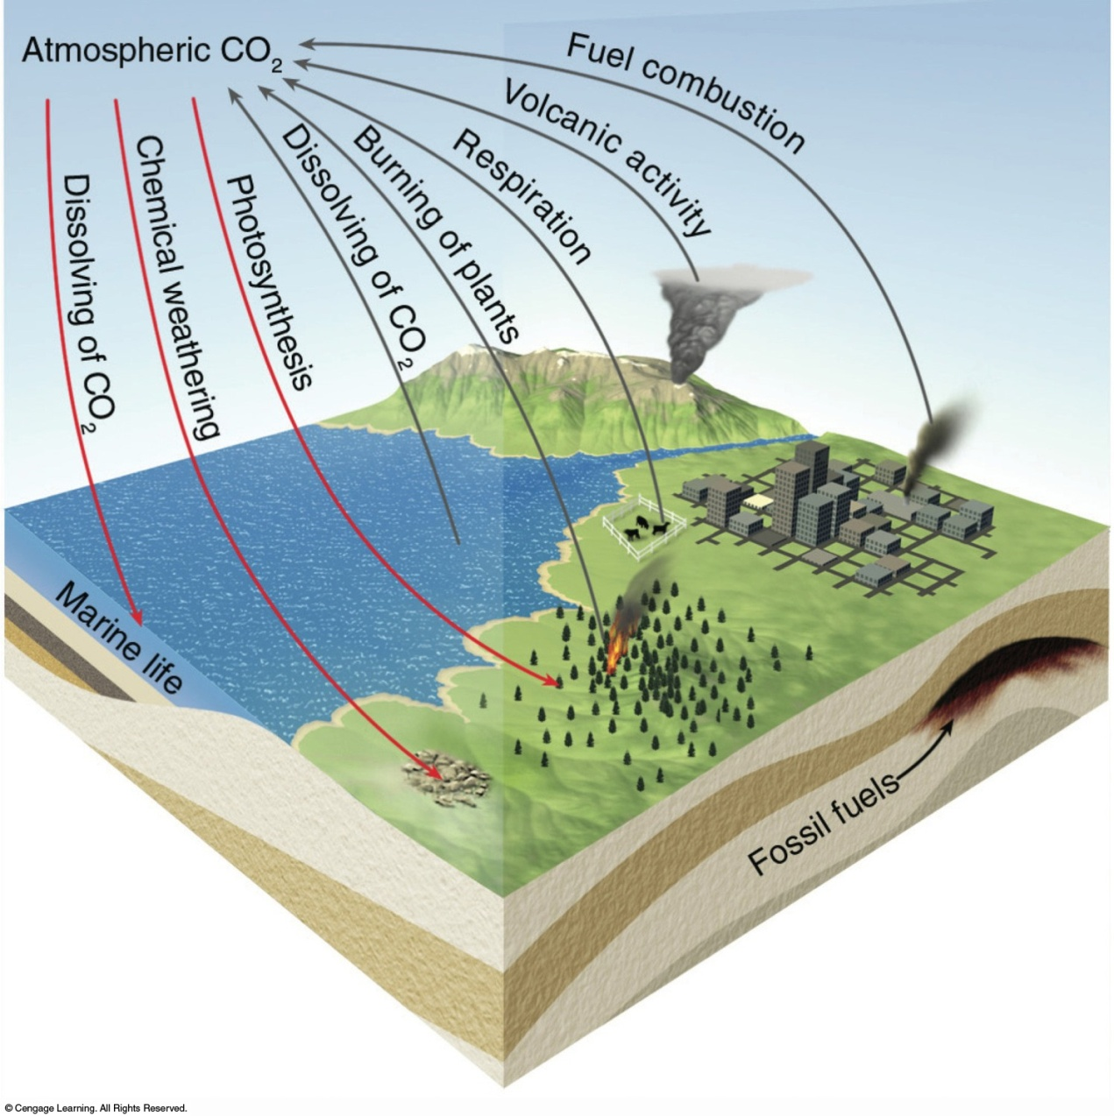
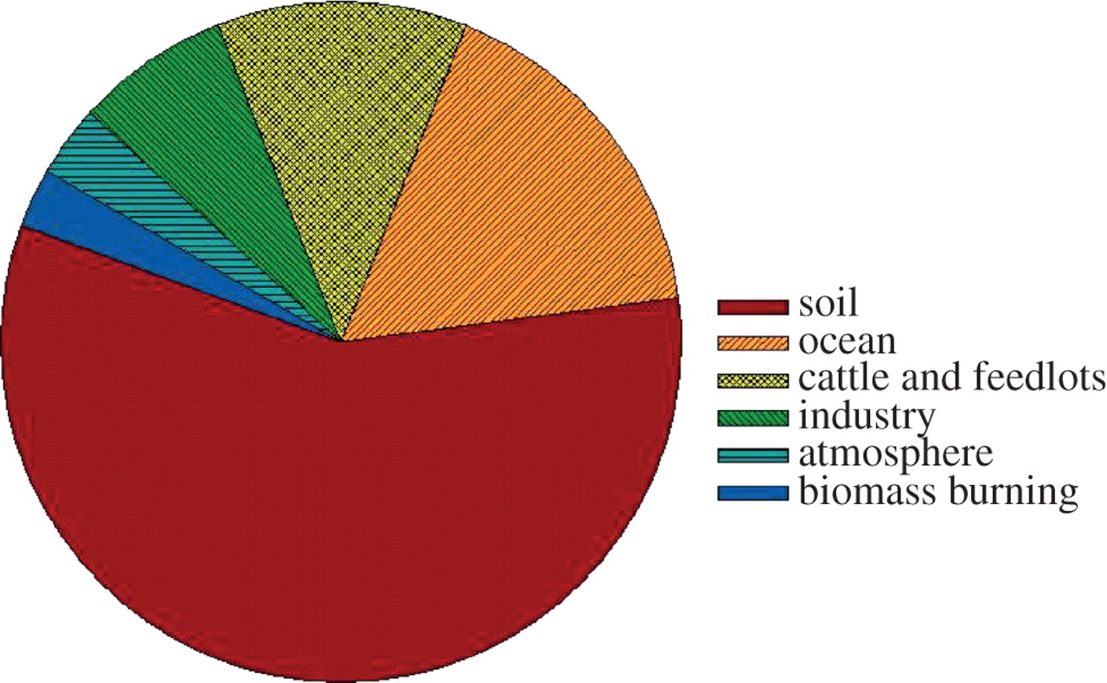
Sources of CO2, Methane, NO2
Sources of Methane
Sources of NO2

Slide 29
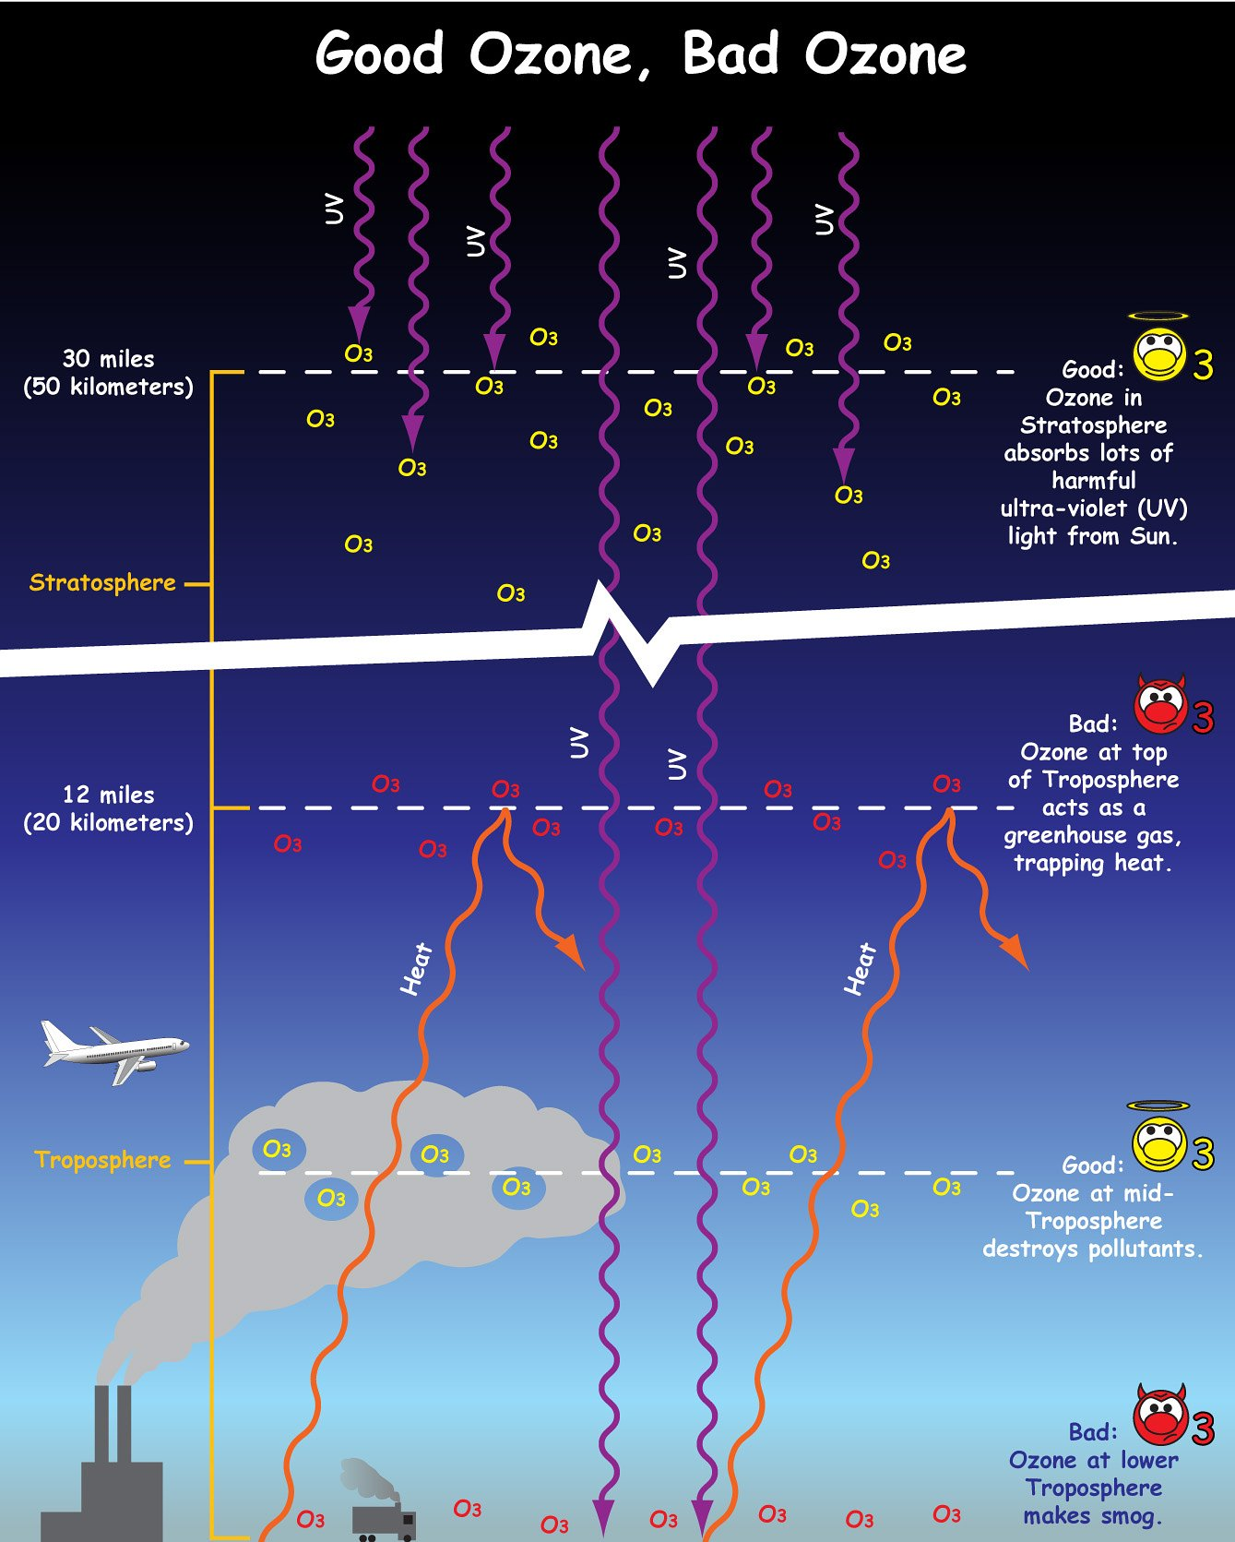
Ozone (O3)
In the stratosphere: ozone absorbs UV radiation and protects us
In the upper troposphere: ozone acts as a greenhouse gas
Near the surface: ozone leads to smog and thus poor air quality
Absorbs UV radiation
Smog!!!

Slide 30
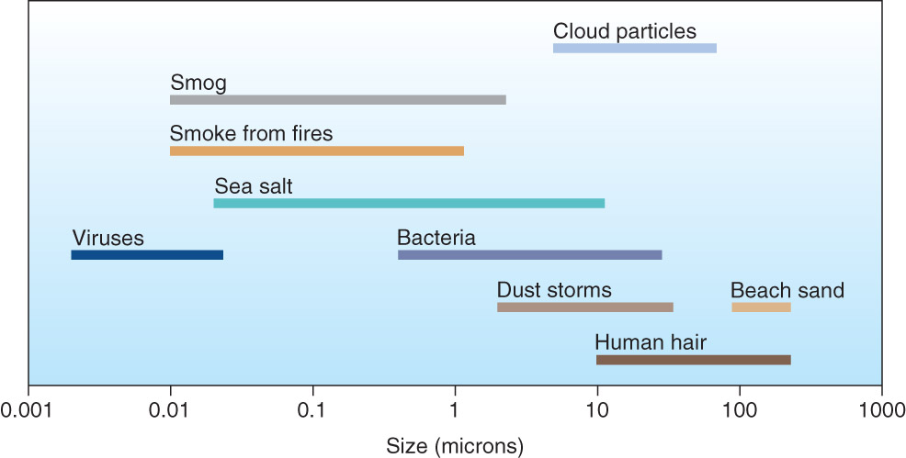
Aerosols
Provide a net cooling effect on the atmosphere
However, effect on air quality is significant and detrimental to warrant aerosol clean up and prevention

Slide 31
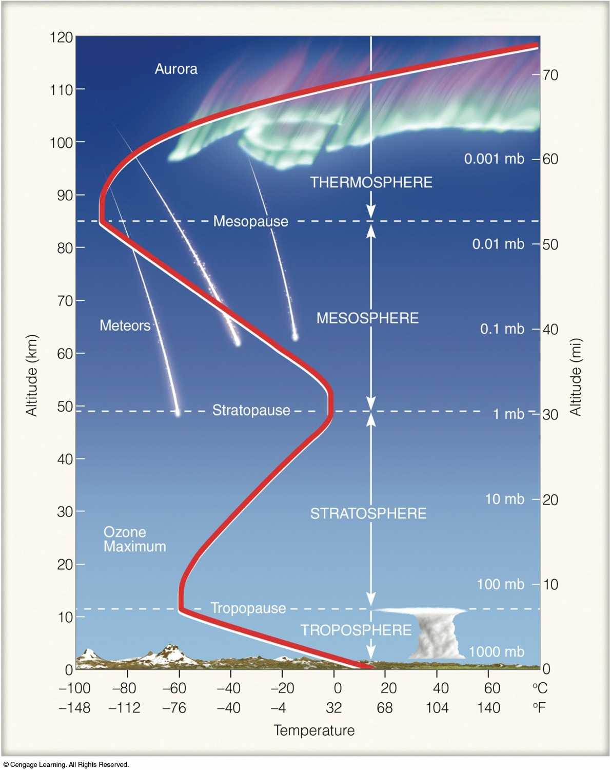
Layers of the Atmosphere
Troposphere makes up first ~10 km, from, about 1000 hPA to 200 hPA
Temperature drops at an “average environmental lapse rate”
Ends at boundary layer called Tropopause
Stratosphere extends from 10 to 50 km, about 200 hPA to 1 hPA
Temperature rises through stratosphere (temp. inversion)

Slide 32
Temperature and Density
Ideal Gas Law
pressure × volume = constant × temperature
pV = nRT
For example, as pressure falls, either temperature decreases or
volume increases (or both)

Slide 33
Understanding Pressure
Ideal Gas Law
pressure = density × temperature × constant
sometimes written as
p=Nk_{b}T
where
p = pressure (mbar)
N = number density (or concentration) (molecules / cm³)
K_{b} = Boltzmann’s constant (1.38 x 10⁻¹⁹ mbar • K⁻¹ • cm³)
T = temperature (Kelvin)

Slide 34
Temperature and Density
Ideal Gas Law
pressure = density × temperature × constant
density = pressure
temperature × constant
As temperature rises, density falls

Slide 35
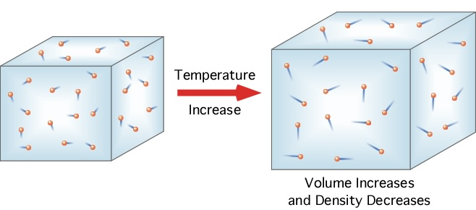
Temperature and Density
As temperature rises and the parcel expands the air inside the parcel gets less dense
(all of the air molecules are spread out over a larger volume)
http://www.our-planet-earth.net/learning/3c.html

Slide 36
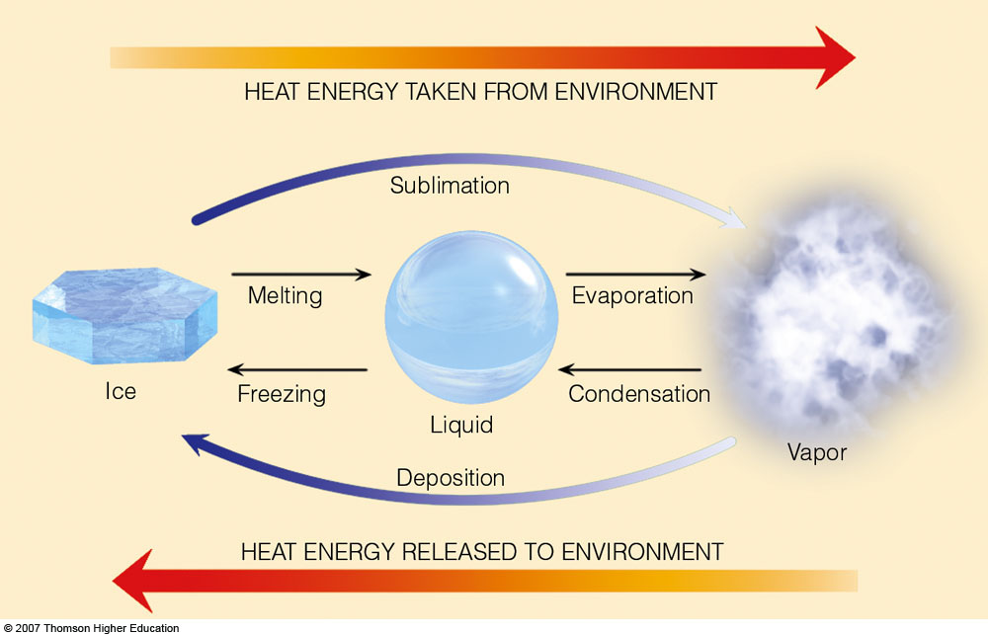
Energy Transfer
Fig 2.3: Essentials of Meteorology

Slide 37
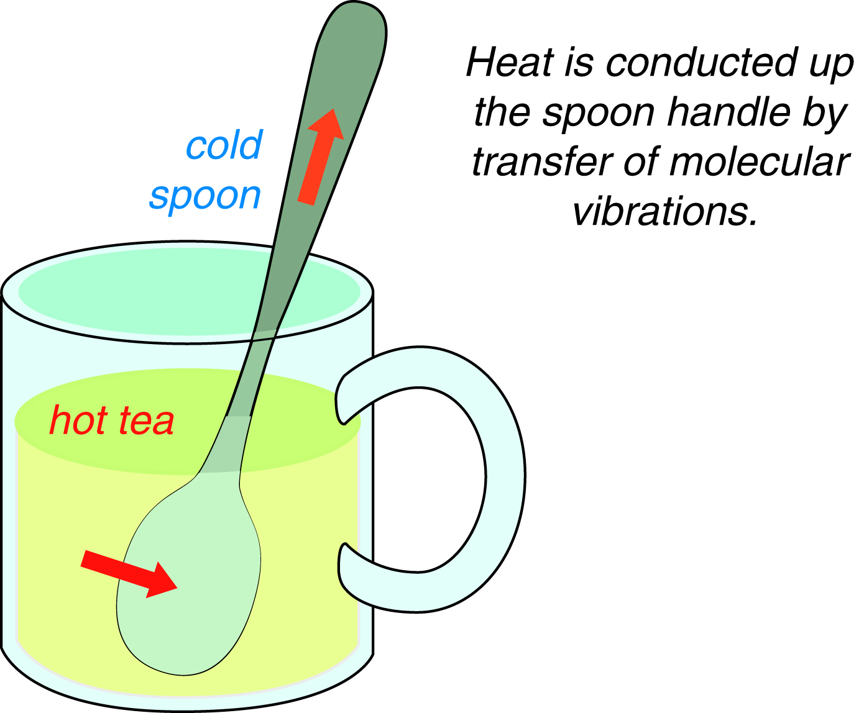
Energy Transfer: Conduction
Conduction – requires contact, energy transferred
from molecule to molecule
Air is not a good conductor
Metals are excellent conductors
Very important at Earth’s surface

Slide 38
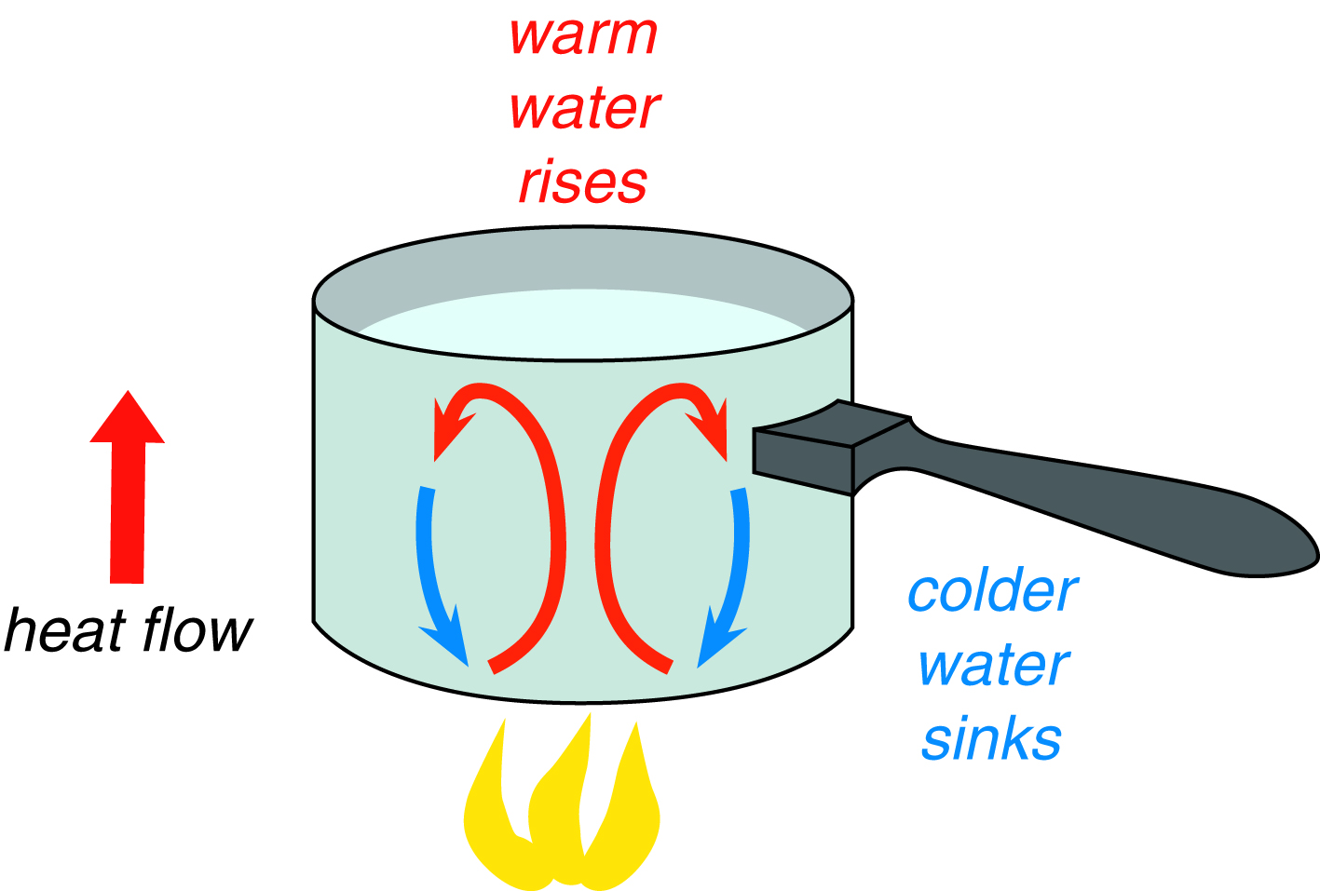
Energy Transfer: Convection
Convection – energy transferred by vertical movement of fluids (air is considered a fluid)
Surface energy transferred upward by convection
“Hot air rises and cool air sinks”
Lava lamps are a good example of convection

Slide 39
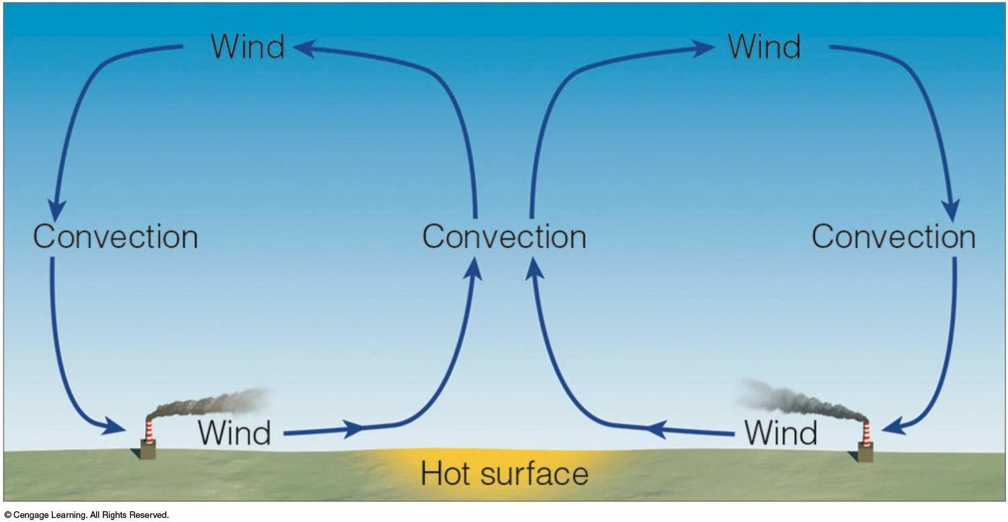
Energy Transfer: Convection
Rising, hot air creates convective circulation

Slide 40
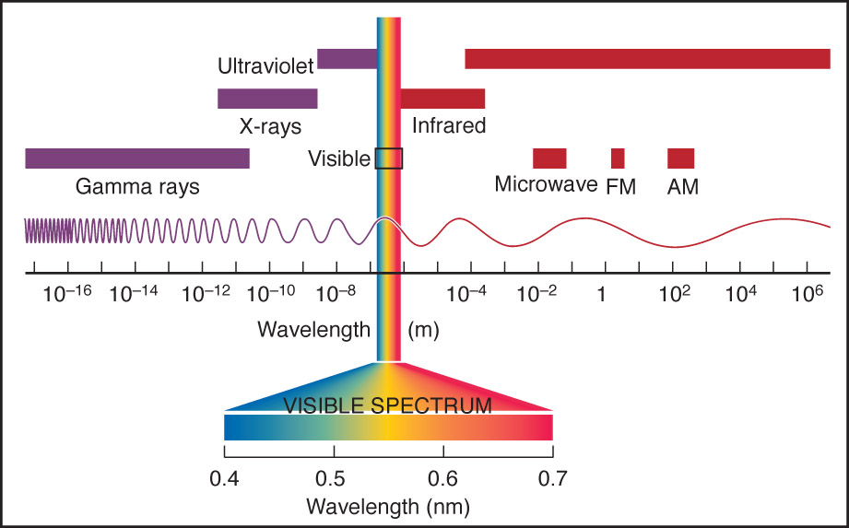
Electromagnetic Spectrum

Slide 41
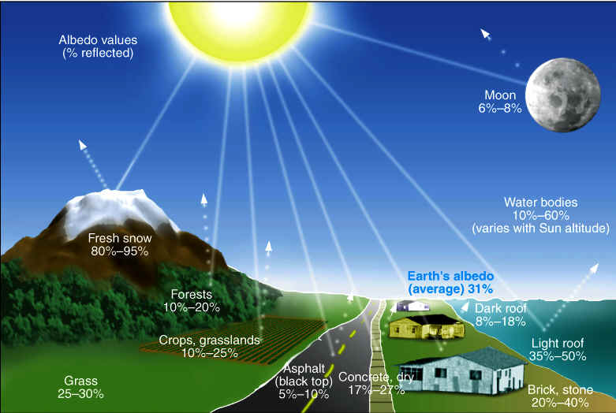
Albedo
100% albedo – totally reflective
0% albedo – perfect black body
Earth average is around 31%

Slide 42
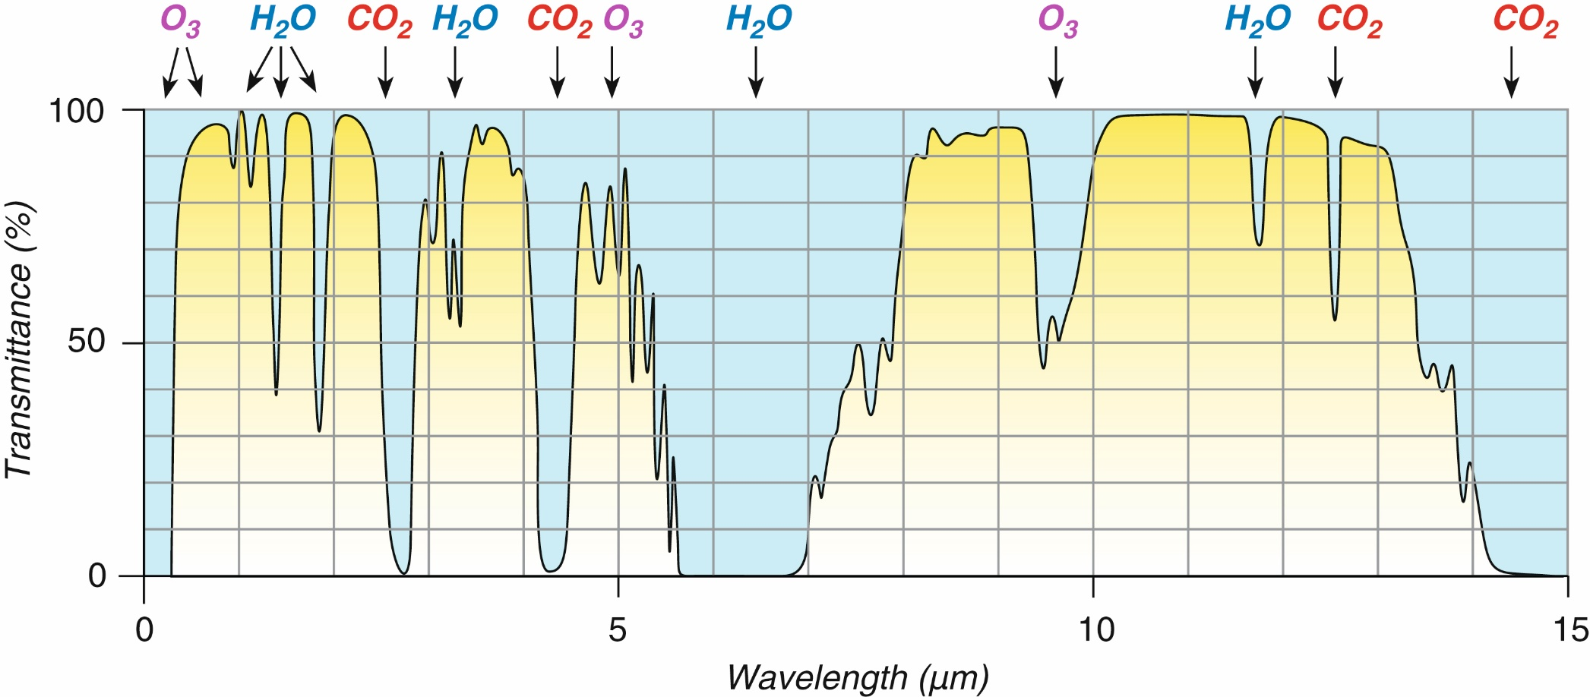
How does energy interact with the atmosphere?
The atmosphere absorbs energy only at certain wavelengths and transmits at others

Slide 43
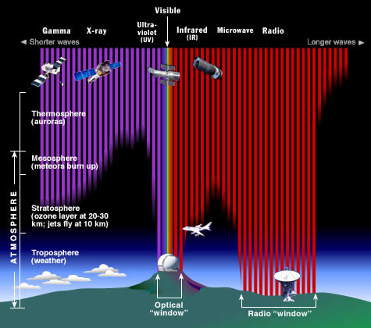
Another way to look at the atmospheric/solar windows

Slide 44
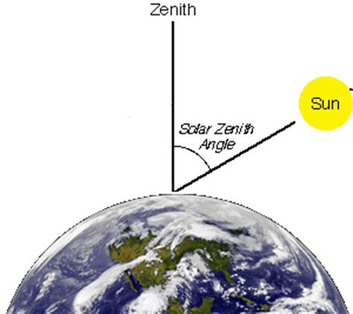
Solar Zenith Angle
Zenith – the point directly over your head
Solar Zenith Angle – the angle between the sun and a point directly overhead
Lower SZA = more direct radiation that makes it to the surface
  Explains why regions closer to the equator are hotter than regions closer to the poles

Slide 45
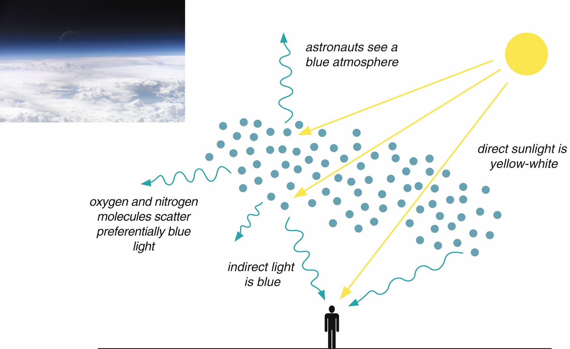
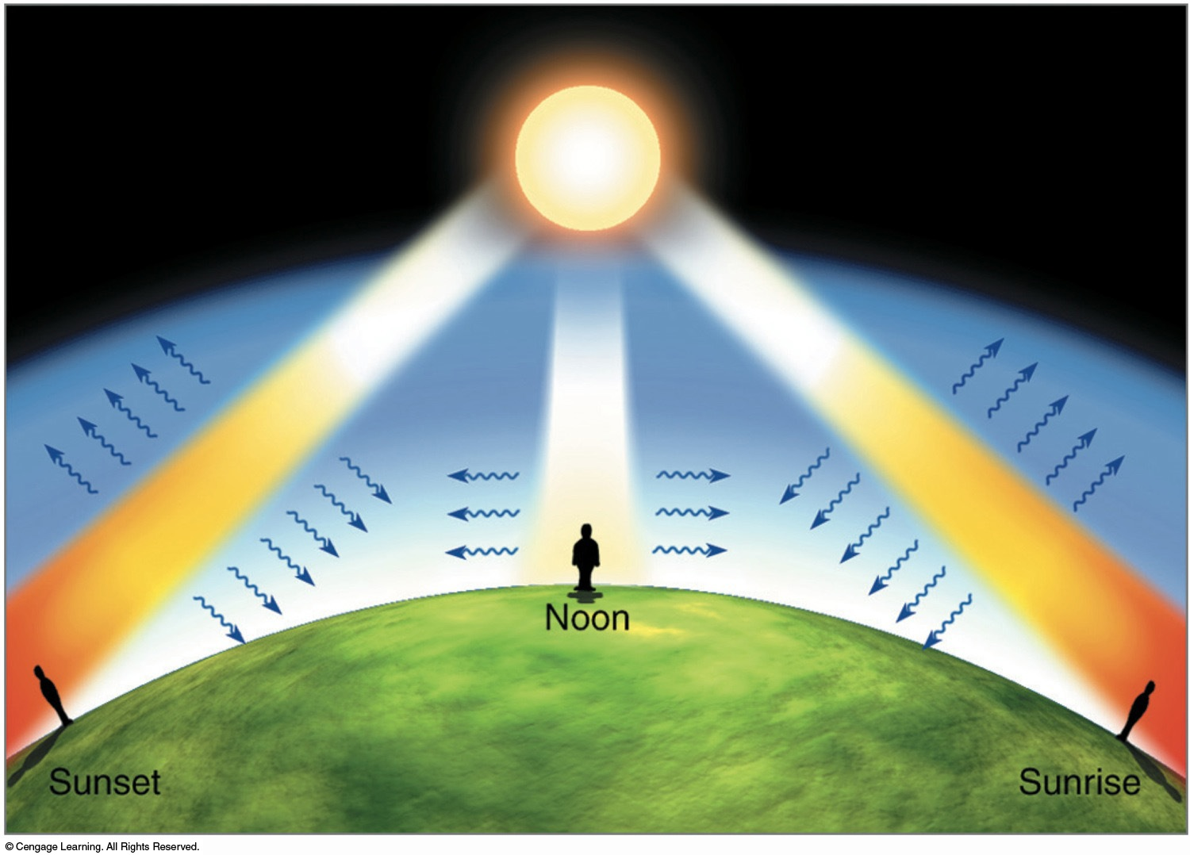
Scattering in the Atmosphere
AKA why is the sky blue?

Slide 46

Earth with the Greenhouse Effect

