Slide 1
Chapter 10 Review

Slide 2
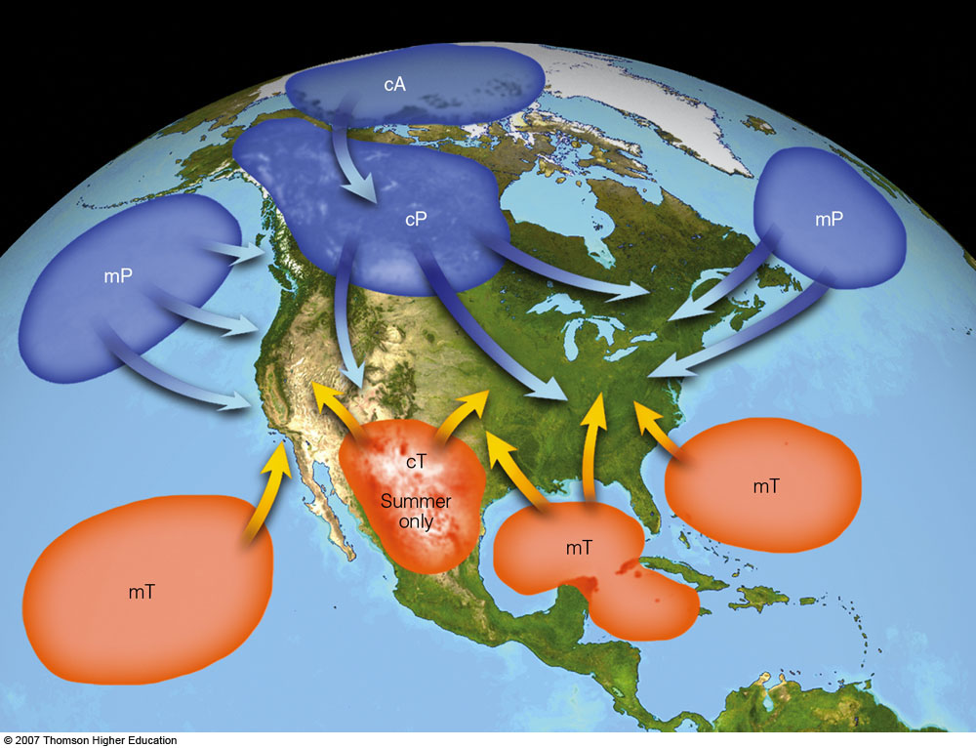
Air Masses
Large body of air whose temperature and humidity are the same in any horizontal direction
Takes the characteristics of the region its located in
Covers huge areas (i.e. hundreds of thousands square mi… or on the order of 10⁵-10⁶ km²)
T: Tropical
P: polar
A: Arctic
c: Continental
m: Maritime

Slide 3
Another way to think about source regions…
Source Region | Arctic (A) | Polar (P) | Tropical (T)
Land | cA | cP | cT
Continental | Extremely cold, dry, stable Ice and snow covered surface Formed over Arctic | Cold, dry, stable Formed poleward of 60° latitude | Hot, dry, stable air ALOFT Unstable surface air Formed between 30°N - 30°S
Water | N/A | mP | mT
Maritime |  | Cool, moist, unstable Formed poleward of 60° latitude | warm, moist, usually unstable Formed between 30°N - 30°S
First letter: surface category
Second letter: location category
Why do we not have mA?

Slide 4
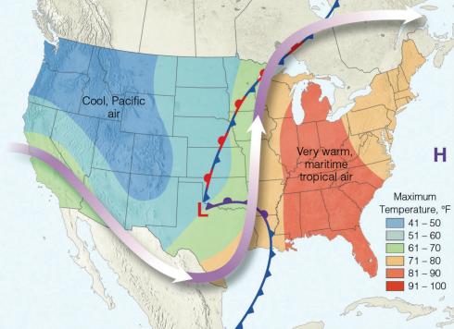
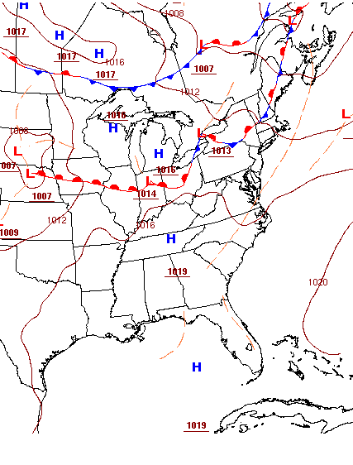
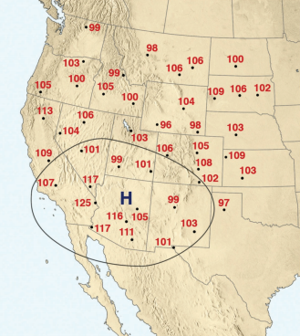
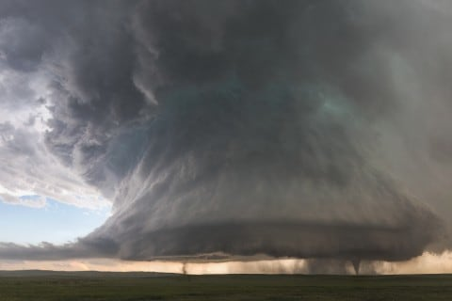
mP air can bring heavy snowfall
On West Coast: orographic lifting
On East Coast: collides with cP air
mT air can lead to oppressive heat wave
FL winter precip: cP air masses forcing mT air mass up/out of the way
cT air masses can lead to dry lines when they collide with mT air masses
i.e. can lead to the formation of super cells!

Slide 5
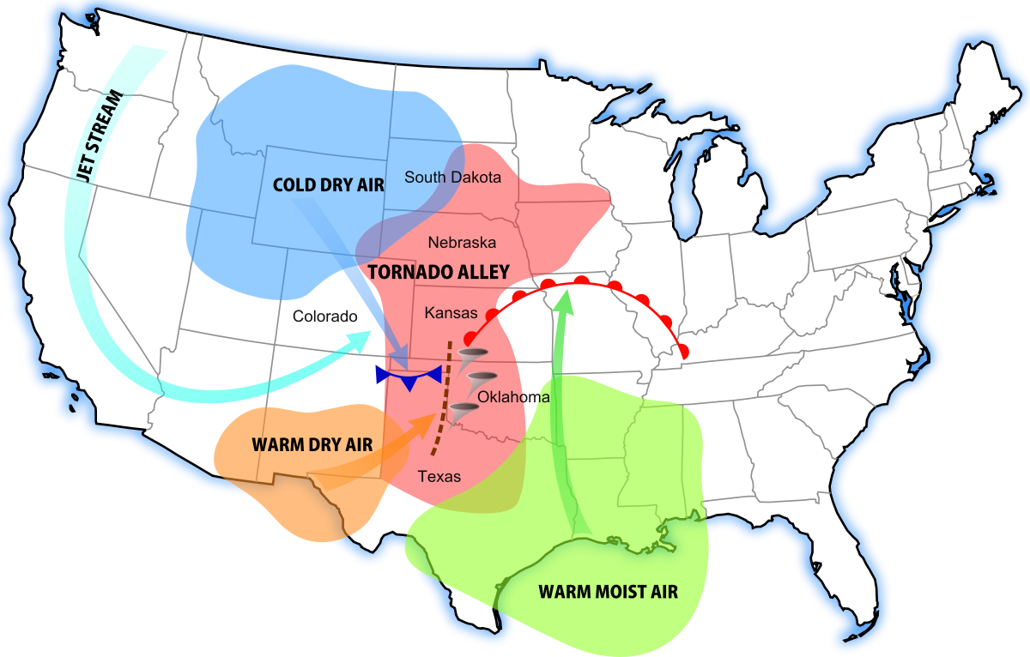
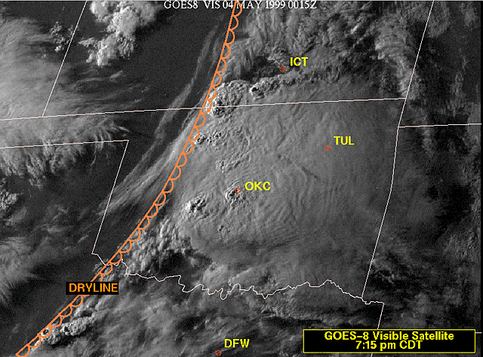
When cT and mT collide…
Dry air behind the dry line lifts moist air ahead of it
Triggers thunderstorm development
Commonly found just east of Rocky Mts
Common in spring and summer
Most tornadoes due to this collision occur between March and June

Slide 6
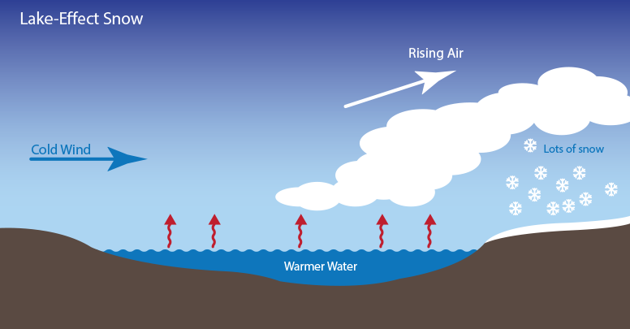
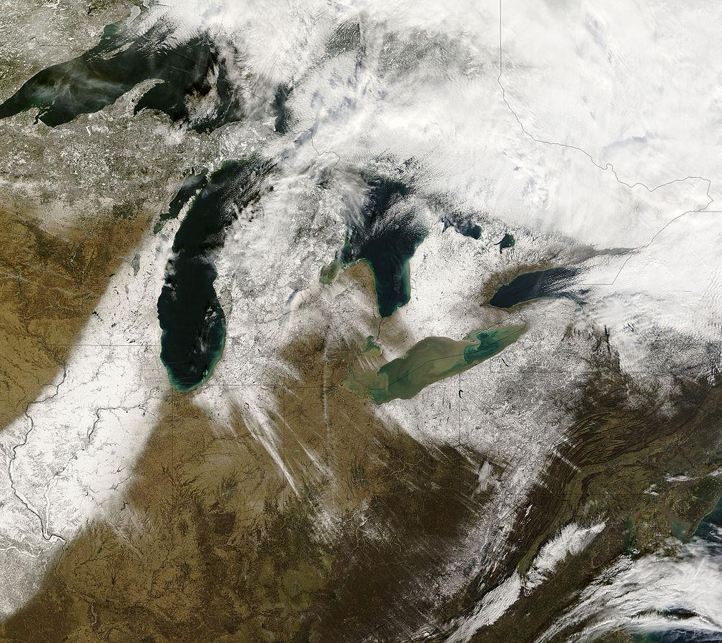
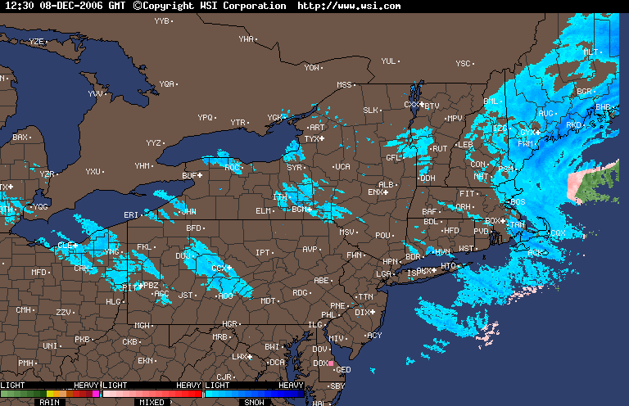
Lake Effect Snow
Occurs when a cold, dry air mass (cP, or cA) advects over a warm body of water
Keep in mind that the body of water isn’t necessarily warm per se… it is just warmer than the air mass above it
Leads to fog then evaporation → results in enough moisture to create snow

Slide 7
DISCLAIMER: ALL FRONTS ARE LOW PRESSURE!!!
See AMS glossary

Slide 8
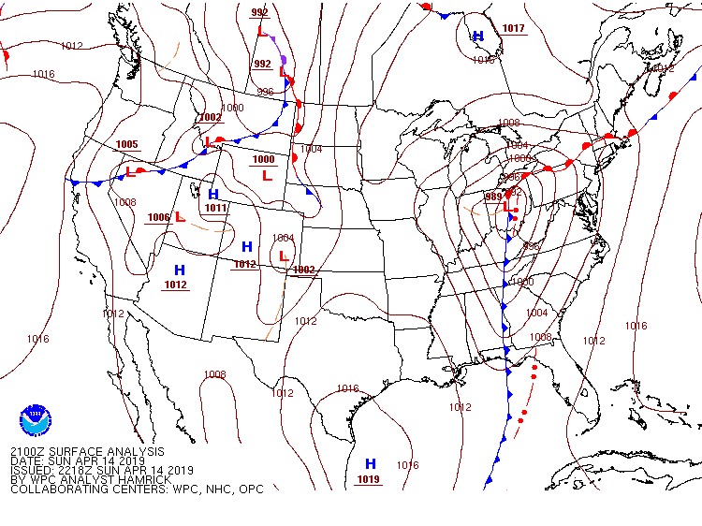
Fronts
Transition zone between two air masses
Example:
Frontal Analysis observed at Sunday, Apr. 14, 2019 at 21Z (5pm LST)
Continental Polar (dry, cool)
Maritime Tropical (warm, moist)

Slide 9
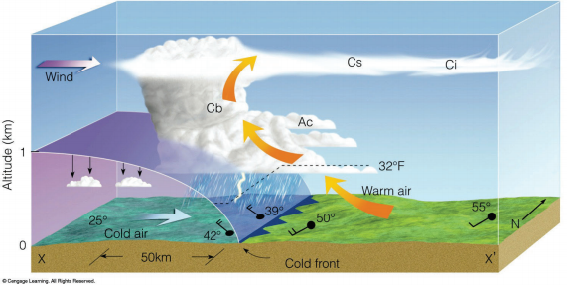
Cold Fronts
Blue triangles pointing toward warm air
Travels at approx. 25 knots
Moves much faster than warm fronts!
Forces warm air up, releasing latent heat, leading to storms
Frontal zone is steep

Slide 10
Cold Fronts
Temperatures are warm (relative), abrupt drop during the passage, then steadily drops after
Pressure falls steadily, reaches a minimum, then rises steadily after
Winds change from S, SW to W, NW
Heavy precip along frontal boundary

Slide 11
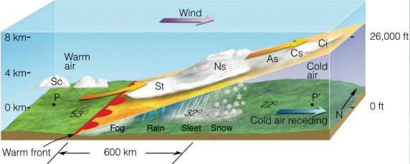
Warm Fronts
Red semi-circles pointing toward cold air
Travels approx. at 10 knots
Warm air slides over cold air
Frontal zone is shallow
Upper level clouds (cirriform) gradually decreasing in altitude, becoming stratiform clouds

Slide 12
Warm Fronts
Temperatures keep rising, eventually level off
Pressure drops, levels off, then rises
For US: winds change from S, SE to S, SW
Light to moderate rain/snow/sleet/rain showers before passing (depending on season)

Slide 13
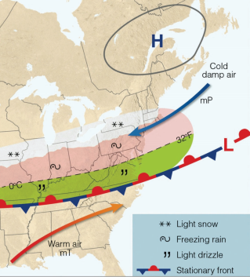
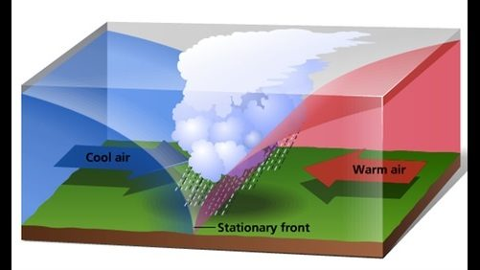
Stationary Fronts
Semicircles, triangles in opposite directions
Barely moves
Winds blow along front in opposite directions
Eventually moves out of the way by the movement of air masses

Slide 14
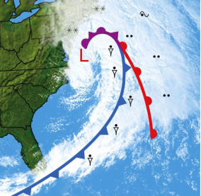
Occluded Fronts
Purple semicircles and triangles pointing in same direction
Pressure falls before passing, reaches a minimum, slowly rises after
Temperature changes depend on type of occlusion
Precip can come from nimbostratus and/or cumulonimbus

Slide 15
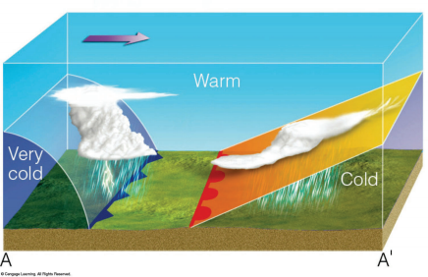
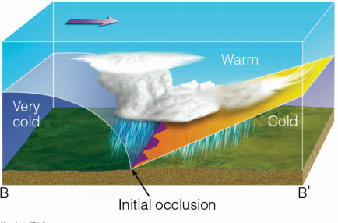
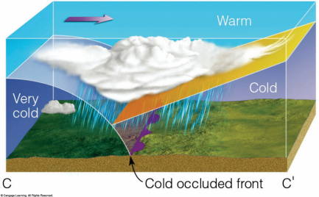
Cold Occluded Fronts
Cold front catches up with warm front, warm air overrides cold air near the surface
Mix of clouds similar to both cold and warm fronts
Very cold air mass is coming from the W
Rare, very few documented cases

Slide 16
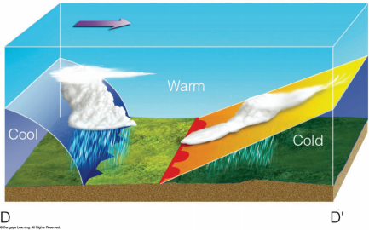
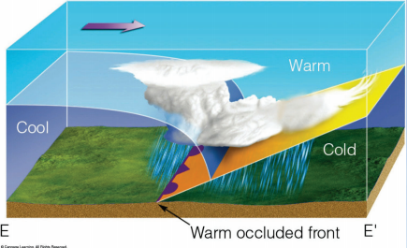
Warm Occluded Fronts
Cold front catches up with warm front, warm air overrides cold air near the surface
Mix of clouds similar to both cold and warm fronts
Cool (not the coldest) air mass is coming from the W

Slide 17
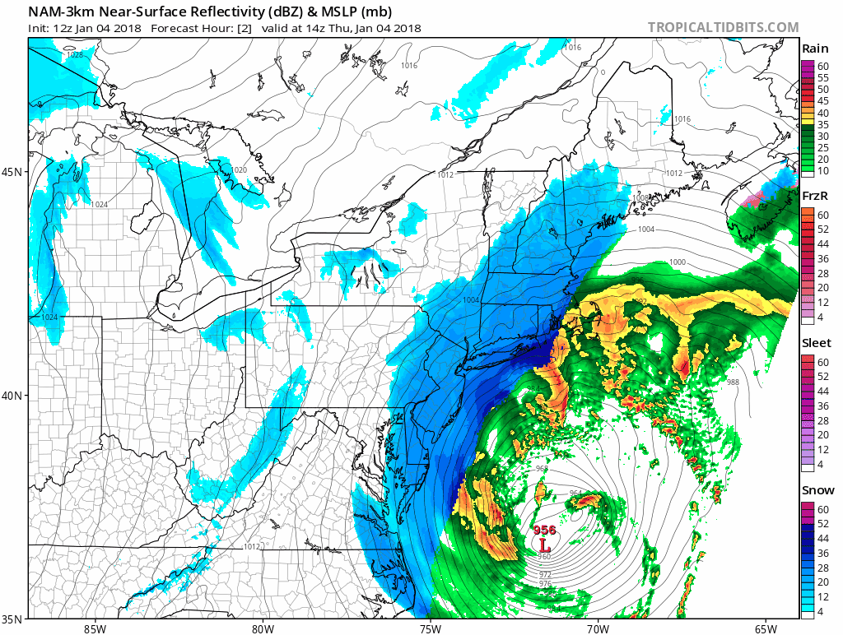
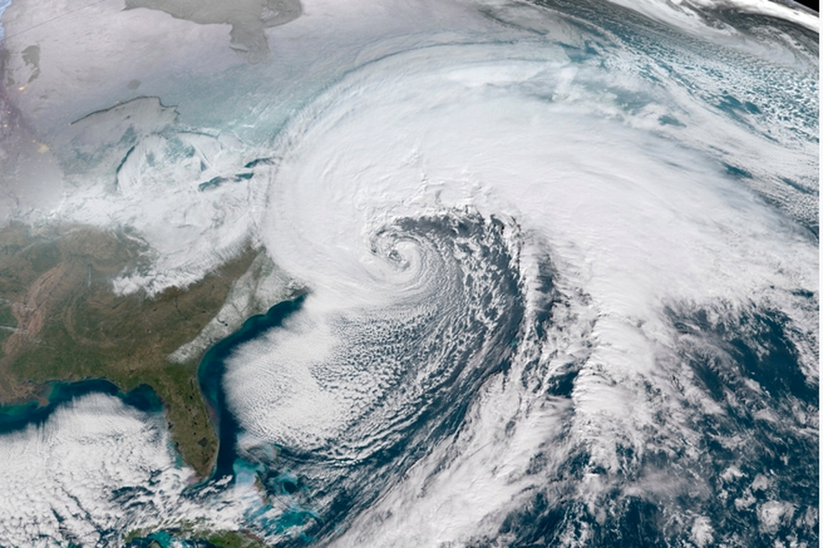
Midlatitude Cyclones
Area of low pressure (counter-clockwise winds in the NH, clockwise winds in the SH)
Important for global heat transport
Redistribute/reduce energy
First studied by Bjerknes (developer of cyclone model/polar front theory)
Can deepen very rapidly
If center drops 24 mb in 24 hours, it is referred as bomb/explosive cyclogenesis
Scale: 1500-5000 km, days to a week
‘Bomb’ cyclone of January 2018

Slide 18
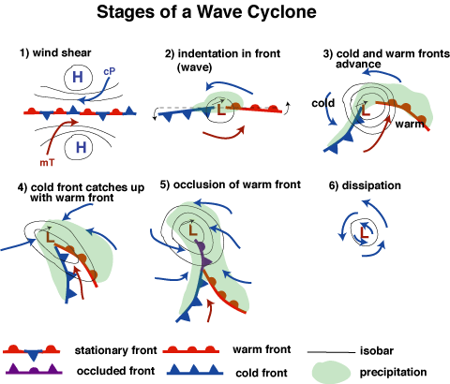
Bjerknes’ Polar Front Theory/Cyclone Model
Strongest point: right before it goes occluded!
Cut off low

Slide 19
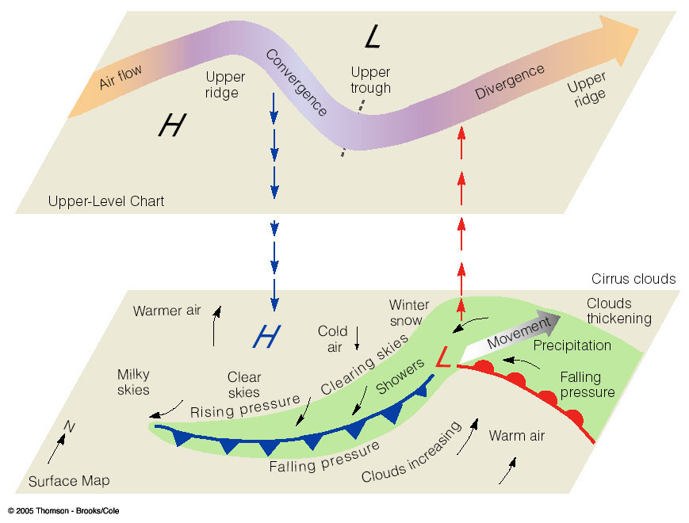
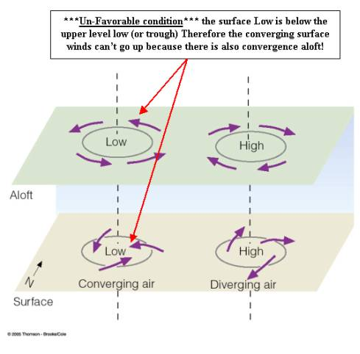
Cyclogenesis/Rossby Waves
Keep in mind: surface highs (lows) will rotate clockwise and outward (counter-clockwise and inward) due to friction!
Supergeostrophic
Air accelerates
Air decelerates
Subgeostrophic

Slide 20
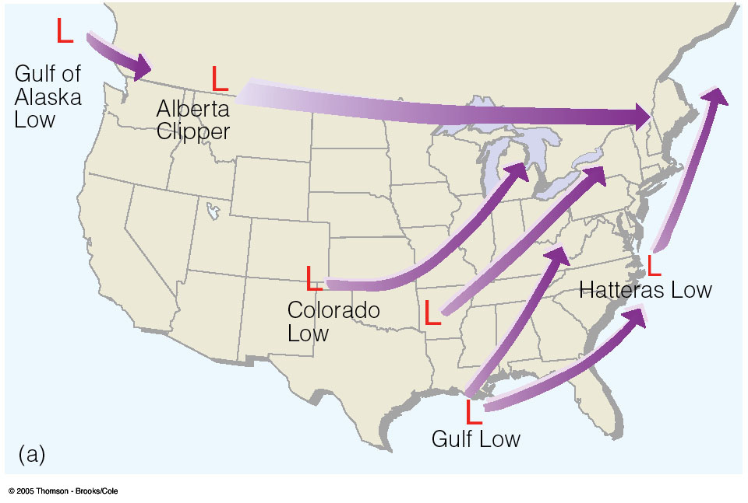
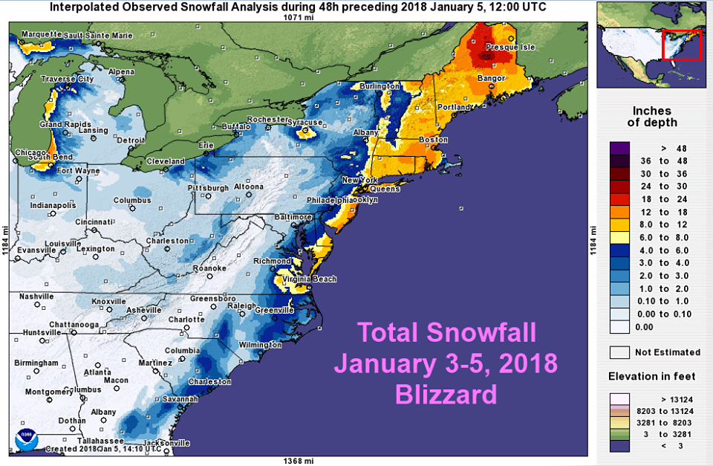
Cyclogenesis
Common regions for development of cyclones
East Coast Lows:
Something we’re too familiar with here
Capable of producing hurricane force winds, flooding, snow
Can last for several days

Slide 21
Useful Links to get you started for the final
Midlatitude cyclones: https://www.atmos.illinois.edu/~snodgrss/Midlatitude_cyclone.html
Thunderstorm basics: https://www.nssl.noaa.gov/education/svrwx101/thunderstorms/ http://ww2010.atmos.uiuc.edu/(Gh)/guides/mtr/svr/type/home.rxml
Tornadoes: https://www.metoffice.gov.uk/learning/wind/tornado/how-are-tornadoes-formed
Fronts: https://okfirst.mesonet.org/train/meteorology/Fronts.html
Three cell model/general circulation: https://cimss.ssec.wisc.edu/wxwise/class/gencirc.html
Jet streams: https://www.weather.gov/jetstream/jet
Hurricanes: https://spaceplace.nasa.gov/hurricanes/en/
Atmospheric optics: http://cimss.ssec.wisc.edu/wxwise/class/optics.html

