Slide 1
Group Project 1 Review
TA: Joey Knisely
www.atmos.umd.edu/~jknisely

Slide 2
This project consists of 3 main parts
An Oxford-style debate between two opposing teams
A group paper outlining your main arguments & supporting evidence
Rough Draft & Final
With annotated bibliography
An individual write up outlining your group’s topic in your own words as well as your own individual contribution
(Also peer evaluations)

Slide 3
Overall Format
Introduction
1st Supportive Speaker
1st opposing Speaker
Sub-Topic A
2nd Supportive Speaker
2nd Opposing Speaker
Q&A
Sub-Topic B
3rd supporting Speaker
3rd opposing Speaker
Q&A
Sub-Topic C
4th supporting Speaker
4th opposing Speaker
Q&A
Conclusion
5th supporting Speaker
5th opposing Speaker
Open discussion

Slide 4
Debate Information
You will be given 2.5 minutes ± 15 seconds to present each subtopic. I will give warnings at 1, 2, and 2.5 minutes.
Teams will be judged on understanding of topic, quality of evidence, and persuasiveness.
YOU SHOULD MEMORIZE YOUR PART! – Using notecards, pieces of paper, phones, etc. of any kind will be an automatic point deduction.
Sources must be cited during the debate.
Teams should be ready to ask the opposite team questions during the 3 min. Q&A sessions.

Slide 5
Rough Drafts
Rough draft (turned into ELMS)
Each group will submit 1 draft to receive comments/suggestions!
Prepared Statements
1St Speaker – Intro
2nd Speaker – Argument 1
3rd Speaker – Argument 2
4th Speaker – Argument 3
5th Speaker – Conclusion
Annotated Bibliography
10+ citations per team
2+ citations per member
3-4 sentences per source describing what relevant material you used and how it supports your argument (should not be direct quotes!)
Your individual name in the annotation

Slide 6
Final Drafts
Final draft (turned into ELMS)
Each group will submit 1 document by noon.
Prepared Statements
1St Speaker – Intro
2nd Speaker – Argument 1
3rd Speaker – Argument 2
4th Speaker – Argument 3
5th Speaker – Conclusion
Annotated Bibliography
10+ citations per team
2+ citations per member
3-4 sentences per source describing what relevant material you used and how it supports your argument (should not be direct quotes!)
Your individual name in the annotation

Slide 7
Format
Rough draft and final draft cannot be in bulleted format
You must have complete thoughts/sentences
Example rough and final drafts will be posted to my discussion page
Use MLA formatting
Works cited must reflect everyone’s citations
Remember: minimum requirement is two citations per person
Each person must have at least one .gov, .edu., or scholarly article!
Your bibliography will be organized together in alphabetical order, however you should identify your individual sources with your name in the annotation.

Slide 8
Proper in-text citations (MLA)
Purdue MLA citations help
Examples:
Author style:
“The bird is the word” (Griffin 26)
As stated by Griffin, “the bird is the word” (26)
It was known that everyone has heard about the bird, but they were unaware it was also the word (Griffin 26)

Slide 9
Individual Write Up
Each member must turn in a write up describing the topic (in your own words), key discussion points, and personal contribution
Must have MLA in-text citations
All sources used MUST appear in group annotated bibliography
See Project 1 Survival Guide document on my website for more details…
This is due on the last day of debates, 3/

Slide 10
Disclaimer!
All written documents will go through Turnitin
If any group scores a high percentage (i.e. a lot of plagiarism), this is grounds to report to the Honor Council
If after submission you cannot see your Turnitin report, contact me
See UMD’s academic integrity codes

Slide 11
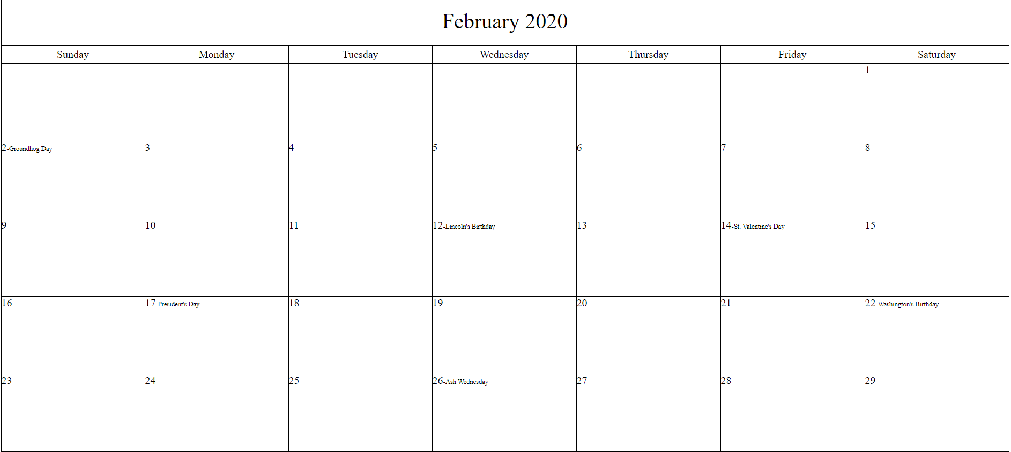
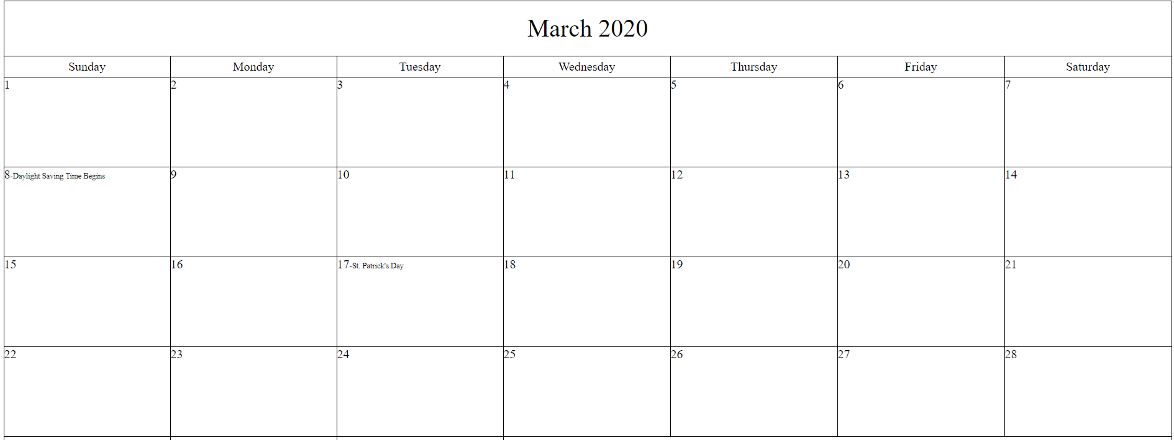
Today
½ mark
*
*½ peer evaluation due
Rough draft due
**ALL GROUPS MUST BE READY TO PRESENT
Groups will be chosen at random
Final Drafts must be turned in AT NOON
1st DEBATE
**
2nd DEBATE
3rd DEBATE
***
***Individual write ups due
Final peer evaluation due

Slide 12
 | Possible Points
Participation (attendance/debate reflection/survey response) 4 pts for each debate sheet turned in 2 pts for survey response | 10
Individual Preparation Presenting material in allotted time No note cards Time: 2 min 30 sec | 10
Quality of supporting evidence (individual) Individual portion of rough & final draft Similar to grade breakdown of ind. write up | 15
Quality of supporting evidence (debate) In class argument, based on verbal citations | 10
Participation within group 5 points for first half, 5 points for second half Based on submissions, peer eval results, etc. | 10
Quality of Individual write up Formatting Sources with annotations In text citations Quality of written arguments On time submission Turn it in report | 15
Total Individual (out of 70 points)
 | Possible Points
Well organized/prepared Preparedness in argument/debate structure Preparedness in Q&A session Persuasiveness as a group | 10
Quality of rough draft Formatting (no bullet points!) Complete thoughts Organization Sources with annotations!!!! At least 2 sources per person (need to hit source minimum for rough draft) Turnitin report | 10
Quality of final draft See rough draft Improvement from rough draft In text citations Sources with annotations At least 2 sources per person Turnitin report | 10
Total Group (out of 30 points)

Slide 13
Group Contract
Include section, group name/color, topic, and stance
Sign and date! Please have back to me ASAP
Member responsibilities: include a short list of everyone’s duties
This is just to get an idea and is tentative
You must give me access to your Google Docs to check your progress (i.e. share with jknisely@umd.edu)
If a team member is not present, get in contact through ELMS asap!

Slide 14
Group Pairs for 104
Pair | Description
Group 1 | We should seek to relocate populations devastated by disasters/extreme weather away from disaster prone areas
Group 2 | We should seek to rebuild areas devastated by disasters/extreme weather, despite their tendency towards disaster
Pair | Description
Group 3 | Government evacuations before extreme weather events should be mandatory
Group 4 | Government evacuations before extreme weather events should NOT be mandatory
Pair | Description
Group 5 | We should be investing more resources in renewable energy sources (e.g. wind, solar, etc.) as opposed to nuclear energy production
Group 6 | We should be investing more resources in nuclear energy production as opposed to renewable energy sources

Slide 15
Group Pairs for 202
Pair | Description
Group 1 | Government evacuations before extreme weather events should be mandatory
Group 2 | Government evacuations before extreme weather events should NOT be mandatory
Pair | Description
Group 3 | Assuming geoengineering techniques (e.g. cloud seeding) can solve climate/weather problems, we should force the atmosphere to behave in a way humans prefer
Group 4 | Assuming geoengineering techniques (e.g. cloud seeding) can solve climate/weather problems, we should NOT force the atmosphere to behave in a way humans prefer
Pair | Description
Group 5 | We should be investing more resources in renewable energy sources (e.g. wind, solar, etc.) as opposed to nuclear energy production
Group 6 | We should be investing more resources in nuclear energy production as opposed to renewable energy sources

