Slide 1
Fall 2019 Midterm Answers

Slide 2
Multiple Choice (slash-delimiters denote the 3 versions)
Question 1/6/4: Cloud formation is inhibited by which of the following?
Correct Answer: subsidence
Question 2/8/7: What type of fog commonly occurs when cold air blows over warm water?
Correct Answer: steam fog
Question 3/10/9: When the environmental lapse rate is less than the dry adiabatic lapse rate, the atmosphere can be described as ___?
Correct Answer: unstable
Question 4/1/6: The highest level of clouds have the prefix of ___?
Correct Answer: cirro
Question 5/2/10: Which of the following best describes greenhouse gases?
Correct Answer: greenhouse gases trap outgoing, longwave, terrestrial radiation

Slide 3
Multiple Choice (slash-delimiters denote the 3 versions)
Question 6/3/1: Since the mid 1800’s, what has been the overall trend in global monthly surface temperature?
Correct Answer: temperatures have increased by about 1°C
Question 7/4/3: Which of the following is not a greenhouse gas?
Correct Answer: Oxygen (O₂)
Question 8/5/2: An airplane is flying overhead, and you see a contrail that hangs around for a long time. What does this tell you about the air the plane is flying through?
Correct Answer: the air is very humid
Question 9/7/5: A temperature inversion makes the atmosphere ___?
Correct Answer: stable
Question 10/9/8: The ratio of water vapor pressure to saturation water vapor pressure is called ___?
Correct Answer: relative humidity

Slide 4
Short Answer 1 (Temperature) A
Question: Why don’t surface temperatures peak at noon when the sun is highest in the sky? When do they peak?
Answer: At noon the Earth is receiving the most direct light but the incoming radiation is still greater than the outgoing terrestrial radiation. The hottest time of the day is when incoming= outgoing radiation (~3 pm)
Common Mistakes: Many students explained when the hottest time of the day is but did not explain why noon was not. Many student said because it takes time for the Earth to heat up, which is partly true but does not explain the whole question.

Slide 5
Short Answer 1 (Temperature) B
Question: Why do ocean temperatures peak later in the year than land temperatures?
Answer: Due to the higher heat capacity or specific heat of water than land, it take water more energy to changes its temperature. Thus, it takes longer for water to heat up than land
Common Mistakes: Saying that oceans take in energy at a slower rate. Oceans take in energy at the same rate as land, but more energy is required to change the temperature. Many students restated the question without a sufficient explanation.

Slide 6
Short Answer 1 (Temperature) C
Question: In the summer, the sun never sets in the Arctic. Why isn’t the Arctic really warm in the summer if the sun is up all of the time?
Answer: Although the sun is in the sky 24/7, it is at a very low angle. Due the shape of the Earth and high solar zenith angle, the incoming radiation travels further through the atmosphere and spreads out over the surface (less direct).
Common Mistakes: I gave partial credit for those who said the ice has a high albedo and reflects ~90% of the incoming radiation. Some confused low and high albedo.

Slide 7
Short Answer 1 (Temperature) D
Question: What is the relationship between temperature and relative humidity?
Answer: Inverse. As temperature increases, relative humidity decreases
Common Mistakes: Some thought the relationship was direct. Some described how temperature and dew point relate to relative humidity without answering the question directly.

Slide 8
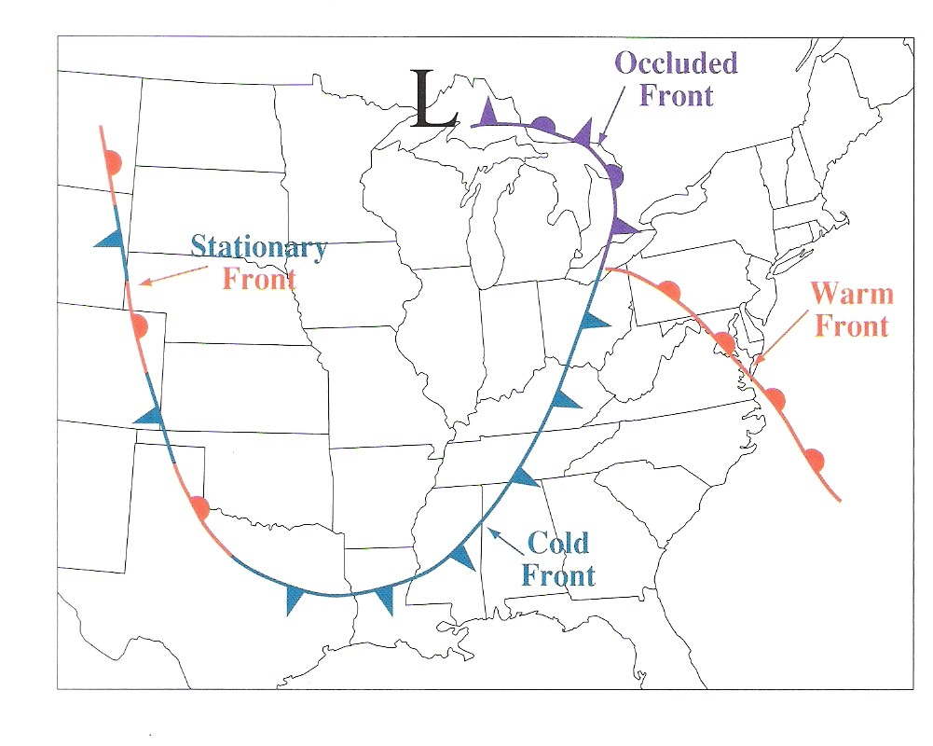
Map Question
Note: This is not the exact question that was asked on the midterm exam; there were three different versions of the map question, so this is just another example
The wind barbs tell us where the winds are coming from; the winds are heading in the same direction that the front is moving in
Higher temperature will be found behind the warm front (place the temperature and dew point on the left side of the station model)
In this example, station A is closer to saturation because the temperature is closer to the dew point
78
65
B
45
41
A

Slide 9
Short Answer 1 (Thermodynamics) A
Question: Two air parcels near the surface begin to rise. Both parcels start out having the same temperature. The environmental lapse rate is the same for both. Why do both air parcels expand as they rise? What effect does this have on the temperature inside the parcels?
Answer: As altitude increases, atmospheric pressure decreases. Thus, as the parcel rises, less pressure (less force) is exerted on the parcel, and the parcel expands. As it expands, it loses temperature, as explained by the ideal gas law PV=nRT.
Common Mistakes: Not mentioning atmospheric or environmental pressure/density, saying temperature or pressure increase

Slide 10
Short Answer 1 (Thermodynamics) B
Question: As both parcels rise, parcel B forms a cloud. Later, one of the air parcels stops rising. Which parcel stops rising and why? Why didn’t the other one?
Answer: Needed to say WHAT happens and WHY. The parcel that does not form a cloud stops first, because it was moving at the dry adiabatic lapse rate (10˚ C/km). The parcel that does form a cloud is saturated, and therefore loses temperature at the moist/saturated lapse rate (~6˚ C/km).
It stops when it matches or is less than the environmental temperature, AKA at a stable layer. Also accepted temperature inversion.
Common Mistakes: Not properly understanding dry vs. moist lapse rates, thinking the parcel stops rising when it forms a cloud

Slide 11
Short Answer 1 (Thermodynamics) C
Question: Why is condensation considered a warming process?
Answer: Condensation is a phase change that releases latent heat into the environment. Thus, it is considered a warming process.
Common Mistakes: Explaining evaporation, but not explaining condensation, saying the parcel absorbs heat

Slide 12
Short Answer 1 (Clouds) A
Question: You’re near the Rocky Mountains out west and it’s a beautiful Fall day so you go out for a hike to look at the leaves on the trees. You notice that there is cloud formation over the mountains but nowhere else. Why are there clouds over the mountains?
Answer: Orographic lifting, explanation of orographic lifting
Common Mistakes: Misspelling orographic (no points lost), fronts caused this, not mentioning any lifting mech (i.e. saying the mountain is high altitude which causes condensation)

Slide 13
Short Answer 1 (Clouds) B
Question: Many of the mountains have a lot of trees on the Western (windward) side while the Eastern side is somewhat barren. How did this happen?
Answer: Air is forced up the mountain on the windward side (i.e. orographic lifting), condenses and rains out. The air is dry when it travels to the leeward side where it warms adiabatically as it travels down.
Common Mistakes: Not mentioning warming by compression/warming adiabatically, saying photosynthesis/wind carrying seeds, confusing windward vs leeward

Slide 14
Short Answer 1 (Clouds) B
Question: Many of the mountains have a lot of trees on the Western (windward) side while the Eastern side is somewhat barren. How did this happen?
Answer: Air is forced up the mountain on the windward side (i.e. orographic lifting), condenses and rains out. The air is dry when it travels to the leeward side where it warms adiabatically as it travels down.
Partial credit:
Explaining windward: +2
Explaining leeward: +2
Not mentioning warming: - 2
Not mentioning warming but mentions sinking: -1

Slide 15
Short Answer 1 (Clouds) C
Question: You go back to your campsite and wake up the next day. Overnight, a cold front brought a blizzard and now a high-pressure system is parked over the area. It’s so sunny you need your sunglasses as you pack up your stuff. You check the satellite images………. the IR images are bright white…. What is the satellite detecting?
Answer: SNOW (quiz 1 question)
Common Mistakes: saying cold/tall clouds, putting both snow/clouds, cold air, etc.

Slide 16
Short Answer 1 (Clouds) D
Question: What is the name of the cloud type that has vertical development and is raining?
Answer: cumulonimbus (cumulo = vertical development, nimbo = rain)
Common Mistakes: switching the order (full points), misspelling cumulo, not confusing strato/cirro with cumulo

Slide 17
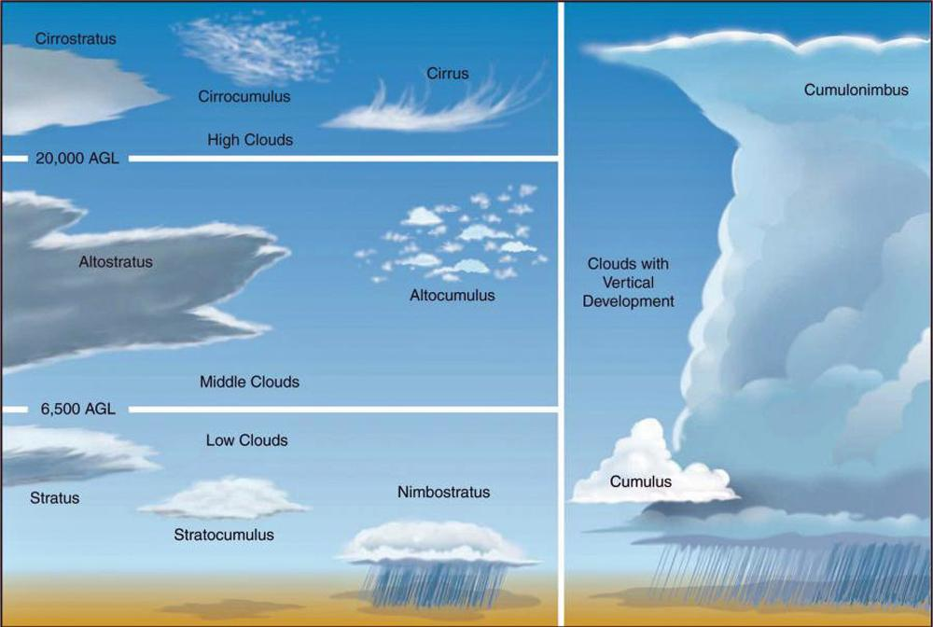

Slide 18
Short Answer 1 (Climate) A
Question: A friend of yours knows you’re taking AOSC200 and asks you to explain climate change. How do you explain this?
Answer: define “climate” as a long-term view of “weather” patterns, (usually 30+ years; can be more than just temperature) making “climate change” a long-term trend/shift in the long-term average
Common Mistakes: Only describing modern anthropogenic climate change (or the enhanced greenhouse effect) without also defining climate & climate change
Would still get you half-credit though

Slide 19
Short Answer 1 (Climate) B
Question: A recent study has reported that there are more wintertime clouds over the Arctic than there used to be. How and why will this affect Arctic sea ice?
Answer: Since it’s Arctic winter, it’s nighttime 24/7, so clouds only act as a “blanket”, returning terrestrial longwave radiation back to the surface – a warming effect. (There’s no solar shortwave radiation to reflect, which would lead to cooling.) More warming means the ice melts!
Common Mistakes:
Stating both cloud effects and thus saying the effect on temperatures/ice is indeterminate.
Only talking about how clouds reflect sunlight, leading to saying you get more ice instead of less.
Assuming the increase in clouds necessarily means more water vapor, and that means ice was already melting (to get more water available).
Assuming the increase in clouds necessarily means the surface was already warmer than usual, making the ice melt.

Slide 20
Short Answer 1 (Climate) B
Question: A recent study has reported that there are more wintertime clouds over the Arctic than there used to be. How and why will this affect Arctic sea ice?
Answer: Since it’s Arctic winter, it’s nighttime 24/7, so clouds only act as a “blanket”, returning terrestrial longwave radiation back to the surface – a warming effect. (There’s no solar shortwave radiation to reflect, which would lead to cooling.) More warming means the ice melts!
Common Mistakes:
Stating both cloud effects and thus saying the effect on temperatures/ice is indeterminate.
Only talking about how clouds reflect sunlight, leading to saying you get more ice instead of less.
Assuming the increase in clouds necessarily means more water vapor, and that means ice was already melting (to get more water available).
Assuming the increase in clouds necessarily means the surface was already warmer than usual, making the ice melt.
If you mentioned both cloud effects but gave the correct (or an alternate) reason as to why the warming effect would dominate (e.g. longer nights, higher SZA, generally cold environment) then you still got full credit

Slide 21
Short Answer 1 (Climate) B
Question: A recent study has reported that there are more wintertime clouds over the Arctic than there used to be. How and why will this affect Arctic sea ice?
Answer: Since it’s Arctic winter, it’s nighttime 24/7, so clouds only act as a “blanket”, returning terrestrial longwave radiation back to the surface – a warming effect. (There’s no solar shortwave radiation to reflect, which would lead to cooling.) More warming means the ice melts!
Common Mistakes:
Stating both cloud effects and thus saying the effect on temperatures/ice is indeterminate.
Only talking about how clouds reflect sunlight, leading to saying you get more ice instead of less.
Assuming the increase in clouds necessarily means more water vapor, and that means ice was already melting (to get more water available).
Assuming the increase in clouds necessarily means the surface was already warmer than usual, making the ice melt.
Both of these answers also mix up causes and effects – these answers assume something else is causing both the clouds and the melting, as opposed to arguing how the clouds themselves lead to heating & melting

Slide 22
Short Answer 1 (Climate) C
Question: Using your answer to b), will this affect global temperatures and, if so, how?
Answer: Ice albedo feedback (Melting ice -> less reflective surfaces -> more sunlight gets absorbed -> even more warming)
Common Mistakes (partial credit)
Water vapor feedback/sea level rise feedback (maybe true, but much weaker)
Saying that a warmer Arctic by itself raises the average (it does, technically, but that’s missing the point)
Any logical follow-through of what you wrote in part B
e.g. you got part B backwards but then correctly used the logic of a feedback to argue for cooler temperatures

Slide 23
Short Answer 1 (Climate) C
Question: Using your answer to b), will this affect global temperatures and, if so, how?
Answer: Ice albedo feedback (Melting ice -> less reflective surfaces -> more sunlight gets absorbed -> even more warming)
Common Mistakes (no credit): No credit for saying that something in the Arctic doesn’t affect global average temperature because the Arctic is a small area! The Arctic is very important to overall global energy balance.

Slide 24
Short Answer 1 (Climate) D
Question: How do increasing greenhouse gas concentrations affect the atmospheric window? How do scientists predict this will affect global surface temperatures?
Answer: More GHGs close/narrow/lessen/etc. the atmospheric window, leading to more atmospheric absorption of outgoing terrestrial longwave radiation, sending heat back down to the surface and increasing temperatures
Common Mistakes:
Not mentioning the window or saying GHGs “affect the window” without saying how or saying GHGs open/strengthen/etc. the window
Saying GHGs have no effect on the window since the window was for incoming solar shortwave radiation (or any mention of solar radiation instead of terrestrial)
Mixing up the atmospheric window with the ozone hole (or any singling-out of ozone; it’s not incredibly different than other GHGs w/r/t the window)

