Slide 1
AOSC 634 Air Sampling and Analysis
Practical Advice
Measuring Devices: Humidity
See Chapter 4.2 of Brock et al.
21 Feb. OK for NIST?
Copyright Brock et al. 1984; Dickerson 2015

Slide 2
Humidity Measurement Overview
Humidity is the only routine, atmospheric chemistry measurement.
It is the most difficult of basic meteorological measurements.
Varies from 3% at the surface in the tropics to 5 ppm in the stratosphere, a range of 10⁴.
There are no simple inexpensive calibration standards – thus the exercise with mass flow controllers.
Meteorologists think of humidity as a property of the atmosphere while chemists think of it as a component of the atmosphere.
Standard rawinsondes are only reliable to about 400 hPa.

Slide 3
Humidity Measurement Principles
Equilibrium Sorption
Salts or solid state sensors such as the Humicap used in the Vaisala and Davis and Hygrister used by many rawinsondes.
Extinction of Light
Lyman alpha (VUV) or IR, fast but relative.
Cavity Ringdown (IR) Picarro.
Condensation
The dew pointer. There are cryogenic dewpointers with liquid nitrogen for upper air work.
Evaporation.
Wet bulb thermometer and psychrometer.

Slide 4
According to manufacturer

Slide 5
http://www.vaisala.com/en/products/humidity/Pages/hmp155.aspx
Also used on Davis Met station

Slide 6
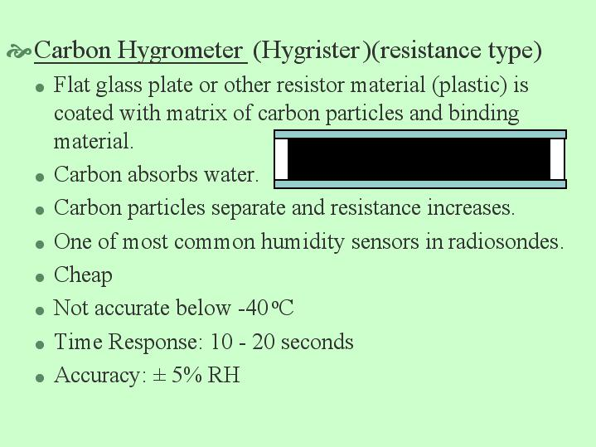
As used on most rawinsondes

Slide 7
Extinction of Light

Slide 8
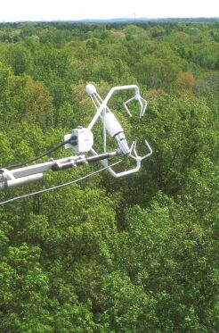

Slide 10
No dispersive element (NDIR)

Slide 14
Developed at NCAR

Slide 15
Lyman alpha photo-fragmentation fluorescence used on WB57 or ER2 for stratospheric water vapor (Weinstock et al., RSI, 1994; JGR 2009)

Slide 16
Condensation
Second order systems

Slide 20
Dewpointer pointers.
What might happen if the mirror is super clean?
Too dirty – say covered with salt?

Slide 21
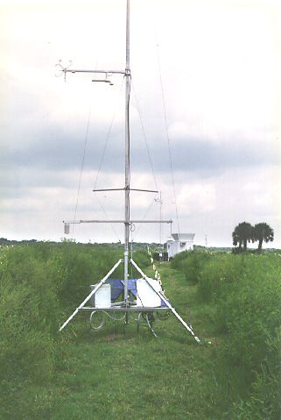
NCAR field stations
Integrated Surface Flux System (ISFS)
Deployable in networks of up to 100 stations.
State variables and fluxes.
Satellite link for DA and communication
http://www.eol.ucar.edu/instrumentation/sounding

Slide 22
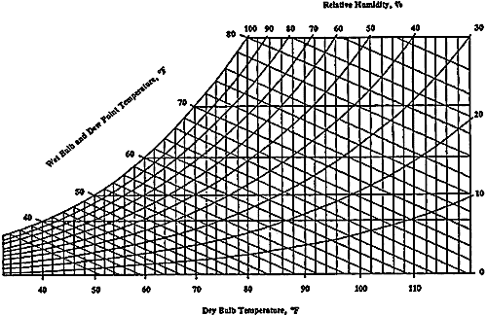
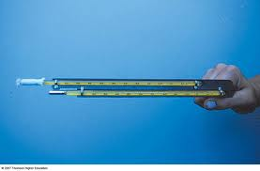
Wet bulb temperature and psychrometers
Simple, cheap, accurate, reliable
Slow, hard to link to data acquisition systems unless used with a wick and PRT.
For theory and derivation of humidity from wet bulb temperature see: http://www.atmos.umd.edu/~russ/syllabus620.html
Lecture 5A, Saturated Temp Dfn's 2012

Slide 23
Summary

Slide 24
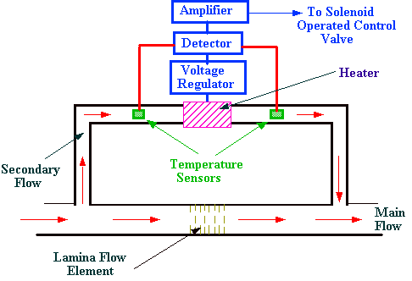
Mass Flow Controller Schematics
Figure 1. Diagram of MFC. Image Courtesy of Chromatography Online.

Slide 25
Bubbler with sintered frit for humidifying a gas flow.
Figure 1. Diagram of MFC. Image Courtesy of Chromatography Online.

Slide 26
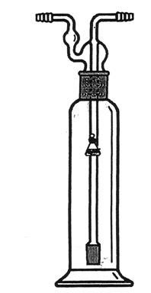
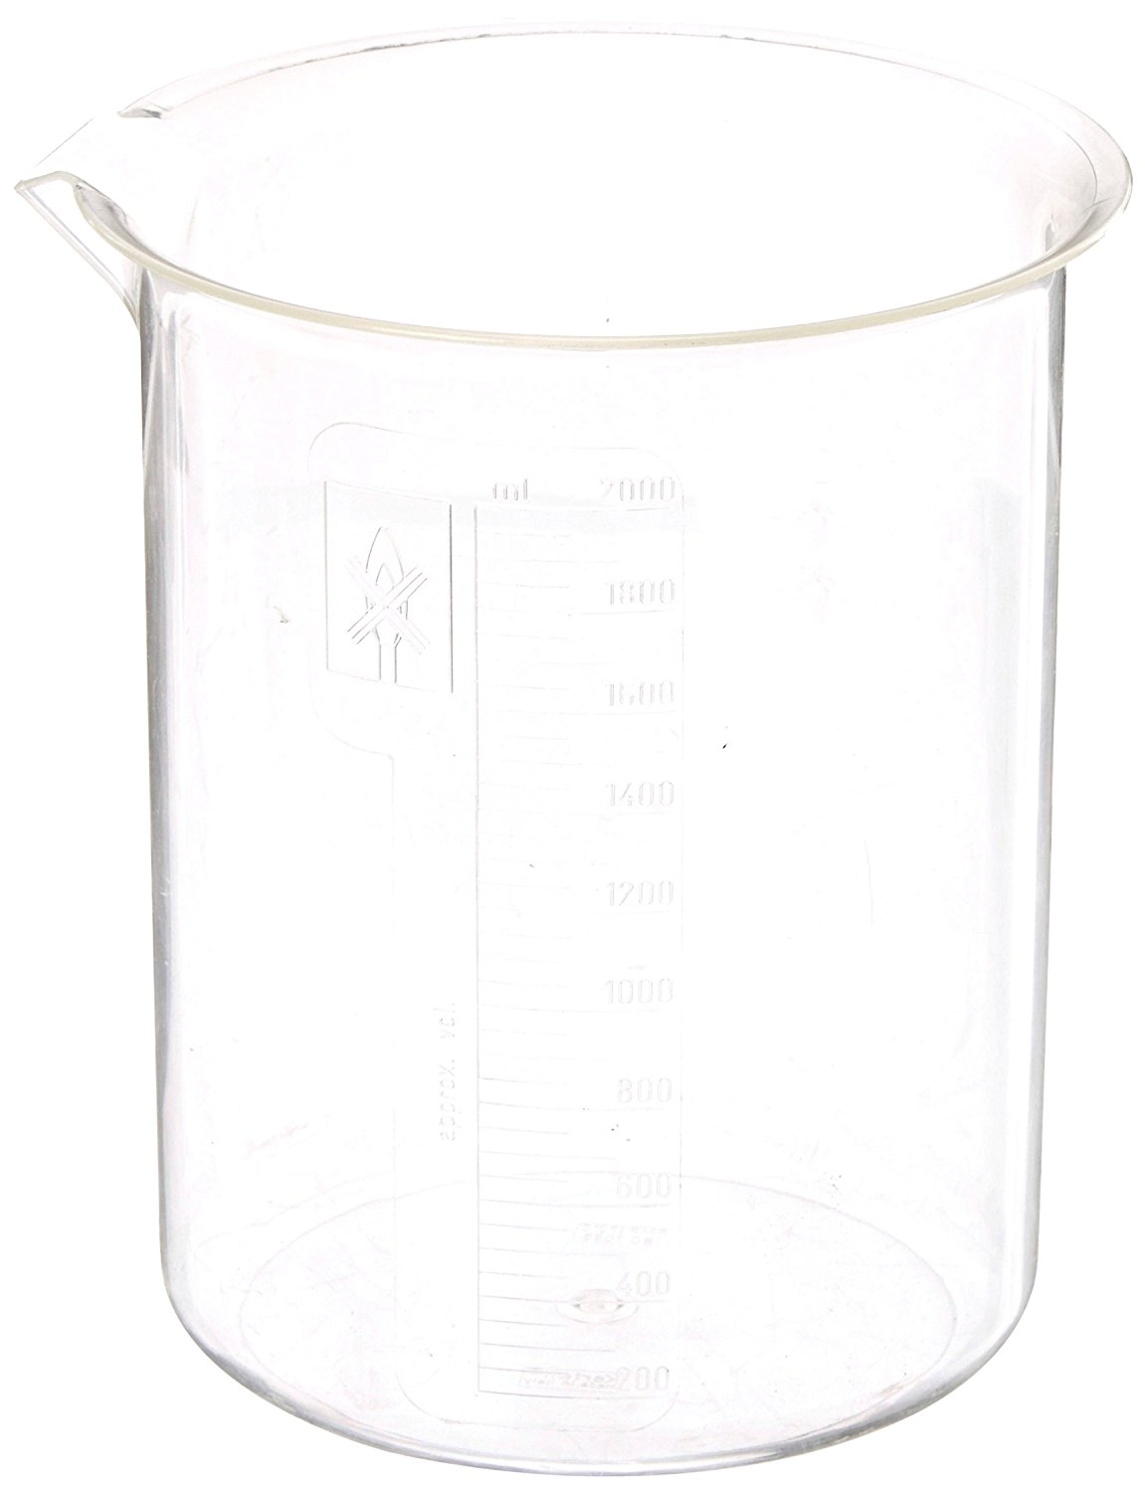
Schematic of selectable RH generation system
MFCd
RH =
100%*Fw/(Fw+Fd)
MFCw

