Slide 1
AOSC 634/458R
Air Sampling and Analysis
Lecture 2
Measurement Theory
Performance Characteristics of instruments
Dynamic Performance of Sensor Systems
Response of a first order system to
A step change
A ramp change
Copyright Brock et al. 1984; Dickerson 2015

Slide 2
Dynamic Response
Sensor output in response to changing input.
Time response: First Order Systems
For a step change in input:
X’(t’) = 1 – e^{–t’}
Where X’ is the normalized output (0-1).
t’ is the time in system time constants, i.e.,
t’ = t/τ where τ is the e-folding time constant.
95% of a step change occurs in 3t’.

Slide 3
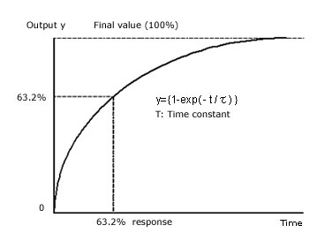
Response of a first order system to a step increase of input.

Slide 5
The finite response time of a first order system creates a time lag for the output relative to the input. For a step change of duration much longer than the time constant of the system:
Where t_{mo} is the time of the mid point of the maximum output.
If t’ >> 1, then t’_{mi} ≅ t’_{mo} – (2t’)
0 1
| |
Signal
Input
output
| | | |
t’₀ t’_{mi} t’_{mo} t’_{f}
Time

Slide 6
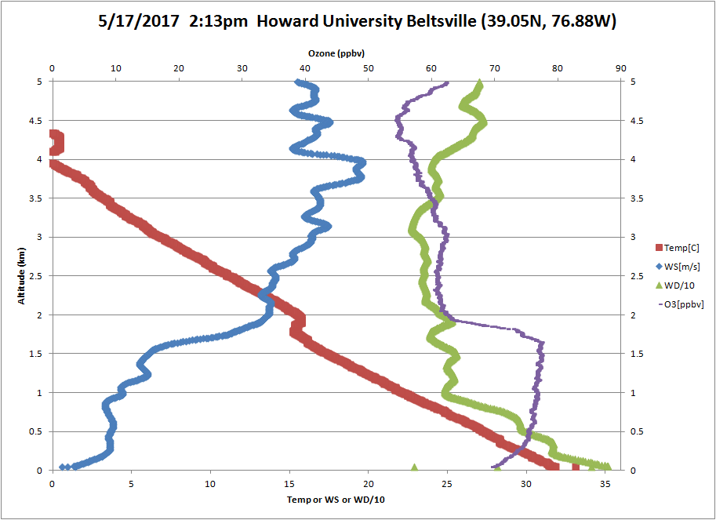

Slide 7
RF2: Morning
Vertical Profile over New Haven & over the Sound

Slide 9
Time Lag, continued.
The apparent middle of the step, a pollution plume or warm air parcel perhaps, will appear about 2t’ later than it occurred. In a sounding or aircraft spiral this shows up as an difference in altitude for instruments with different response times.
The time integral of the input and output will, however, be the same.

Slide 10
Time Lag, continued.
This holds even if t < t’ although the amplitude will be in error (too small).

Slide 11
For a step change of duration less than the response time of the instrument (t’ or τ) the integral is still the same as the input integral, but the amplitude is now reduced.
At very high frequencies (>> 1/τ), the input begins to look like a DC signal again.
0 1
| |
Signal
Input
output
Time

Slide 12
Response to a ramp input.
Or in normalized variables
For all t’ > 0
The transient approaches zero after a few time constants.
For t >> t’

Slide 13
Response of a first order system to ramp input in normalized variables.
In Brock’s book X’(t’) is output, the same as X’_{O}(t’)
Input
Output
The output is always less than the input by a constant.
The output lags the input amplitude by t’.

Slide 14
If time t is less than a few time constants τ then the output X_{o} is a function of time given by
Where the far right term is transient.

Slide 15
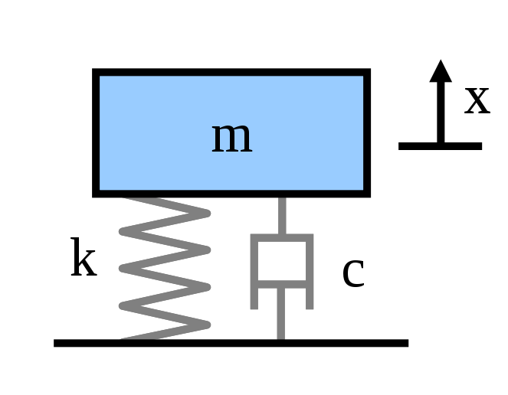
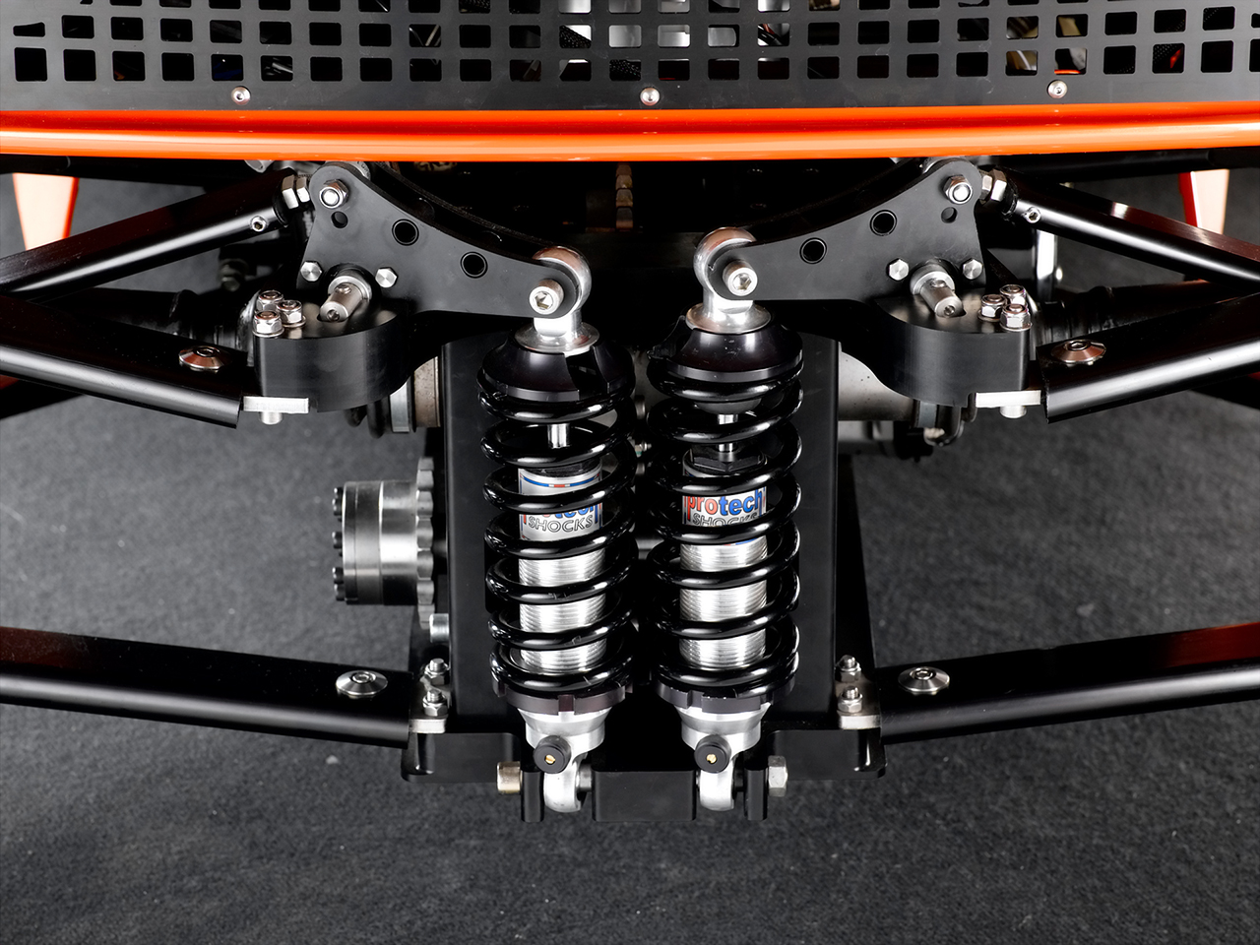
Implications
A first order system is a crude low-pass filter. For t’ > 10 a strong attenuation occurs.
Example: Spring – shock absorber (dashpot) system.
R

Slide 16
Implications, continued.
Example: Spring – shock absorber (dashpot) system.
Restoring force F_{spring} = -kX
Resistive force of F_{shock} = -R (dx/dt)
(For gas shocks remember Δp α F)
F_{spring} lags displacement by π (180º)
F_{shock} lags displacement by π/2 (90º)
F_{sp} + F_{sh} + F_{I} = 0
R

Slide 17
Implications, continued.
For low frequency input (α << 1, or long slow bumps):
F_{sh} ~ 0 and F_{sp} is large
For high frequency input (α >>1, or closely space bumps):
F_{I}(t) leads displacement by π/2
F_{sh} is large (dx/dt is large)
The shock absorber prevents the car from bouncing when it goes over a big bump.
If the displacement is small the F_{sp} is small.

Slide 18
Summary
Many environmental sensors demonstrate first order response characteristics.
The time constant, τ, of a first order system can be determined from the response to a step decrease:
ln(X₀/X_{t}) = t/τ
τ = t/(ln(X₀/X_{t}))
The finite response time of a sensor not only dictates the sampling time necessary to respond to a step change, it also:
Creates a time lag between an observed signal and its observation.
Induces an amplitude depression for high frequency fluctuations.

Slide 19
Summary
As an example, fires produce both black carbon and CO₂, but think of correlating the slow response Aethalometer with the fast response Picarro. You need to know the first order response time τ for each instrument. Correlating bumps or spikes requires adjusting for both lag and amplitude. This is in addition to any lag caused by different transport times between inlet and detector.

Slide 20
Next Time
The time response, X, of a first order system can be described by a linear first order ODE.

