Slide 1
AOSC 634/458R
Air Sampling and Analysis
Lecture 1
Measurement Theory
Performance Characteristics of instruments
Nomenclature and static response
Can you download Picarro data?
Copyright Brock et al. 1984; Dickerson 2019

Slide 2
Static Response
Sensor output in response to many,
unchanging input points.
.
:
:
..
..
..
:
..
.
..
.
..
Output
..
..
:
.
..
::
.
:
..
..
:
..
} bias or zero offset
..
..
Input

Slide 3
Static Response
I = Input, atmospheric, oceanic, or other environmental signal.
O = Output, sensor response voltage, current, counts, etc.
Nomenclature varies but concepts are fundamental.
Sensitivity – slope of I/O diagram.
Bias (zero offset) – Y intercept. Mass flow controllers are a good example.
Range – max to min measureable.
Span – max minus min.
Linearity – how well the calibration curve fits a straight line.
Resolution – the smallest change in the input that can produce a change in the output.

Slide 4
Primary vs. secondary variables
Example - a pressure transducer sensitive to temperature.

Slide 5
UV absorption instruments
The [O₃] indicated is actually a molecular number density. The mixing ratio (ppb) has to be corrected for air temperature and pressure.
The ozone instrument has sensitivity to a secondary input – air density.

Slide 7
Example of threshold, a cup anemometer with static friction.
Indicated wind speed
Input - Actual wind speed

Slide 8
Additional Nomenclature
I don't like the traditional definitions of "precision" and "accuracy" given in Brock’s book, but they are in common use among meteorologists. Here are alternative definitions in common use by analytical chemists and meteorologists.
Precision - The standard deviation of a series of measurements made under constant conditions.

Slide 10
A metric oftern more useful than “accuracy”

Slide 11
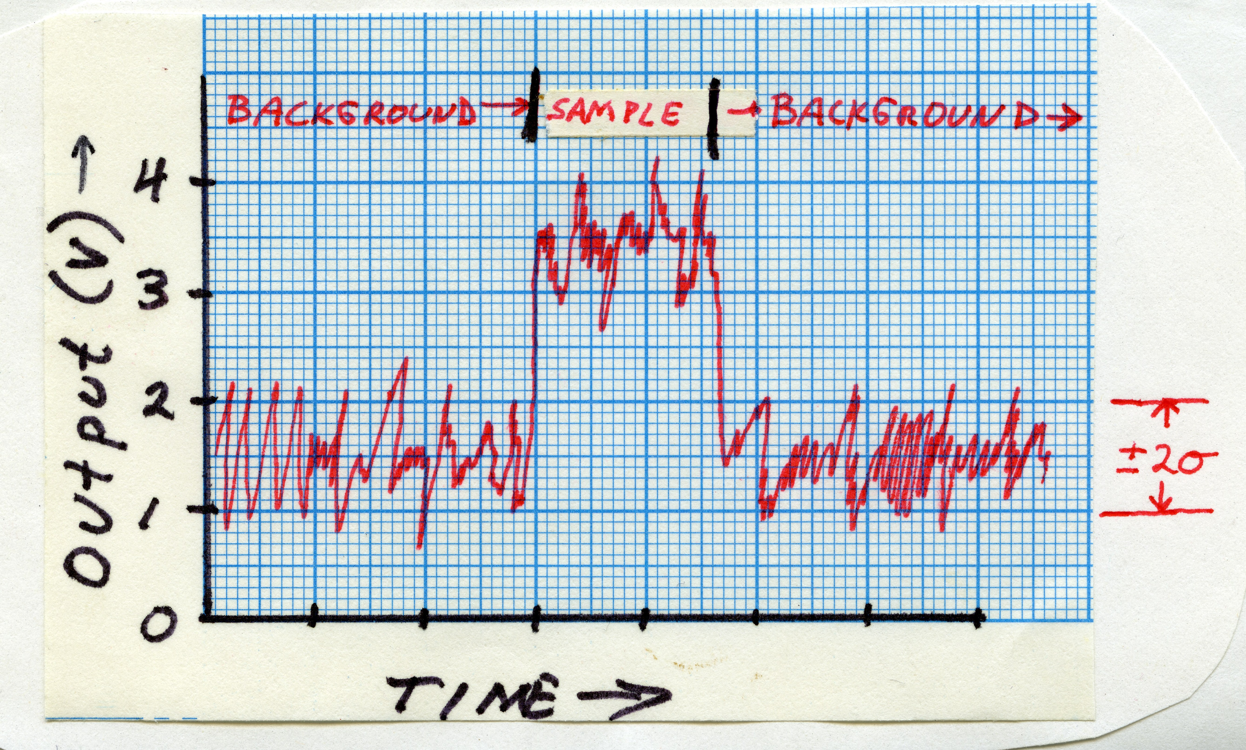
Detection limit- Also called lowest detectable level, this is the concentration or amount below which an instrument cannot provide meaningful information. Because several definitions are common use, a good paper will define the detection limit used. Consider an atomic emission spectrometer that produces a net output of 2 V for an aqueous solution of 2.0 μM Na⁺, and a background signal with Gaussian noise with a standard deviation of 0.25 V when the signal integration time is 1 s. The signal-to-noise ratio is 2:1 for [Na⁺] of 2.0 μM for ±2σ. For a rainwater or aerosol sample then, the detection limit for sodium is 1.0 μM at a signal-to-noise ratio of 1:1 with a 95% confidence interval for a 1 s integration time. Again, the detection limit might be better for longer sampling times, but the experimenter must prove this.

Slide 12
Summary
There are may “figures of merit” for an instrument or measurement.
What is best depends on the application at hand.
For example do you want an instrument that is fast and sensitive for flux measurements of aircraft observations, or one that is stable and insensitive to temperature and pressure for monitoring? Example CH₄ or CO₂ flux from the surface vs. global trend monitoring.

