Slide 1
Shale Gas Production via Hydraulic Fracturing
Modified from AOSC 433/633 & CHEM 433/633
Ross Salawitch & Tim Canty
Russ Dickerson
▪ Overview of shale gas production via horizontal drilling and hydraulic fracturing (aka fracking)
▪ Concerns about shale gas production:
  − Earthquakes
  − Contamination of ground water
  − Air quality (surface O₃ precursors and PM_{2.5})
  − Climate (fugitive release of CH₄)

Slide 2
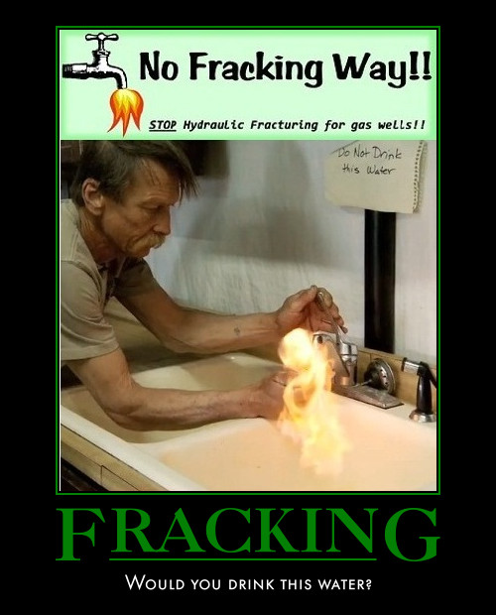
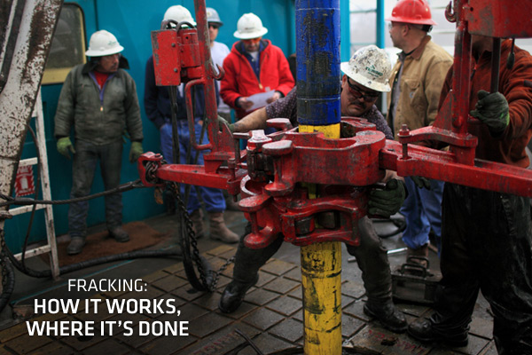
Is natural gas really better for global climate than coal?

Slide 3
Is natural gas really better for global climate than coal?

Slide 4
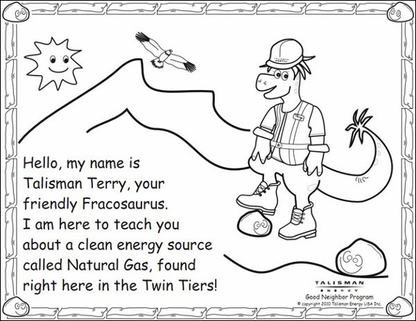
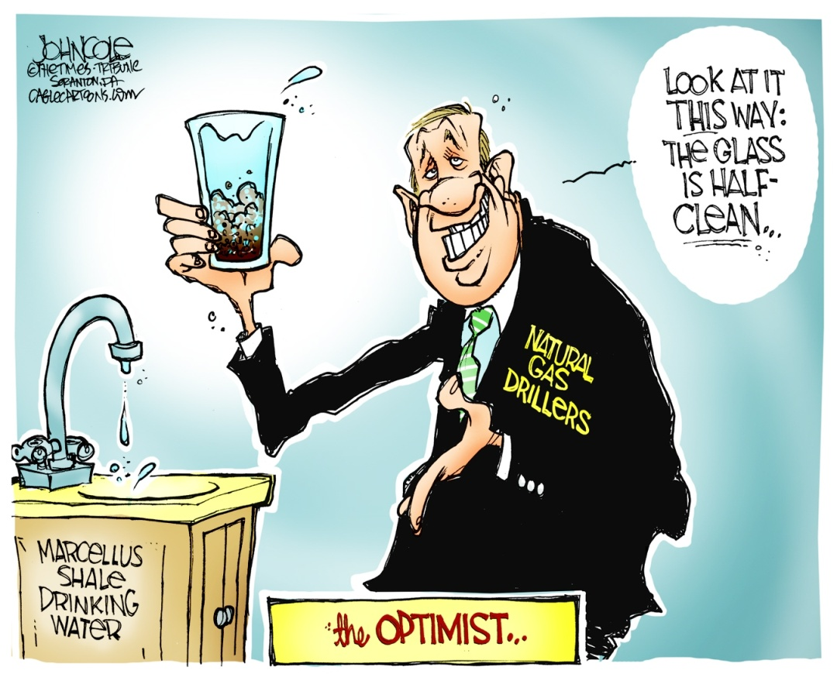
Is natural gas really better for global climate than coal?

Slide 5
Flight track color coated with CO₂ mixing ratio
[CO₂]-350 ppm

Slide 6
Test flights for Picarro CH₄ /CO₂ analyzer on 8/15/2013
AM spiral up
AM spiral down
PM spiral down
PM spiral up

Slide 7
CH₄ vertical profiles over Millington, rural eastern MD
8/15/2013
PM descent
~ 15 km to NE

Slide 8
CO₂ vertical profiles over MD1 (Millington, MD) on 8/15/2013

Slide 9
From NASA’s
DISCOVER-AQ July 2011
CH₄ looks like a pollutant.

Slide 11
But sometimes CH₄ looks like a product of wetland forest activity

Slide 12
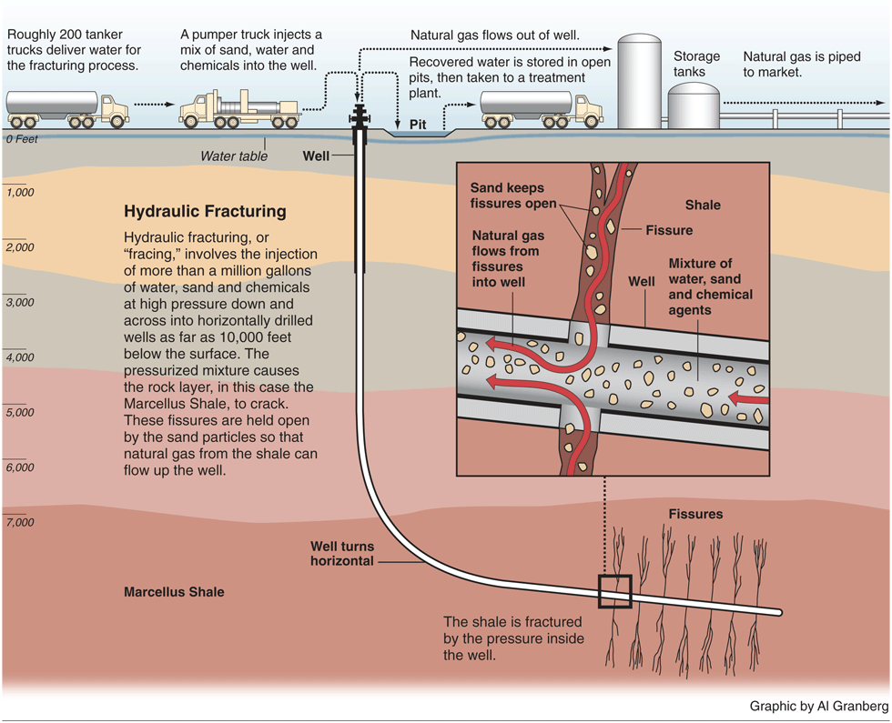
Hydraulic Fracturing
▪ Pumping of chemical brine to loosen deposits of natural gas from shale
▪ Extraction of CH₄ from shale gas became commercially viable in 2002/2003 when two mature
technologies were combined: horizontal drilling and hydraulic fracturing
▪ High-pressure fluid is injected into bore of the well at a pressure that fractures the rock
Shale gas fracturing of 2 mile long laterals
has been done for less than a decade
Image: http://www.propublica.org/images/articles/natural_gas/marcellus_hydraulic_graphic_090514.gif
Notes:
12

Slide 13
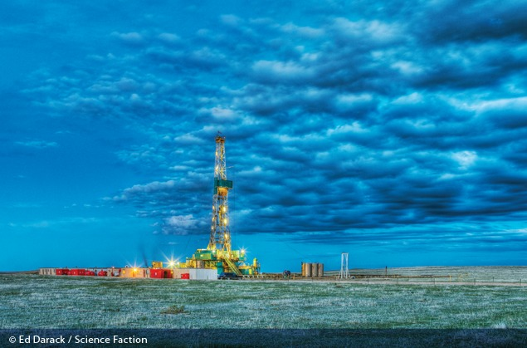
A hydraulic fracturing natural gas drilling rig on the Eastern Colorado plains.
In 2009 there were more than 38,000 natural gas wells in the state of Colorado.
Weinhold, Envir. Health Perspective, 2012: http://ehp.niehs.nih.gov/120-a272/

Slide 14
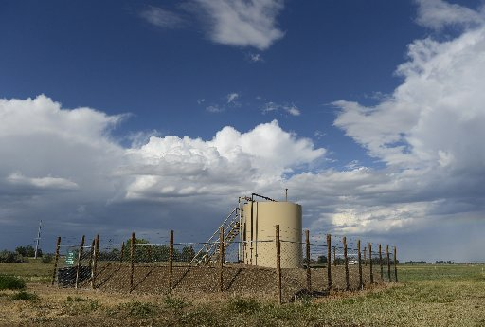
Storage tank of fracking well, Longmont, Colorado
http://www.timescall.com/portlet/article/html/imageDisplay.jsp?contentItemRelationshipId=4995872

Slide 15
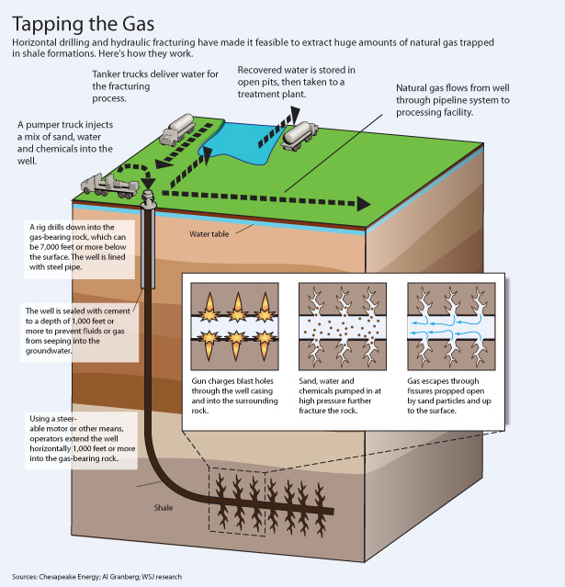
Proppant: solid material, typically treated sand or man-made ceramic materials, designed to keep an induced hydraulic
fracture open
Image: http://online.wsj.com/article/SB10001424052702303491304575187880596301668.html
Notes:
15

Slide 16
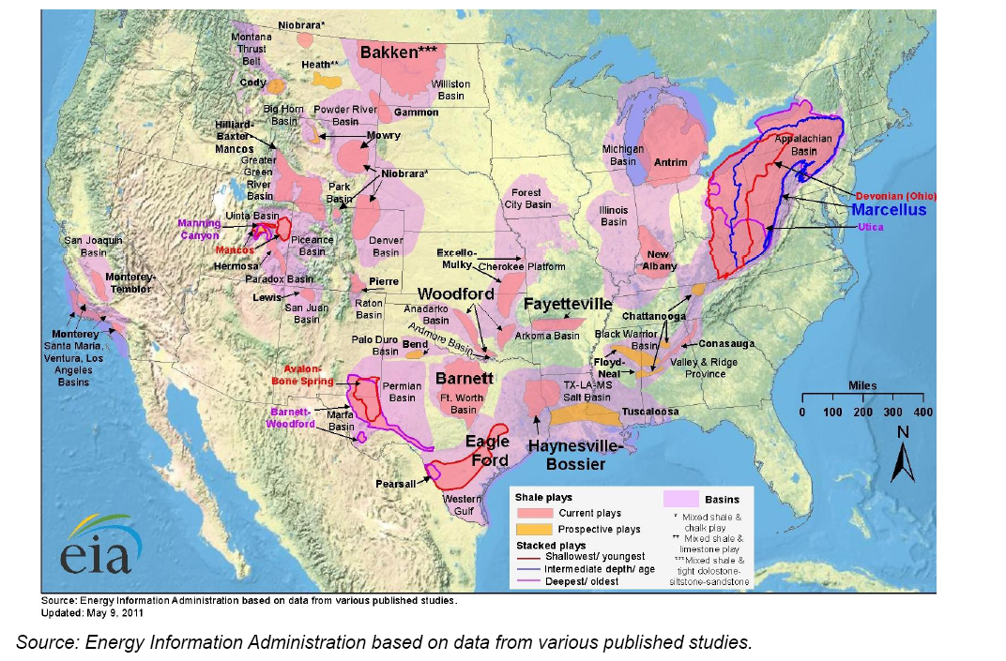
Lower 48 Hydraulic Fracturing Geography
http://photos.state.gov/libraries/usoecd/19452/pdfs/DrNewell-EIA-Administrator-Shale-Gas-Presentation-June212011.pdf
Notes:
16

Slide 17
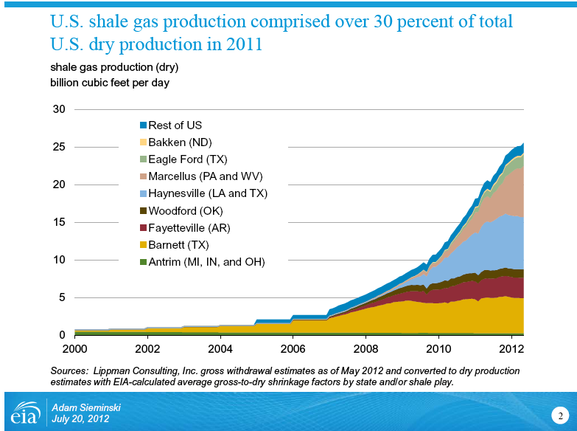

Shale Gas Production
Figure: http://www.eia.gov/pressroom/presentations/sieminski_07202012.pdf
Table: http://www.shalegas.energy.gov/resources/081811_90_day_report_final.pdf
Notes:
17

Slide 18
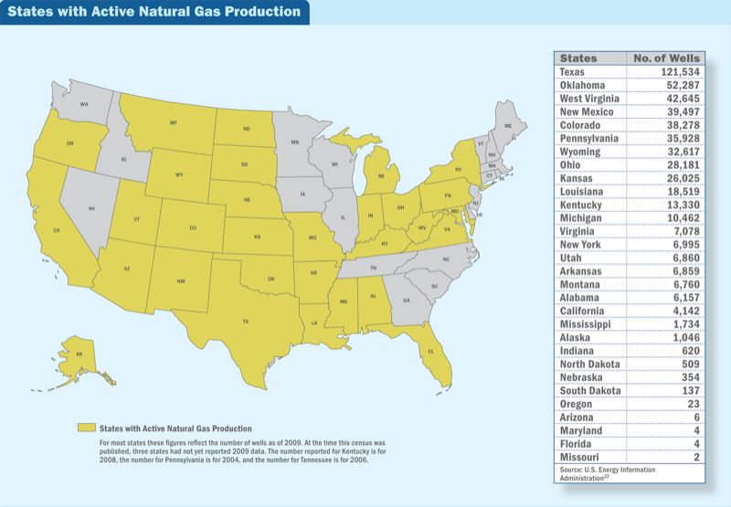
States with Active Natural Gas Production
as of 2009 (most states)
Weinhold, Envir. Health Perspective, 2012: http://ehp.niehs.nih.gov/120-a272/
Notes:
18

Slide 19
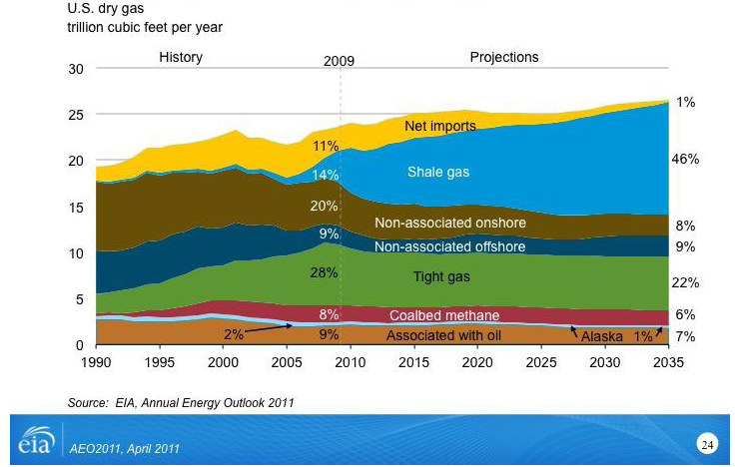

Shale Gas provides domestic source to meet U.S. consumer needs
2013
U.S. DOE 90 Day Shale Gas Subcommittee Interim Report (11 Aug 2011)
http://www.shalegas.energy.gov/resources/081811_90_day_report_final.pdf
Notes:
19

Slide 20
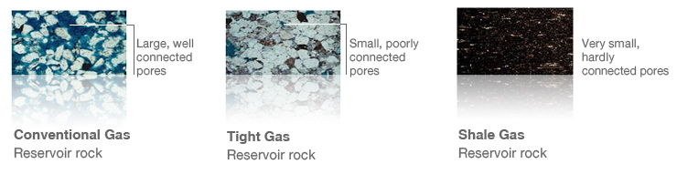
Shale Gas provides domestic source to meet U.S. consumer needs
Tight gas: CH₄ dispersed within low porosity silt or sand that create “tight fitting”
environment; has been extracted for many years using hydraulic fracturing
Shale gas: CH₄ accumulated in small bubble like pockets within layers sedimentary
rock such as shale, like tiny air pockets trapped in baked bread
Image:
http://www.wintershall.com/en/different-types-of-reserves-tight-gas-and-shale-gas.html
Notes:
20
Tight gas: CH4 that is dispersed within low-porosity silt or sand that create a “tight-fitting” environment for the gas.
Shale gas: CH4 accumulated in tiny bubble-like pockets within layered sedimentary rock such as shale, the way tiny air pockets are trapped in a loaf of bread as it bakes.

Slide 21
States with Active Natural Gas Production
as of 2009 (most states)
Weinhold, Envir. Health Perspective, 2012: http://ehp.niehs.nih.gov/120-a272/
Notes:
21

Slide 22
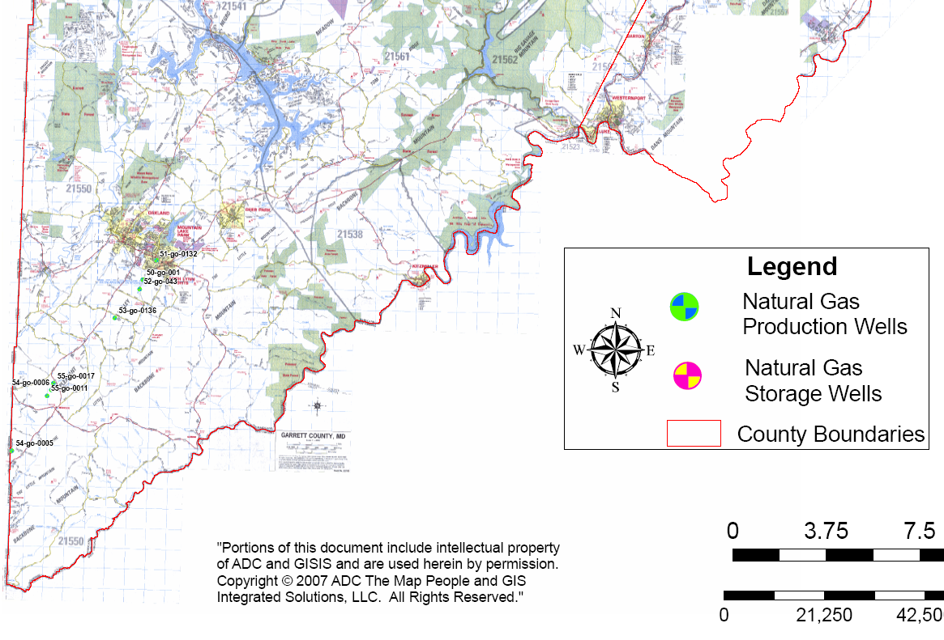
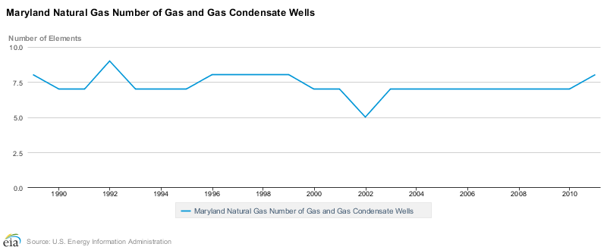
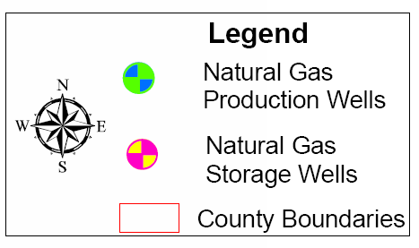
Md Active Natural Gas Production
Garrett County
Map: www.mde.state.md.us/programs/Land/mining/Non%20Coal%20Mining/Documents/www.mde.state.md.us/assets/document/mining/NaturalGasWellLocationMap.pdf
Chart: http://www.eia.gov/dnav/ng/hist/na1170_smd_8a.htm
Notes:
22

Slide 23
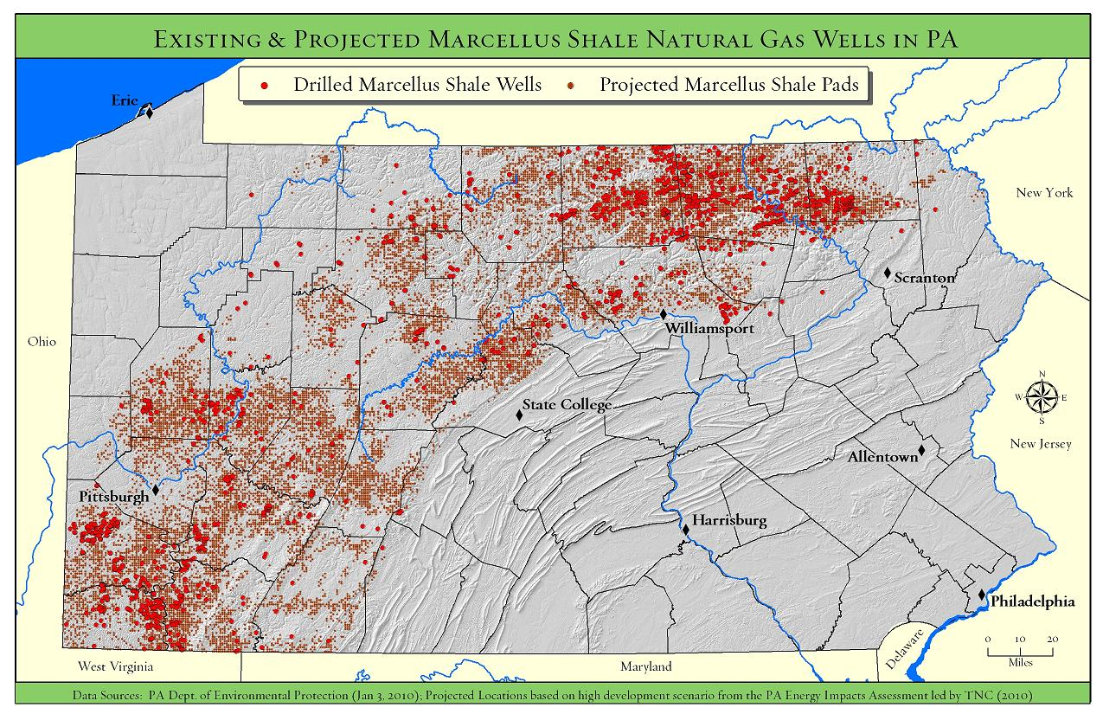
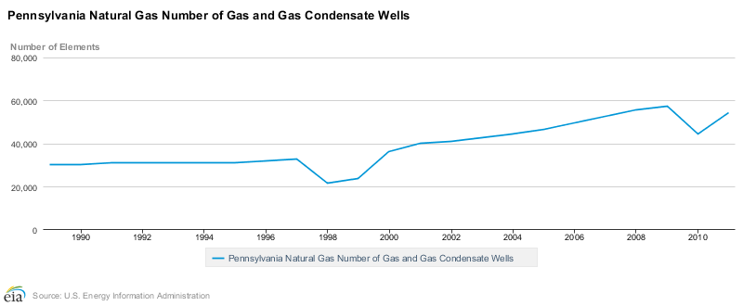
PA Active Natural Gas Production
Map: http://www.nature.org/ourinitiatives/regions/northamerica/unitedstates/pennsylvania/explore/marcellus-existing-projected-50pct.jpg
Chart: http://www.eia.gov/dnav/ng/hist/na1170_spa_8a.htm
Notes:
23

Slide 24
Shale Gas Production & Public Policy
▪ U.S. imports very little CH₄ (some imports from Canada)
▪ Price of CH₄ has fallen by a factor of 2 since 2008
▪ Concerns about shale gas production fall into four categories:
  − Earthquakes
  − Contamination of ground water
  − Air quality (surface O₃ precursors and PM_{2.5})
  − Climate (fugitive release of CH₄)
▪ Former U.S. Dept of Energy Secretary David Chu (served 21 Jan 2009 to 22 April 2013)
commissioned two reports from the Shale Gas Subcommittee of the Secretary of Energy
Advisory Board (SEAB) to “identify measures that can be taken to reduce the environmental
impact and to help assure the safety of shale gas production”
▪ First report (11 Aug 2011) identified 20 action items (see table, next slide)
▪ Second report (18 Nov 2011) outlined recommendations for implementation of action items
▪ Notably absent from the reports is extended discussion of earthquake issue
▪ On 17 April 2012 Reducing Air Pollution from EPA issued new standards for the oil and
natural gas industry that will not fully take effect until 1 Jan 2015
http://www.epa.gov/airquality/oilandgas/pdfs/20120417presentation.pdf
SEAB Shale Gas Subcommittee Reports:
http://www.shalegas.energy.gov/resources/081811_90_day_report_final.pdf
http://www.shalegas.energy.gov/resources/111811_final_report.pdf
Notes:
24

Slide 25
Shale Gas Production & Public Policy
▪ First report (11 Aug 2011) identified 20 action items
1. Improve public information about shale gas operations
2. Improve communication among state and federal regulators
3. Improve air quality: 4. Industry to measure CH₄ & other air pollutants 5. Launch federal interagency effort to establish GHG footprint over shale gas extraction life cycle 6. Encourage companies & regulators to reduce emissions using proven technologies & best practices
7. Protect water quality: 8. Measure and report composition of water stock 9. Manifest all transfers of water among different locations 10. Adopt best practices for well casing, cementing, etc & conduct micro-seismic surveys to “assure that hydraulic growth is limited to gas producing formations” 11. Field studies of possible CH4 leakage from shale gas wells to water reservoirs 12. Obtain background water quality measurements (i.e., CH₄ levels in nearby waters prior to drilling)
Protect water quality (cont.): 13. Measure and report composition of water stock
14. Disclosure of fracking fluid composition
15. Reduce use of diesel fuel for surface power
16. Manage short-term & cumulative impacts on communities & wild life: sensitive areas can be deemed off-limit to drilling and support infrastructure through an appropriate science based process
17. Create shale gas industry organiz. to promote best practice, giving priority attention to: 18. Air: emission measurement & reporting at various points in production chain 19. Water: Pressure testing of cement casing & state-of-the-art technology to confirm formation isolation
20. Increase R & D support from Administration & Congress to promote technical advances such as the move from single well to multiple-well pad drilling
http://www.shalegas.energy.gov/resources/081811_90_day_report_final.pdf
Notes:
25

Slide 26
Shale Gas Production & Public Policy
▪ First report (11 Aug 2011) identified 20 action items
1. Improve public information about shale gas operations
2. Improve communication among state and federal regulators
3. Improve air quality: 4. Industry to measure CH₄ & other air pollutants 5. Launch federal interagency effort to establish GHG footprint over shale gas extraction life cycle 6. Encourage companies & regulators to reduce emissions using proven technologies & best practices
7. Protect water quality: 8. Measure and report composition of water stock 9. Manifest all transfers of water among different locations 10. Adopt best practices for well casing, cementing, etc & conduct micro-seismic surveys to “assure that hydraulic growth is limited to gas producing formations” 11. Field studies of possible CH4 leakage from shale gas wells to water reservoirs 12. Obtain background water quality measurements (i.e., CH₄ levels in nearby waters prior to drilling)
Footnote 25:
Extremely small micro-earthquakes are triggered as an integral part of shale gas development. While essentially all of these earthquakes are so small as to pose no hazard to the public or facilities (they release energy roughly equivalent to a gallon of milk falling of a kitchen counter), earthquakes of larger (but still small) magnitude have been triggered during hydraulic fracturing operations and by the injection of flow-back water after hydraulic fracturing. It is important to develop a hazard assessment and remediation protocol for triggered earthquakes to allow operators and regulators to know what steps need to be taken to assess risk and modify, as required, planned field
operations.
http://www.shalegas.energy.gov/resources/081811_90_day_report_final.pdf
Notes:
26

Slide 27
Shale Gas Production & Public Policy
▪ First report (11 Aug 2011) identified 20 action items
Protect water quality (cont.): 13. Measure and report composition of water stock
14. Disclosure of fracking fluid composition
15. Reduce use of diesel fuel for surface power
16. Manage short-term & cumulative impacts on communities & wild life: sensitive areas can be deemed off-limit to drilling and support infrastructure through an appropriate science based process
17. Create shale gas industry organiz. to promote best practice, giving priority attention to: 18. Air: emission measurement & reporting at various points in production chain 19. Water: Pressure testing of cement casing & state-of-the-art technology to confirm formation isolation
20. Increase R & D support from Administration & Congress to promote technical advances such as the move from single well to multiple-well pad drilling
The Subcommittee shares the prevailing view that the risk of fracturing fluid leakage into drinking water sources through fractures made in deep shale reservoirs is remote. Nevertheless the Subcommittee believes there is no economic or technical reason to prevent public disclosure of all chemicals in fracturing fluids, with an exception for genuinely proprietary information. While companies and regulators are moving in this direction, progress needs to be
accelerated in light of public concern.
http://www.shalegas.energy.gov/resources/081811_90_day_report_final.pdf
Notes:
27

Slide 28
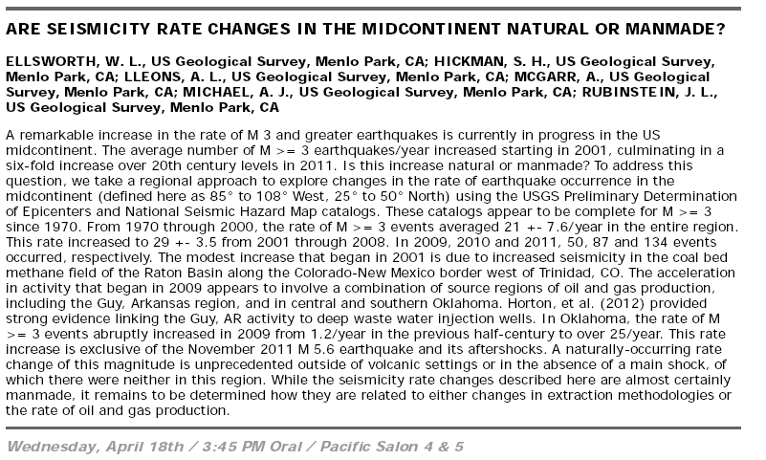
Concern #1: Earthquakes
2012 Seismological Society of America meeting
Notes:
28

Slide 29
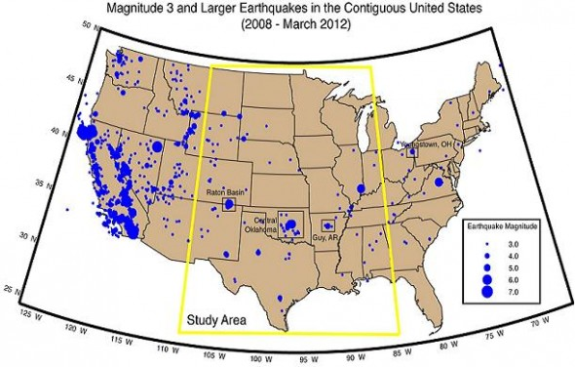
Concern #1: Earthquakes
Ellsworth’s study area:
http://www.esa.org/esablog/ecology-in-the-news/increase-in-magnitude-3-earthquakes-likely-caused-by-oil-and-gas-production-but-not-fracking
Notes:
29

Slide 30
Concern #1: Earthquakes
Ellsworth’s study suggests:
▪ Deep waste water injection wells are the culprit, especially if in the vicinity of a fault
▪ Increased fluid pressure in pores of the rock can reduce the slippage strain between rock layers
▪ Speed of pumping is important (slow better than fast)
▪ On 19 June 2012, Dr. William Leath of the U.S. Geological Survey testified before the U.S.
Senate Committee on Energy and Natural Resources, stating:
  The injection and production practices employed in these technologies have, to varying degrees, the
  potential to introduce earthquake hazards
  Since the beginning of 2011 the central and eastern portions of the United States have experienced a
  number of moderately strong earthquakes in areas of historically low earthquake hazard. These include
  M4.7 in central Arkansas on Feb27, 2011; M5.3 near Trinidad, Colorado on Aug 23, 2011; M5.8 in central
  Virginia also on Aug 23, 2011; … M5.6 in central Oklahoma on Nov 6, 2011 … and M4.8 in east Texas on
  May 17, 2012. Of these only the central Virginia earthquake is unequivocally a natural tectonic earthquake.
  In all other cases, there is scientific evidence to at least raise the possibility that the earthquakes were
  induced by wastewater disposal or other oil- and gas-related activities.
  USGS scientists documented a seven-fold increase since 2008 in the seismicity of the central U.S., an
  increase largely associated with areas of wastewater disposal from oil, gas & coalbed methane production
USGS testimony:
First three bullets:
http://www.esa.org/esablog/ecology-in-the-news/increase-in-magnitude-3-earthquakes-likely-caused-by-oil-and-gas-production-but-not-fracking
USGS testimony:
http://www.usgs.gov/congressional/hearings/docs/leith_19june2012.DOCX
Notes:
30

Slide 31
Concern #1: Earthquakes
Ellsworth’s study suggests:
▪ Deep waste water injection wells are the culprit, especially if in the vicinity of a fault
▪ Increased fluid pressure in pores of the rock can reduce the slippage strain between rock layers
▪ Speed of pumping is important (slow better than fast)
▪ On 19 June 2012, Dr. William Leath of the U.S. Geological Survey testified before the U.S.
Senate Committee on Energy and Natural Resources, stating:
  The injection and production practices employed in these technologies have, to varying degrees, the
  potential to introduce earthquake hazards
  Since the beginning of 2011 the central and eastern portions of the United States have experienced a
  number of moderately strong earthquakes in areas of historically low earthquake hazard. These include
  M4.7 in central Arkansas on Feb27, 2011; M5.3 near Trinidad, Colorado on Aug 23, 2011; M5.8 in central
  Virginia also on Aug 23, 2011; … M5.6 in central Oklahoma on Nov 6, 2011 … and M4.8 in east Texas on
  May 17, 2012. Of these only the central Virginia earthquake is unequivocally a natural tectonic earthquake.
  In all other cases, there is scientific evidence to at least raise the possibility that the earthquakes were
  induced by wastewater disposal or other oil- and gas-related activities.
  USGS scientists documented a seven-fold increase since 2008 in the seismicity of the central U.S., an
  increase largely associated with areas of wastewater disposal from oil, gas & coalbed methane production
USGS testimony:
See also:
Frohlich, Two-year survey comparing earthquake activity and injection-well locations in the Barnett Shale, Texas,
PNAS, 2012 http://www.pnas.org/content/early/2012/07/30/1207728109.full.pdf+html
which reaches similar conclusions
Notes:
31

Slide 32
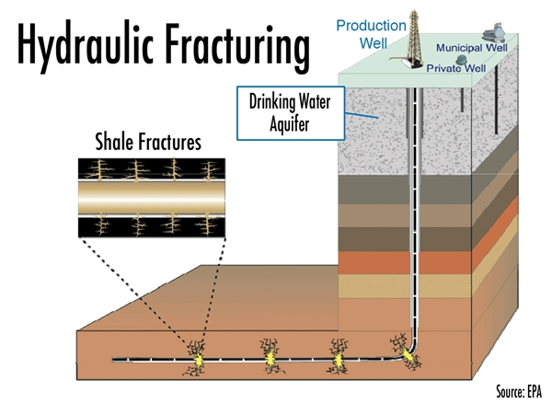
Concern #2: Water Quality
http://savethewater.org/wp-content/uploads/2013/02/Stock-Save-the-water-New-Study-Predicts-Fracking-Fluids-Will-Seep-Into-Aquifers-Within-Years.jpg
Notes:
32

Slide 33
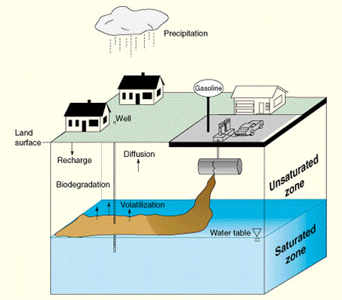
Concern #2: Water Quality
Spread of contaminants in ground water determined by
Dispersion – differential flow of water through small openings (pores)
in soil
Diffusion – random molecular (Brownian) motion of molecules in water
very slow in condensed phase.
Sorption – some chemicals may be absorbed by soil while others are adsorbed (adhere to surfaces)
Highly diffusive chemicals (e.g. MTBE) can spread very quickly even though ground water is relatively motionless.
http://toxics.usgs.gov/topics/gwcontam_transport.html
Notes:
33

Slide 34
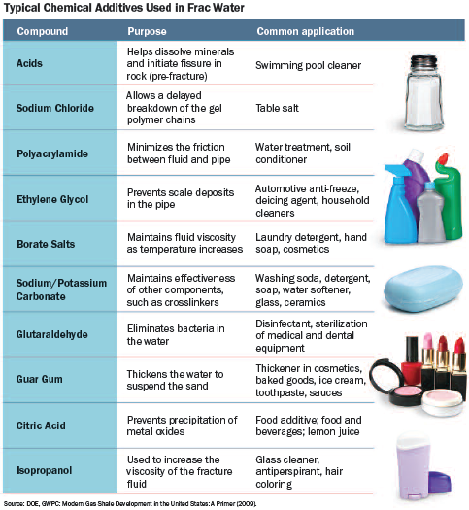
Concern #2: Water Quality
Benzene?
http://www.exxonmobilperspectives.com/2011/08/25/fracking-fluid-disclosure-why-its-important/
Notes:
34

Slide 35
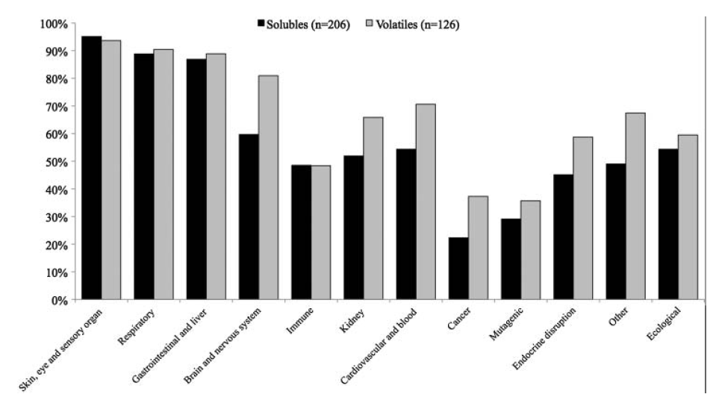
Concern #2: Water Quality
http://www.exxonmobilperspectives.com/2011/08/25/fracking-fluid-disclosure-why-its-important/
http://www.tandfonline.com/doi/pdf/10.1080/10807039.2011.605662
Many chemicals used in fracking have “everyday” uses …
We control how chemicals are used in homes, not the case for fracking
Notes:
35

Slide 36
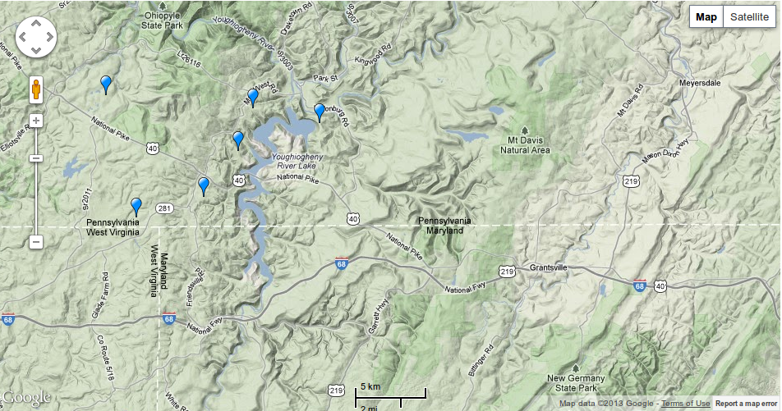
Fluid composition:
Concern #2: Water Quality
April 2011: www.fracfocus.org created as central disclosure registry for industry use
Currently, official disclosure venue for 10 states (Colorado, Louisiana, Mississippi, Montana, North Dakota, Ohio, Oklahoma, Pennsylvania, Texas, Utah)
Searchable database & Google map interface allow user to obtain info for individual wells
Notes:
36

Slide 37
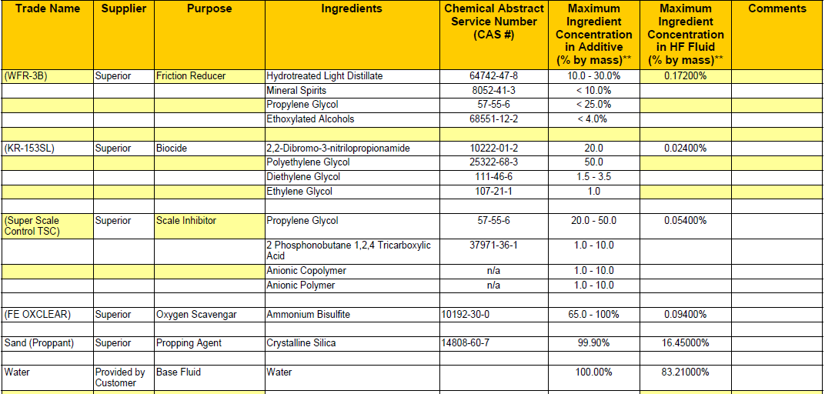
Fluid composition:
Concern #2: Water Quality
April 2011: www.fracfocus.org created as central disclosure registry for industry use
Currently, official disclosure venue for 10 states (Colorado, Louisiana, Mississippi, Montana, North Dakota, Ohio, Oklahoma, Pennsylvania, Texas, Utah)
Searchable database & Google map interface allow user to obtain info for individual wells
Notes:
37

Slide 38
Fluid composition:
Concern #2: Water Quality
April 2011: www.fracfocus.org created as central disclosure registry for industry use
Currently, official disclosure venue for 10 states (Colorado, Louisiana, Mississippi, Montana, North Dakota, Ohio, Oklahoma, Pennsylvania, Texas, Utah)
Searchable database & Google map interface allow user to obtain info for individual wells
Recent study by Harvard Law highlights flaws in this system:
  Timing of Disclosures: Site does not notify States if company submits late
  Substance of Disclosure: Site does not provide state specific forms, no minimum reporting standards
  Nondisclosures: Companies not required to disclose chemicals if they are considered a “trade secret”
  ~20% of all chemicals not reported.
  http://www.eenews.net/assets/2013/04/23/document_ew_01.pdf
Notes:
38

Slide 39
Concern #2: Water Quality
Research in progress:
  Isotopic analysis of sites in Pennsylvania indicate levels of CH₄ in wells near (< 1km) drilling sites 17 times higher than sites further away, Osborn et al. (PNAS, 2011)
  Independent analysis of these sites suggests elevated CH₄ due to topography rather than fracking, Molofsky et al. (Oil Gas J., 2011), no evidence of fracking fluid in wells, Schon (PNAS, 2011)
  Continued (unpublished) research supports notion that CH₄ in wells due to nearby drilling sites, Vengosh et al. (PEPS, 2013)
  Surface water quality degraded through release from treatment facilities (increases Cl–) and through release from wells (increases total suspended solids), Olmstead et al. (PNAS, 2012)
Notes:
39

Slide 40
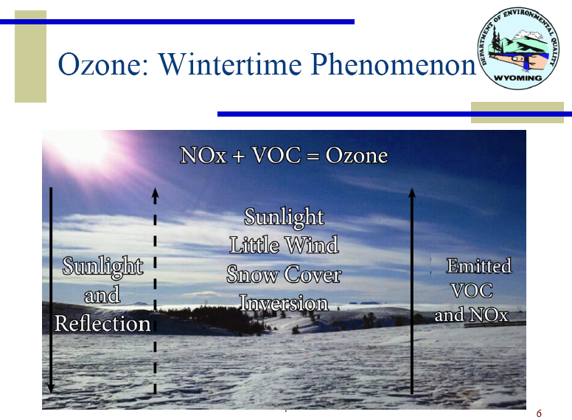
Concern #3: Air Quality (Case Study 1: Wyoming)
http://deq.state.wy.us/out/downloads/UGRBTaskForce02212012WDEQAQD.pdf
Notes:
40

Slide 41
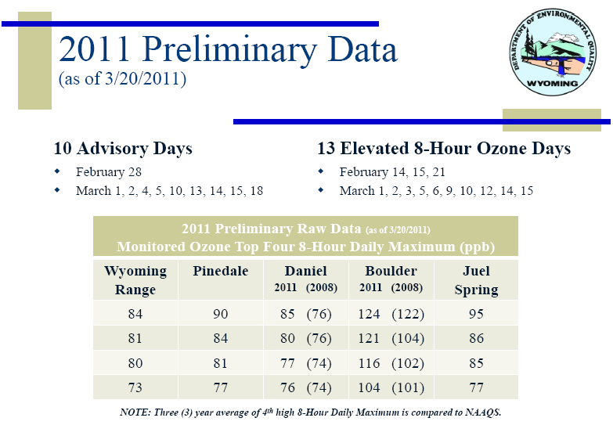
Concern #3: Air Quality (Case Study 1: Wyoming)
http://deq.state.wy.us/out/downloads/March22PublicMtg_2011Ozone_WDEQ.pdf
Notes:
41

Slide 42
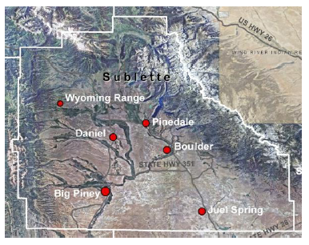
Concern #3: Air Quality (Case Study 1: Wyoming)
http://deq.state.wy.us/out/downloads/March22PublicMtg_2011Ozone_WDEQ.pdf
Notes:
42

Slide 43
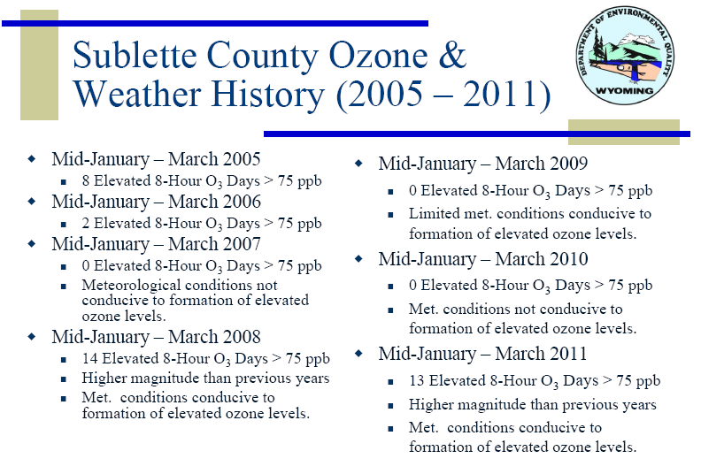
Concern #3: Air Quality (Case Study 1: Wyoming)
http://deq.state.wy.us/out/downloads/March22PublicMtg_2011Ozone_WDEQ.pdf
Notes:
43

Slide 44
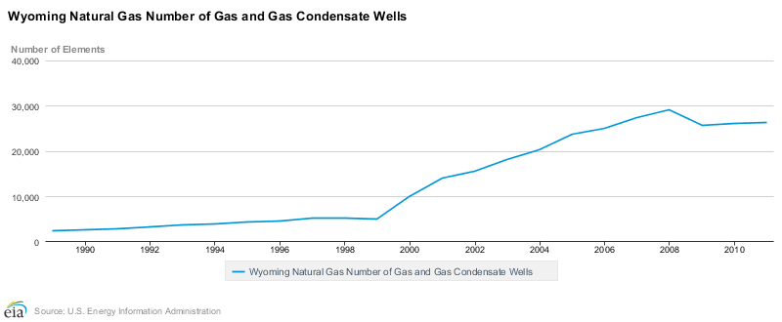
Concern #3: Air Quality (Case Study 1: Wyoming)
Chart: http://www.eia.gov/dnav/ng/hist/na1170_swy_8a.htm
http://deq.state.wy.us/out/downloads/March22PublicMtg_2011Ozone_WDEQ.pdf
Notes:
44

Slide 45
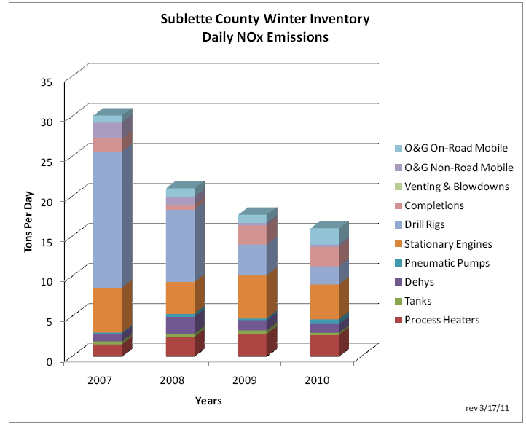
Concern #3: Air Quality (Case Study 1: Wyoming)
http://www.shalegas.energy.gov/resources/071311_corra.pdf
Notes:
45

Slide 46
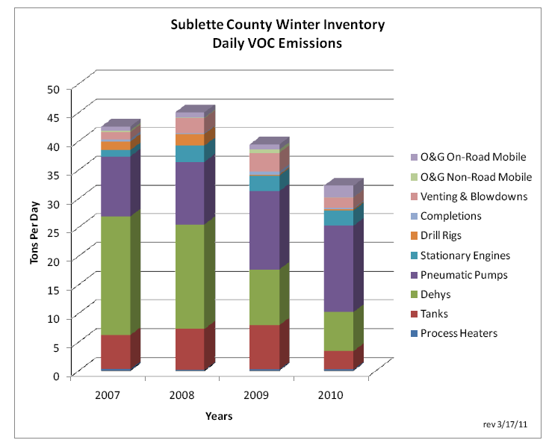
Concern #3: Air Quality (Case Study 1: Wyoming)
http://www.shalegas.energy.gov/resources/071311_corra.pdf
Notes:
46

Slide 47
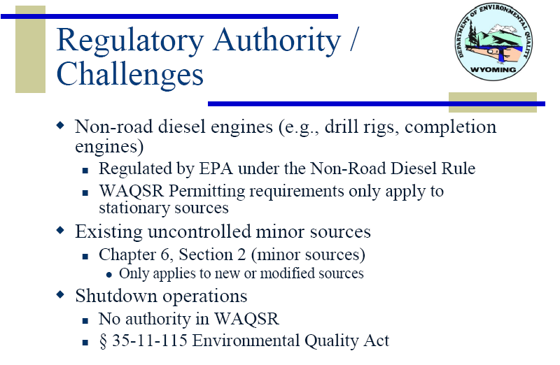
Concern #3: Air Quality (Case Study 1: Wyoming)
http://deq.state.wy.us/out/downloads/March22PublicMtg_2011Ozone_WDEQ.pdf
Notes:
47

Slide 48
Concern #3: Air Quality (Case Study 2: Maryland)
• Washington County contains ~10% of PA’s Marcellus wells
• Charleroi lies at the eastern edge of drilling operations (downwind)
• Drilling rights granted by residents at the end of 2008
NO₂ trends for summer time only
Surface Data
Satellite Data
Tim Vinciguerra et al., in preparation, 2013
Notes:
48

Slide 49
Concern #3: Air Quality (Case Study 2: Maryland)
• Washington County contains ~10% of PA’s Marcellus wells
• Charleroi lies at the eastern edge of drilling operations (downwind)
• Drilling rights granted by residents at the end of 2008
HCHO (formaldehyde) rising more rapidly post 2009
Satellite Data
Tim Vinciguerra et al., in preparation, 2013
Notes:
49

Slide 50
Concern #3: Air Quality (Case Study 2: Maryland)
• Washington County contains ~10% of PA’s Marcellus wells
• Charleroi lies at the eastern edge of drilling operations (downwind)
• Drilling rights granted by residents at the end of 2008
Surface O₃ during summer also rising since 2009
Surface Data
Tim Vinciguerra et al., in preparation, 2013
Notes:
50

Slide 51
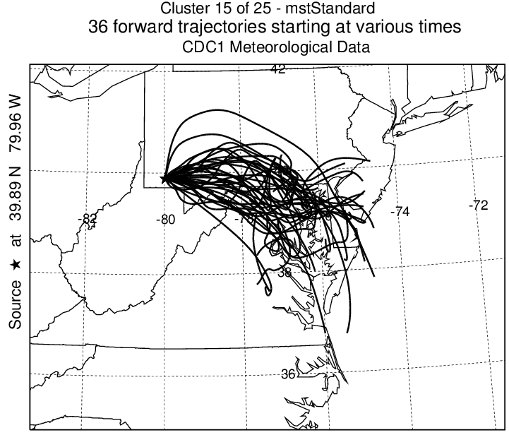
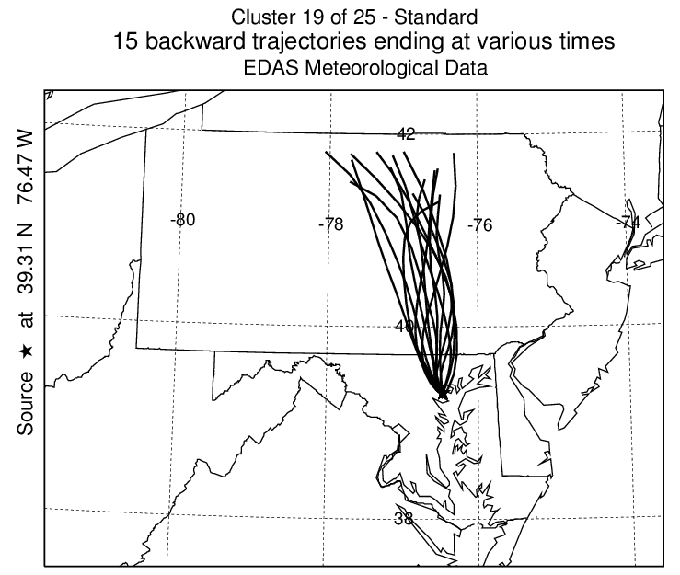
Concern #3: Air Quality (Case Study 2: Maryland)
• Air mass trajectories (meteorological modeling) show air parcels affected
by fracking can reach the Baltimore/DC region
Russ Dickerson et al., in preparation, 2013
Notes:
51

Slide 52
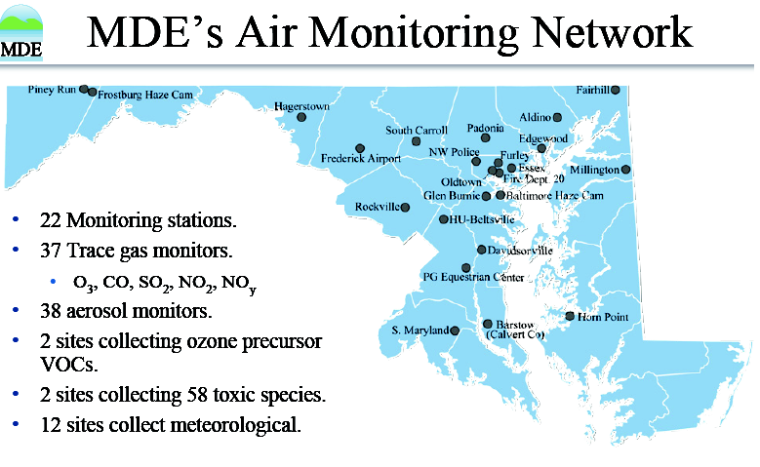
Concern #3: Air Quality (Case Study 2: Maryland)
• Air mass trajectories (meteorological modeling) show air parcels affected
by fracking can reach the Baltimore/DC region
• Fracking releases a stew of VOCs, including ethane (C₂H₆)
• Ethane and other VOCs measured at Essex MDE site
Russ Dickerson et al., in preparation, 2013
Notes:
52

Slide 53
Concern #3: Air Quality (Case Study 2: Maryland)
• Air mass trajectories (meteorological modeling) show air parcels affected
by fracking can reach the Baltimore/DC region
• Fracking releases a stew of VOCs, including ethane (C₂H₆)
• Ethane and other VOCs measured at Essex MDE site
Russ Dickerson et al., in preparation, 2013
Notes:
53

Slide 54
Concern #3: Air Quality (Case Study 2: Maryland)
• Air mass trajectories (meteorological modeling) show air parcels affected
by fracking can reach the Baltimore/DC region
• Fracking releases a stew of VOCs, including ethane (C₂H₆)
• Ethane and other VOCs measured at Essex MDE site
Russ Dickerson et al., in preparation, 2013
Notes:
54

Slide 55
Concern #3: Air Quality (Case Study 2: Maryland)
• Air mass trajectories (meteorological modeling) show air parcels affected
by fracking can reach the Baltimore/DC region
• Fracking releases a stew of VOCs, including ethane (C₂H₆)
• Ethane and other VOCs measured at Essex MDE site
Russ Dickerson et al., in preparation, 2013
Notes:
55

Slide 56
Concern #3: Air Quality (Case Study 2: Maryland)
• Air mass trajectories (meteorological modeling) show air parcels affected
by fracking can reach the Baltimore/DC region
• Fracking releases a stew of VOCs, including ethane (C₂H₆)
• Ethane and other VOCs measured at Essex MDE site
Russ Dickerson et al., in preparation, 2013
Notes:
56

Slide 57
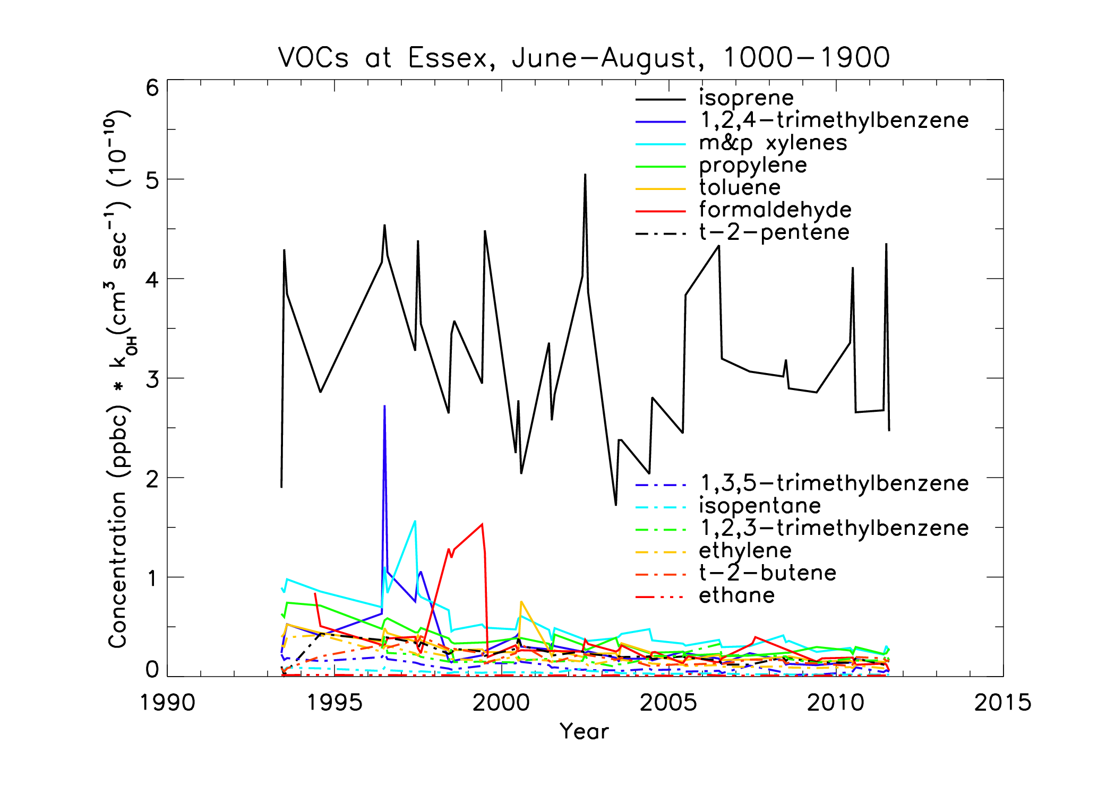
Concern #3: Air Quality (Case Study 2: Maryland)
• Air mass trajectories (meteorological modeling) show air parcels affected
by fracking can reach the Baltimore/DC region
• Fracking releases a stew of VOCs, including ethane (C₂H₆)
• Ethane and other VOCs measured at Essex MDE site
Russ Dickerson et al., in preparation, 2013
Notes:
57

Slide 58
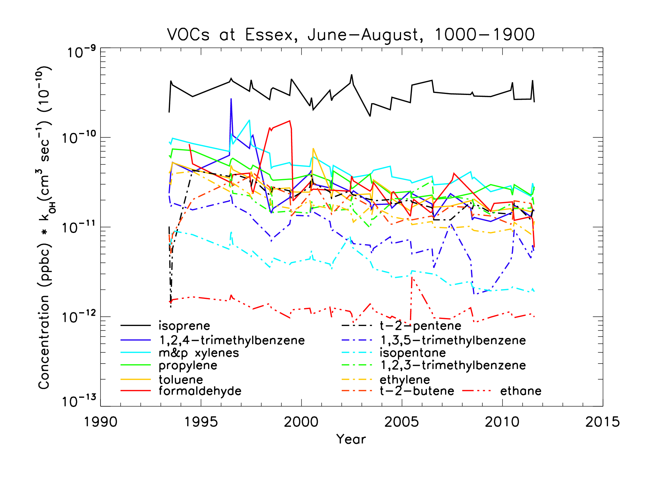
Concern #3: Air Quality (Case Study 2: Maryland)
• Air mass trajectories (meteorological modeling) show air parcels affected
by fracking can reach the Baltimore/DC region
• Fracking releases a stew of VOCs, including ethane (C₂H₆)
• Ethane and other VOCs measured at Essex MDE site
Russ Dickerson et al., in preparation, 2013
Notes:
58

Slide 59
Concern #4: Climate
Based on your knowledge of material presented so far in class (i.e., this is not in the reading), why is there a break-even point for leakage of CH₄ from fracking and, if the NOAA estimate is correct what are the consequences for global warming of a greater U.S. reliance on fracking?
Answer: there is a break even point because:
i) as shown in Lecture 18, Slide 28 (class version), under normal operating conditions w/ no leaks,
less CO₂ is released to the atmosphere per kWh if gas (CH₄) is used to generate electric power than if coal is used to generate electric power:
ii) however, since CH₄ has a larger GWP than CO₂, if CH₄ escapes via leakage rather than being
oxidized via combustion, then the net GWP of the sum of rising atmospheric CH₄ due to leakage
plus rising CO₂ following combustion of natural gas can exceed the GWP of rising CO₂ from
the combustion of fossil fuel, normalized to kWh generated from fracking and coal.
Fossil Fuel | GHG Output (pounds CO₂ per kWh)
Oil Sands | 5.6
Coal | 2.1
Oil | 1.9
Gas | 1.3
http://www.eia.gov/cneaf/electricity/page/co2_report/co2emiss.pdf
http://www.iop.org/EJ/abstract/1748-9326/4/1/014005
Notes:
59

Slide 60
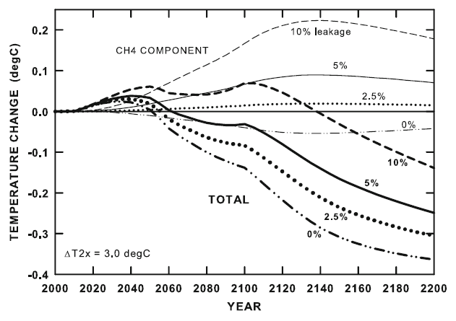
Concern #4: Climate
Climate Model Theory
The effects of methane leakage rates on global mean surface T. The top four curves (CH4 COMPONENT)
show the effects of CH₄ abundance changes only, while the bottom four curves (TOTAL) show the total effect of changes in CH₄, aerosols, and CO₂. The latter two effects are independent of the CH₄ leakage rate.
T. M. L. Wigley, Climatic Change, 2011
Notes:
60

Slide 61
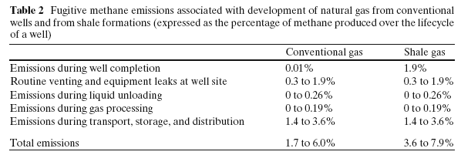
Concern #4: Climate
Modeling of Shale Gas Production
Howarth et al., Climatic Change, 2011
Notes:
61

Slide 62
Concern #4: Climate
Criticism of Modeling of Shale Gas Production
Cathles et al. believe Howarth et al.’s argument fails on four critical points:
1) The 7.9% upper limit for CH₄ leakage from well drilling exceeds a reasonable upper limit
by about a factor of 3
2) Importance of rapidly improving technology to reduce fugitive CH₄ emissions is dismissed
3) Study places undue emphasis on 20 yr time horizon:
  As Pierrehumbert (2011) explains, “Over the long term, CO₂ accumulates in the atmosphere
  like mercury in the body of a fish, whereas CH₄ does not. For this reason, it is the CO₂
emissions, and the CO₂ emissions alone, that determine the climate that humanity will
need to live with.”
4) CH₄ end use for heating is compared to coal end use for electricity generation:
“Electric industry has large stock of old, inefficient coal-fired electric generating plants
that could be considered for replacement by natural gas … The much lower construction
costs associated with gas power plants means modern gas technology will likely replace
this old coal technology as it is retired. If total (well drilling to delivery) leakage is limited
to less than 2% (which may be the current situation …) switching from coal to natural gas
would dramatically reduce the greenhouse impact of electricity generation.”
Cathles III et al., Climatic Change, 2012
Notes:
62

Slide 63
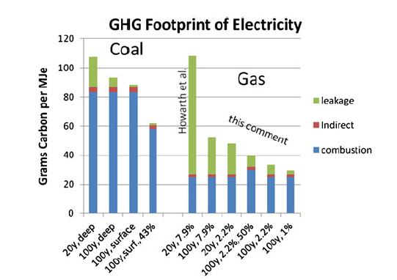
Concern #4: Climate
Criticism of Modeling of Shale Gas Production
Cathles et al. believe Howarth et al.’s argument fails on four critical points:
1) The 7.9% upper limit for CH₄ leakage from well drilling exceeds a reasonable upper limit
by about a factor of 3
2) Importance of rapidly improving technology to reduce fugitive CH₄ emissions is dismissed
3) Study places undue emphasis on 20 yr time horizon
4) CH₄ end use for heating is compared to coal end use for electricity generation
Cathles III et al., Climatic Change, 2012
Notes:
63

Slide 64
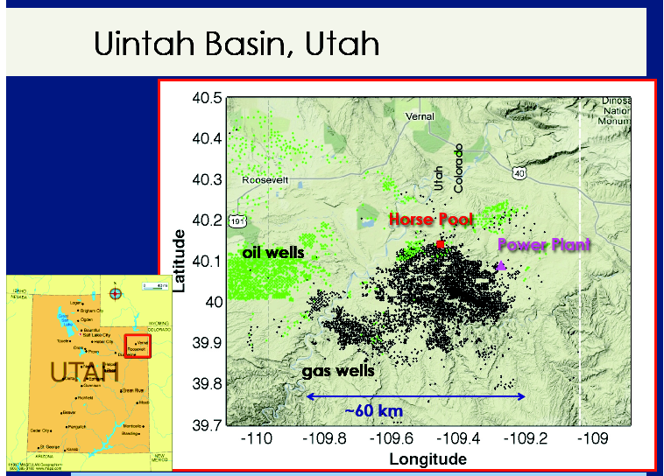
Concern #4: Climate
Observed fugitive CH₄ emissions
3 Jan 2013 Nature News article:
    Industry officials and some scientists contested the claim, but at the American Geophysical Union meeting in San Francisco last month, the research team of C. Sweeney & A. Karion reported preliminary results from a field study in the Uinta Basin of Utah suggesting even higher rates of methane leakage: an eye-popping 9% of the total production. This figure is nearly double the cumulative loss rates estimated from industry data
http://www.nature.com/news/methane-leaks-erode-green-credentials-of-natural-gas-1.12123
A. Karion et al., Geophys. Res. Lett., 2013
Notes:
64

Slide 65
Closing thoughts
Karion et al., GRL 2013
CH4 Leakage rate 6-12%
Allen et al. PNAS, 9/16/12
CH4 Leakage rate <0.5%

