Slide 1
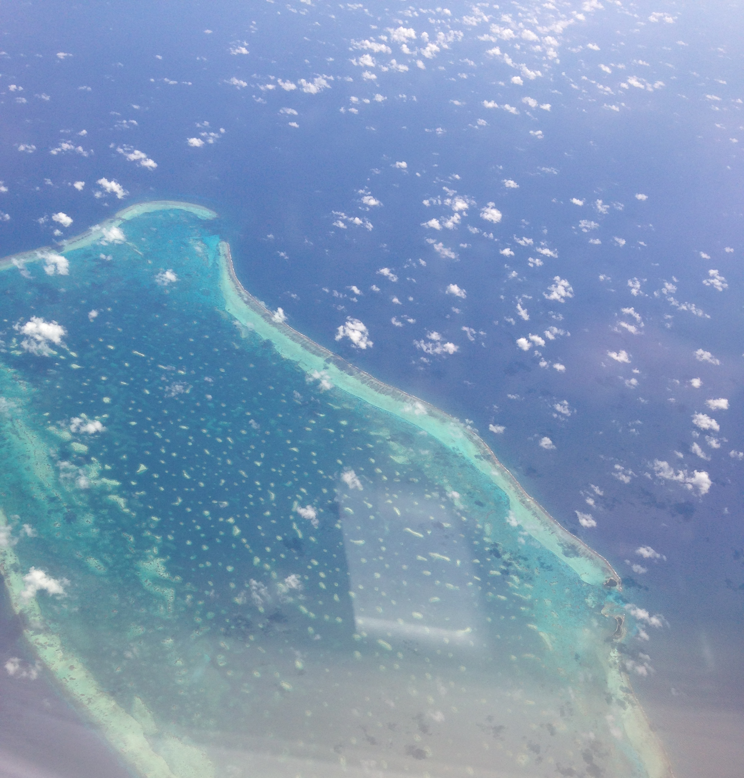

Basic Ocean Chemistry
AOSC 620
Why do we care?
Source of much food.
Sink for much CO₂ and acids.
Biodiversity.
Great store and transport of heat.
Source of water vapor.
Wallace & Hobbs Chapt. 2.

Slide 2


Slide 3
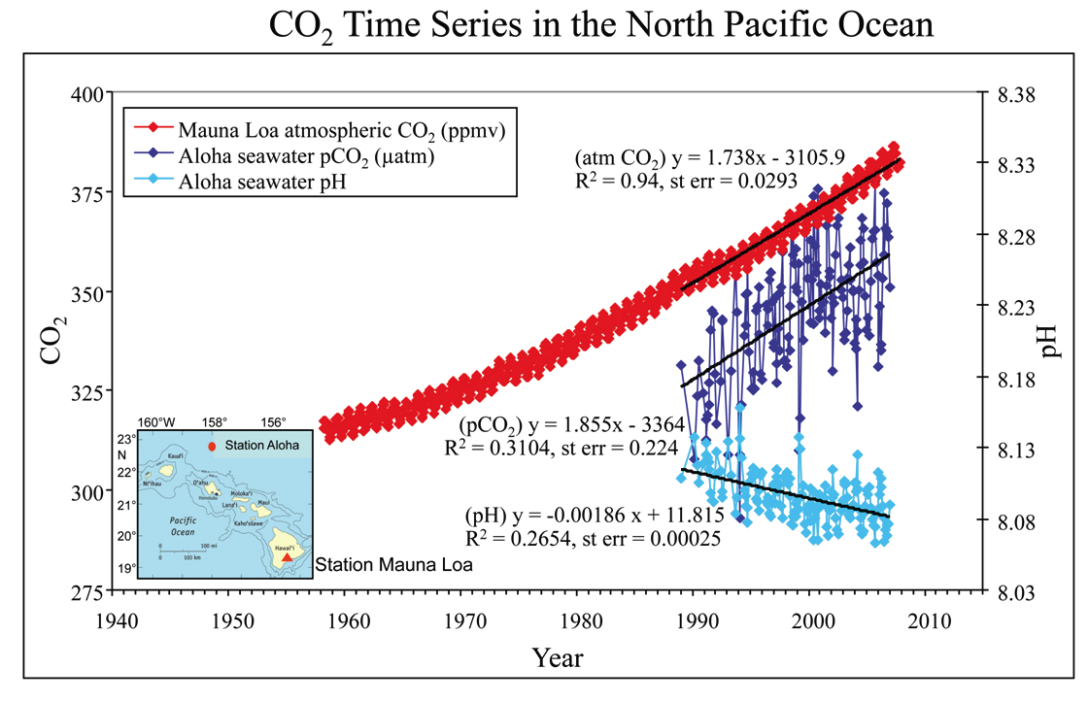
cf Feely et al, 2009
Notes:
Time series of atmospheric CO2 at Mauna Loa (in ppmv) and surface ocean pH and pCO2 (μatm) at Ocean Station Aloha in the subtropical North Pacific Ocean. Note that the increase in oceanic CO2 over the last 17 years is consistent with the atmospheric increase within the statistical limits of the measurements. Mauna Loa data: Dr. Pieter Tans, NOAA/ESRL (http://www.esrl.noaa.gov/gmd/ccgg/trends); HOTS/Aloha data: Dr. David Karl, University of Hawaii (http://hahana.soest.hawaii.edu) (modified after Feely, 2008). Cf Feely et al

Slide 4
Important Issues
Mean composition.
Response to changing input.
pH and biota
Nutrients color and NPP.
Source of NaCl, halogens, S, and organic aerosol.
Ocean Acidification

Slide 5
Key Concepts
A buffered solution is resistant to pH change such as buffered aspirin, blood plasma (~0.14M Na⁺), and sea water (~0.2 M Na⁺).
Buffer – a solution containing like amounts of a weak acid HB plus its conjugate base B–.
Carbonic acid, H₂CO₃, is a weak acid.
HB_{aq} = H⁺ + B–

Slide 6
Key Concepts, continued
4. In a solution of a weak acid plus its conjugate base ion, such as carbonic acid plus a carbonate salt such as sodium carbonate, the concentration of the acid HB and base B– are nearly constant and change only a little as acid or base are added.
[HB] ≈ [HB]₀
[B–] ≈ [B–]₀

Slide 7
Sodium bicarbonate, NaHCO₃ plus
Sodium chloride, NaCl
Yields a buffer pH = 10.
Monobasic potassium phosphate NaH₂PO₄ plus
Dibasic potassium phosphate Na₂HPO₄
Yields a buffer pH = 7.

Slide 8
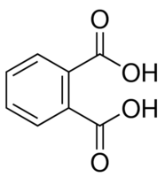
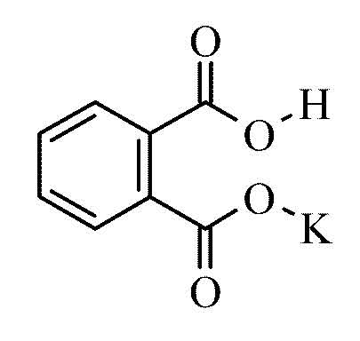
Phthalic acid plus Potassium Acid Phthalate
Yields a buffer pH = 4.

Slide 9
Key Concepts, continued
4. In a solution of a weak acid plus its conjugate base, such as carbonic acid plus sodium carbonate, the concentration of the acid HB and base B– are nearly constant and change only a little as acid or base are added.
[HB] ≈ [HB]₀
[B–] ≈ [B–]₀
5. The oceans are buffered and were long thought impervious to acids.
6. Le Chatêlier’s principle – when a system at equilibrium is disturbed it will respond to partly counteract the disturbance. The added H⁺ makes more acid HB.

Slide 10
Let’s look at pure water (rainwater is pure compared to seawater) and see how the pH changes with increasing CO₂. Assume today’s barometric pressure 1013 hPa = 1.00 atm. Thus the partial pressure of CO₂ is the same as its mixing ratio.
In water CO₂ reacts slightly, but [H₂CO₃] remains constant as long as the partial pressure of CO₂ remains constant.

Slide 11
Let’s repeat the calculation from Lecture 3 with this increase in CO₂:
H⁺ = (1.36x10⁻⁵ x 4.30x10⁻⁷ )^{½} = 2.42x10⁻⁶ →
pH = -log(2.42x10⁻⁶) = 5.616
Compared to 5.638 for 380 ppm CO₂ . Slightly more acid.
But rainwater is not buffered, and sea water is.
Note K_{a1} is an equilibrium constant more generally written K_{eq}.

Slide 12
Let’s consider a buffered system of carbonic acid and bicarbonate such as NaHCO₃ (Alka Seltzer).

Slide 13
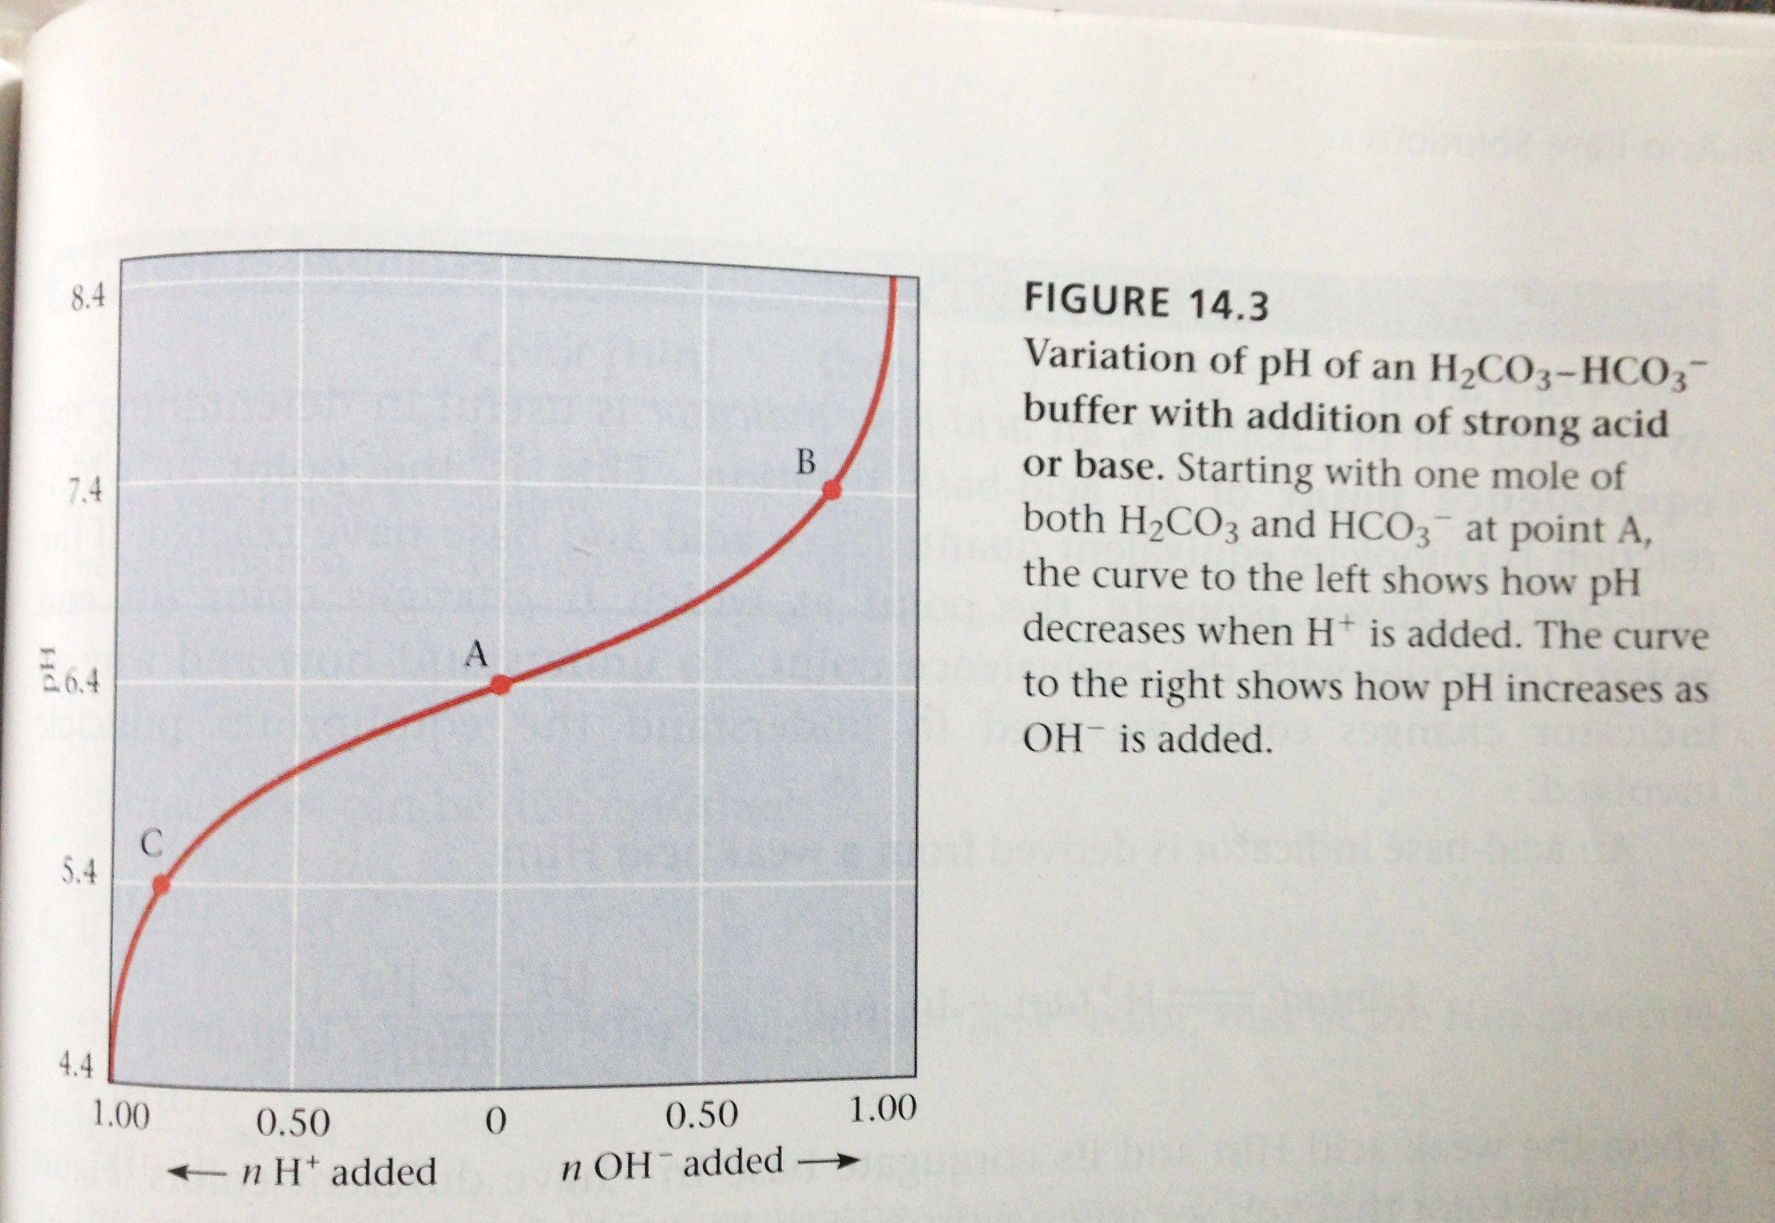
Blood ➔
A buffer made of equal molar solutions of carbonic acid and sodium bicarbonate will keep a pH of ~6.35 if small amounts of acid or base are added. Blood is better buffered for acids than bases.

Slide 14
Blood and seawater have a lot in common. Blood is a salt solution buffered at pH 7.4 due in part to the carbonate system. This dissolved HCO₃– plays a major role in respiration. In the lungs the bicarbonate is converted back to CO₂ where it is exhaled.
In seawater are dissolved substantial concentrations of minerals, and if the concentration of bicarbonate from erosion is just ~6x10⁻⁴ M then the pH will be ~8.

Slide 15
Buffering capacity refers to the ability of a water body to maintain a healthy pH despite the addition of acids. The higher the concentration of the conjugate salts (carbonates and bicarbonates in blood and natural waters) the greater the buffering capacity. Dissolved Ca, K, and Mg improve the buffering capacity of fresh water. In the ocean it’s Na, Mg, and Ca.
CO₂ _{(aq)} + H₂O = H₂CO₃ = HCO₃⁻ + H⁺ = CO₃²⁻ + 2 H⁺.

Slide 16
So far we have only considered carbon dioxide and bicarbonate, but to be more complete we must include carbonate. The second proton is bound more tightly:
CO₂ _{(aq)} + H₂O = H₂CO₃ = HCO₃⁻ + H⁺ = CO₃²⁻ + 2 H⁺.
K_{a1} = 4.30x10⁻⁷
K_{a2} = 5.61x10⁻¹¹

Slide 17
CO₂ _{(aq)} + H₂O = H₂CO₃ = HCO₃⁻ + H⁺ = CO₃²⁻ + 2 H⁺
Solving the two equilibrium equations simultaneously.
As dissolved CO₂ (H₂CO₃) goes up so goes H⁺ and the pH goes down.

Slide 18
For sea water at equilibrium:
With similar equations for the other components. The term on the far right is sometimes referred to total dissolved inorganic carbon or DIC. The dissociation constants and solubility all vary with temperature, but the principle is sound.

Slide 19
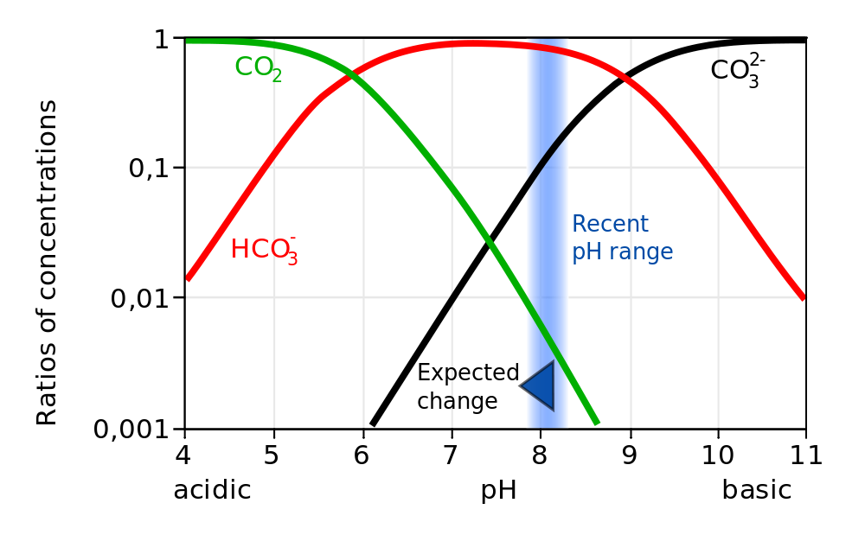

Slide 20
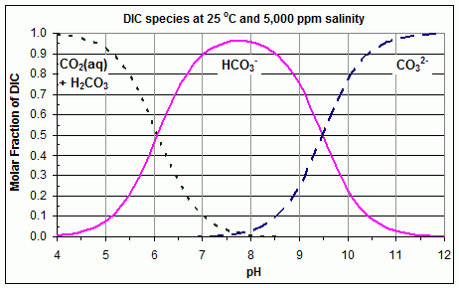

Slide 21
Increasing acidity may have a range of adverse consequences, including depressing metabolic rates and immune responses in some organisms, dissolving shells, and coral bleaching. Decreasing oxygen levels can kill off algae.

Slide 22
Carbonates enter the ocean as salts such as Na₂CO₃. The solubility of CaCO₃ in cold water is low, 1.4x10⁻³ g/100 ml, while the solubility of CaSO₄ is much higher, 0.209 g/100 ml. This is why marble and limestone sculptures are stable in clean rainwater, but not in acid rain and why CaCO₃ seashells are stable. Add acid to any of these:
2H⁺ + CaCO₃ -> H₂O + Ca²⁺ + CO₂ ⬆

Slide 23
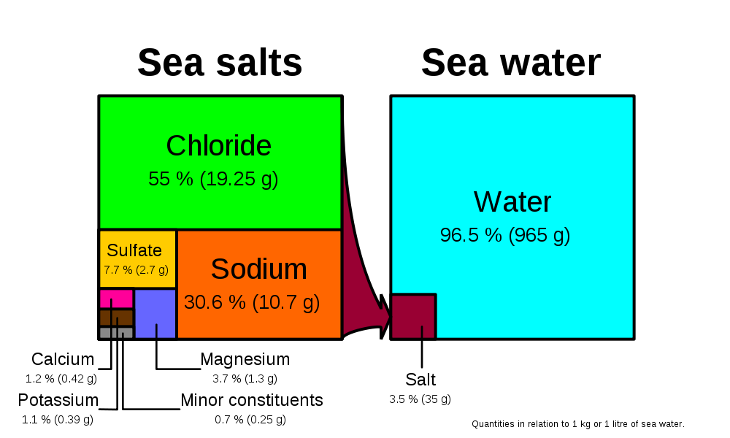
Seawater composition by mass. Carbon is about 0.002 M.

Slide 25
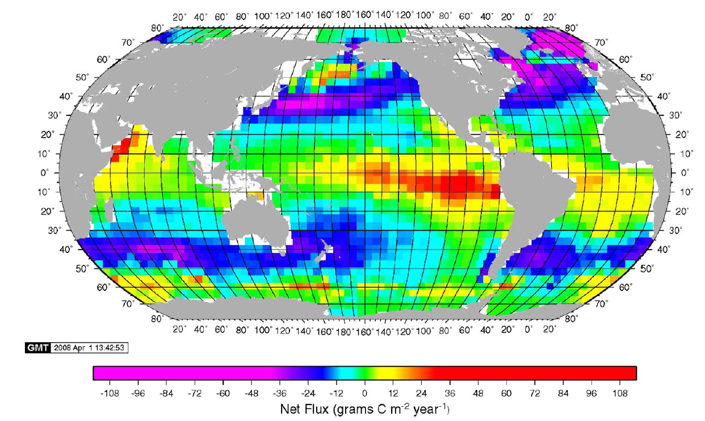
Chapter 3: Air-sea interface
Mean annual CO₂ flux across the air water interface
Takahashi, T., et al., 2009, Climatological mean and decadal change in surface ocean pCO₂, and net sea–air CO₂ flux over the global oceans, Deep-Sea Research II, 56, 554–577

Slide 28
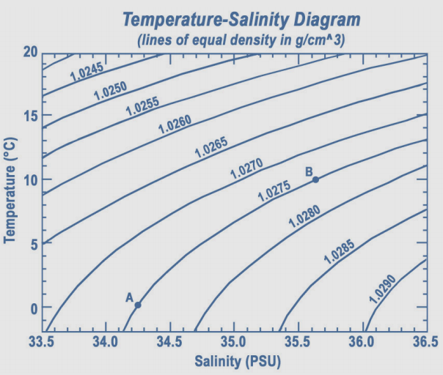

Slide 29
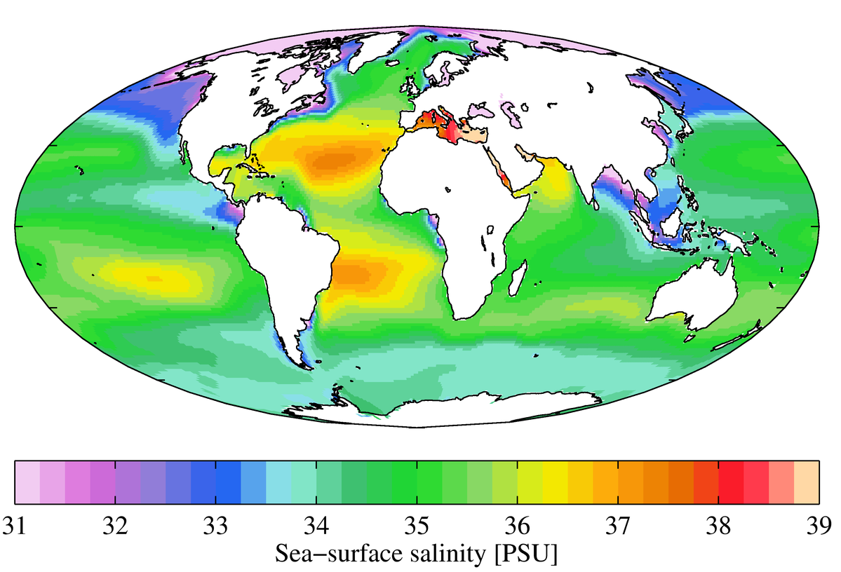

Slide 30
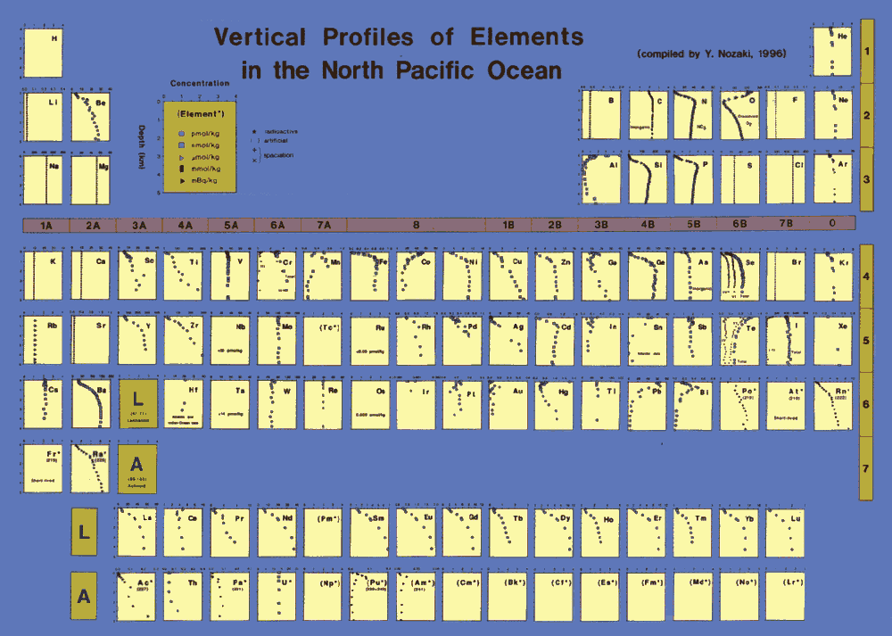
Chapter 1: Introduction
You find practically all elements in seawater

Slide 31
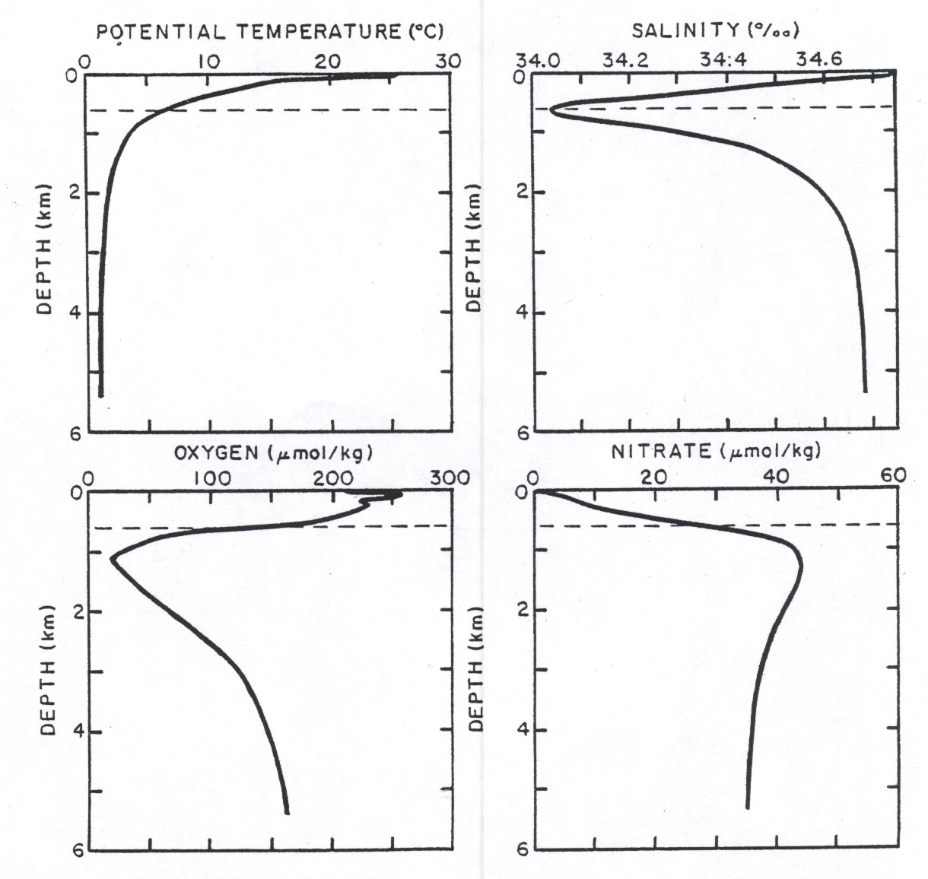
Chapter 5: Organic matter export and remineralisation
GEOSECS
Station 214
32º N 176º W
North Pacific
Broecker & Peng, 1982, Tracers in the Sea, ELDIGIO.

Slide 34
Osmotic Pressure
Osmotic pressure, π, in directly proportional to to molarity, M.
Using R in 0.0821 L•atm/mol•K
Seawater contains ~35 g/L or 35/58.5 = 0.6 M salt.
Salt upon dissolving generates two ions.
π = 1.2•0.0821•298 = 29 atm (~400 psi)

Slide 35
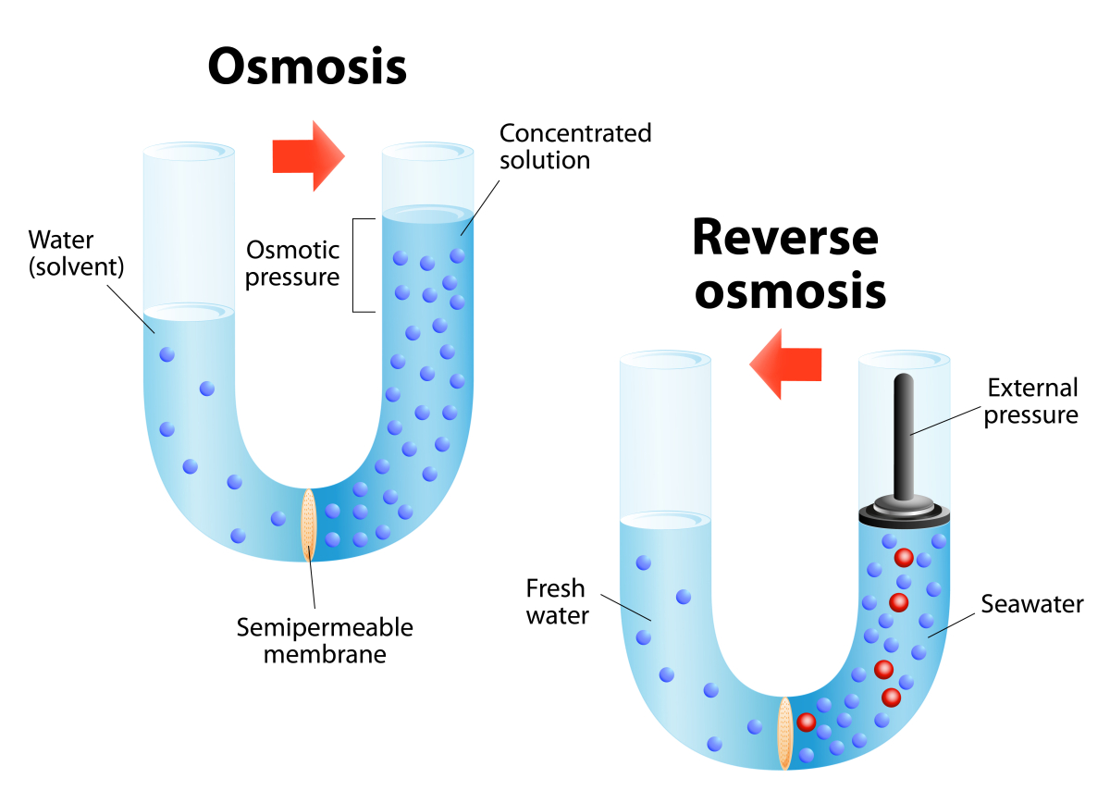

Slide 36
Summary
We can calculate the change in pH and carbonate expected in the oceans due to rising atmospheric CO₂.
The oceans are buffered, but can still see a change in pH.
This change is deleterious to sea life esp that dependent on CaCO₃ shells.
N cycling comes later.

Slide 37
