Slide 1
Welcome to AOSC200: Weather and Climate Discussion
Section 104 and 202
TA: Joey Knisely

Slide 2
Outline
Welcome
About Your TA
About this course
About the Discussion

Slide 3
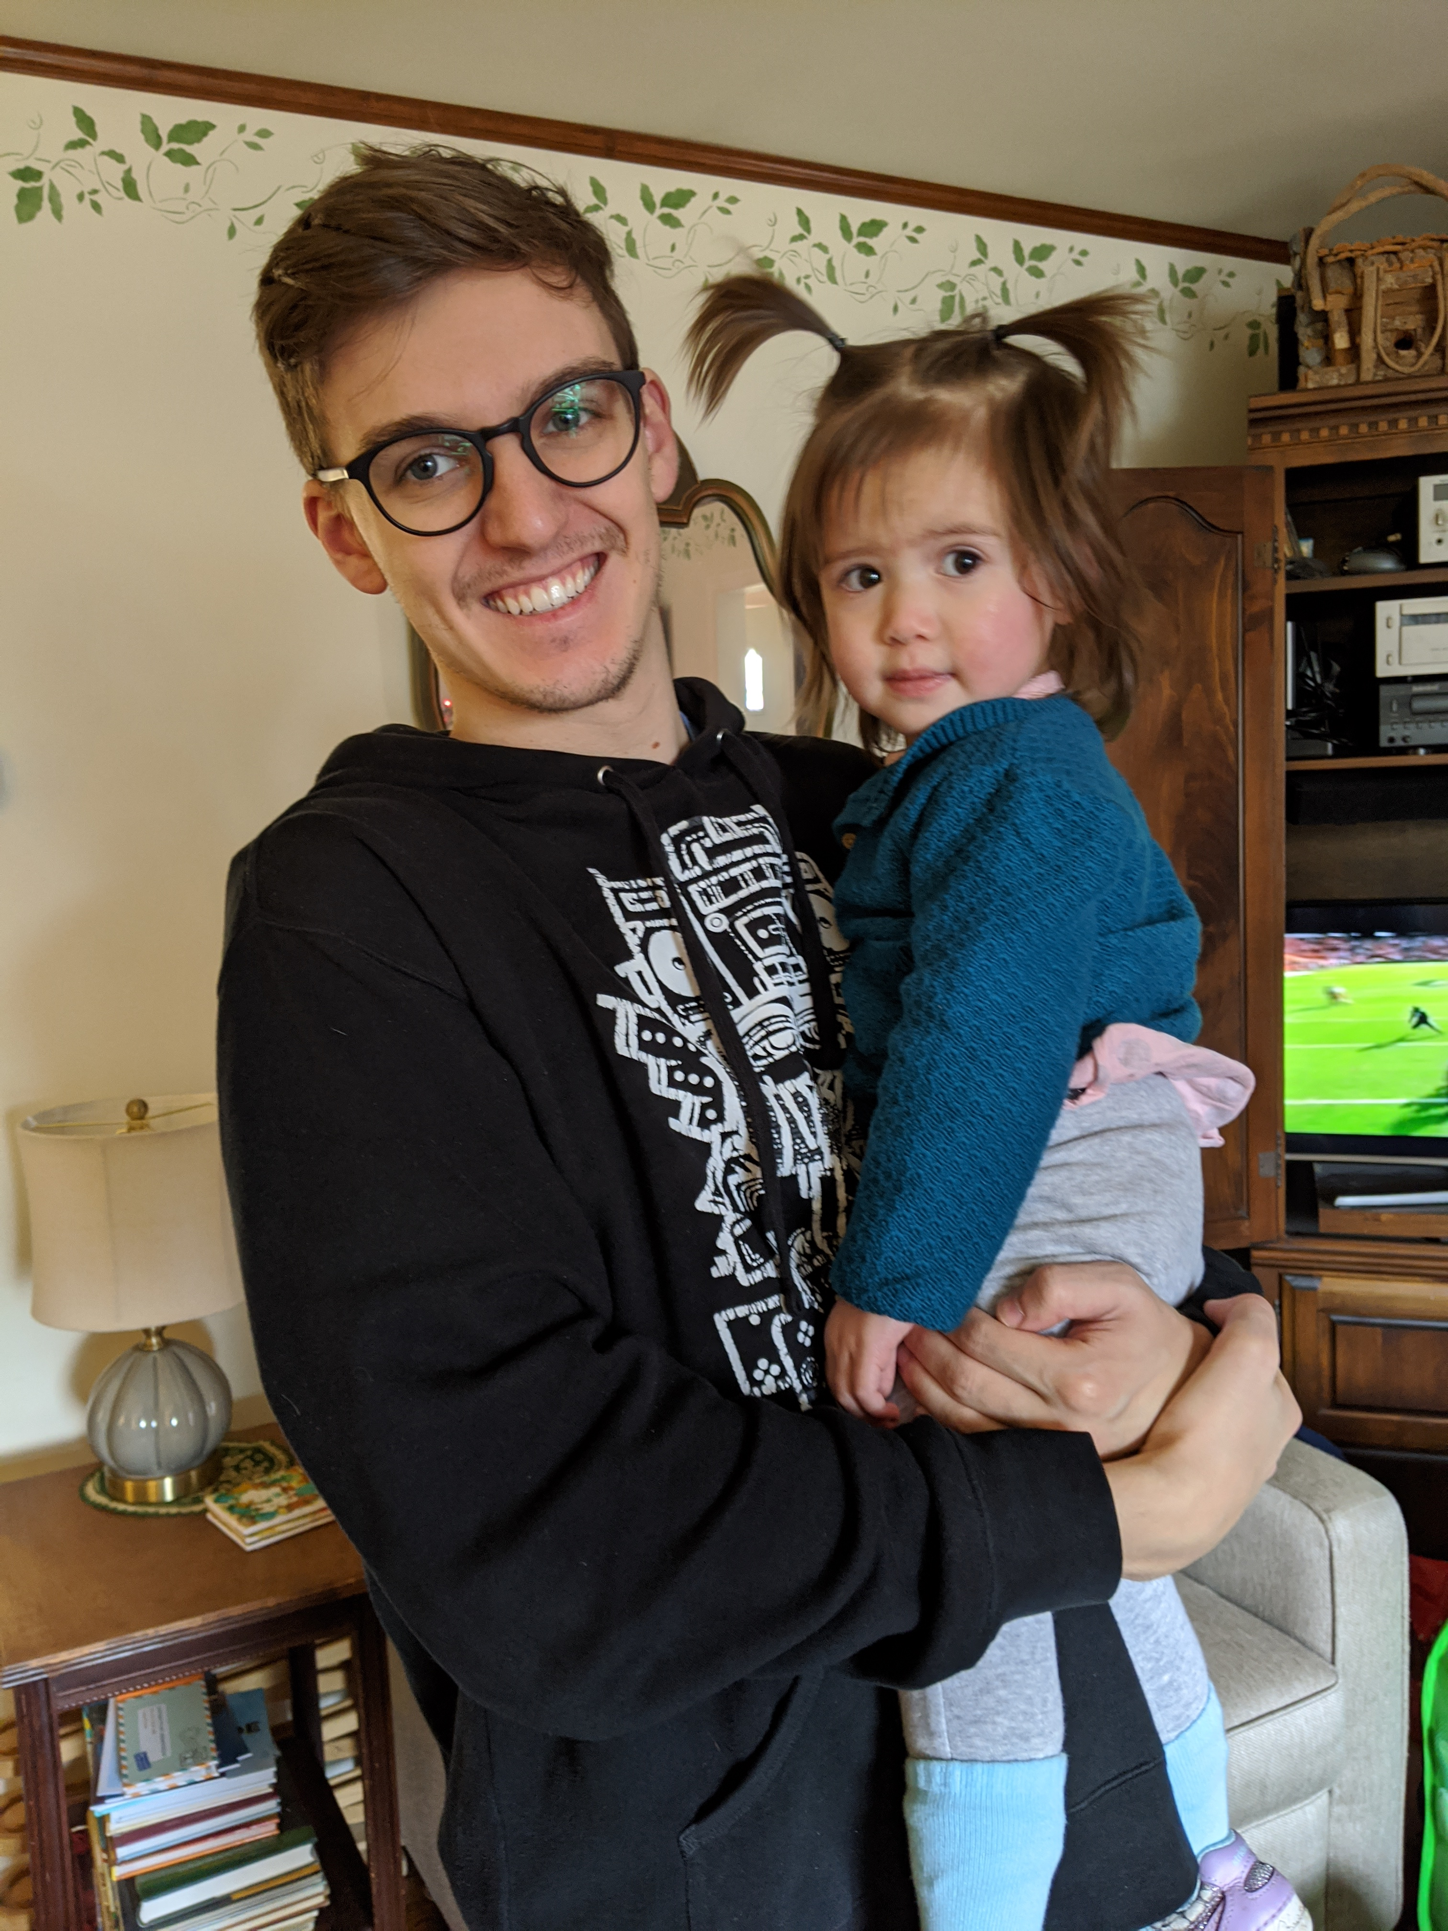
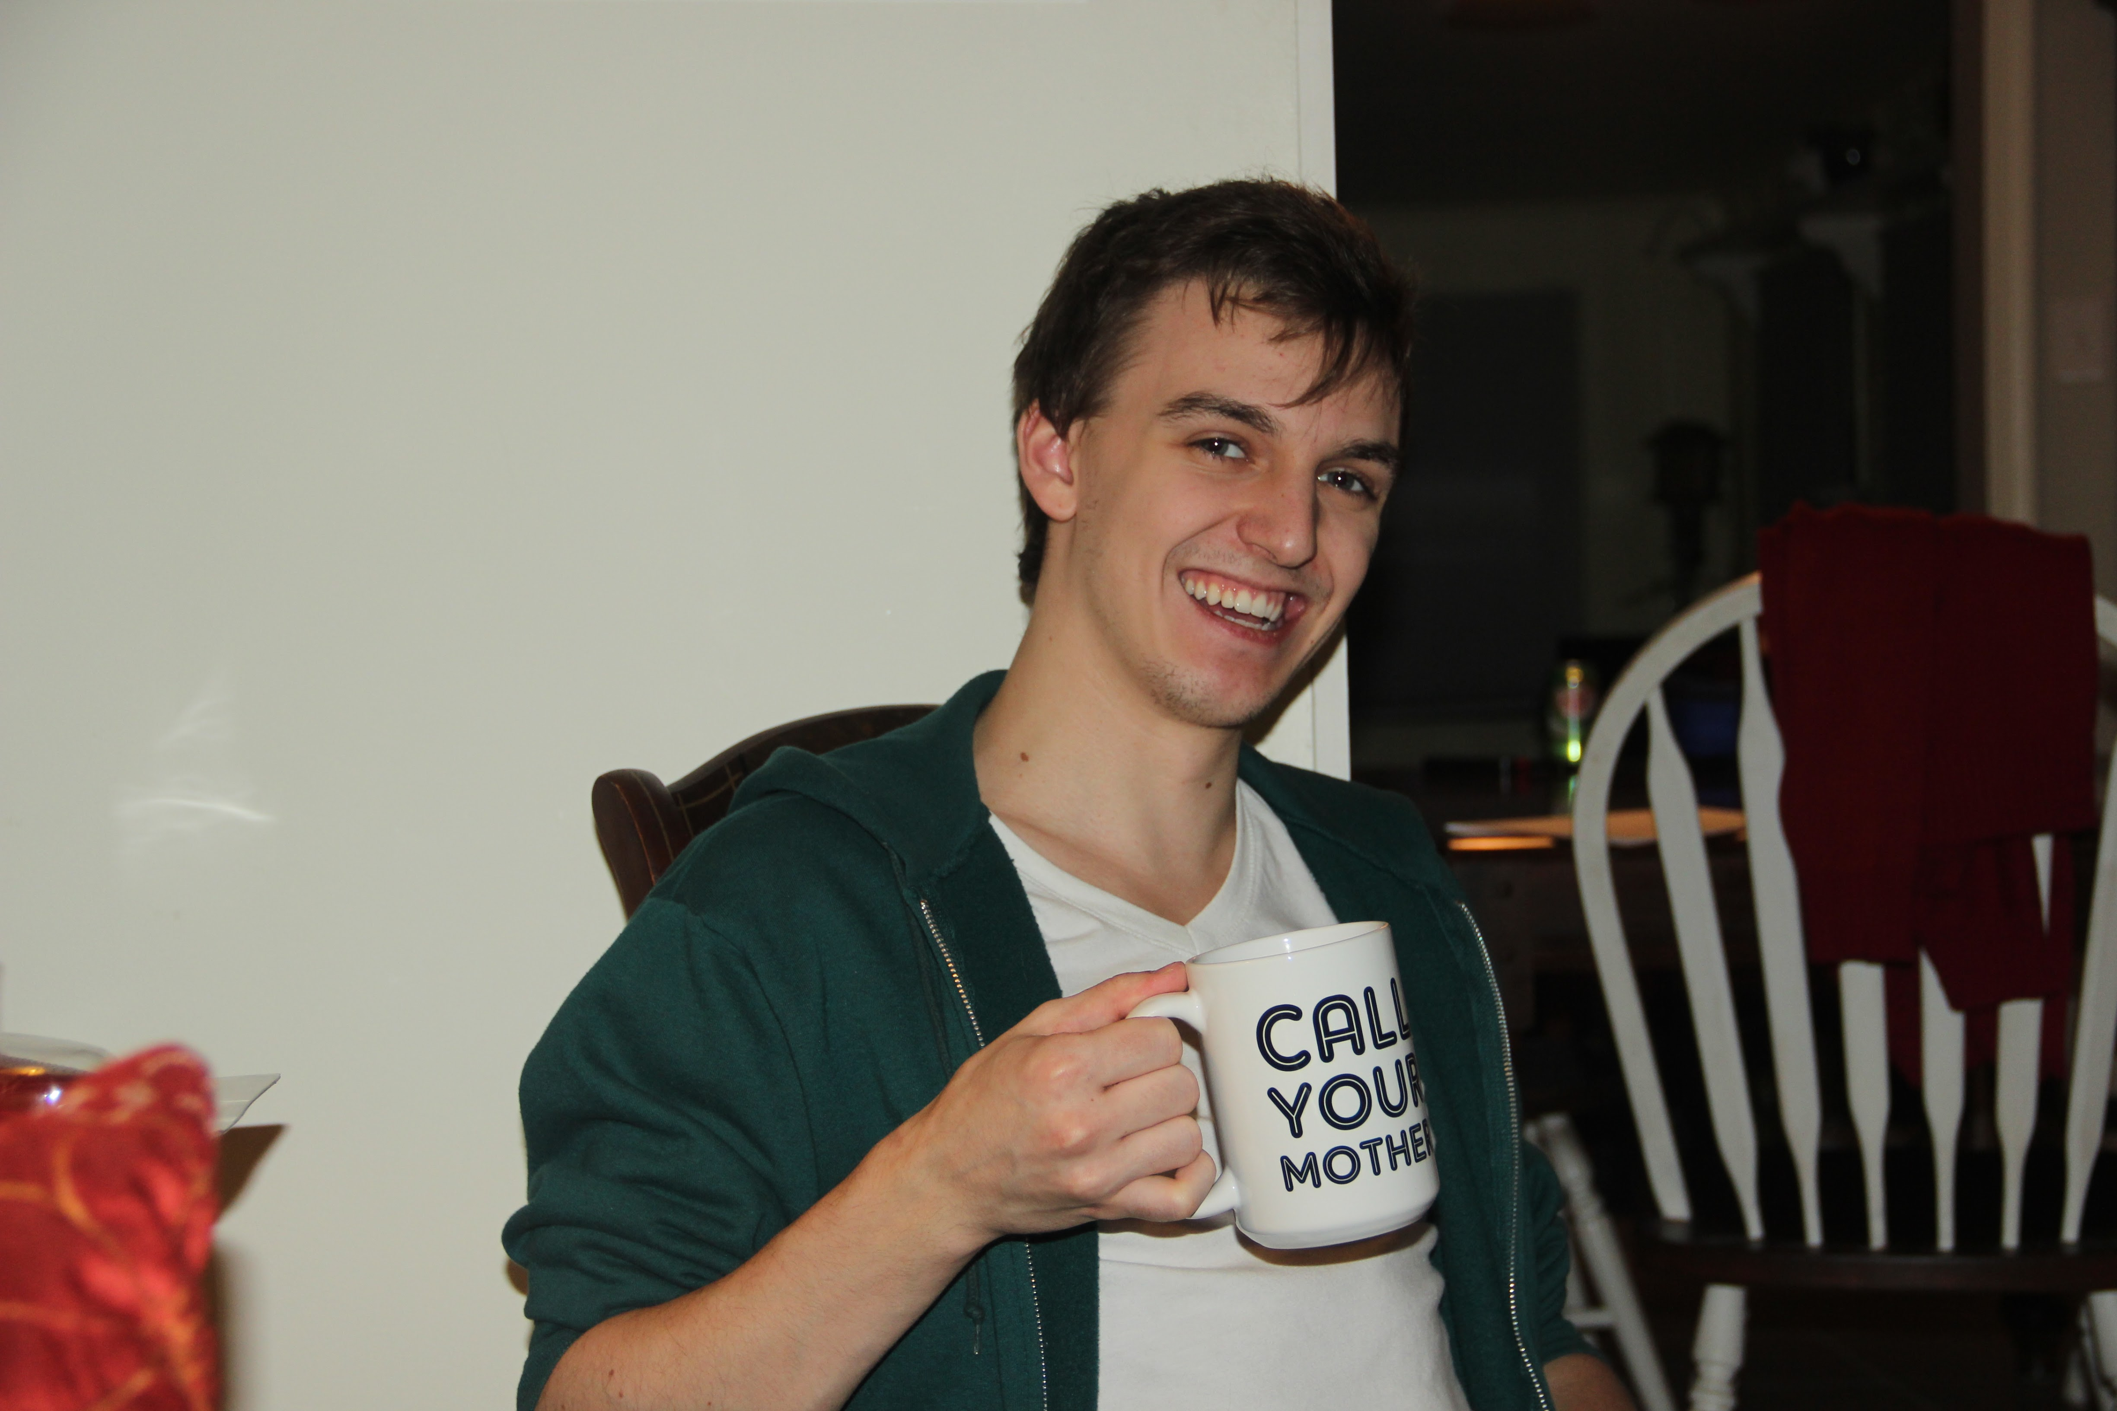
About your TA
Went to high school in central PA
Graduated from PSU in 2016 with a bachelor’s in Physics, minor in Math
Didn’t know what to do with myself so I worked in kitchens/env. Labs
Enrolled in AOSC Ph. D. program with interest in atmos. dynamics and data assimilation/modeling
Hobbies: cooking, reading, music, hiking, looking at cat pictures, drinking beer

Slide 4
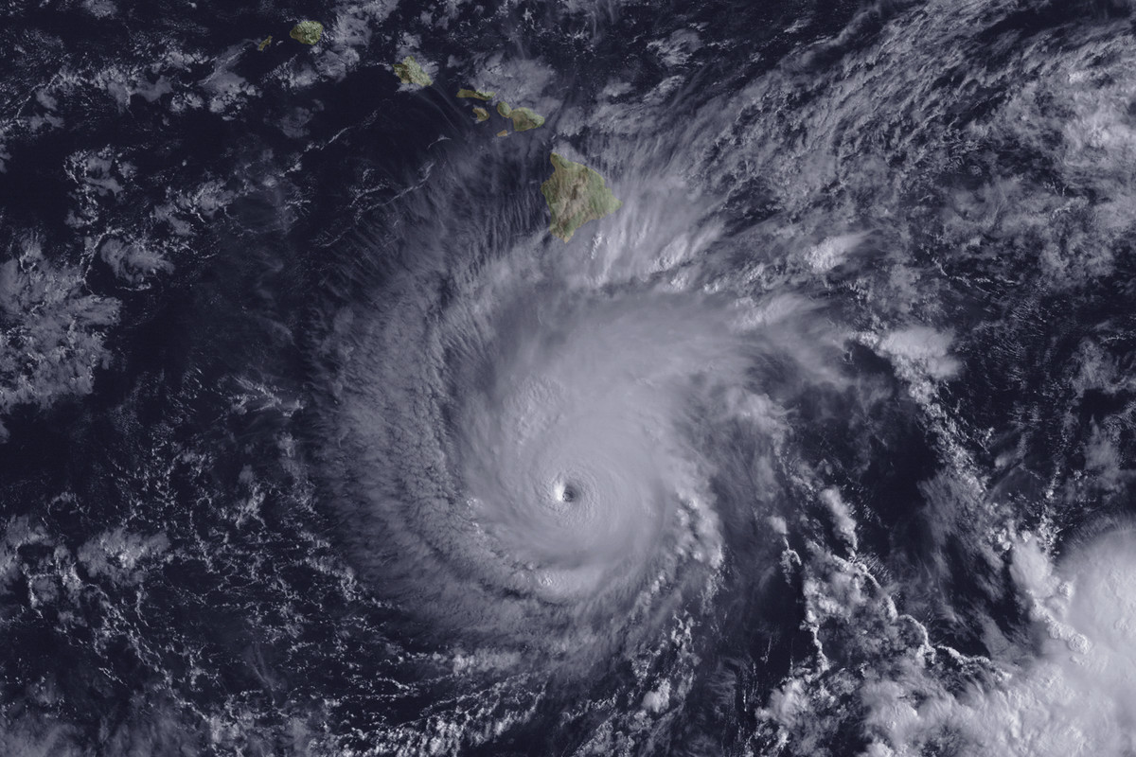
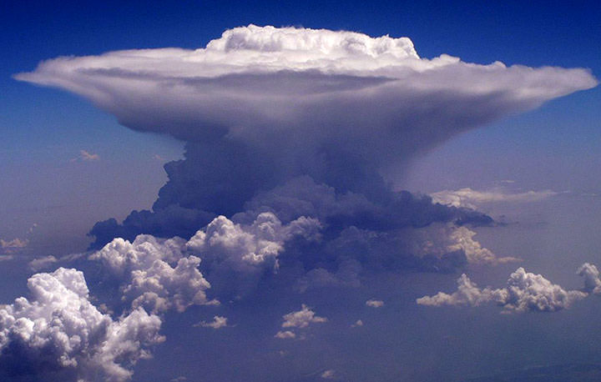
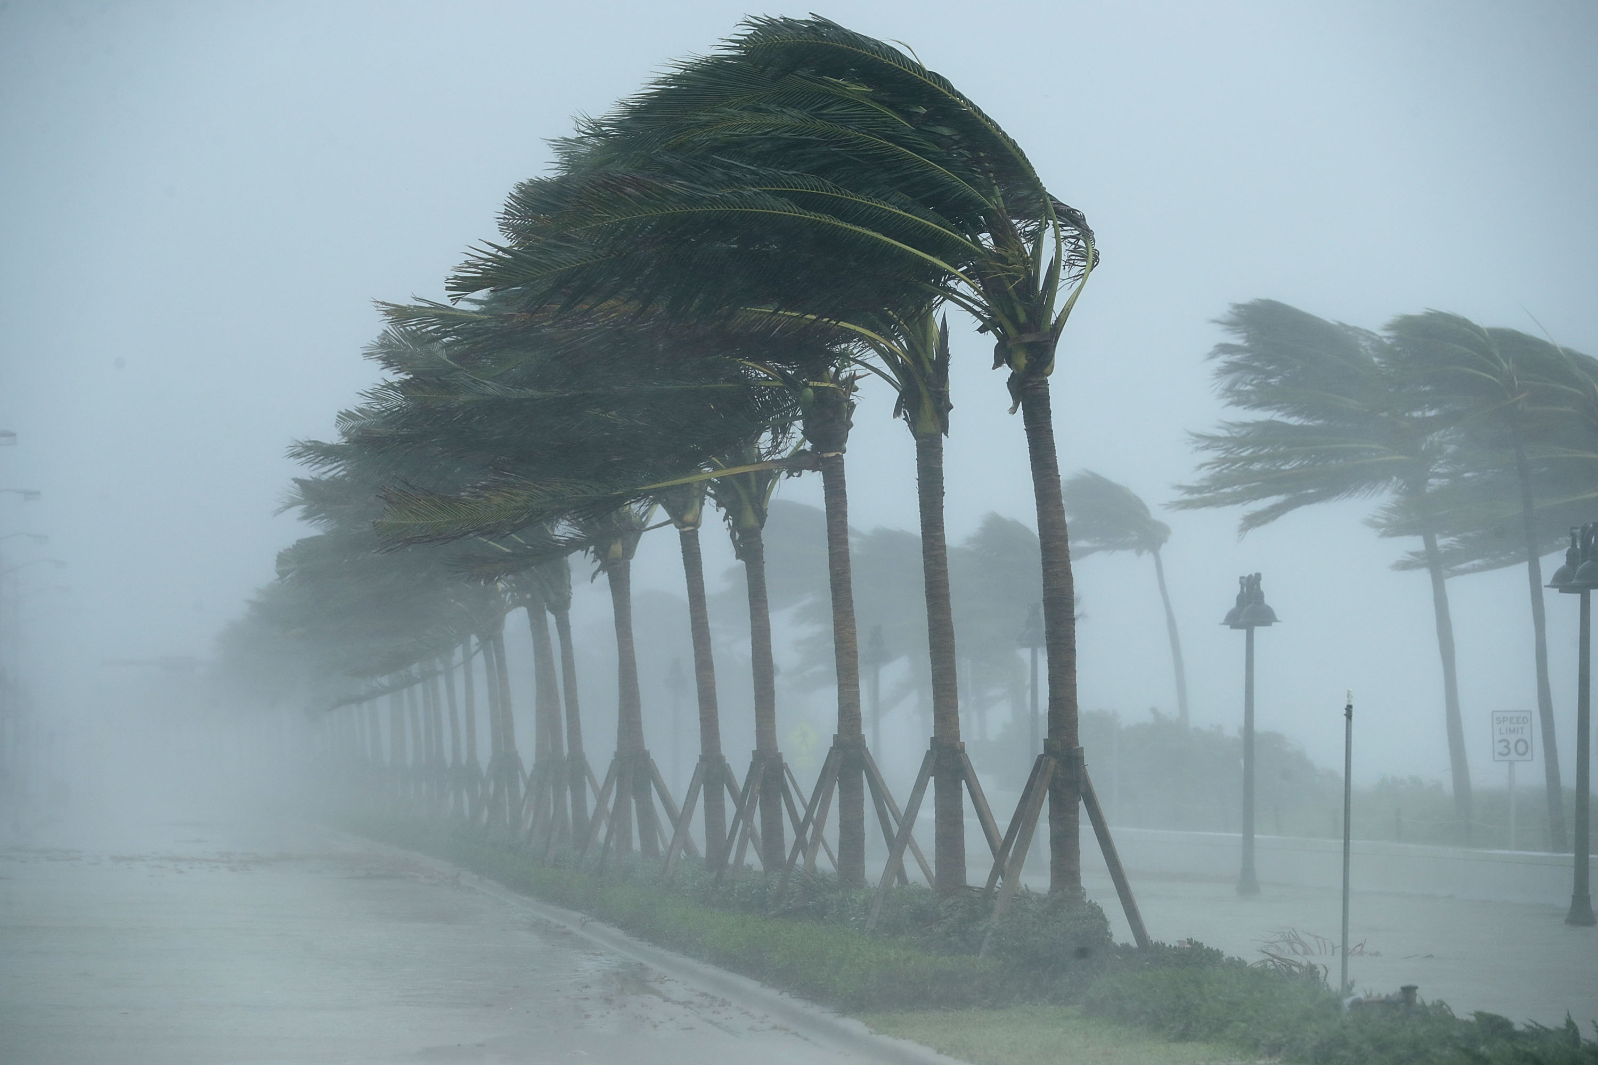
Welcome
Please introduce yourself:
name,
program of study, and,
any one notable weather event you experienced (exciting/terrifying)

Slide 5
About your TA
Office hours: Wed 02:00-3:00pm in ATL3416, or by appointment.
Email: jknisely@umd.edu

Slide 6
About this Course
AOSC200 Main course webpage is on ELMS
Past quizzes, exams, etc will be posted on ELMS
Overall breakdown of grades:
Admission Tickets 5%
Topic of the day 10%
Quizzes 20%
Projects 20%
Mid-Term 20%
Final 25%

Slide 7
About the Discussion session
We will review course material & discuss group projects
All you need to know about the discussion is on my webpage:
https://www.aosc.umd.edu/~jknisely
I do NOT take attendance, but participation in discussion will affect your grade.
For missed discussions, please refer my webpage for in-class presentations and other useful documents.
BRING QUESTIONS!! (or email them to me!)

Slide 8
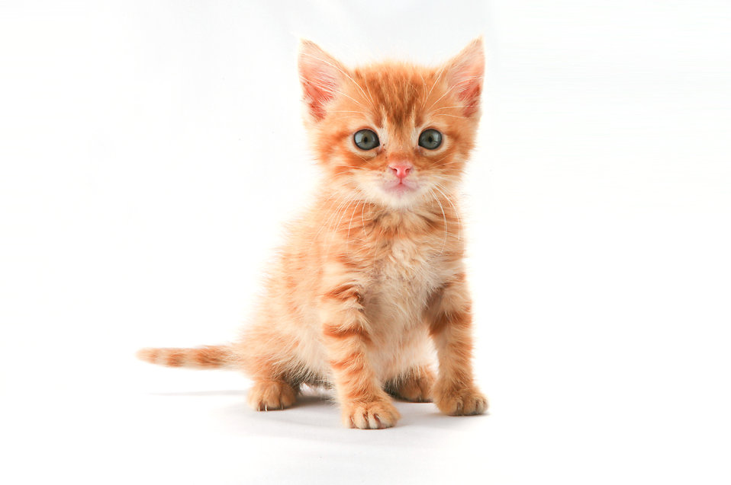
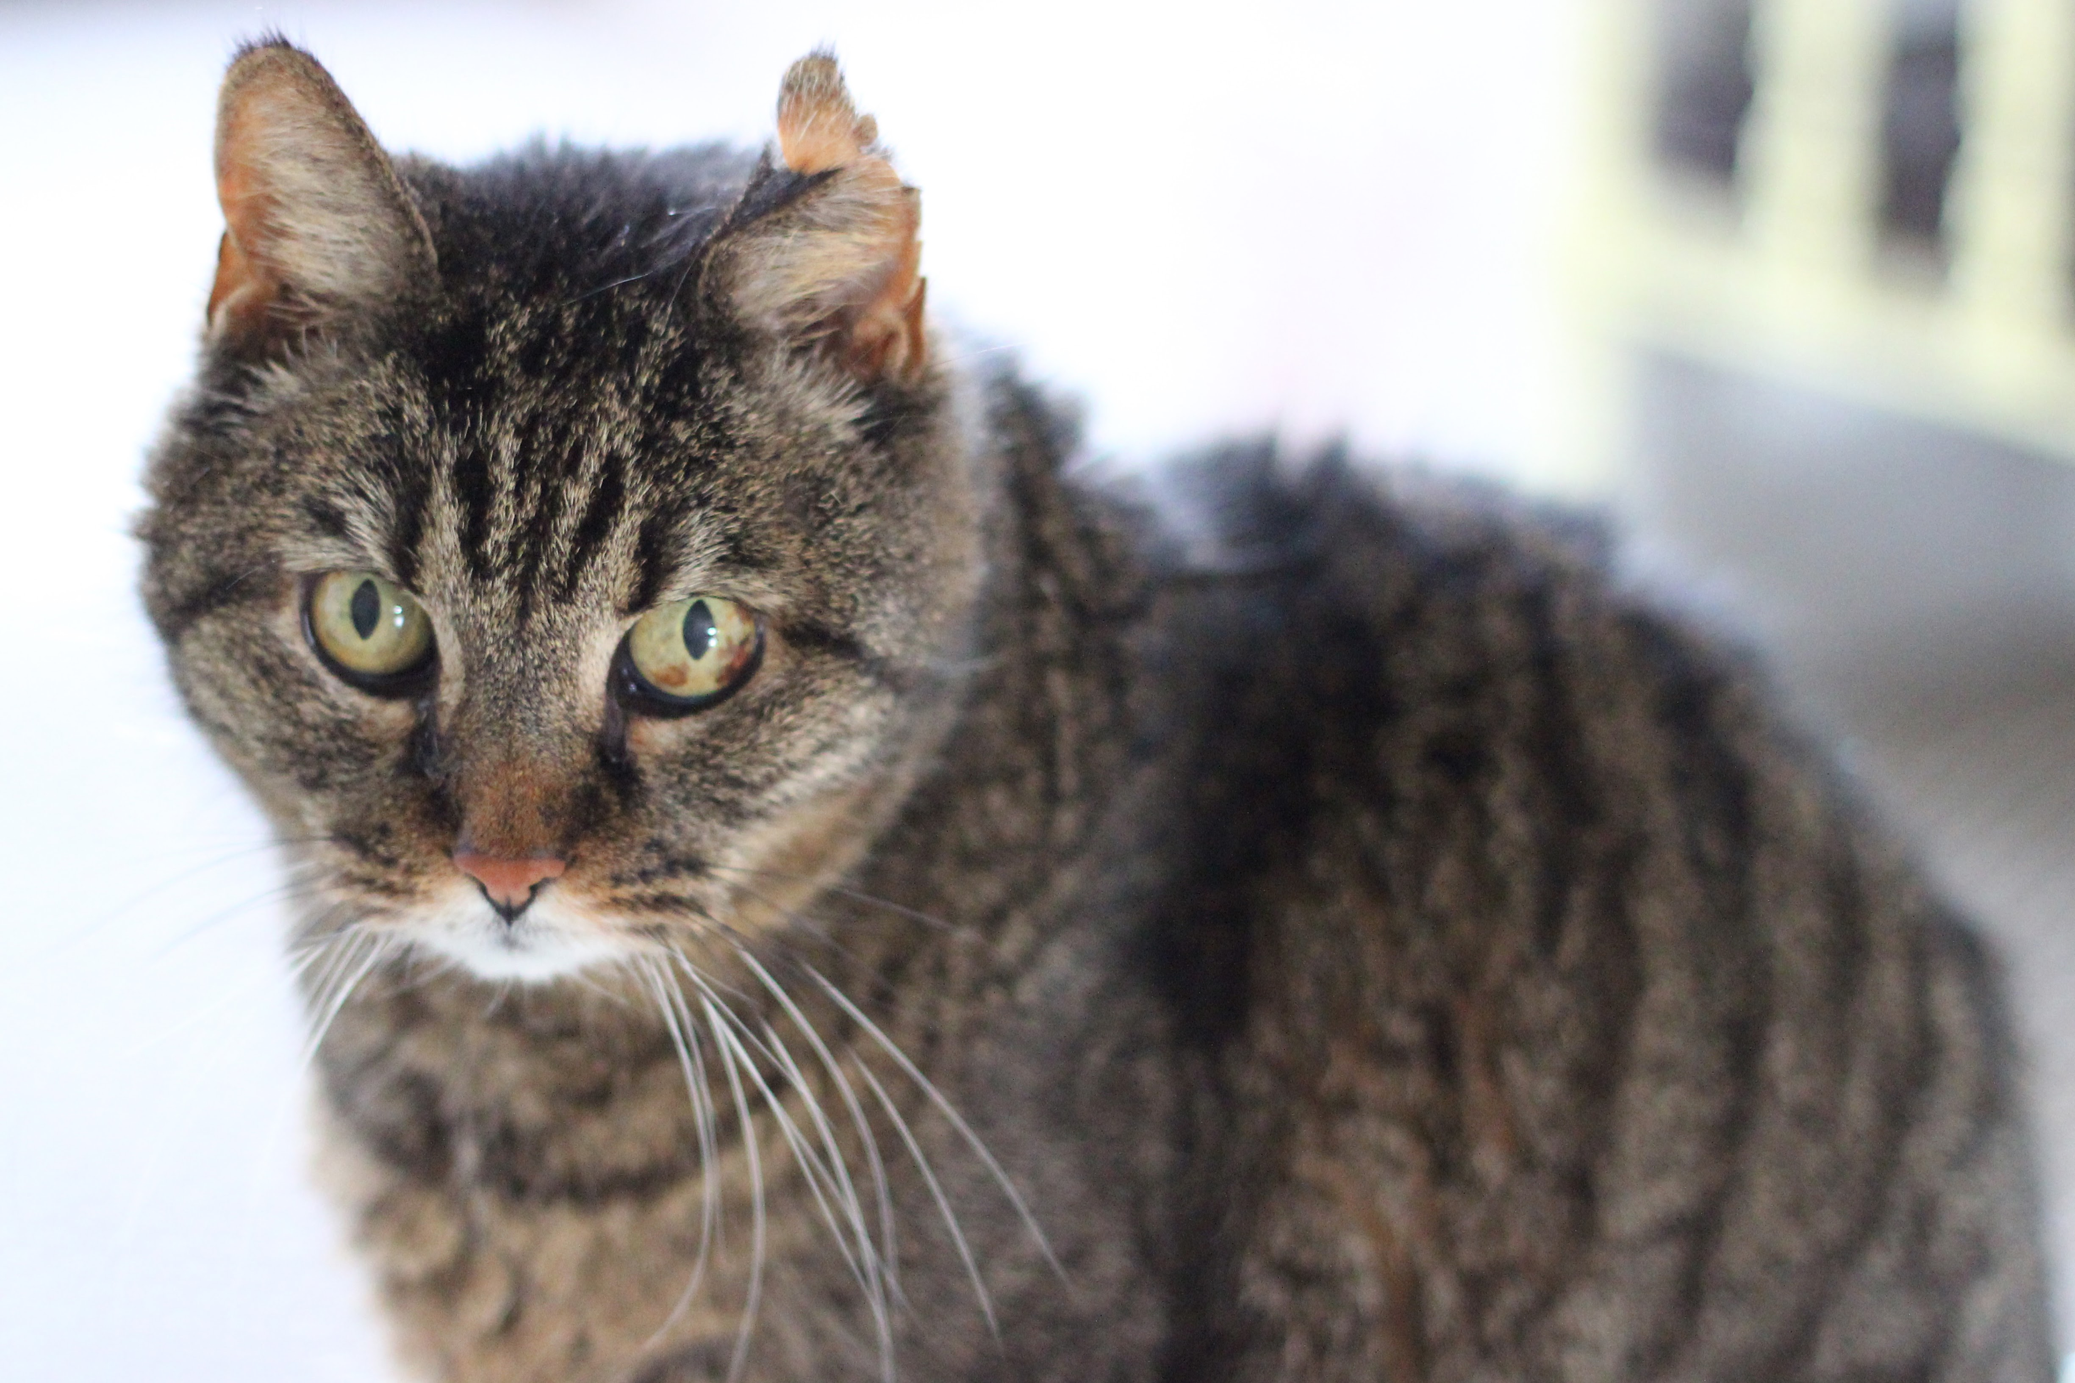
This Photo by Unknown Author is licensed under CC BY
Questions ?
[7]

